Slide 1


Load Impact Evaluation:
Base Interruptible Program
Dan Hansen
Mike Clark
Nick Crowley
Christensen Associates Energy Consulting
DRMEC Spring Workshop
April 26, 2019

Slide 2
Presentation Outline
Program Description
Ex-post Methodology
Ex-post Load Impacts
Ex-ante Methodology
Enrollment Forecast
Ex-ante Load Impacts

Slide 3
1. BIP Program Description
Emergency DR program for non-residential customers, events triggered by CAISO or local system emergencies
Customers receive a monthly capacity credit in exchange for a commitment to reduce energy consumption to their Firm Service Level (FSL)
The FSL represents the customer’s minimal operational requirements
15, 20, or 30-minute notice of events
Failure to reduce load to the FSL can result in excess energy charges, an increase in the FSL (and commensurate reduction in capacity credits), re-test events, or de-enrollment from the program

Slide 4
2. Ex-post Methodology
Individual regressions were used to estimate BIP ex-post load impacts
This method was chosen for two reasons:
  Difficulty in finding adequate control-group customers
  Some customers have volatile loads, so even customers that match reasonably well on average may not have a comparable load on a specific day
Customer-specific specification search conducted to:
  Determine whether each customer has a weather-sensitive load
  Find the best fitting weather and shape variables by groups defined by weather sensitivity and industry group

Slide 5
2. Ex-post Methodology:
Weather-sensitivity summary
BIP load impacts do not tend change significantly with temperatures because the biggest responders do not have weather-sensitive loads
However, there are weather-sensitive customers in BIP that cause the program reference load to change somewhat with temperatures

Slide 6
3. Ex-post Load Impacts:
Events
Date | Day of Week | PG&E | SCE | SDG&E
7/18/2018 | Wednesday | Emergency Event, 10:05-11:59 p.m. (1 subLAP)
7/27/2018 | Friday | Emergency Event, 7:45-11:59 p.m. (1 subLAP)
8/9/2018 | Thursday |  |  | Temp. and System Load 12:00-4:00 p.m.
9/26/2018 | Wednesday | Test, 4:00-10:00 p.m.
9/27/2018 | Thursday |  | M&E Event, 3:20-7:00 p.m.

Slide 7
3. Ex-post Load Impacts:
Events (2)
Utility | Hours of Availability | Hours of Actual Use | No. of Available Dispatches | No. of Actual Dispatches
PG&E | 180 / year 6 / day | 12.1 | 10 / month 1 / day | 3
SCE | 180 / year 6 / day | 3.7 | 10 / month 1 / day | 1
SDG&E | 120 / year 4 / day | 4 | 10 / month | 1

Slide 8
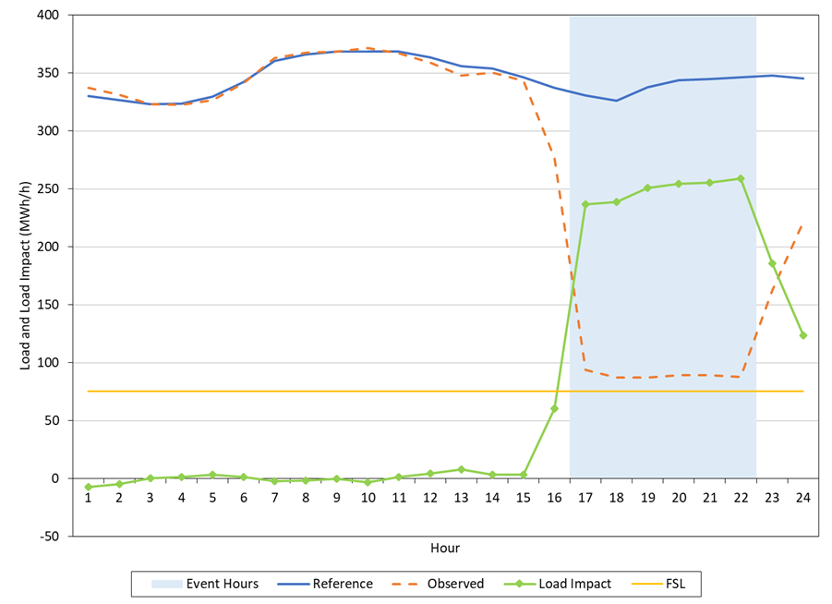
3. Ex-post Load Impacts:
PG&E September 26th Event
Event from 4:00 to 10:00 p.m.
480 enrolled customers
Avg. Ref. Load = 338 MW
Avg. Load Impact = 249 MW
FSL = 75.4 MW
% Load Impact = 74%
FSL Achievement = 95%
Top 10 responders account for 45% of the total load impact

Slide 9
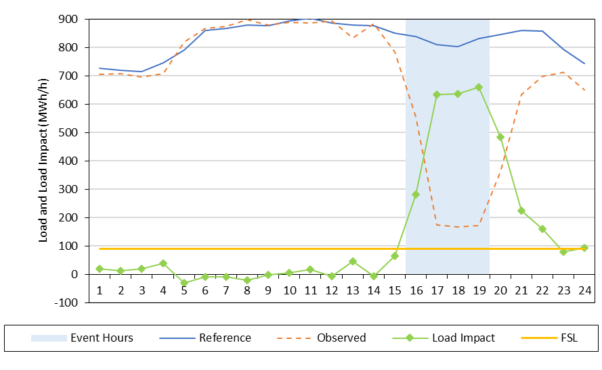
3. Ex-post Load Impacts:
SCE September 27th Event
Event from 3:20 to 7:00 p.m.
545 enrolled customers
Avg. Ref. Load = 815 MW
Avg. Load Impact = 643 MW
FSL = 90.9 MW
% Load Impact = 79%
FSL Achievement = 89%
Top 10 responders account for 39% of the total load impact
Values above represent HE 17-19, excluding the partial event hour of HE 16

Slide 10
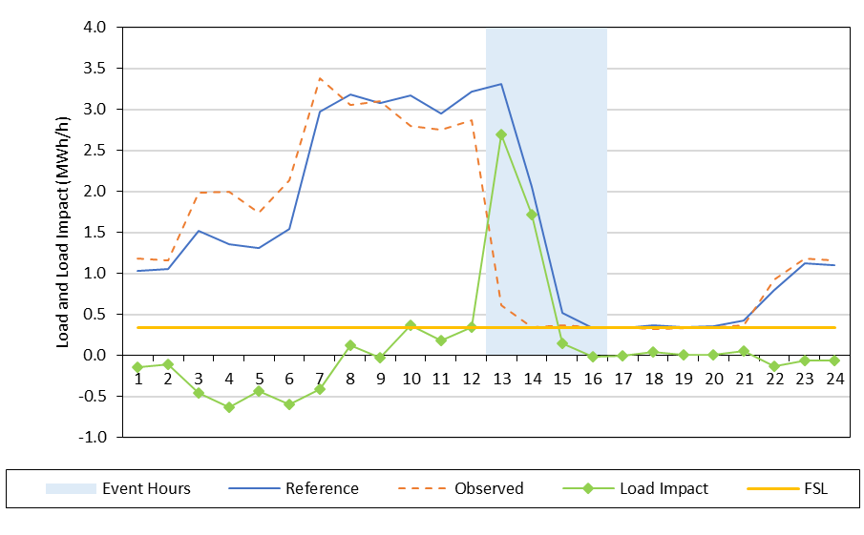
3. Ex-post Load Impacts:
SDG&E August 9th Event
Event from 12:00 to 4:00 p.m.
3 enrolled customers
Avg. Ref. Load = 1.6 MW
Avg. Load Impact = 1.1 MW
FSL = 0.34 MW
% Load Impact = 73%
FSL Achievement = 94%
Reference load drops during event hours, so there’s little need for customer response by the later event hours

Slide 11
4. Ex-ante Methodology
Ex-ante load impacts are based on the most recent full or test / M&E event day, by customer
Each customer’s ex-ante load impact is set to its ex-post FSL achievement rate:
  ExPost Achievement = ExPost Load Impact / (Ref. – FSL)
  ExAnte Impact = ExPost Achievement x (Ref. – FSL)
Load impact is zero if FSL is above the reference load
We remove customers who have left BIP
Customers who have joined BIP are assigned the program-level FSL achievement rate (applied to their own reference loads and FSL, if available)

Slide 12
4. Ex-ante Methodology (2)
Reference loads are simulated using the following:
  Customer-specific regressions to obtain effect of weather and time-period indicators on usage
  Ex-ante day types and weather conditions (e.g., August peak month day in a utility-specific 1-in-2 weather year)
Load impacts display little to no relationship with weather conditions
  Biggest responders do not tend to have weather-sensitive loads

Slide 13
5. Enrollment Forecast
The table below shows August enrollment in each year of the forecast
  PG&E forecasts flat enrollment
  SCE forecasts declining enrollment
  SDG&E forecasts an increase in enrollment

Slide 14
6. Ex-ante Load Impacts: by Year and Weather Scenario
Year | Weather | # SAIDs | Load Impact (MW) | Temp. (°F) | FSL (MW)
Aug. All Years | PG&E 1in2 | 421 | 253.7 | 93.1 | 69.8
 | PG&E 1in10 |  | 255.4 | 96.2
PG&E
Year | Weather | # SAIDs | Load Impact (MW) | Temp. (°F) | FSL (MW)
Aug. 2019 | SCE 1in2 | 492 | 622.8 | 90.4 | 82.3
 | SCE 1in10 |  | 625.9 | 94.7
Aug. 2029 | SCE 1in2 | 456 | 561.0 | 90.3 | 76.8
 | SCE 1in10 |  | 563.8 | 94.6
SCE
Year | Weather | # SAIDs | Load Impact (MW) | Temp. (°F) | FSL (MW)
Aug. 2019 | SDG&E 1in2 | 6 | 0.9 | 85.8 | 0.5
 | SDG&E 1in10 |  | 0.9 | 89.0
Aug. 2029 | SDG&E 1in2 | 9 | 1.3 | 85.8 | 0.7
 | SDG&E 1in10 |  | 1.3 | 89.0
SDG&E

Slide 15
6. Ex-ante Load Impacts:
PG&E Ex Post vs. Ex Ante
Ex Post / Ex Ante | Date / Scenario | # SAIDs | Reference Load (MW) | Load Impact (MW) | Temp. (°F) | FSL (MW) | FSL Achievement
Ex Post | 9/26/2018 | 480 | 338 | 249 | 79 | 75 | 95%
Ex Ante | Aug. 2019 Typical Event Day | 421 | 331 | 254 | 93 | 70 | 97%
The total load impact increases even though enrollment decreases by 59 service accounts
Relatively low responders left the program, offset by some joiners and an increase in the load impacts from customers remaining in the program
All ex-ante forecasts from this point forward reflect the utility-specific 1-in-2 peak day

Slide 16
6. Ex-ante Load Impacts:
SCE Ex Post vs. Ex Ante
Ex Post / Ex Ante | Date / Scenario | # SAIDs | Reference Load (MW) | Load Impact (MW) | Temp. (°F) | FSL (MW) | FSL Achievement
Ex Post | 9/27/2018 | 545 | 815 | 643 | 82 | 91 | 89%
Ex Ante | Aug. 2019 Typical Event Day | 492 | 795 | 623 | 90 | 82 | 87%
Enrollment drops by a larger percentage than load impacts (10% vs. 3%) because relatively low responders left the program

Slide 17
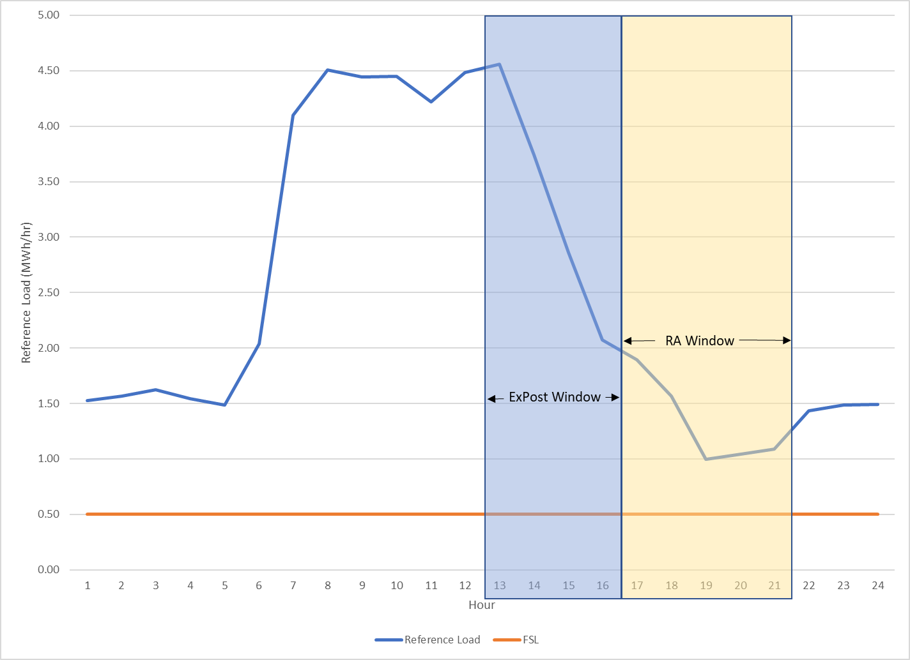
6. Ex-ante Load Impacts:
SDG&E Ex Post vs. Ex Ante
Ex Post / Ex Ante | Date / Scenario | # SAIDs | Reference Load (MW) | Load Impact (MW) | Temp. (°F) | FSL (MW) | FSL Achievement
Ex Post | 8/9/2018 | 3 | 1.6 | 1.1 | 95.0 | 0.34 | 94%
Ex Ante | Aug. 2019 Typical Event Day | 6 | 1.3 | 0.9 | 85.8 | 0.5 | 102.9%
Differences are primarily due to program load dropping off in the middle of the RA window
  Ex-post event hours = HE 13 to 16 (12 to 4:00 p.m.)
  Ex-ante RA window = HE 17 to 21 (4 to 7 p.m.)
As a result, there’s a lot less load to curtail during the RA window
The higher FSL achievement is due to some customer-specific reference loads falling below their FSL

Slide 18
6. Ex-ante Load Impacts:
PG&E, Previous vs. Current Aug. 2019 Forecast
When Created | # SAIDs | Aggregate |  |  | Per-customer
 |  | Reference Load (MW) | Load Impact (MW) | FSL (MW) | Reference Load (kW) | Load Impact (kW)
Following PY2017 (Previous) | 362 | 309 | 220.5 | 75.5 | 853 | 609
Following PY2018 (Current) | 421 | 331 | 253.7 | 69.8 | 785 | 603
The current forecast has more customers
The per-customer reference load is slightly lower, but the per-customer load impact is nearly the same

Slide 19
6. Ex-ante Load Impacts:
SCE, Previous vs. Current Aug. 2019 Forecast
When Created | # SAIDs | Aggregate |  |  | Per-customer
 |  | Reference Load (MW) | Load Impact (MW) | FSL (MW) | Reference Load (kW) | Load Impact (kW)
Following PY2017 (Previous) | 550 | 825 | 636 | 105 | 1,501 | 1,157
Following PY2018 (Current) | 492 | 795 | 623 | 82 | 1,616 | 1,266
Note that the previous forecast uses the HE14-18 RA window while the current forecast uses the HE17-21 RA window

Slide 20
6. Ex-ante Load Impacts:
SDG&E, Previous vs. Current Aug. 2019 Forecast
When Created | # SAIDs | Aggregate |  |  | Per-customer
 |  | Reference Load (MW) | Load Impact (MW) | FSL (MW) | Reference Load (kW) | Load Impact (kW)
Following PY2017 (Previous) | 8 | 2.8 | 1.5 | 1.6 | 345 | 183
Following PY2018 (Current) | 6 | 1.3 | 0.9 | 0.5 | 220 | 144
The previous forecast assumed higher enrollment
The higher reference load and load impact from the previous evaluation is largely due to the earlier RA window (1 to 6 p.m. vs. 4 to 9 p.m.)

Slide 21
Questions?
Contact – Dan Hansen,
Christensen Associates Energy Consulting
Madison, Wisconsin
  dghansen@CAEnergy.com
  608-231-2266

