Slide 1
Load impact evaluation of Non-Residential Critical Peak and Peak day Pricing
2019 DRMEC Load Impact Workshop ● April 26, 2019
Kelly Marrin, Project Director

Slide 2
Agenda
  Program Descriptions
  Methodology
  Ex Post Impacts
  Ex Ante Impacts
  Key Findings

Slide 3
Program Description

Slide 4
Program Description
Critical Peak Pricing / Peak Day Pricing
  Program Basics:
    Non-Residential customers only
    Statewide price responsive DR program
    Customers experience an increase in price (above existing on-peak price) during events
    Operates year-round
  Events:
    Event hours are 2-6 PM
    Number of events per year varies
      PG&E 9 to 15
      SCE 12
      SDG&E maximum of 18
    Customers are notified on a day ahead basis

Slide 5
Program Description
Program changes
  PG&E:
    Defaults are on hold until TOU period transition change is implemented in November 2020.
    46,000 customers unenrolled as they transitioned to CCA
  SCE:
    No key changes in 2018
    2019 begins the default of customers with demands below 200 kW and large Ag and Pump customers
    Event window changed to 4-9 PM effective March 1, 2019
    Capacity Reservation Level (CRL) and CPP-lite options are no longer available
  SDG&E:
    New TOU periods established
      CPP event window moved from 11 – 6 PM to 2 – 6 PM
      Underlying TOU on-peak period is 4 – 9 PM
    Commission approved time periods for grandfathered TOU rates

Slide 6
Program Description
2018 Participation, Typical Event Day
Participation by Size | PG&E | SCE | SDG&E
Small < 20 kW | 119,004 | 106 | -
Medium 20 ≤ x < 200 kW | 34,014 | 659 | 12,854
Large ≥ 200 kW | 1,712 | 2,251 | 1,211
Total | 154,731 | 3,016 | 14,065
Participation by Industry | PG&E | SCE | SDG&E
1. Agriculture, Mining & Construction | 6,031 | 76 | 366
2. Manufacturing | 5,043 | 694 | 1,053
3. Wholesale, Transport, Other Utilities | 17,218 | 512 | 893
4. Retail Stores | 13,018 | 269 | 1,987
5. Offices, Hotels, Finance, Services | 46,968 | 823 | 7,005
6. Schools | 3,371 | 281 | 749
7. Institutional/Government | 24,757 | 261 | 1,885
8. Other/Unknown | 38,324 | 99 | 128
Total | 154,731 | 3,016 | 14,065

Slide 7
Program Description
Communication Around Events
Not all the participants were aware of events
  SCE and SDG&E provide day ahead notification to customers with contact information
  PG&E provides day ahead notification, and an enhanced level of support which included post event feedback

Slide 8
Methodology

Slide 9
Introduction to Regression
Regression analysis is about identifying and estimating statistical relationships between variables.
Regression analysis studies the dependence of one variable, the dependent variable, on one or more other variables, the explanatory variables, with a goal of estimating and/or predicting the mean of the former in terms of the known values of the latter.¹
Y_{it} = β₀ + β₁ x_{it} + . . . . β_{n} x_{it} + ε_{I}
We use regression models to estimate the counter-factual – what would have happened in absence of an event
The model uses information from non-event days to predict how much energy customers would have used in absence of an event
¹ Gujarati, D., Basic Econometrics, p.18, McGraw-Hill, 2003.

Slide 10
Estimating Impacts
Actual consumption on an event day
Consumption on the same day but in absence of an event
Actual Load
Weather Variables
Calendar Variables
Participation Variables
Reference Load
Weather Variables
Calendar Variables
Participation Variables
Reference Load
Actual Load
Impacts

Slide 11
Subgroup level modeling approach
Utility | Size Group | Ratio | Analysis Method
PG&E | Small | 1.3 | Within Subjects
 | Medium | 1.6 | Within Subjects
 | Large | 3.7 | Matched Control
SCE | Small | 3,904.3 | Matched Control
 | Medium | 199.0 | Matched Control
 | Large | 5.3 | Matched Control
SDG&E | Medium | 0.4 | Within Subjects
 | Large | 0.9 | Within Subjects
Each utility and size group is at a different stage in the default schedule
Design was selected based on eligible non-participants favoring the development of a control group when feasible
For all subgroups, regardless of design, we developed hourly fixed effect regression models
  Subgroups include: utility, size, and industry
  Each model was optimized and validated using our optimization approach

Slide 12
Subgroup level Regression Approach
Baseline
Weather
Calendar
Impacts
Event
AM Load
Develop a set of candidate models using building blocks set up in logical groups
~16-20 Candidate Models
1

Slide 13
Subgroup level Regression Approach
Testing and optimization process that minimizes error and bias to select the best model for each subgroup
Model the actual load
Model the reference load
Calculate the impacts
In-sample testing
Out-of-sample testing
MAPE and
MPE
2
3
Reference Load
Actual Load
Impacts

Slide 14
Ex-Post Impacts

Slide 15
Ex Post impacts
Event Summary
Date | Day of Week | PG&E | SCE | SDG&E
6/12/2018 | Tuesday | X
6/13/2018 | Wednesday | X
7/06/2018 | Friday |  | X | X
7/09/2018 | Monday |  | X
7/10/2018 | Tuesday | X | X
7/16/2018 | Monday | X
7/17/2018 | Tuesday | X | X
7/18/2018 | Wednesday |  | X
7/19/2018 | Thursday | X
7/24/2018 | Tuesday | X |  | X
7/25/2018 | Wednesday | X |  | X
7/27/2018 | Friday | X
8/01/2018 | Wednesday |  | X
8/02/2018 | Thursday |  | X
8/06/2018 | Monday |  | X | X
8/07/2018 | Tuesday |  | X | X
8/09/2018 | Thursday |  | X | X
9/28/2018 | Friday |  | X
10/18/2018 | Thursday |  | X
Total |  | 9 | 12 | 6

Slide 16
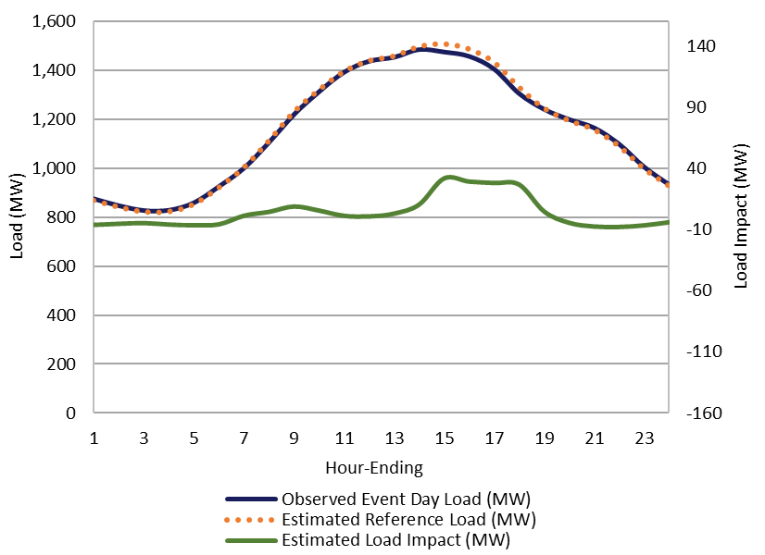
Ex Post impacts – PG&E
Average Summer Event, Average Event Hour
Utility | Size Group | # Enrolled | Ref. Load (MW) | Load Impact (MW) | % Load Impact | Event Temp
PG&E | Large | 1,712 | 445.5 | 23.9 | 5.4% | 93.1
 | Medium | 34,014 | 750.0 | 4.9 | 0.7% | 93.2
 | Small | 119,004 | 243.7 | (0.1) | 0.0% | 93.0
ALL PG&E |  | 154,731 | 1,439.2 | 28.8 | 2.0% | 93.1
  Large customers provide the majority of the impact
  Small customer impacts are essentially zero – negative impacts result from modeling noise or bias
  Hottest overall weather of the three IOUs
Notes:
Data is confidential because of 15/15 rule and/or to protect aggregator confidentiality

Slide 17
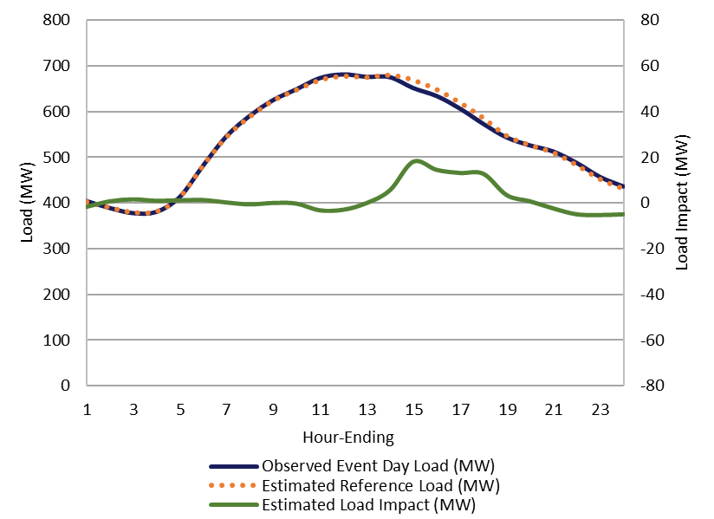
Ex Post impacts – SCE
Average Summer Event, Average Event Hour
Utility | Size Group | # Enrolled | Ref. Load (MW) | Load Impact (MW) | % Load Impact | Event Temp
SCE | Large | 2,251 | 583.7 | 14.2 | 2.4% | 89.8
 | Medium | 659 | 45.9 | 0.2 | 0.5% | 89.4
 | Small | 105 | 0.2 | 0.0 | 2.7% | 88.9
ALL SCE |  | 3,016 | 629.9 | 14.5 | 2.3% | 89.4
  Again large customers provide the majority of the impact
  Participation in medium and small classes is opt-in so contributions are low
Notes:
Data is confidential because of 15/15 rule and/or to protect aggregator confidentiality

Slide 18
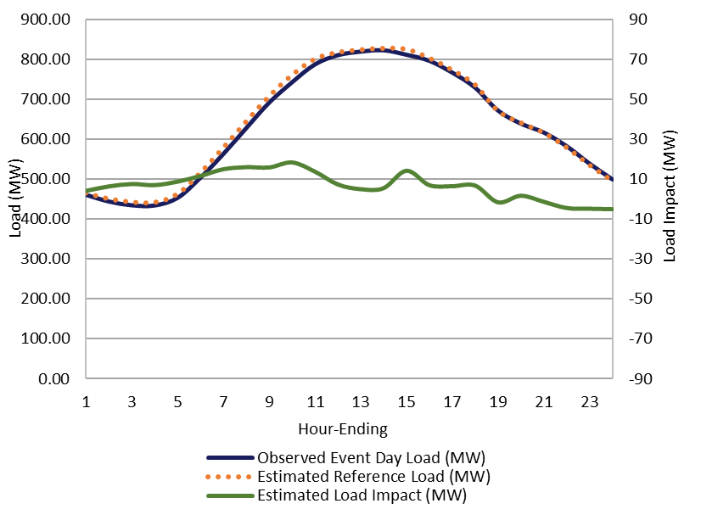
Ex Post impacts – SDG&E
Average Summer Event, Average Event Hour
Utility | Size Group | # Enrolled | Ref. Load (MW) | Load Impact (MW) | % Load Impact | Event Temp
SDG&E | Large | 1,211 | 348.1 | 6.9 | 2.0% | 88.5
 | Medium | 12,854 | 437.5 | 1.9 | 0.4% | 88.2
ALL SDG&E |  | 14,065 | 785.6 | 8.8 | 1.1% | 88.3
  Again large customers provide the majority of the impact
  Small customers are not included in this evaluation
  Coolest weather of the three IOUs
Notes:
Data is confidential because of 15/15 rule and/or to protect aggregator confidentiality

Slide 19
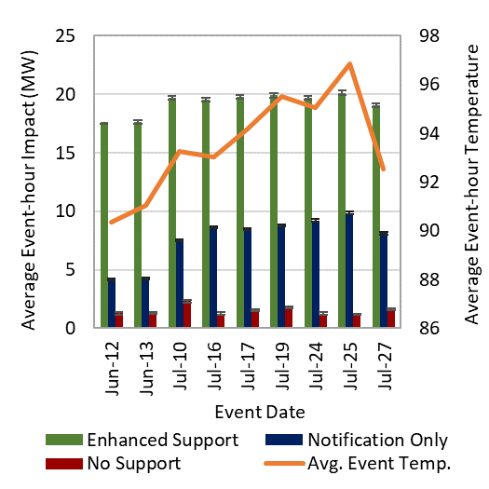
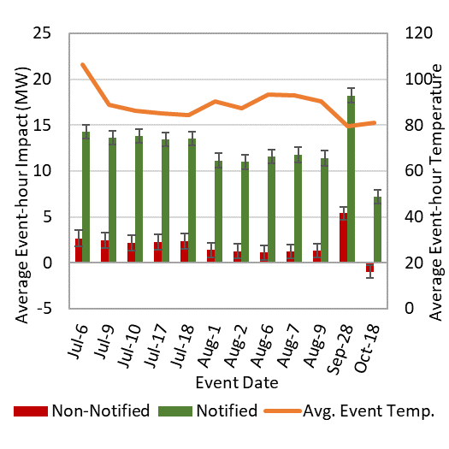
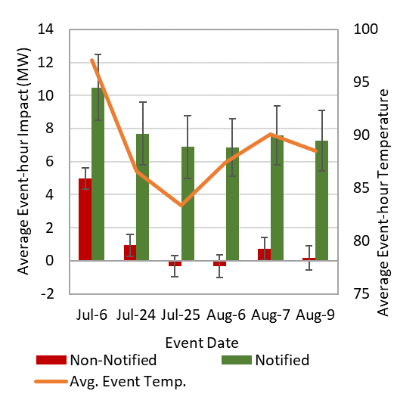
Ex-Post Impacts
Communication Level
Type |  | Aggregate
 | # Enrolled | (MW) |  | % Load Impact | Avg. Event Temp.
 |  | Ref. Load | Load Impact
No Communication | 26,614 | 762 | 4.4 | 0.6% | 90.3
Communication | 145,197 | 2,093 | 47.7 | 2.3% | 91.0
PG&E
SCE
SDG&E

Slide 20
Ex Post Impacts
Utility System Peak Hour
Utility |  | # Enrolled | Ref. Load (MW) | Load Impact (MW) | % Load Impact | Event Temp
PG&E - PDP | 7/25/2018 (HE19) | 145,372 | 1,310.1 | 28.5 | 2.1% | 97
SCE - CPP | 7/6/2018 (HE16) | 3,082 | 663.7 | 16.9 | 2.5% | 107
SDG&E - CPP | 8/09/2018 (HE17) | 14,109 | 792.5 | 4.8 | 0.6% | 87
  PG&E had the latest system peak at HE 7 PM, they also had the largest impact with nearly 29 MW
  SCE had the hottest system peak with a temperature of 107 and an impact of 17 MW
  SDG&E’s system peak was at HE 5PM, and their impact was nearly 5 MW

Slide 21
Ex Post Impacts
Statewide System Peak Hour, 7/25/2018 - HE18
Utility | # Enrolled | Ref. Load (MW) | Load Impact (MW) | % Load Impact | Event Temp
PG&E - PDP | 145,372 | 1,410.9 | 30.4 | 2.1% | 97
SCE - CPP | - | - | - | - | -
SDG&E - CPP | 14,043 | 711.7 | 5.5 | 0.6% | 80
Statewide | 159,415 | 2,122.6 | 35.9 | 1.7% | 96
  The total load reduction across all three programs on the statewide system peak was 36 MW
  SCE did not call an event on the statewide peak day

Slide 22
Ex-Ante Impacts

Slide 23
Ex Ante Impacts
Methodology
  Use subgroup level regression models from ex post analysis
  Predict per-customer weather-adjusted impacts for all subgroups
    Apply Utility and CAISO weather scenarios
  Use enrollment forecasts from IOUs to forecast aggregate impacts
    Enrollment was derived based on
      Default schedules
      Population growth
      Historical trends
  IMPORTANT - RA Window Change
    2017 evaluation 2-6 PM (coincident with operating hours)
    2018 evaluation 4-6 PM
      SCE coincident with operating hours
      SDG&E and PG&E NOT coincident with operating hours

Slide 24
Ex Ante Impacts
Comparison of current and previous ex-ante forecast
 | Previous Forecast, 2018 |  | Current Forecast, 2019
Utility | Accounts | Aggregate Impact (MW) | Accounts | Aggregate Impact (MW)
PG&E | 238,238 | 46.6 | 137,077 | 9.6
SCE | 103,300 | 59.6 | 300,243 | 26.7
SDG&E | 13,282 | 15.3 | 14,074 | 3.7
Statewide | 354,820 | 121.5 | 451,394 | 40.0
Results are average event-hour impacts for August peak day; Utility Peak 1-in-2 weather conditions.
  PG&E
    Decrease in enrollment due to change in default schedule
    Changes in RA window mean that only 2 of the 5 RA hours are program hours, with three of those hours occurring directly after the event when some customers might be increasing load.
  SCE
    Increase in enrollment due to change in default schedule.
    Decrease in impacts due to more realistic assumptions about impacts for small and medium customers
  SDG&E
    Decrease in impacts almost entirely due to changes in the RA window – similar to PG&E above

Slide 25
Ex Ante Impacts
Enrollment and Impacts, Typical Event Day, Utility 1-in-2
Utility | PY 2019 Enrollment | PY 2019 Load Impact (MW) | PY 2029 Enrollment | PY 2029 Load Impact (MW)
PG&E- PDP | 137,077 | 9.7 | 222,272 | 21.4
SCE - CPP | 300,243 | 26.8 | 370,542 | 29.2
SDG&E - CPP | 14,074 | 3.3 | 13,281 | 4.5
Statewide | 451,394 | 39.8 | 606,094 | 55.1
Drivers
  PG&E forecasts increased participation and impacts as default schedule resumes in 2020.
  SCE enrollments and impacts make an initial jump in 2019 with default, then grow steadily over time with population
  SDG&E enrollments actually decrease over time as medium customers opt out of the program. Impacts on the other hand increase slightly as large customers join the program.
Notes:
SDG&E CBP DO values include growth in Technical Incentives (TI) program (7%)

Slide 26
Key Findings
Ex Post Analysis – Typical Event Day
Impacts by Utility
Utility | # Enrolled | Ref. Load (MW) | Load Impact (MW) | % Load Impact | Event Temp
PG&E | 154,731 | 1,439 | 28.8 | 2.0% | 93.1
SCE | 3,016 | 630 | 14.5 | 2.3% | 89.4
SDG&E | 14,065 | 786 | 8.8 | 1.1% | 88.4
Statewide | 171,811 | 2,855 | 52.0 | 1.8% | 90.3
  Overall state level reduction of 52 MW
  PG&E contributes 55% of impacts
  Per participant percentage impacts are low across all three utilities 1-2%
Impacts by Size
Size | # Enrolled | Ref. Load (MW) | Load Impact (MW) | % Load Impact | Event Temp
Large | 5,174 | 1,377 | 45.0 | 3.3% | 90.5
Medium | 47,527 | 1,233 | 7.1 | 0.6% | 91.3
Small | 119,110 | 243.9 | (0.1) | 0.0% | 93.0
Statewide | 171,811 | 2,855 | 52.0 | 1.8% | 91.6
  Large customers contribute more than 86% of the impacts but make up only 3% of the participants
  Small customers essentially contribute zero

Slide 27
Key Findings
Ex Post Analysis (Cont.)
Notification is critical to improving participant response
  They can’t respond to an event if they don’t know about it
Additional support and communication around events improves response further
  PG&E’s enhanced communication customers that receive post event feedback performed better than other customers across the board
Type |  | Aggregate
 | # Enrolled | (MW) |  | % Load Impact | Avg. Event Temp.
 |  | Ref. Load | Load Impact
No Communication | 26,614 | 762 | 4.4 | 0.6% | 90.3
Communication | 145,197 | 2,093 | 47.7 | 2.3% | 91.0

Slide 28
Key Findings
Ex Ante Analysis
Despite increased enrollment from additional defaults forecasted impacts dropped dramatically from 121 MW to 40 MW
  New RA window only includes 2 program operating hours (PG&E and SDG&E) while the other three hours are post event hours
  Updated assumptions about impacts for SCE’s small and medium default customers resulted in much smaller impacts
    Assumptions were based on PG&E’s experience which showed that the defaulted small and medium participants had low impacts

Slide 29
Project Contributors
IOU Contributors
AEG Contributors
Gil Wong, PG&E
Overall Project Manager
GxWf@pge.com
Lizzette Garcia-Rodriguez, SDG&E
SDG&E Project Manager
LGarcia-Rodriguez@semprautilities.com
Edward Lovelace, SCE
SCE Project Manager
Edward.Lovelace@sce.com
Kelly Marrin
Project Director
kmarrin@appliedenergygroup.com
Katie Chiccarelli
Project Manager
kchiccarelli@appliedenergygroup.com
Abigail Nguyen
Analysis Lead
anguyen@appliedenergygroup.com
Anthony Duer
Senior Analyst
aduer@appliedenergygroup.com

