Slide 1



SOMAH Third Party Evaluation
Phase I Draft Report Presentation
June 4, 2020
Notes:
THIS COVER PAGE OFFERS THE OPTION TO ADD IMAGERY

Slide 2

Agenda
Phase I Research Activities
SOMAH Program Overview
    Participation to Date
Phase I Data Review
Summary of Recommendations
Phase II Activities and Timeline
Q&A
Notes:
William

Slide 3
About the SOMAH Evaluation
Team and Objectives
Evaluation Team
  Itron – William Marin, Amy Buege
  ILLUME – Anne Dougherty, Erin Allingham
Evaluation Objectives
  3rd Party independent evaluation of the SOMAH Program
    Process Evaluation – Improve understanding of how SOMAH Program is working and areas for improvement
    Evaluability Assessment – Assess data collection protocols to support future program evaluations
    M&V – Reporting on key program metrics to assess SOMAH’s performance vs. goals
Notes:
William
New programs, such as SOMAH, require methods to quickly identify issues that threaten program’s ability to achieve / measure intended outcomes

Slide 4
About the SOMAH Evaluation
Two Phase Evaluation
The evaluation is being conducted in two phases:
  Phase I focus: Process evaluation and data review / evaluability assessment
    Output: PTLM and a process flow analysis, program metric definition/assessment, program data evaluability assessment
    Key Deliverable: Phase I Final Report (to inform 7/30 report to CA legislature)
  Phase II focus: Ex-Post Measurement and Verification (M&V) activities
    Metrics evaluated: # of installed projects, program/project costs, customer/tenant satisfaction, and program’s energy (MW and MWh), environmental (GHGs), and economic (bill savings) impacts
    Key Deliverable: Phase II Final Report
Notes:
Phase II approach may vary depending on the number of projects installed and interconnected

Slide 5
Phase I Activities
Program Materials/Data Review
  SOMAH handbook, PIP, ME&O Plan, Website, Program tracking data (PowerClerk)
Establish/Verify Data Collection Protocols
  PV Performance data, Billing data
Participation-to-Date Assessment
In-depth Staff and Stakeholder Interviews
  4 SOMAH PA organizations, 5 IOUs, CPUC Staff
Program Theory and Logic Model (PTLM) and Metrics Development
  Process Flow Chart will be finalized in Phase II

Slide 6
SOMAH Program Overview
Notes:
ILLUME – feel free to change heading if you like

Slide 7
SOMAH Program Goals and outcomes
Identified through stakeholder interviews and document review
Key Goals:
Increase access to solar and its benefits to communities who generally this lack access
Develop solar workforce in disadvantaged communities through workforce and job training requirements and job hiring practices to benefit local and underserved groups
Key Outcomes:
300 MW of installed solar generating capacity on multifamily affordable housing
Economic growth in disadvantaged communities through jobs and lowered cost of living
Relevant Phase 1 Findings:
Finding 1: It is sometimes unclear whether the program focus pertains to disadvantaged communities defined by CalEPA (referred to in the report as “DACs”), or more broadly to historically disadvantaged or vulnerable communities.
Finding 2: The SOMAH PA also defines and emphasizes local and underserved hiring practices; however, there is a lack of clarity on how success will be measured in this regard.
Notes:
Snapshot of PTLM, preview of findings to be discussed at the end.

Slide 8
SOMAH Program Project Steps
Extent of applicant progress to date
Upfront Technical Assistance
Reservation Request
Energy Efficiency Milestone
Proof of Project Milestone
Incentive Claim
Inspection
Payment
Track A only
Notes:
SOMAH has two pathways, designated as “tracks,” that can be used to apply for a SOMAH incentive: Track A and Track B.
Track A is intended for property owners who would like to receive technical assistance services from the SOMAH PA to help assess the solar potential at their property, and/or identify eligible contractors for their project.
Track B is designed for property owners who do not require technical assistance to submit a project reservation and have identified an eligible contractor they would like to work with for their project.

Slide 9
Summary Program activities to date
The SOMAH Program is still in its early stages, having officially launched in July 2019
ACTIVITY | DESCRIPTION
Program launch and administration | Developing and maintaining the application database, Processing and reviewing applications submitted to the program to date, Developing an Online Bidding Tool, and Providing weekly updates of the SOMAH Program Working Data Set on the California Distributed Generation Statistics website (https://www.californiadgstats.ca.gov/).
Marketing, Outreach, and Education | Website and content development (a comprehensive program website with modules for property owners, tenants, contractors, and job seekers; a web-based program handbook; tenant-facing materials; program related toolkits for contractors; an application guide; and program reports), and Engaging property owners to educate and encourage participation.
Workforce Development | Engaging Job Training Organizations (JTOs) to take part in program outreach to eligible workers, Creating a Job Training Portal, and Conducting Contractor Eligibility Trainings.
Technical Assistance | Preparing capacity-building activities to serve Track A applicants Coordination with related programs for leveraging energy efficiency and energy storage resources and incentives

Slide 10
SOMAH Program Participation to Date

Slide 11
SOMAH Applications To Date
340 Applications submitted (as of May 4th)
PV System Capacity is 27% of 300MW SOMAH Program goal
Incentives ~ $180M
Notes:
24 applications removed due to cancellations or duplicates
81.6 MW is 27% of overall program goal of 300MW
Total incentives for 316 applications is just shy of $180M

Slide 12
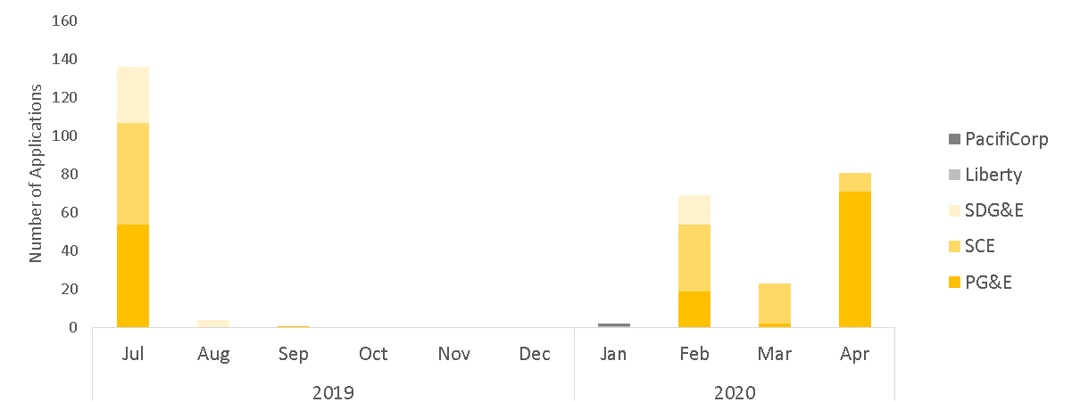
Application Timeline
Notes:
Three of 5 IOUS exhausted year 1 funding on first day of program
SDG&E waitlist indefinitely closed due to backlog of customers on waitlist
February 2020 funding was renewed for SCE and SDG&E
April 2020 funding was renewed for PG&E

Slide 13
Current Application Status
Notes:
Only 7% cancelled, will likely rise over time, MASH was 57% (why so high??)
Currently not an easy way to determine reason why application was cancelled (we did find 9 our 23 were dupes)
From Tory: Resolution approved on Thursday's voting meeting. 25 identified projects, still verifying between IOUs and PAs. Only 5 received MASH, other 23 are in both queues. They have to choose SOMAH or MASH.

Slide 14
Track A Applications
Notes:
Only 8 Track A Applications submitted
One completed Upfront Technical Assistance
6 cancelled (2 of these were duplicates)
One waitlisted and suspended
Those that were suspended reached deadline for documentation submittal – not submitted and so cancelled.

Slide 15
Application Suspensions
Notes:
We reviewed a sample of 20 random reservation request suspension notices to better understand why 2/3rd of SOMAH applications are waiting for the Reservation Request Approval (average time to get approval is 224 days)
Primary Issues:
Signature on the submitted document – not signed, signed by wrong person, wrong type of signature
Form submitted – either it was missing or was not generated through portal (a sample copy)
Document had missing info or errors

Slide 16
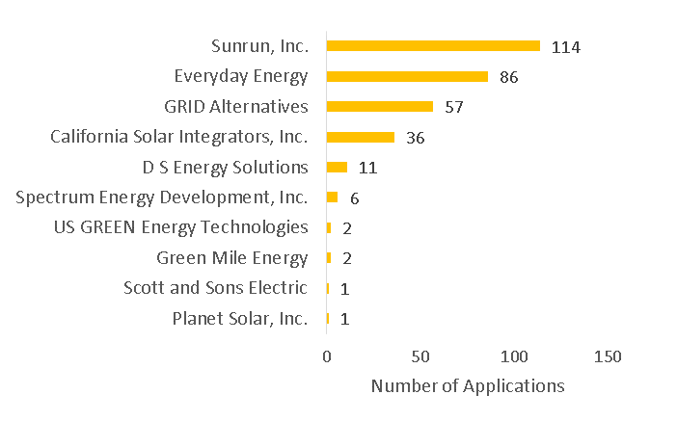
Project Contractor
Relevant Phase 1 Findings:
Finding 3: The SOMAH program has little diversity in the applicant pool and is currently being dominated by large contractors, with very limited numbers of smaller contractors or property owners participating.
Notes:
post-SOMAH launch Sunrun, Inc and Everyday Energy merged under the Sunrun, Inc. name. Together these two contracts make up nearly 2/3rds of the applications submitted.

Slide 17
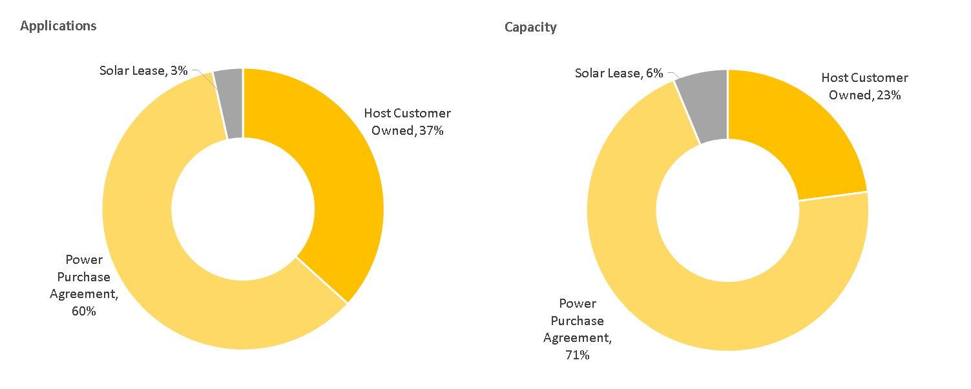
Ownership Status
Notes:
In the first year of the program, 60% SOMAH projects were financed using a 3rd-party ownership model as opposed to ownership of the system by the Host Customer.
The majority of third-party owned systems utilized a Power Purchase Agreement as opposed to a solar lease.
According to data in DG Stats, 69% of MASH 1.0 projects and 48% of MASH 2.0 projects were 3rd owned.
The capacity of the 3rd party owned systems was larger which is evident looking at the two figures as they made up 60% of applications but 71% of capacity.

Slide 18
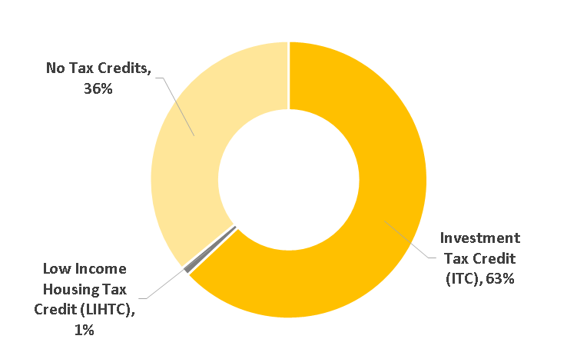
Tax Credits and Incentives
Outstanding Question:
How are Tax Credits being verified?
Notes:
SOMAH participants who purchase their solar PV system are eligible for the Federal Investment Tax Credit (ITC) or the Low-Income Housing Tax Credit (LIHTC).
The ITC is a one-time credit on federal taxes, can be used to offset a portion of the total PV system cost. Because it is a tax credit, it cannot be claimed by non-profit organizations and thus it is common for non-profit organizations to utilize a PPA or Solar Lease so the ITC can be claimed by the third-party owner to offset a portion of the system cost.
* The ITC was 30% for systems installed in 2019 and declines to 26% in 2020 and 22% in 2021.
The LIHTC is an indirect federal subsidy used to finance the construction and/or rehabilitation of low-income affordable rental housing. These tax credits are awarded to affordable housing developers and then typically sold by the developers to private investors in order to obtain funding to finance the project. Once the project is placed in service (i.e., rentable) the investors can claim the LIHTC over a 10-year period.
Incentives are about 30% lower if you claim one and 50% lower if you claim two. Very few participants are reportingly claiming both.

Slide 19
system costs and incentives by Ownership Type
Notes:
Host Customer Owned Incentives are 50% higher due primarily to the much lower % of applications reporting to take a Tax Credit

Slide 20
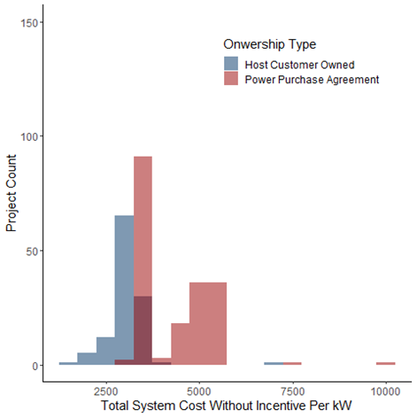
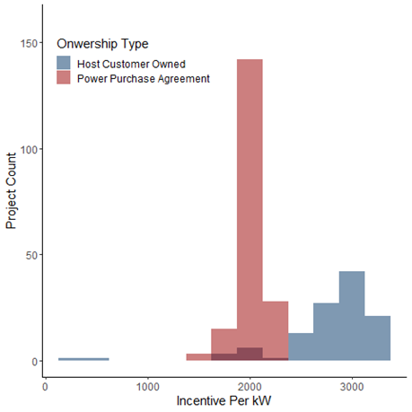
Distribution of system costs and incentives

Slide 21
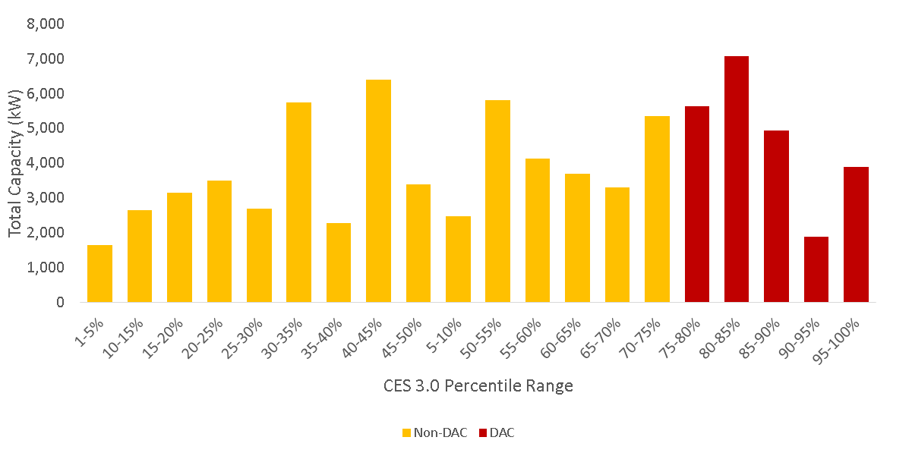
Program Eligibility - CalEnViroScreen
Notes:
28% of applications and 29% of MW were for projects in DAC. The reminder of projects had CalEnviroScreen Scores that ranged from 1-75%

Slide 22
Program Eligibility Verification
Relevant Phase 1 Findings:
Finding 4: Less than a quarter of participating properties met both the income and DAC program eligibility requirements.
Notes:
According to the tracking data roughly ¾ of applications qualified based only on income and about 20% qualified based on both income and DAC. Very few applications qualified based on DAC alone.
Evaluation team looked up the properties by census track and found misclassifications in both directions. We are still working with the PAs to try and sort out why this is happening.
In Phase II we will explore the differences between these groups of participants to ensure the program funds are being distributed in the manner in which the legislation intended.

Slide 23
Host Customer Prolificness
20 Applicants submitted only 1 application (6% of total)
40% submitted between 2 and 9 applications
54% submitted 10 or more applications
Notes:
At this time, the “Umbrella Company” field is sparsely populated as it was added after the program launch and so is blank for early applicants who have not yet updated it. The evaluation team performed manual lookups based on the property names and Host Customer contact names (that are most often the same for all projects belonging to a larger developer company).

Slide 24
Phase I Data Review
Notes:
ILLUME – feel free to change heading if you like

Slide 25
Phase I Data review – Program Tracking Data
PowerClerk 2.0 serves as both the online application portal and tracking database
    It stores tracking data fields, uploaded forms, PA correspondence with applicants and internal project status notes
Currently there is no easy was to access the data not stored in tracking data fields
    Expanding the fields included in the tracking data fields to include items such as application suspension or cancelation reason could help identify program flow issues that could be remedied
Relevant Phase 1 Findings:
Finding 5: The program application portal stores many application elements as forms rather than in data fields that can be easily queried which can make assessing the state of the program a more difficult task.
Notes:
It stores forms such as VNEM allocation Forms, Letter of Authorization, Multiple bid waiver
The forms can be downloaded on an individual basis but fields can’t be queried

Slide 26
Phase I Data review - Energy Usage Data
During Reservation Request Step IOUs provide 36-months of electricity usage data in aggregate for tenant units and common areas to help with system sizing
    Unit vacancy hard to determine based on data provided
    For one IOU the date of the data feeds was not provided
The IOU data feeds as provided to SOMAH PA would make it difficult in Phase II to accurately assess individual tenant bill impacts and impacts to CARE budgets
Relevant Phase 1 Findings:
Finding 6: The historical consumption data being provided to the PA from the IOUs lacks elements that are needed to ensure the program systems are accurately sized and program funds are appropriately distributed.
Notes:
PA working with IOUs to determine a process to “normalize” data when individual meters cannot be found based on the data provided – this is helping to minimize delays

Slide 27
Phase I Data review – PV Generation Data
To date no SOMAH projects have been installed and interconnected and thus to SOMAH PV generation data was available to review
System owners are required to contract with a PMRS for 20 years (15-min interval production data)
    To date no process in place to request this data by SOMAH PA
    During Phase II of this study we will work with PA to ensure that the accessibility, content and format meet the needs of current and future SOMAH program evaluations
Relevant Phase 1 Findings:
Finding 7: The evaluation team was unable to confirm a mechanism exists to ensure PV generation data will be available to fully quantify program impacts.
Notes:
Performance Monitoring and Reporting service

Slide 28
Program Assessment to Date
Notes:
ILLUME – feel free to change heading if you like

Slide 29
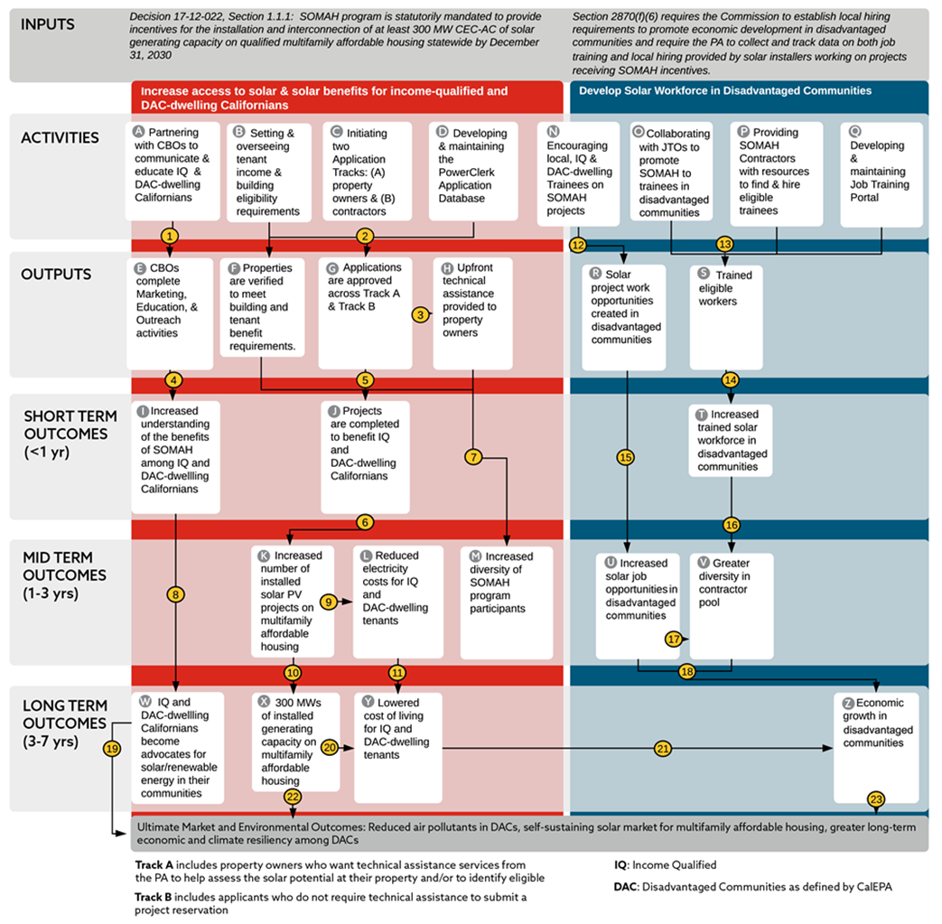
Program theory and Logic Model
Purpose:
  Document program goals, activities ,and outputs
  Identify measurable metrics and definition of success for future evaluations
Feedback on PTLM and metrics (Section 6 of report) encouraged
Notes:
What is the process for determining what metrics will be adopted?

Slide 30
Metrics Overview
Focus of metric | Examples of potential metrics
ME&O effectiveness | ME&O activities completed Target audience aware of SOMAH
Successful installations | SOMAH projects approved, milestones achieved, and completed MWs of installed capacity on eligible housing
Program benefit spillover | HUD & USDA MF housing projects approved, milestones achieved, and completed
Technical assistance (TA) | Applicants who receive upfront TA in Track A Applicants satisfied with upfront TA
Distribution of program benefits | SOMAH Projects approved, completed across various MF categories: Low-income, DAC, HUD/USDA
Workforce development | Projects that met trainee requirements Job-seekers trained/hired for SOMAH jobs
Economic development | Increased earning among SOMAH-trained workers Reduced electricity costs for SOMAH tenants
Environmental benefit | Days of good air quality Program’s carbon impact
Notes:
This is covered exhaustively in the report, but by way of overview

Slide 31
Summary of Findings and Recommendations

Slide 32
Phase I Findings and Recommendations
Finding 1: It is sometimes unclear whether the program focus pertains to disadvantaged communities defined by CalEPA (referred to in the report as “DACs”), or more broadly to historically disadvantaged or vulnerable communities.
    Recommendation 1: Identify and fully define the operational definition(s) of a “disadvantaged community” and set benchmarks for success around this definition.
Finding 2: The SOMAH PA also defines and emphasizes local and underserved hiring practices; however, there is a lack of clarity on how success will be measured in this regard.
    Recommendation 2: Tighten the workforce development requirements to ensure the job seeker benefits are being applied to the intended populations.

Slide 33
Phase I Findings and Recommendations
Finding 3: The SOMAH program has little diversity in the applicant pool and is currently being dominated by large contractors, with very limited numbers of smaller contractors or property owners participating.
    Recommendation 3: Consider various methods of expanding applicant diversity, including setting diversity goals, caps on large contractors, and supplemental program outreach.
Finding 4: Less than a quarter of participating properties met both the income and DAC program eligibility requirements.
    Recommendation 4: Explore the gap between DAC and income-qualified properties to better understand the differences in the populations and the resulting fund allocations

Slide 34
Phase I Findings and Recommendations
Finding 5: The program application portal stores many application elements as forms rather than in data fields that can be easily queried which can make assessing the state of the program a more difficult task.
    Recommendation 5: Create additional fields in the program tracking database to facilitate tracking and reporting on key program metrics.
Finding 6: The historical consumption data being provided to the PA from the IOUs lacks elements that are needed to ensure the program systems are accurately sized and program funds are appropriately distributed.
    Recommendation 6: The SOMAH PA should continue to work with the IOUs to ensure the data provided in the Reservation Request step is sufficient to properly size SOMAH incentivized systems.

Slide 35
Phase I Findings and Recommendations
Finding 7: The evaluation team was unable to confirm a mechanism exists to ensure PV generation data will be available to fully quantify program impacts.
    Recommendation 7: A formal data collection process should be established to ensure these data elements are retained as needed for future evaluation efforts.

Slide 36
Phase II Activities and Timeline

Slide 37
Phase II Activities
Program Impact Assessment
Analysis of Tracking, Billing and PV data to assess:
    Characteristics of program participants
    Program spending assessment
    Bill impacts for program participants
    Environmental benefits of program
    Electrical load impacts
    Impacts to CARE budget
    Comparison of program accomplishments to goals

Slide 38
Phase II Timeline
July 2020 – Revise research plan as needed based on Phase I findings
August – December 2020 – Phase II data collection
    Participant billing data
    Solar PV data
    Interviews – tenants, property owner/manager, trainer/trainee
August – December 2020 – Phase II process and impact analysis
January 2021 – Phase II draft report and public webinar
March 2021 – Phase II final report and webinar on final report
Notes:
Timing could be problematic due to timing of system install and interconnection

Slide 39
Q & A

