Slide 1
Unbundling Flexible and Generic Attributes for Procurement Purposes
February 9, 2015

Slide 2
Agenda
Current State: bundled attributes
What if the attributes were unbundled?
Inefficiencies created by bundling
SDG&E’s proposed change

Slide 3
Currently: Bundling Flexible and Generic Attributes for Procurement Purposes
“A megawatt may be sold only once as either flexible or inflexible.” Adopted Flexible Capacity Procurement Framework (D.14-06-050)
Permissible outcomes under bundling using 1 MW resource example
  Sell 1 MW to LSE 1 as both flexible and generic
  Sell 1 MW to LSE 1 as generic only
Not permitted under bundling:
  Sell 1 MW flex attribute to LSE 1, and sell 1 MW generic to LSE 2
  Literally construed, bundling also prohibits a resource from initially selling only generic capacity to LSE1, and then later selling the flex attribute to LSE 1

Slide 4
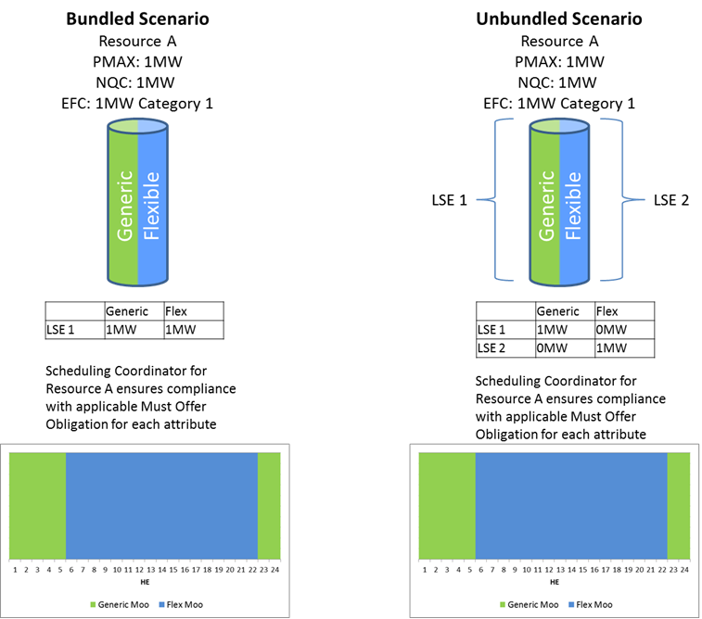
What if the Attributes are “Unbundled?”
Notes:
To this end, we adopted a flexible capacity framework to start in 2015. D.13-06-024 recognized a need for flexible capacity in the RA fleet and defined flexible capacity need: “Flexible capacity need” is defined as the quantity of economically dispatched resources needed by the CAISO to manage grid reliability during the greatest three-hour continuous ramp in each month. Resources will be considered as “flexible capacity” if they can sustain or increase output, or reduce ramping needs, during the hours of “flexible need.”

Slide 5
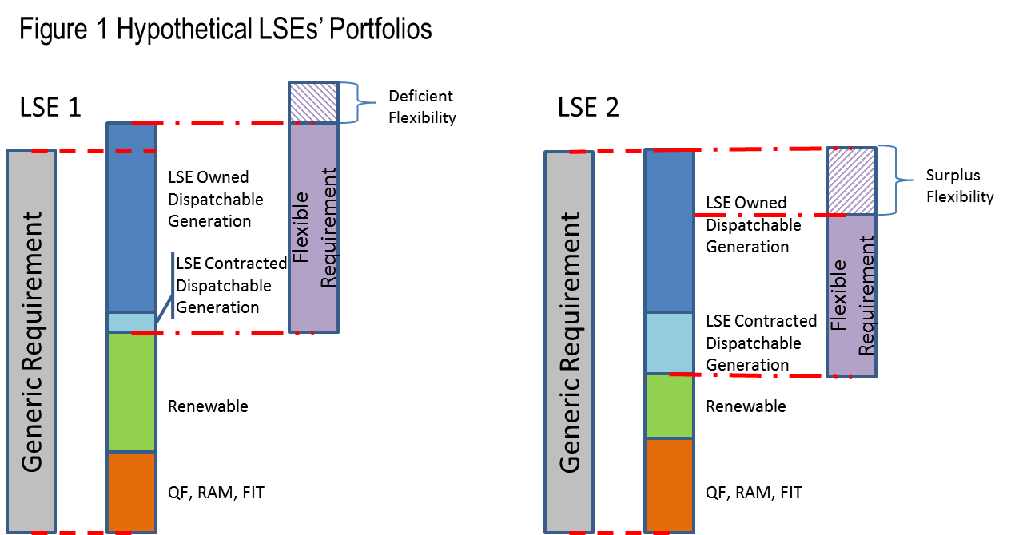
Inefficiencies Created by Bundling for Procurement Purposes
In satisfying its generic requirement, LSE 2 effectively stranded flexible capacity that could be sold to others.
Because the underlying generic capacity is needed to meet LSE 2’s generic requirement, current bundling rule bars LSE 2 from offering surplus flexibility to LSE 1.
Notes:
Unbundling flexible and generic attributes
Ensures procurement efficiency and mitigates over-procurement
Does not compromise the availability of MWs to meet physical system needs across the day

Slide 6
Inefficiencies Created by Bundling for Procurement Purposes
LSE 1’s options to cure its flexible deficiency are administratively and artificially constrained because of bundling.
Additionally, bundling will cause LSE 1 to over-procure generic capacity to satisfy its flexible deficiency.

Slide 7
Inefficiencies Created by Bundling for Procurement Purposes
In nearly all instances, procuring the bundled product is the least cost, best fit solution.
SDG&E anticipates the vast majority of transactions for flexibility will be bundled with the underlying generic attribute.
A prescriptive rule requiring bundling in all instances does not necessary promote least cost/best fit procurement.
In fact, requiring bundling in every instance promotes overprocurement, artificially constrains the market for flexibility, and potentially exposes incremental capacity to SCP penalties.
Take away:
Artificially or administratively constraining the market for RA products or attributes is unquestionably bad for ratepayers.

Slide 8
SDG&E’s Proposed Change
Allow unbundling for procurement by removing the following sentence from the previous decision:
“A megawatt may be sold only once as either flexible or inflexible”

