Slide 1
Vehicle-Grid Integration (VGI)
© 2011San Diego Gas & Electric Company. All copyright and trademark rights reserved.

Slide 2
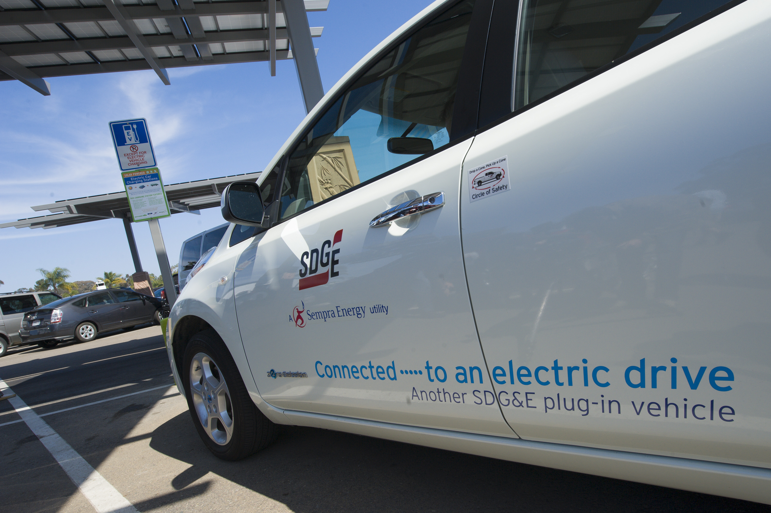
Create an excellent customer experience and accelerate the growth of electric transportation by ensuring the safe, reliable and efficient integration of EV loads with the grid
SDG&E Goal – Grid-Integrated Charging
Technology
Pricing
Innovation
Education
More plug-in EVs
More zero emission, grid-integrated miles
2
Notes:
2

Slide 3
Customer & Service Provider Support
Learn by doing – challenges, costs and opportunities
SDG&E Fleet and employee charging (Workplace Pledges)
EV Rate and Technology Experiment
EV Project
car2go
eVgo / NRG
Zoo Project
Grant applicants (Chargepoint, ECOtality)
Direct customer contact – calls, education and outreach
Field engineer assigned to all service providers

Slide 4
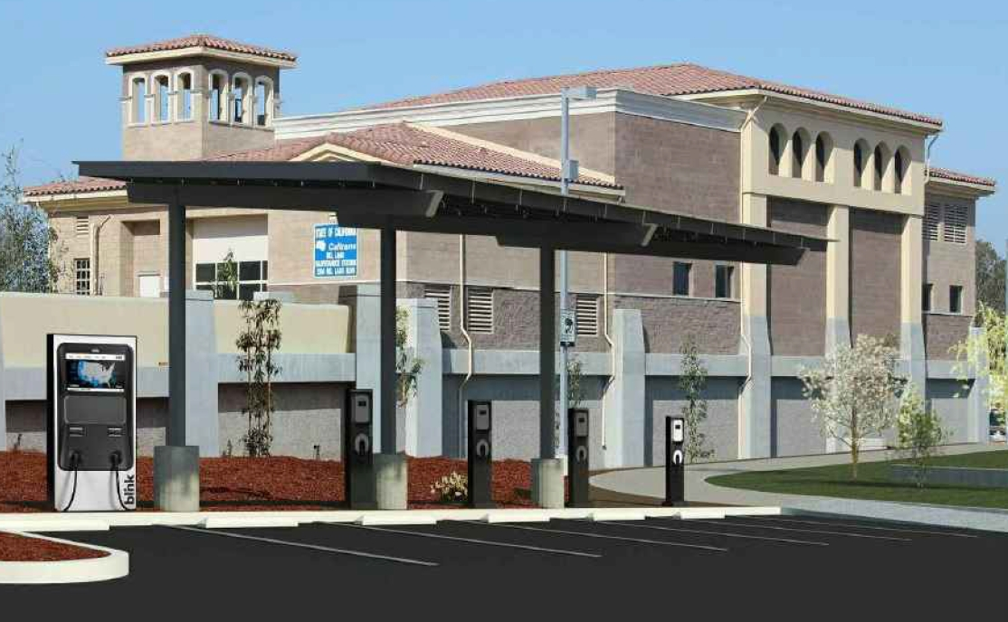
Del Lago Transit Station – CalTrans

Slide 5
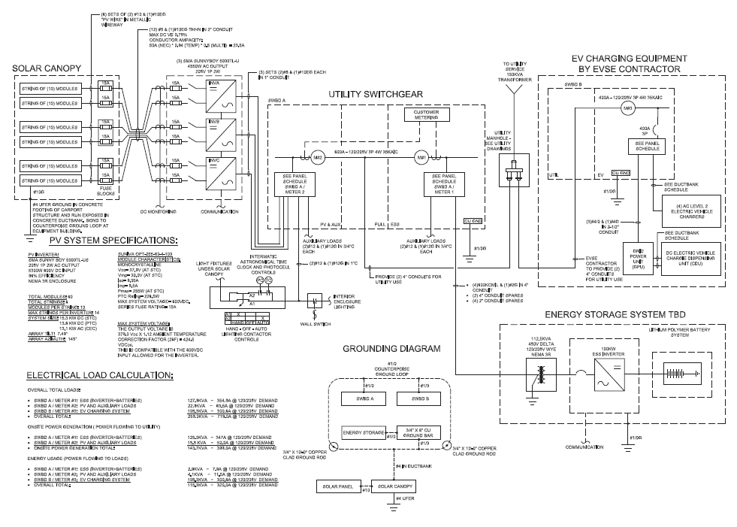
Utility Infrastructure
Notes:
How SDG&E views “EV charging infrastructure” – example of a comprehensive utility infrastructure schematic: PV with inverters, stationary battery storage with inverters, transformer and line extension equipment to support Level 2 EVSE and DC Fast Charger.

Slide 6
SDG&E Experimental EV Rates
40
35
30
25
20
Cents per kWh
15
10
5
0
EV-TOU
Rate 2
Rate 3
On-peak
Off-peak
Super Off-peak
Summer example – Separately metered experimental EV rates (EPEV-X, EPEV-Y, EPEV - Z) “on-peak” is noon to 8pm, and “super off- peak” for all EV rates is midnight to 5am. All other times are “off-peak”.
6
Notes:
6

Slide 7
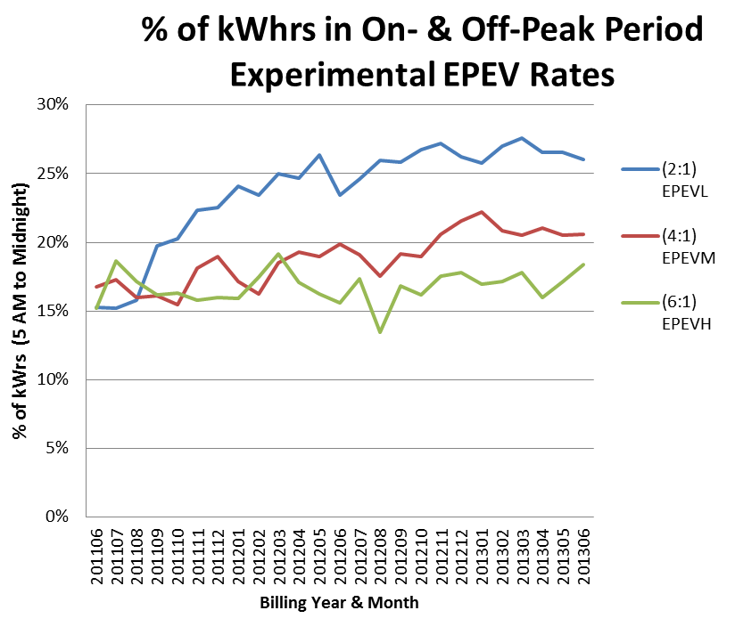
EV Rate & Technology Study Findings
Notes:
Although, in general the TOU pricing encourages off-peak and super off-peak charging, it appears that customers with the lower on-peak pricing are not discouraged to charge the vehicle on-peak. A longitudinal study design was necessary to better understand the persistence of price and charging behavior. Continuous communication of the rates and lower fueling cost benefits is essential.

Slide 8
Need for Grid-integrated Charging
EV Charging – An active role by the utility is necessary to meet the needs of our customers and the electric vehicle market
Employ pricing solutions
Accelerate innovation
Technology – More progress must be made in advancing efficient grid-integrated charging to
Lessen the growing evening peak demand
Integrate renewable energy resources
Increase benefits of improved grid utilization for all customers

Slide 9
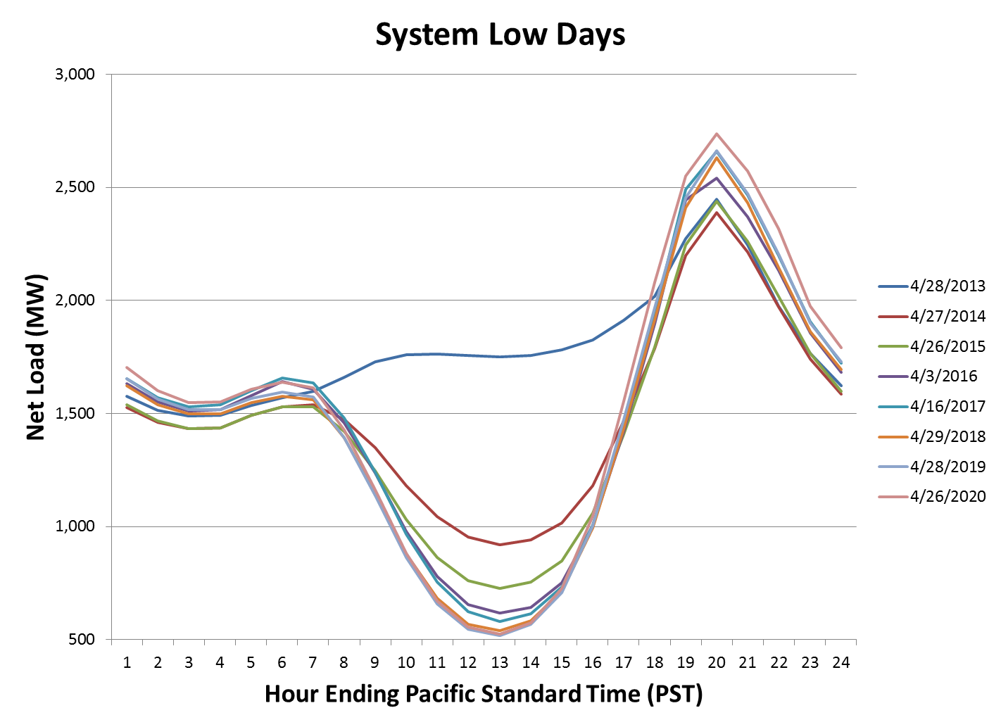
Demand, Net of Renewable Energy
Flat price - Nashville

Slide 10
Demand, Net of Renewable Energy
80% of PEV production to be low battery capacity plug-in hybrids – workplace charging is needed to maximize zero emission miles traveled
TOU price – SDG&E

Slide 11
VGI Employee Charging Study
Implement an innovative day-ahead, time-variant pricing plan for SDG&E workplace employees
Enable grid-integrated charging
Optimize with grid conditions
EV batteries to provide benefits of energy storage
Increase the utilization of renewable energy resources
Assess charging decisions – pricing with enabling technology
Test functionality of a managed charging process driven by employee price preferences
Increase EV adoption and zero emission miles driven per EV
Create a replicable charging innovation through third party service providers operating to SDG&E specifications

Slide 12
Workplace & Fleet Charging Solutions
SDG&E workplace charging – employees schedule charging times based on the changing cost of energy during day
Eight 1.3 kW & two 8 kW charging units managed at one smart kiosk

Slide 13
Architecture – How it Works
SDG&E contracts with third parties to build, install, operate and maintain facility to SDG&E’s specifications
Each EVSE is separately metered and driver is billed
SDG&E,
CAISO and
other sources
DR messages,
prices and
other parameters
Back office
Authorization
logic and control commands

Slide 14
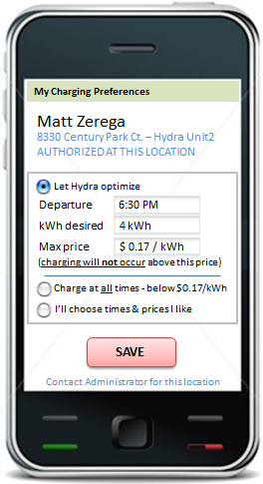
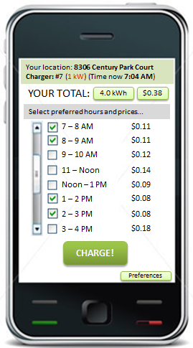
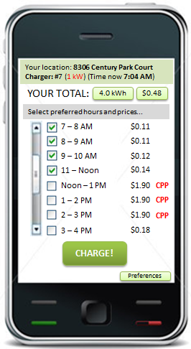
VGI Pricing App
Basic settings –
“set & forget”
Advanced settings –
choose hourly prices

Slide 15
Benefits
Use of energy storage capacity of EV to take energy when supply is plentiful, integrated with renewable energy
Reduce on-peak charging, reduce utility operating costs
Increase EV adoption and zero emission miles driven per EV
Cash in employees’ pocket from gasoline cost savings
Increased environmental benefits, US energy independence
All customers benefit from improved utilization of the grid

Slide 16
Utility Role
Ensure EV charging does not become a market barrier
Keep innovating and exploring VGI solutions
Customer and stakeholder education
Proactively support customers and service providers
Maintain competitive electricity pricing
Maximize benefits to all customers through improved grid utilization and integration of renewable energy resources

