Slide 1
Rulemaking 13-11-007: Alternative Fueled Vehicles
Public Workshop on
Vehicle-Grid Integration &
PEV/EVSE Financing
California Public Utilities Commission
December 4, 2013

Slide 2
Agenda
Commissioner Peterman (Opening Remarks)
Vehicle Grid Integration Panel
Opening Presentation
Discuss Question 1
Break
Discuss Questions 2 & 3
Lunch
Vehicle Cost Financing
Break
Infrastructure Installation Financing
Wrap-Up and Next Steps

Slide 3
New CPUC Rulemaking
Rulemaking on Alternative-Fueled Vehicles, instituted November 14, 2013.
Two concurrent tracks
Vehicle-Grid Integration
Energy Division White Paper
Rate Revisions and Financing Opportunities
Rate Design
Upfront vehicle costs
Infrastructure installation

Slide 4
Vehicle-Grid Integration
Overview:
Adam Langton, CPUC
Panelists:
Ed Kjaer, SCE
Richard Lowenthal, Chargepoint
Peter Klauer, CAISO

Slide 5
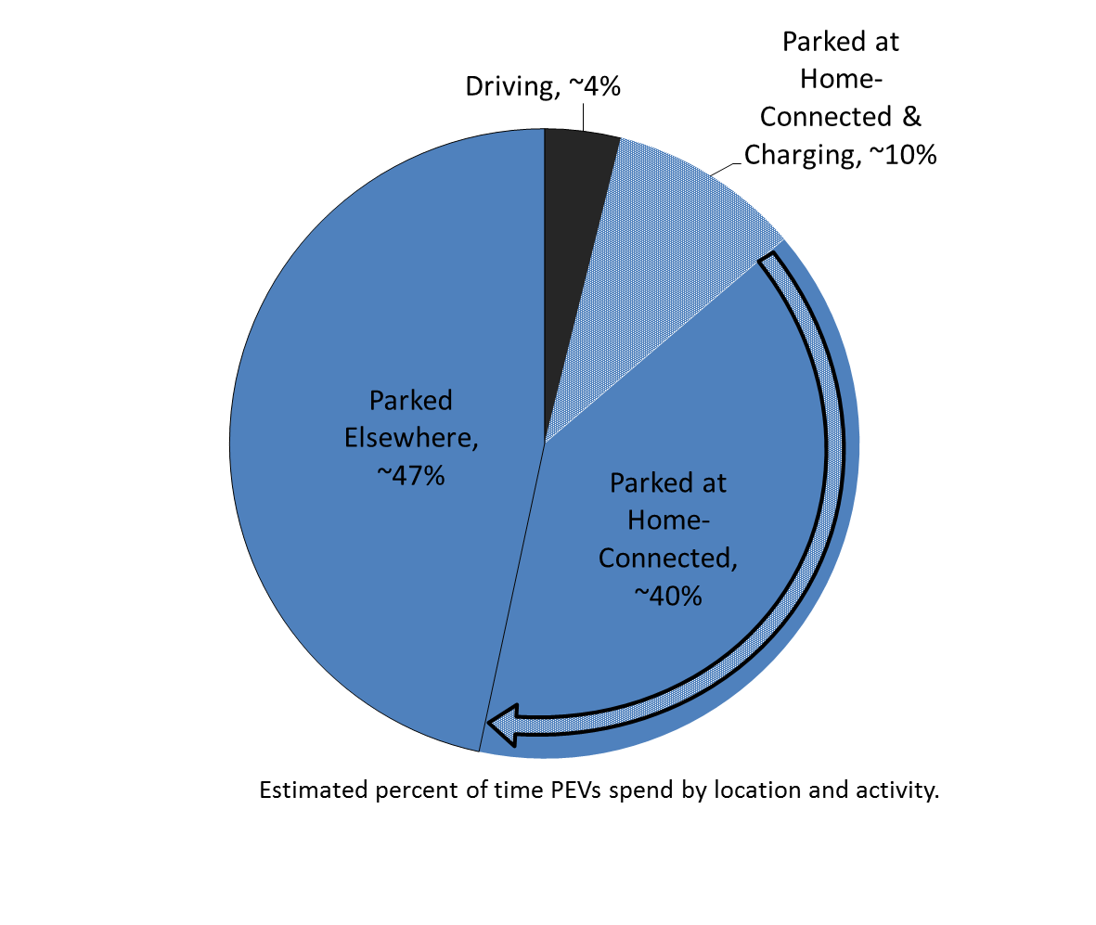
The Opportunity
Low Utilization Rate
Operational Flexibility
Embedded Technology

Slide 6
Potential Applications as Grid Storage
Wholesale Market Services | Distribution Infrastructure Services | Customer-Facing Services
Frequency Regulation | Upgrade Deferral | Power Quality
Spin/Non-Spinning Reserves | Voltage Support | Power Reliability
Load Following/Ramping |  | Retail Energy Time-Shift
 |  | Demand Charge Mitigation

Slide 7
Wholesale Market Needs

Slide 8
Resource Aggregation

Slide 9
Uni- or Bi-Directional Power Flow

Slide 10
Objectives of Actors in the PEV Value Chain

Slide 11
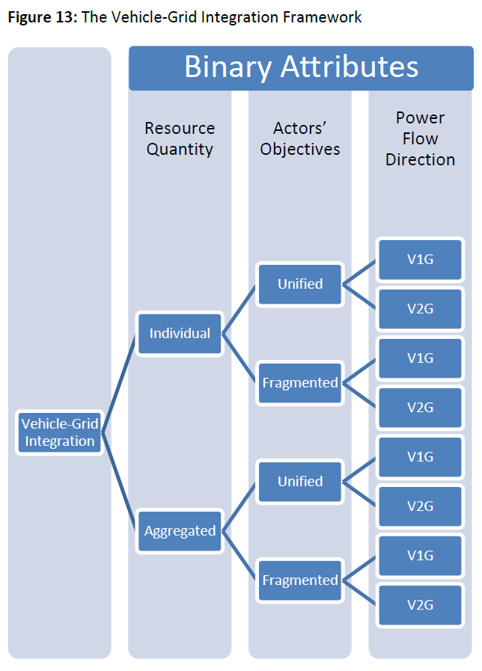
Framework for VGI
Fragmented Actors
Aggregated Resources
Controlled Charging
+ Battery Discharging
(V2G)
Unified Actors
Individual Resource
Controlled Charging
(V1G)

Slide 12
Primary Regulatory Questions
Secondary
Regulatory Questions
How and Where is the “Resource” defined?
What is the utility role in aggregating resources?
How do utilities capture distribution benefits?
How should competing grid signals be prioritized?
Interconnection
Wholesale Market Products
Utility Tariffs
Metering and Telemetry
Communication Standards

Slide 13
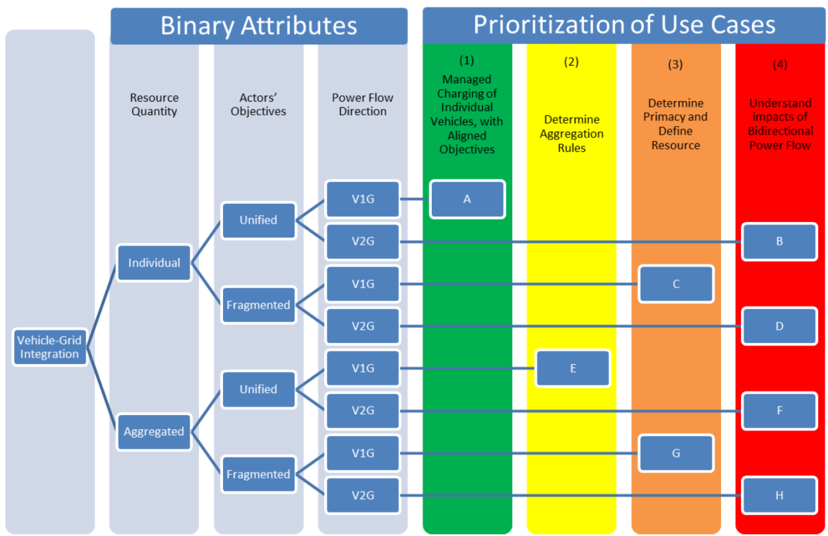
Prioritization

Slide 14
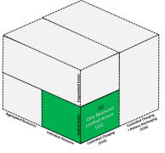
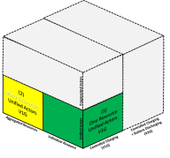
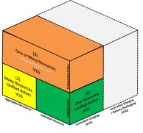
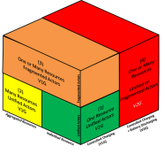
Inter-Agency Roadmap Approach
Prioritize VGI Use Case Implementation by Value of Grid Application
Regulatory
Developed & Demonstrated V2G Products
What is VGI? Why is it important?
Barriers to Address
Commercial Deployment of Use Case
Technological
Application Primacy
Resource Definition
Values for Compensation
Needed Solutions
CPUC & CAISO Requirements for Tariffs & Products
Revision
Revision
Revision
Design, Metering, Communications, Interconnection
Aggregators’ Role
Establish VGI Use Cases
1
2
3
4
Determine Impact, Value, and Market Potential of Applications

Slide 15
Discussion Questions
Is the VGI Use Case Framework adequate? How do we prioritize future State VGI activities?
Does the Energy Division White Paper capture all of the regulatory barriers related to CPUC jurisdiction?
Are the four regulatory questions the right areas of focus for this proceeding?

Slide 16
Discussion Question 1
Is the VGI Use Case Framework adequate?
How should the State prioritize implementation?
Should we first implement the use cases that are feasible from a regulatory standpoint, and subsequently pursue more complex Use Cases?
Does sequencing Use Cases make sense from a technology commercialization standpoint?
How should we design initial policies so that they’re ready for subsequent Use Cases?

Slide 17
Discussion Question 2
Does the Energy Division White Paper capture all of the regulatory barriers related to CPUC jurisdiction?
If not, what additional barriers exist?
Resource Definition
Resource Aggregation
Utility Capture/Return of Distribution Benefits
Primacy of wholesale & retail grid services
Safety
Interconnection
Wholesale Products
Utility Tariffs
Metering & Telemetry
Communication Standards

Slide 18
Discussion Question 3
Are the four regulatory questions the right areas of focus for this proceeding?
What other issues or proceedings implicate vehicle-grid integration?

Slide 19
Gaps & Barriers to AFV Financing

Slide 20
The Utility Roles In Addressing Up-Front Vehicle Costs
Moderator:
Noel Crisostomo, CPUC
Presenters:
Snuller Price, E3
Adam Langton, CPUC
Respondents:
Alex Keros, GM
Aaron Johnson, PG&E

Slide 21
The Utility Roles In Addressing EV Infrastructure Installation Costs
Moderator:
Damon Franz, CPUC
Presenters:
Mark Duvall, EPRI
Greg Haddow, SDG&E

Slide 22
Wrap Up and Next Steps
R.13-11-007 Schedule (see p. 26 of OIR)
Interagency VGI Roadmap (see ZEV Action Plan)
What additional activities?
Event | Date
Voted on at Commission Meeting / Filed | November 14, 2013
Date of Issuance | November 22, 2013
Opening Comments Due | December 13, 2013
Reply Comments Due | December 20, 2013
Event | Date
Submit additional comments to CEC | ASAP
Publish Final Roadmap (Living 1st Version) to G.O. | December 30, 2013

