Slide 1
VGI Requirements Group Update

Slide 2
Group info
Meetings Tuesday and Thursday
730am – 900am
Webinar
Current Members: Vincent Chen (Luccid), Jeremy Whaling (Honda), Jordan Smith (SCE), George Bellino (EPRI), Mike Bourton (Kitu), Lance Atkins (Nissan), Craige Rodine (Charge Point)
Agency Staff: Elise Keddie (ARB), Stephanie Palmer (ARB), Justin Regnier (CEC)

Slide 3
Grouping and Normalizing Terms for Actors
Power Flow Entity (PFE) | BMS (Building Management System) | EV Battery System | Energy Connection System (ECS) | EV Power Converter | EV Driver |  | Energy Meter
Formerly known as Network Service Provider (NSP) |  | Electric Vehicle (EV) | formerly known as EVSE |  |  | Plug in location, utility customer, bill payer
Clearing House | Energy Management System | PHEV | Electric Vehicle Supply Equipment | Inverter | Driver | Site Host | End User Meter Device (EUMD)
Aggregator | Building Site Controlller | PEV | Charger | Power Factor Correction | End User | Ratepayer | Battery Energy Storage System (BESS)
Controlling Entity | Fleet Management Controller | Electric Vehicle | Level 2 EVSE | Rectifier | Owner | Bill Payer | Site meter
Alternative Energy Supplier (AES) | Customer Energy Management System | BEV | Charger (DC) | Bi-driectional inverter |  | Home Owner | Sub Meter
Demand Clearing House | Fleet Management System |  | Level 1 EVSE | Charger (AC)
Electric Vehicle Electric Vehicle Service Provider (EVSESP) | Home Energy Management System
Electric Vehicle Service Provider (EVSP) | Site Controller
Energy Portal (EP)
Energy Services Communication Interface (ESCI)
Energy Services Company (ESCO)
Energy Services Interface (ESI)
ISO
Municipal Owned Utilities
OVGIP
Publicly Owened Utilities (POU)
Smart Energy Portal (SEP)
Utility

Slide 4
Functional Requirements Skeleton
Intent:
Harmonize functional elements common to all use-cases
Provide a consistent set of general terms to use during discussion
Allow for all implementation approaches to be overlaid on the functional requirements
Provide a structure for the future communications standards protocol mapping sub-group to use
EV Battery System
EV Power Converter System
Energy Connection System
EV Driver
Functional Communication links & requirements shown here
Power Flow Entity
Energy Meter
Utility Customer
Building Management System

Slide 5
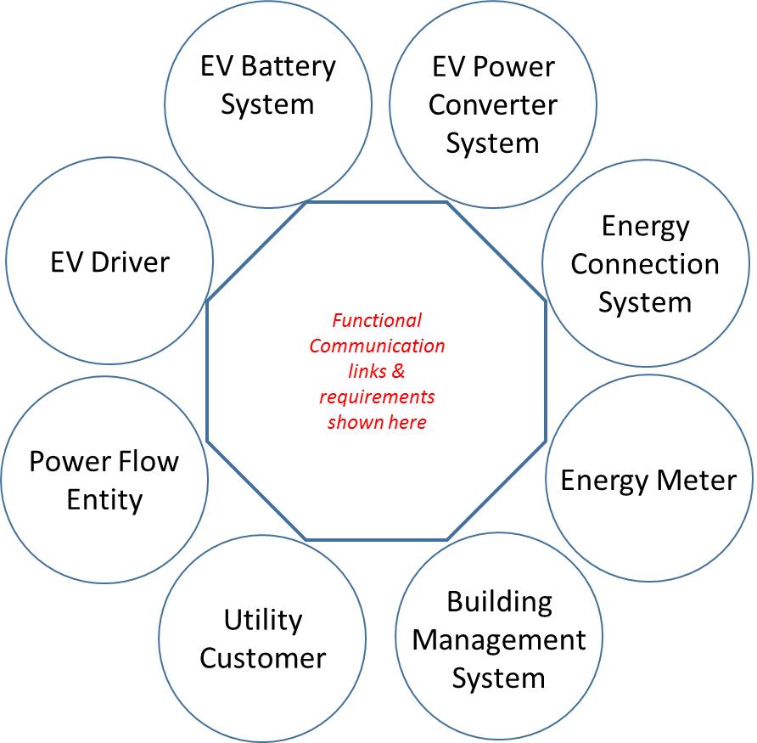
Specific Implementation Overlay Examples
The implementation specific products or business entity approaches can be identified by combining elements from the functional requirements skeleton.
Your individual implementations of interest should be able to be overlaid
Car
Car
DC EVSE
EVSE
Driver Phone App
Utility
Charge Station Operator
Home
Site Host

Slide 6
Outline for Deliverable 1

Slide 7
Overview of the need for the working group
Past efforts (VGI Roadmap, Ruling, CPUC report)
Current Proceedings/Dockets
CPUC
CEC (IEPR)
ARB - SB 454
Discussion of separation of technology from value
What was the agencies goal in doing this?
Allowing for a focused conversation on each
Recognizing the difficulty in predictions on future value and market structure
Yogi Berra - “It's tough to make predictions, especially about the future.”
Discussion of definition sub group
Why are definitions needed
Different Standard Setting groups
Different nomenclature for ISO/Wholesale market, Utilities, Automakers, Policy Makers
Go over each section of definitions
Discussion of use cases
Discuss tags - V1G, V2G, aggregated, non –aggregated, fragmented, non -fragmented, other, unified
1 paragraph summary of each use-case (72)
How it works
Final tags assigned

Slide 8
Discussion of requirements
Discuss communication path ways, why are each important and what they can accomplish
Discuss customer requirements
Discuss functional requirements
Discuss non-functional requirements
Discuss alternative ways to execute without the use of a protocol
Discuss grouping and normalizing terms to actors
Discuss whether the EVSE or PEV controls the power flow
Discussion of mapping requirements to network architecture
Discuss current standards that are available
Summary of key points from each section

Slide 9
Backup

Slide 10
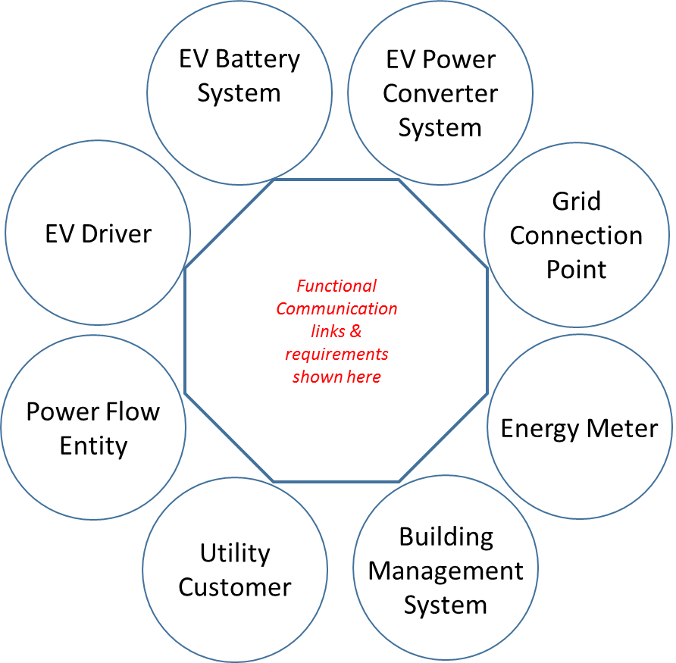
Communication Protocol Mapping Concept
Communication standards and approaches can then be mapped between the products and business entities. Those standards can then be evaluated on their ability to carry-out the functional requirements listed for that interface in the functional requirements skeleton.
Car
CHAdeMO
ISO 15118
or
SAE J2847
Car
DC EVSE
EVSE
Vendor specific
Driver Phone App
OCPP
Utility
Charge Station Operator
IEEE 2030.5
OpenADR
Home
Site Host
Requirements Sub-group DRAFT

