Slide 1
Team Name: AMI Water Trifecta Pilots
Water Energy Nexus AMI Pilot Workshop
January 19, 2016

Slide 2
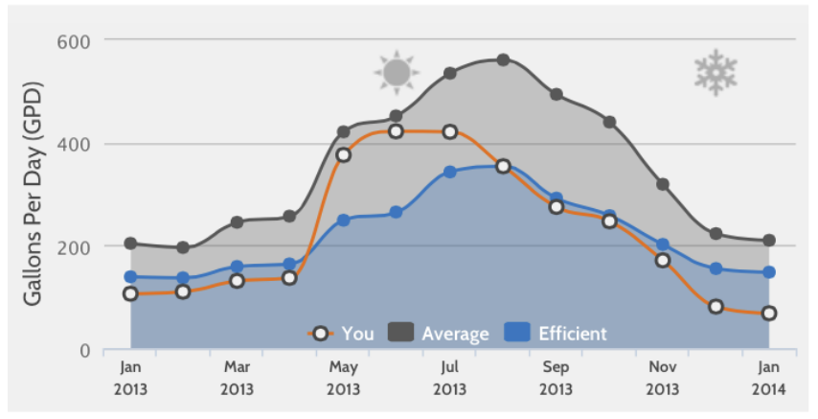
Partner on Integrated Water & Energy Information Behavioral Study
Provide side-by-side match-ups of customer’s Energy & Water Usage Information and measure changes in behavior based on:
  Comparisons to neighbor’s usage
  Comparisons to previous usage patterns
  Communication of goal-oriented information daily/weekly
  Compare and contrast climate zone behaviors
  Compare and contrast socio-economic zone behaviors
Potential barriers to immediate implementation:
  Ideation Process
  Existing Behavioral Definition
  TRC

Slide 3

AMI Partnership Projects
Water agency partners to provide pre- and post-AMI water usage for sample accounts. SCE analyzing both water and electricity usage for savings opportunities
City of Downey
System has approximately 22,500 water meters
City of Newport Beach
System has 27,800 water meters
City of Santa Monica
System has 18,500 water meters
100% ground water
65% ground water
AMI Using Neptune Technology
20% ground water
AMI Using cell phone towers
AMI Using Aclara Technology
Saved 166,000 gallons on first installation (510 kWh)
SCE interest: collect and analyze AMI data and verify any reduction in water loss
Use the CPUC WE tool to provide incentive for future deployment

Slide 4
Study How Green Button “Connect My Data” can Aid Engagement in Partnership with Water IOUs
What is needed to Create Cross-utility Customer Engagement?
  Systems and technologies ability to support integrated views
    Features to present AMI data for customer decision making
    Measurement
  Privacy
  Timeliness
  Standards based integration
How are water IOUs planning for expanding customer awareness to include AMI?
What is the right timing?
  Relative to Water AMI Deployment
  Relative to customer experience

