Slide 1

Energy Storage Safety at CPUC
2010-2017
The Energy Storage Safety Forum
February 22-24, 2017
Arthur O’Donnell - Supervisor, Risk Assessment & Safety Advisory
Safety & Enforcement Division

Slide 2
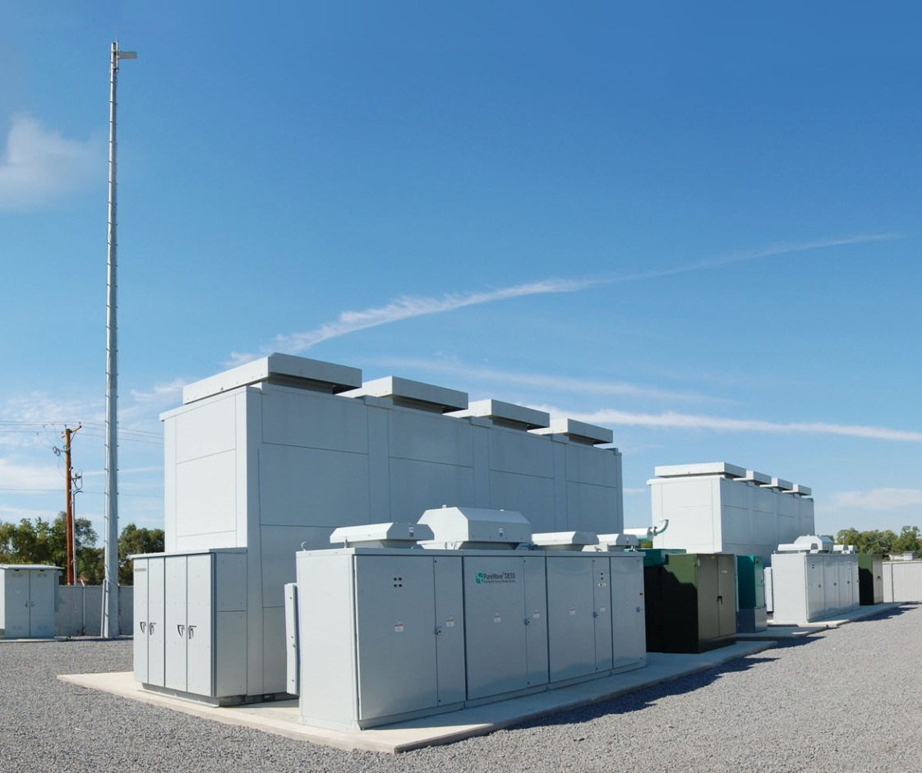
AGENDA
CPUC’s 1.3 GW Energy Storage Initiative
  Background
  2013 Decision – Storage Targets
  Current State of Market
  Customer-Side Systems – Local Permitting
  Safety Considerations in Procurement – Grid Scale
  Utility Owned -- Inspection Guidelines

Slide 3
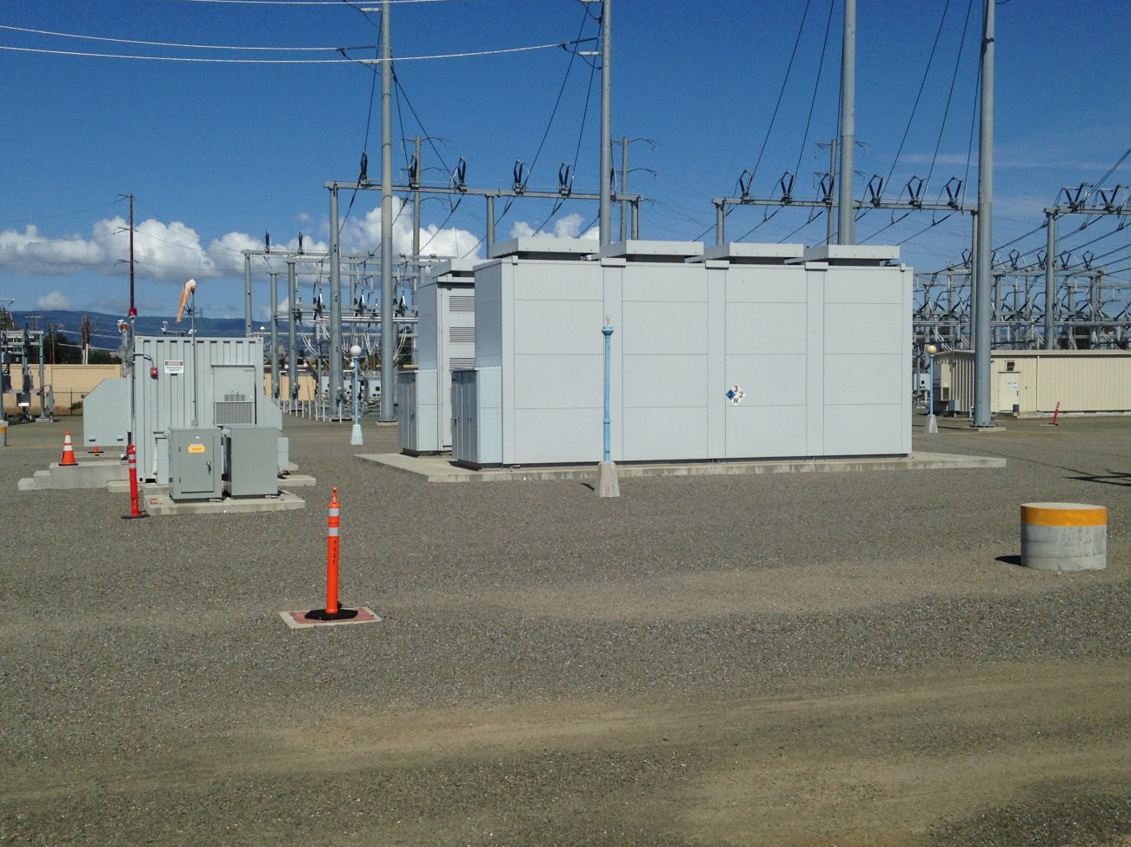
1,325 MW in operation by 2024

Slide 4
Summary of AB 2514 (2010 Skinner)
Directed CPUC to open a proceeding to:
  Adopt procurement targets, if appropriate, for each LSE to procure viable & cost-effective energy storage
    To be achieved by EOY 2015 & EOY 2020
  Consider policies to encourage deployment of energy storage
Deadline for CPUC decision by October 2013
CPUC to re-evaluate its determinations every three years
Notes:
b) (1) On or before March 1, 2012, the governing board of each local
publicly owned electric utility shall initiate a process to determine
appropriate targets, if any, for the utility to procure viable and cost-effective
energy storage systems to be achieved by December 31, 2016, and December
31, 2021. As part of this proceeding, the governing board may consider a
variety of possible policies to encourage the cost-effective deployment of
energy storage systems, including refinement of existing procurement
methods to properly value energy storage systems.

Slide 5
Storage OIR R.10-12-007
Established framework of storage applications/Use Cases
  21 end uses
  Distinct types of storage to consider from policy perspective
Identified regulatory barriers to storage deployment
Recognized distinct storage flexibility benefits
Developed specific Use Case descriptions
Preliminary cost-effectiveness analysis of selected use cases by EPRI & DNV KEMA

Slide 6
Goals & Objectives
Goal: To begin integrating energy storage into the power grid in support of statewide strategies to reduce carbon emissions
  Drive storage market transformation
  Eliminate or reduce regulatory, commercial, and financial barriers to storage deployment
  Gain development and operational experience
Storage projects must address at least one policy objective:
  Integration of renewable energy sources
  Grid optimization (peak reduction, reliability needs or T&D deferment)
  Reduction of GHG emission

Slide 7
Category | Storage “End Use”
Independent System Operator / Wholesale Market | Frequency regulation Spin/non-spin/replacement reserves Ramp Black start Real time energy balancing Energy price arbitrage Resource adequacy
Renewables Integration | Intermittent resource integration: wind (ramp/voltage support) Intermittent resource integration: photovoltaic (time shift, voltage sag) Supply firming
Transmission & Distribution (Grid Operation) | Peak shaving: off-to-on peak energy shifting (operational) Transmission peak capacity support (upgrade deferral) Transmission operation (short duration performance, inertia, system reliability) Transmission congestion relief Distribution peak capacity support (upgrade deferral) Distribution operation (Voltage Support/VAR Support) Outage mitigation: micro-grid
Customer Use | Time-of-use /demand charge bill management (load shift) Power quality Peak shaving (demand response), Back-up power

Slide 8
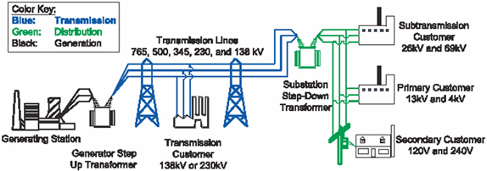
Energy Storage Systems
Bulk Generation |  | Xmission | Distribution | Behind-the-Meter
Renewable –Sited Storage | Transmission Connected Bulk Storage | Transmission Grid Storage | Distribution Grid Storage | Customer-Sited Storage
CSP Wind + Storage | A/S Peaker Load following | FERC Jurisdiction | Substation Level Storage Distributed Peaker Community ES | Bill mgt / PLS Power quality EV charging
⬅== Transmission-Connected ==➔

Slide 9
What Was in the Initial Decision
On October 17, 2013, the CPUC approved final decision D. 13-10-040 to set storage procurement targets and policies for load-serving entities (utility & non-utility):
Up to 1,325 MW of storage by 2020 in 4 biennial bidding auctions, starting December 2014;
PG&E 580 MW; SCE 580 MW; SDG&E 165 MW (totals)
Storage for Transmission-connected, Distribution-level and Customer-Side of the Meter applications;
Up to 50% utility ownership for storage across all categories (except);
Distribution for reliability is utility-owned;
Storage from other solicitations (SGIP, LTPP) may apply to targets;
Non-utility LSEs have later targets ~ 1% of peak load by 2020;
Market Transformation rationale for targets.
Cost-effectiveness needed to be “disproved” by utilities.

Slide 10
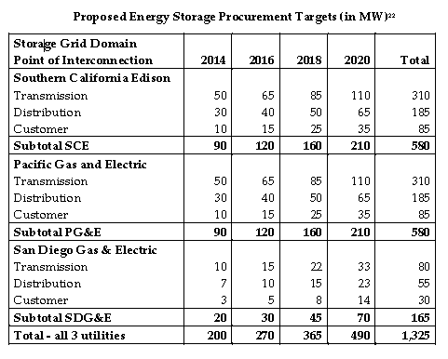
Procurement Targets: by Year and Utility

Slide 11
Additional Directives in the CPUC Decision
Every two years, utility procurement applications due March 1, followed by a solicitation on December 1
Ownership
  Utility-owned storage limited to 50% of cumulative targets
  IOU allowed to own storage assets on customer-premise
  IOU could contract with either Customer or third party-owned assets
Pumped Storage >50 MW not eligible
Target Flexibility
Project Eligibility
Other Guidelines
  Program Evaluation
  Cost Effectiveness Evaluation

Slide 12
Procurement Targets: Current Status
Utility | Total MW Goal By 2024 | Total Procured to Date | AB 2868 procurement | Proposed for 2016 RFO
Southern California Edison | 580 | 537.7 | 166.7 | 20
Pacific Gas & Electric | 580 | 94 | 166.7 | 115.3
San Diego Gas & Electric | 165 | 116.6 | 166.7 | 144
Total | 1,325 | 749 | 500 | 279.3

Slide 13
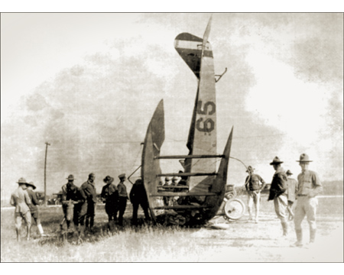
Any technology has its problems, especially an emerging technology

Slide 14
Installed by Technology 2013-2015
Lithium Ion remains dominant with ~98% of 2016 installations – GTM Research

Slide 15
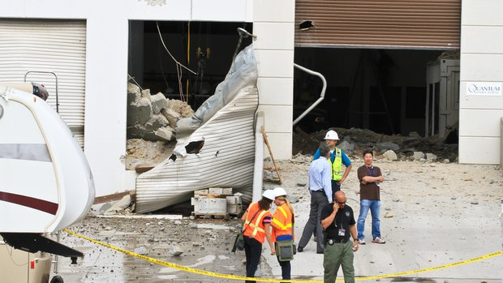
Flywheel Storage Device Blast
Poway, California
June 10, 2015

Slide 16
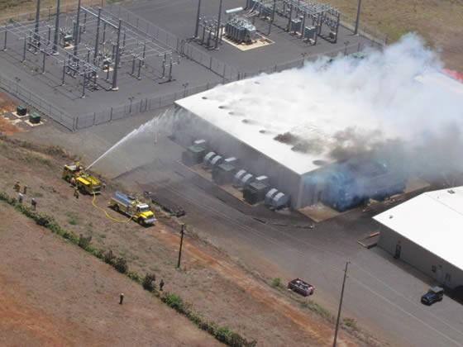
Kahuku Wind Facility Fire, 2012
"The fire had spread through some of the batteries and was now in front of the door so the use of the dry chemical was not sufficient to knock down the fire to the point where we could extinguish,"
-- Capt. Terry Seelig, Honolulu Fire Department

Slide 17
Storage Safety in California Proceedings
Customer-Side Systems
In 2014, Commission was determining energy storage eligibility for net energy metering (NEM) program and sought to incorporate safety as a program criterion.
However, CPUC does not have jurisdiction over local permitting for residential and small commercial units under our Rule 21 interconnection process.
In D.14-05-033 Commission staff were directed to work with State Fire Marshal, Governor’s Office of Planning & Research and others to “develop a set of comprehensive standards and practices to improve permitting and inspection by local authorities….” and to promulgate them on Commission web site and help promote them statewide.

Slide 18
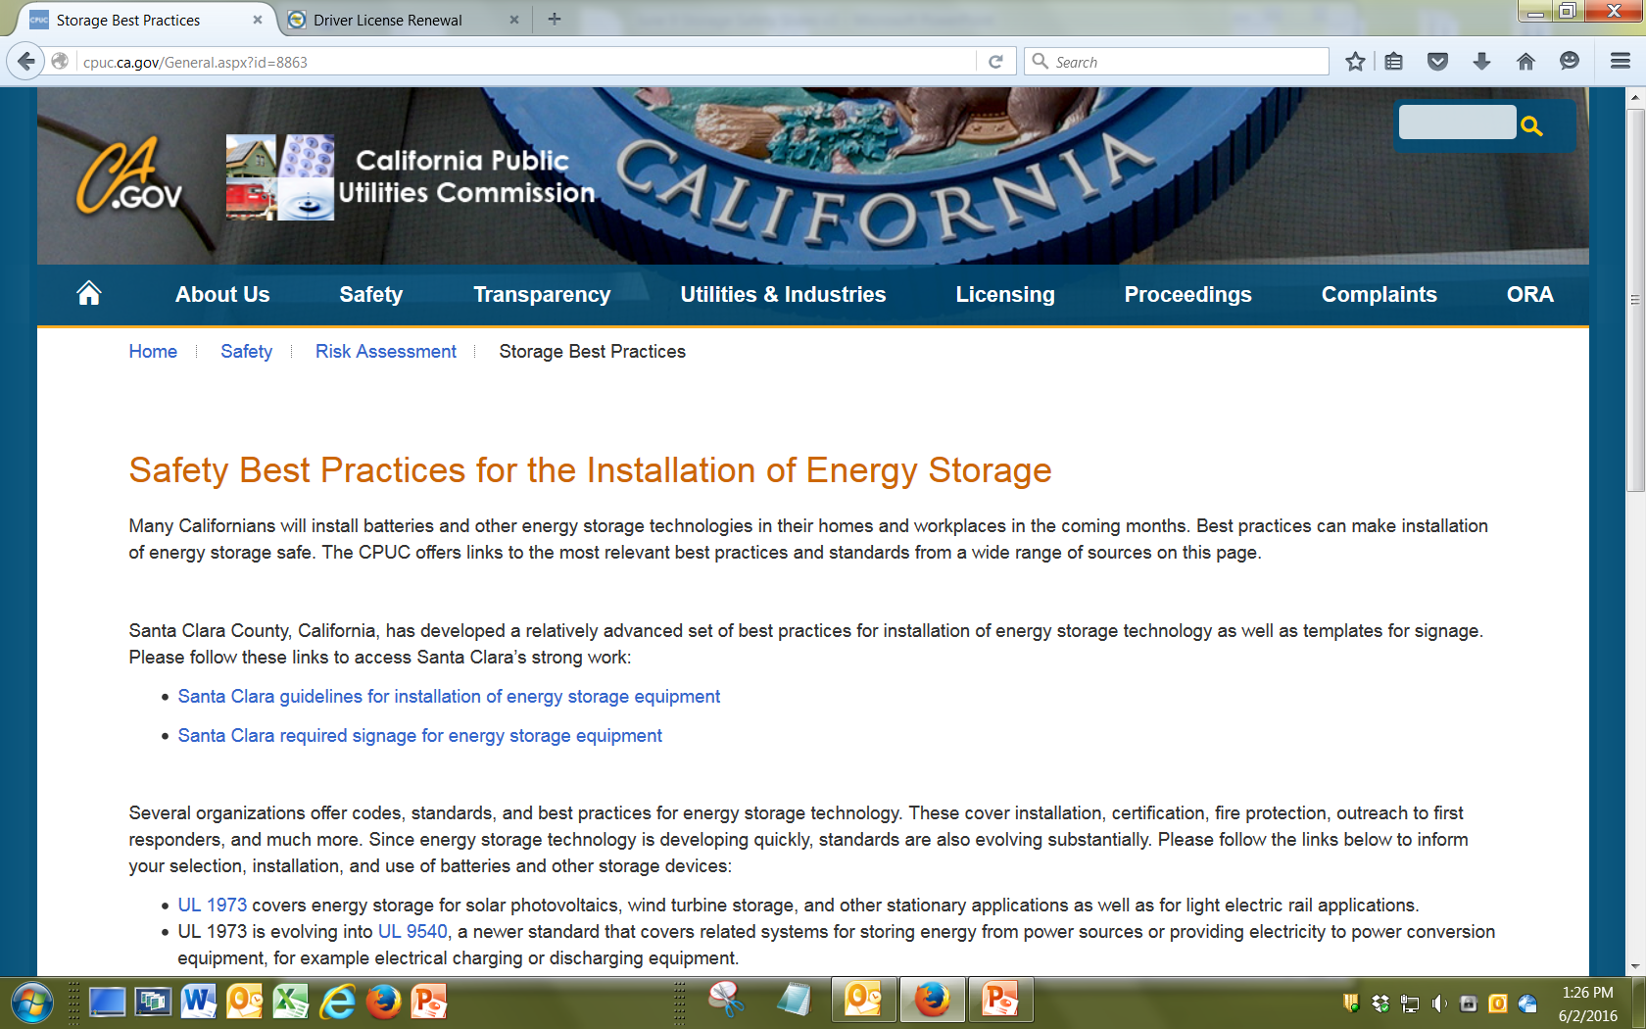
Storage Safety in California Proceedings
Customer-Side Systems

Slide 19

Interconnection of storage battery systems
Field Inspection Guidelines for interconnected residential battery storage systems
Multiple references to National Electrical Code 690.71, etc. & UL 1741
A system maintenance plan shall be submitted to the building inspection office at time of permit application in order to ensure the homeowner is aware of the system maintenance requirements.
Energy storage systems shall be listed to UL 1989 or 9540 as applicable.
Applicant must provide a letter from the serving utility indicating they have been notified of the proposed battery/ energy storage system installation.
Any field modifications to the electrical service, or line side connections are subject to field inspector approval and may require accredited third party field evaluation.

Slide 20
All appropriate signage must be installed in accordance with NEC (see Santa Clara County interconnected power system signage guidelines).
Signs Shall Be Weatherproof and Suitable for the Environment they are Installed.
Lettering Shall Be a Minimum Letter Height of 3/8” Permanently Affixed.
A Permanent Plaque or Directory, Denoting All Electric Power Sources on or in the Promises Shall Be Installed at Each Service Equipment Location and at Locations of all Power Sources Capable of Being Interconnected.

Slide 22
Safety in the California
Energy Storage Procurement Proceeding
Decision 16-01-017 requires “all applications to identify all relevant safety considerations implicated by the application.”
The Commission had been criticized by the legislature for not originally having safety in the energy storage proceeding.
The 2014 and 2016 applications from the utilities included safety language but to a very mixed degree. Common elements:
  Project Safety Plan;
  System specifications, Factory & Site Acceptance Testing standards;
  Attestation of performance to safety requirements and Prudent Electrical Practices, by both Seller and a Licensed Professional Engineer;
  Notification of any safety incidents within 5 days;
  Shut down in case of serious incidents; utility has to approve restart.

Slide 23
Storage Safety in California Proceedings
Grid-Scale Systems
In August 2015, CPUC SED and Energy Division staff conducted a workshop to review safety and operational experience of utility installed energy storage:
UL gave an overview of its safety standards for storage, with a particular focus on development of UL 9540 as well as on UL 1973. UL also discussed certification and labeling of energy storage technologies.
Sandia National Lab presented on behalf of the Energy Storage Integration Council (ESIC) Subgroup on Safety, Draft of “Guide to Safety in Utility Integration of Energy Storage Systems” was presented.

Slide 24
Storage Safety in California Proceedings
Grid-Scale Systems
California utilities gave presentations on early operations and lessons learned at their own storage facilities:
PG&E: The 2 MW battery energy storage project at the Vaca-Dixon substation, operational in August 2012 and commenced market operations in August 2014.
The 4 MW Yerba Buena battery energy storage project near San Jose, operational in May 2013, completed the interconnection process in August 2014, and began market participation in Fall 2015.

Slide 25
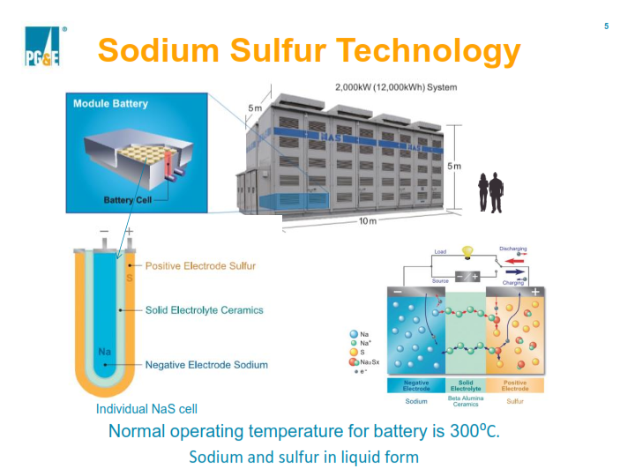
Storage Safety in California Proceedings
Grid-Scale Systems

Slide 26
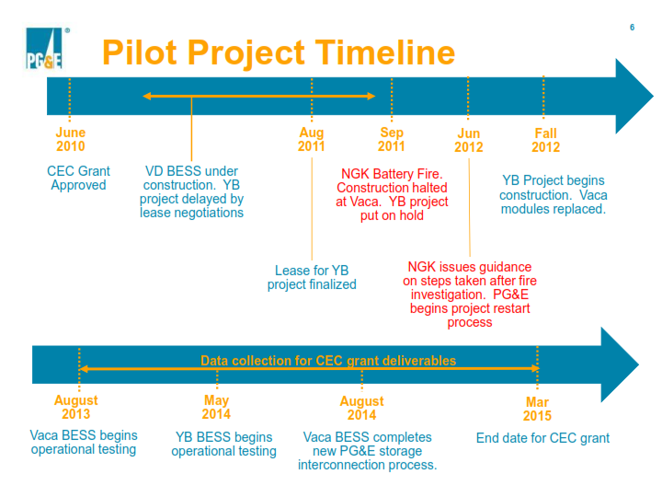
Storage Safety in California Proceedings
Grid-Scale Systems

Slide 27
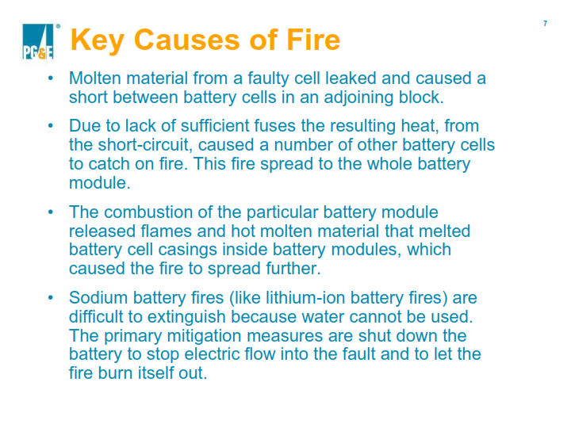
Storage Safety in California Proceedings
Grid-Scale Systems

Slide 28
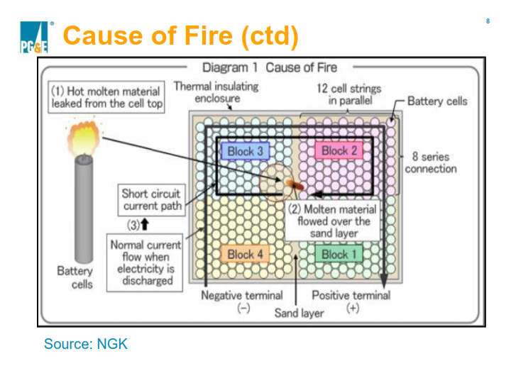
Storage Safety in California Proceedings
Grid-Scale Systems

Slide 29
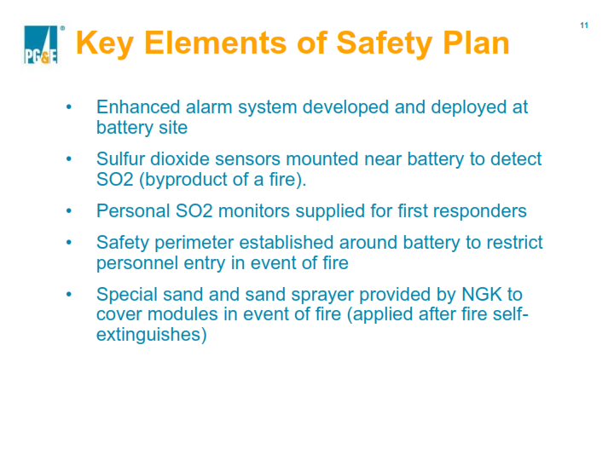
Storage Safety in California Proceedings
Grid-Scale Systems

Slide 30
Storage Safety in California Proceedings
Grid-Scale Systems
What PG&E considers necessary for ensuring NAS battery safety:
24/7 monitoring by distribution operations with key alerts for fire and SO₂ alarms
24/7 monitoring by a system integrator
Yearly system inspections
Twice-yearly testing of fire alarm and external SO₂ detection systems
Bi-annual replacement of the internal SO₂ detector (inside battery modules)
Ongoing review of battery performance and temperatures to identify potential problems early.

Slide 31
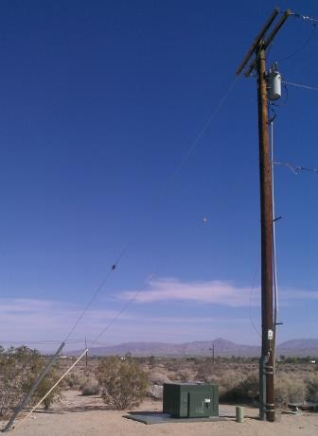
Storage Safety in California Proceedings
Grid-Scale Systems
Lessons from other IOUs not quite so dramatic, but still valuable:
SDG&E – Borrego Springs
Substation storage,
  Gen 1: 500 kW/1.5 MWh ESS
  Gen 2: 1 MW/3 MWh ESS added
Community Energy Storage
(3) 25 kW/50 kWh ESS

Slide 32
Storage Safety in California Proceedings
Grid-Scale Systems
SDG&E offered the following Lessons Learned from its integration of energy storage technology:
Safety standards for grid-scale energy storage are largely under-defined:
  Site safety: all applicable OSHA, NEC, and NFPA requirements
  Fire: NFPA 704
  Operation: IEEE1547/UL1741/UL1642
  Enclosure: NEMA 3R
  Signage: ANSI Z535
  Cybersecurity: NISTIR 7628
Standards development is not at pace with regulatory requirements – and this creates challenges in terms of approvals.

Slide 33
Storage Safety in California Proceedings
Grid-Scale Systems
SCE Irvine Smart Grid Projects
Residential Energy Storage Unit (RESU)
  4kW / 10kWh
  Installed in 13 homes
Community Energy Storage (CES)
  25kW / 50kWh
  1 device serving 9 homes
Electric Vehicle Charging Station with PV and Storage (BESS)
  100kW / 100 kWh
  Paired with 20 EV charging stations & 48 kW PV array
Large Distributed Energy Storage System (DBESS)
  2 MW / 500kWh
  Connected to a 12 kV distribution circuit

Slide 34
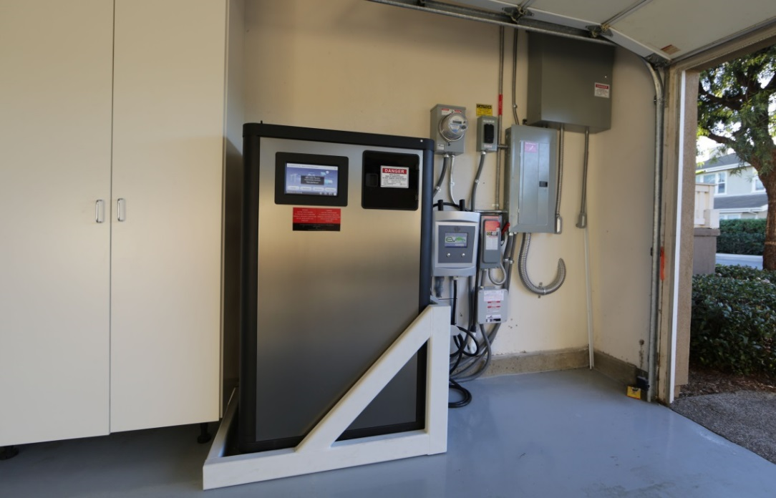
Storage Safety in California Proceedings
Grid-Scale Systems
Residential Energy Storage Unit (RWSU)
Garage installation required safety brace to protect against vehicle collisions
RESUs experienced multiple issues in the field that required on-site visits to resolve:
  Software failures
  System lockups that could cause battery over discharge. New software versions introduced fixes to improve reliability.
SCE described a need for coordination with local officials, regional officials, state-level officials, “time consuming but worthwhile.”

Slide 35
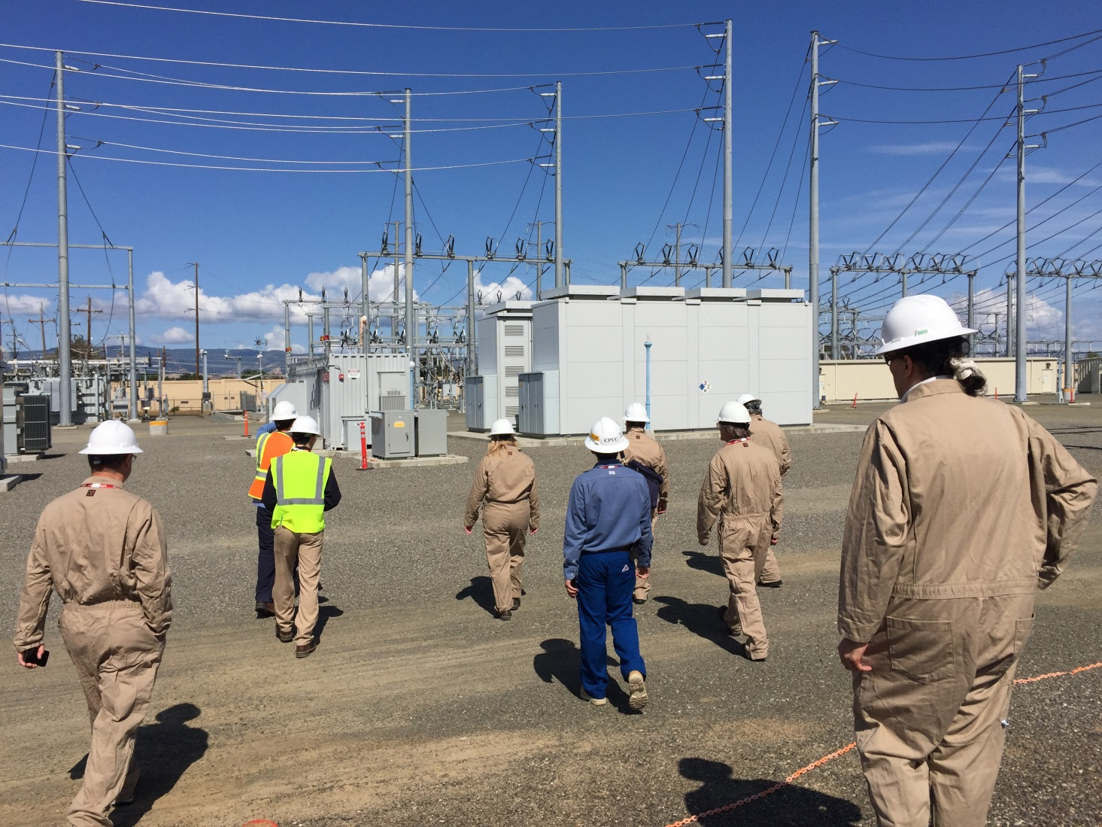
CPUC SED Working Group in Action at the Vaca-Dixon Substation

Slide 36
CPUC Safety & Enforcement Division
Energy Storage Inspection Guidelines
CPUC had no precedent in developing protocols;
For Utility-Scale, Grid-Connected Storage Co-located at Utility Substations and other sites;
Participation from PG&E, SCE, SDG&E, NGK, NEC, CESA, ESRB, Amber Kinetics;
CPUC has determined no need to revise General Order 174 (Substations) but SED inspectors are beginning to use the list;
Application to non-IOU facilities pending.

Slide 37
Guidelines for SED Inspectors for Energy Storage Facilities (Page 1)
Is an overall safety plan in place?
  Does the facility have a safety plan documented?
  Does it address manmade and natural disasters like wildfire, earthquake, flood, chemical spill, toxic gas release, explosion, terrorism, etc.?
  Does it include outreach to first responders and local authorities? i.e. conduct periodic drill with fire, police, hazmat, etc.
  Does it include training?
  Are signage and safety placards compliant with American National Standards Institute, National Fire Protection Association, and other applicable standards?
  Does the facility have a monthly in-service inspections and maintenance checklist?
    Storage management system (fire monitors, SO₂ monitors, wind sock, log book, smoke detectors, etc.)
    Fire plan box (on substation fence)
    Equipment (generators, transformers, switch gear and control cabinet, battery towers, etc.)
  Does the facility have maintenance records, such as a preventative maintenance log?
  Does the facility have an appropriate access protocol?

Slide 38
Guidelines for SED Inspectors for Energy Storage Facilities (Page 2)
Is the facility inspected regularly by the company or utility per manufacturer’s recommendations?
  Battery Modules.
    Inspection of cables and wiring.
    Torque check of bolted connections (when applicable)
    Insulation resistance measurement (per industry standards)
    Heater resistance.
    Battery residence.
  Cable run.
    IR or Ultrasound inspection of terminals
    Insulation resistance measurement (per industry standards)
  SO₂ detector if applicable.
  Control cabinet.
    Inspection of cables and wiring.
  Total system.
    Protection relay test.

Slide 39
Guidelines for SED Inspectors for Energy Storage Facilities (Page 3)
Is the facility inspected regularly by the company or utility, per manufacturer’s recommendations? (flywheels only)
  At commissioning, are flywheel units properly installed, with civil design per manufacturer specification?
  Inspection of cables and wiring.
  Insulation resistance measurement of cables.
  Run automated control system test. Verifies control connectivity, functionality of internal sensors within each flywheel unit – voltage, current, vibration sensing, and vacuum system state. Test carried out from control center.
SED inspectors examine the following (both visual and records review)
  Interconnection equipment
  Storage facility
  Battery enclosure
  Battery module (varies by technology)
  Hazardous materials policy and management program if applicable
Because energy storage technology will evolve over time, this checklist will also need to evolve over time.

Slide 40
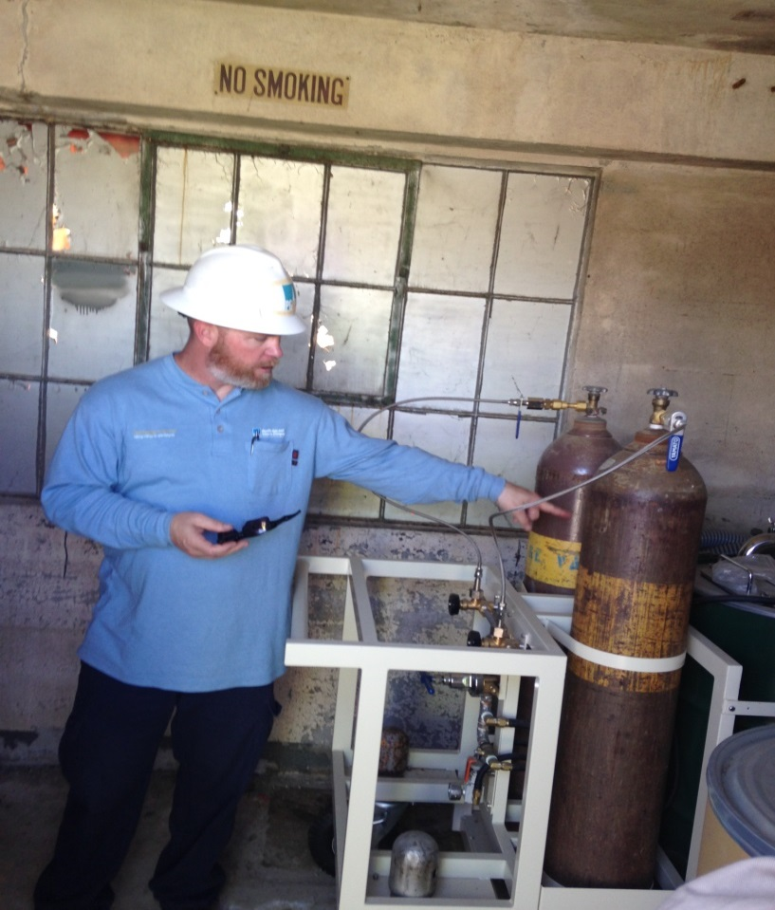
Vaca-Dixon Sodium Sulfur Battery
Fire Extinguisher
Do not pour water on a sodium sulfur
Battery.

Slide 41
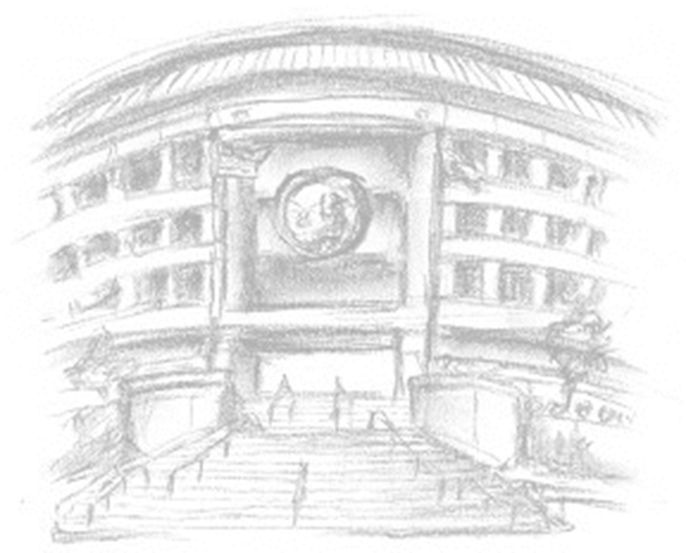
Thank You!
For further information related to
Energy Storage & Safety Issues,
please contact:
Arthur O’Donnell
ao1@cpuc.ca.gov
415-703-1184
www.cpuc.ca.gov

