Slide 1
Advice Letter Electronic Filing (Pursuant to Res. T-17670, Adopted 11/7/19)
Communications Division

Slide 2
This presentation will cover a step-by-step guide for:
Communications Division
Filing advice letters for carriers
Filing and responding to protests

Slide 3
Step-by-Step Guide for Filing Advice Letters and Supplements
Communications Division

Slide 4
Advice Letter Basics
Definition
An AL is an informal request by a utility for CPUC approval or authorization outside a formal proceeding
Requirements
General Rules and Telecommunication Industry Rules for filing advice letters are available in GO 96-B

Slide 5
Step 1. Prepare the Advice Letter (AL)
Original and/or AL Supplement filing
AL summary form
Cover sheet
Supporting documents
Service List

Slide 6
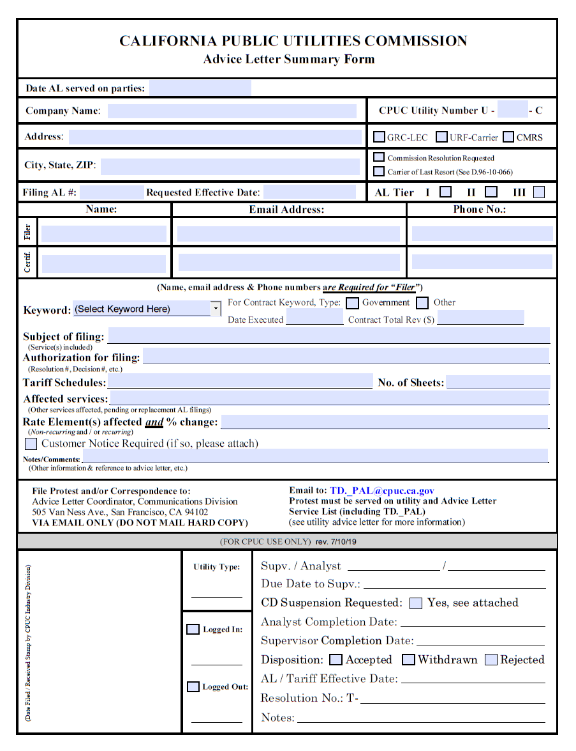
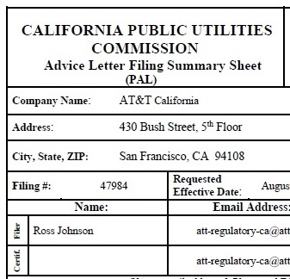
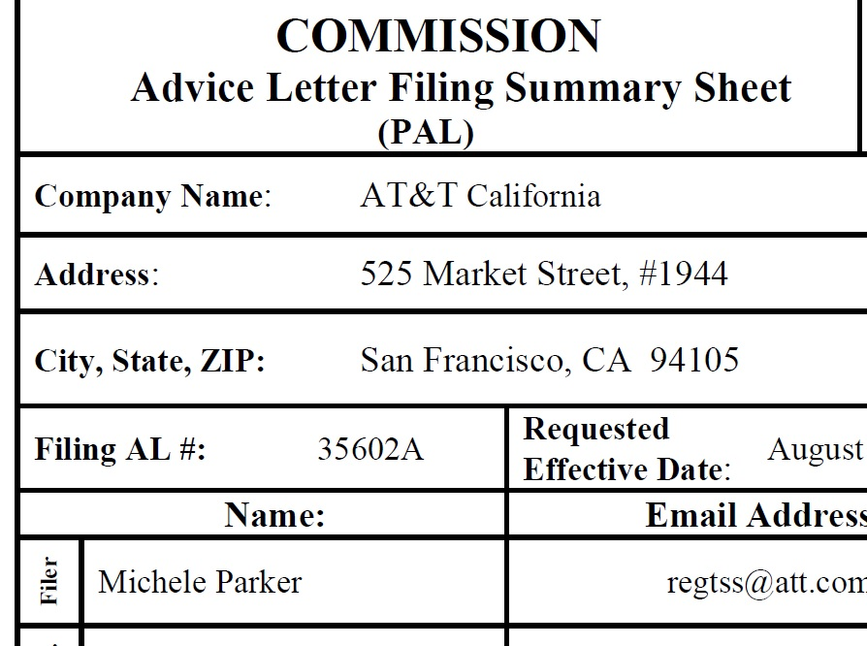
1.1 Complete the AL Summary Form
AL filing must be filed sequentially
Number [1, 2, 3…] for the original AL
Letter [A, B, C…] for the supplemental AL
Please email TD._PAL@cpuc.ca.gov to request information about the next available AL number.

Slide 7
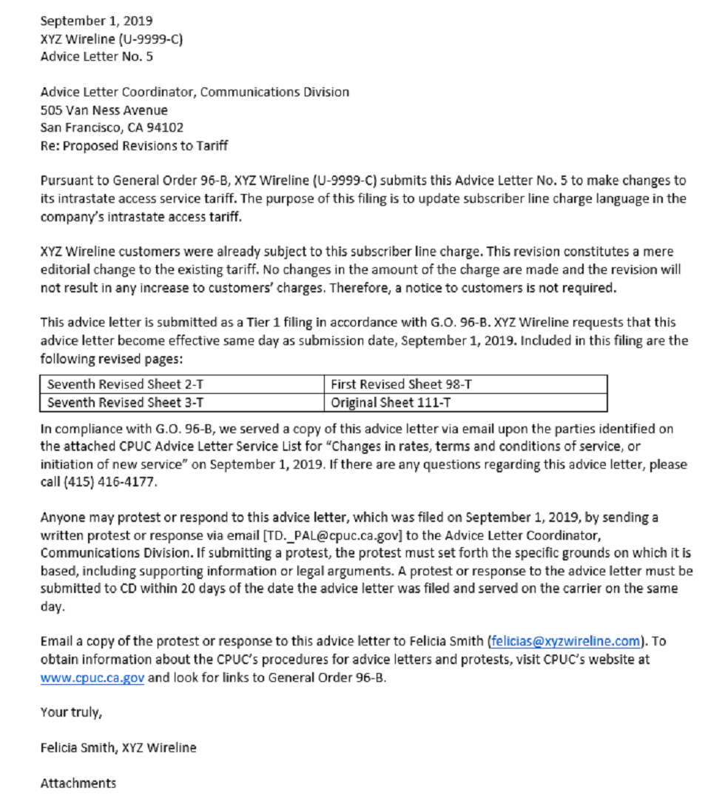
1.2 Prepare the AL Cover Letter Sheet
A complete AL cover letter sheet summarizes the content of the advice letter
An incomplete AL cover letter sheet may result in rejection of the AL filing
A. Date of submission
B. Brief description of the AL
C. CPUC authority (decisions, resolutions, GO, PU Codes, etc.)
D. Service(s) affected by the AL
E. Effective date
F. Date served on parties
G. Language about filing and serving the protest or response

Slide 8
1.3 Prepare and Include Supporting Documents and Determine AL Tier Level
Supporting documents vary by AL type
e.g. contracts, performance bonds, tariffs, interconnection agreements
More info on AL Tier Levels
Summary of ALs by Tier Level
G.O. 96-B, Industry Rule 7 (Advice Letter Review, Sections 1-4)

Slide 9
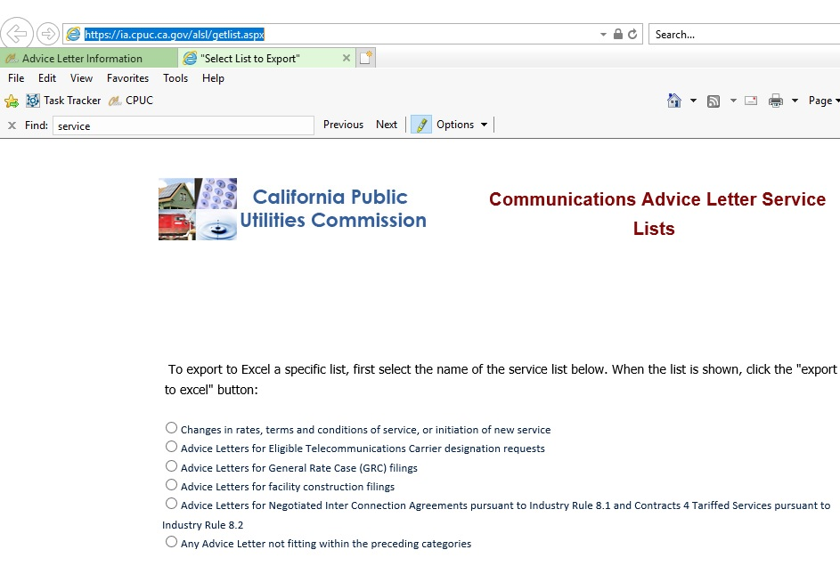
1.4 Obtain the Telco Service List
Pursuant to G.O. 96-B, AL must be served to the appropriate Service List.
A. Go to the Telco service list site
B. Select appropriate list
Notes:
LLT 10/31 notes: add that this is pursuant to GO 96-B [section] requirement

Slide 10
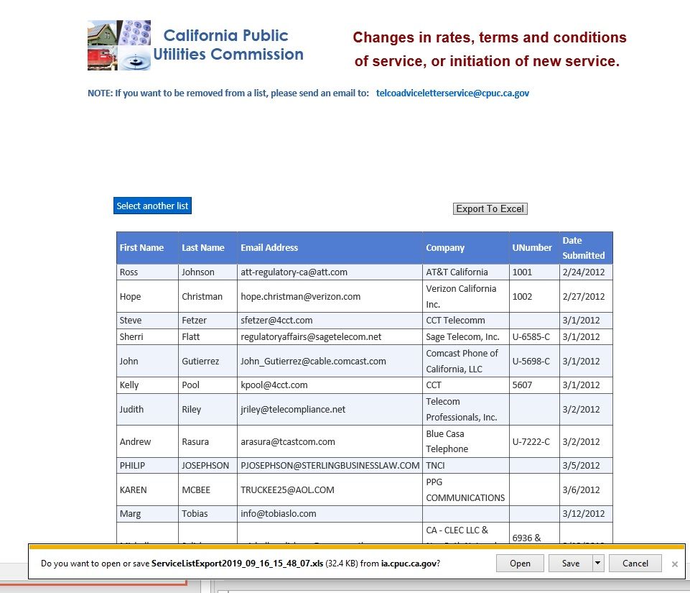
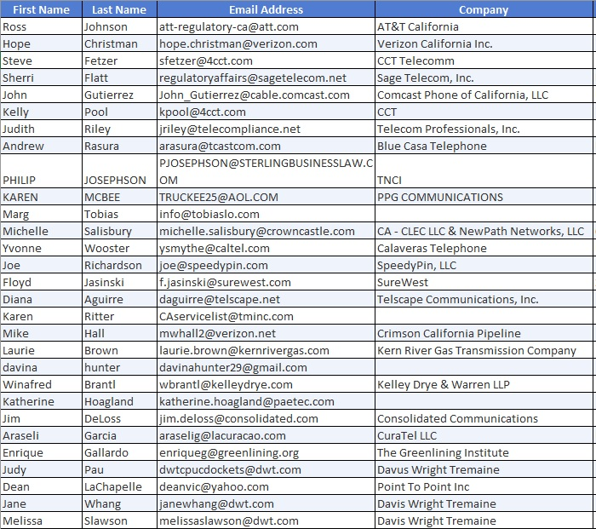
1.4 Prepare and Include the Service List
C. Export the list
E. Save the list as PDF
D. Open in Excel

Slide 11
Step 2. Ensure Documents Comply with Filing Requirements
Original and/or AL Supplement filing
PDF Format
File Name Format
Email Subject
PDF/A Compliance
File Size
Email Body

Slide 12
2.1 PDF format
All documents submitted with the filing must be in PDF format.
AL summary form
Cover sheet
Service List
Supporting documents
Exception: In addition to submitting maps and spreadsheets in PDF, submit the corresponding shapefiles and Excel files thru the sFTP site:
https://cpucftp.cpuc.ca.gov

Slide 13
2.2 PDF/A compliance
All documents submitted with the filing must be PDF/A compliant.
Adobe Acrobat
https://helpx.adobe.com/acrobat/using/pdf-x-pdf-a-pdf.html
Nitro
https://www.gonitro.com/user-guide/pro/article/create-a-pdf-a-file

Slide 14
2.3 File name format
Combine all documents into single PDF attachment.
Original AL Filing
Supplement Filing
Summary form
Summary Form
Cover sheet
Cover sheet
Service List
Service List
Supporting Documents
Supplemental Documents
[Utility Number] [ Carrier Name]
[AL Number]
9999 XYZ Wireless AL5
[Utility Number] [ Carrier Name]
[AL Number] [Letter] Supplement
9999 XYZ Wireless AL5A Supplement

Slide 15
2.4 File size
Limit
5 MB per email
What if file is >5 MB?
Split the file into two files
Email separately
If sending multi-part email
1st email: SF & CS
2nd/3rd email: SL & SD
Secure FTP
Use CPUC’s sFTP if not possible for multi-part emails
Additional Resource: CPUC Kiteworks sFTP
SF [summary form]; CS [cover sheet], SL [service list]; SD [supporting docs]

Slide 16
News+
2.5 Email subject format
Original AL Filing
[Utility No.] [Carrier No.] [AL Name] [If confidential, indicate ‘Confidential’] [Part X of Y if submitting multi-part email]
e.g. 9999 XYZ Wireless AL5
Supplement Filing
[Utility No.] [Carrier Name] [AL No. Letter] [If confidential, indicate ‘Confidential’] [Part X of Y if submitting multi-part email]
e.g. 9999 XYZ Wireless AL5 Part 1 of 2
e.g. 9999 XYZ Wireless AL5 Confidential
e.g. 9999 XYZ Wireless AL5 Confidential Part 1 of 2
e.g. 9999 XYZ Wireless AL5A Part 1 of 2
e.g. 9999 XYZ Wireless AL5A Confidential
e.g. 9999 XYZ Wireless AL5A Confidential Part 1 of 2
e.g. 9999 XYZ Wireless AL5A
Note: Use the same email subject format if sending via CPUC’s sFTP.

Slide 17
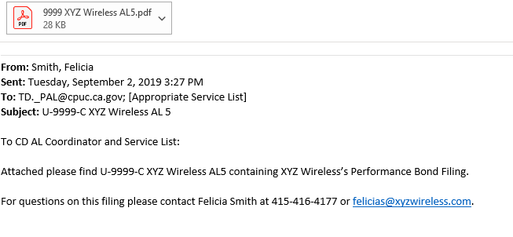
2.6 Email body

Slide 18
Step 3. Submit Filing via Email
The cut off time to be considered filed the same day as submitted is 5:00 PM PST. Files received by CD after 5:00 PM PST or on a non-business day will be considered filed the following business day.
Public version
Confidential version

Slide 19
3.1 Submission and Confirmation
Email filing to TD._PAL@cpuc.ca.gov and to the Service List
Public version
Confidential version
Advice Letter and/or Supplement
CD
Service List
Advice Letter and/or Supplement
CD
Note: Confidential filing must be submitted in accordance with the submission process outlined in D.16-08-024

Slide 20
Just to recap the process
1. Prepare the AL
Cover sheet
Service List
2. Ensure Docs Comply with Requirements
PDF format
File size
3. Submit Filing via Email
Public version (Communications Division & Service List)
Confidential version (Communications Division only)
Supporting docs
PDF/A
File name format
Email subject
Email body
Summary form

Slide 21
Step-by-Step Guide for Filing Protests and Protest Responses
Communications Division

Slide 22
Step 1. Prepare the Protest or Response to Protest

Slide 23
1.1 Protest or Response to Protest
General Order 96-B (General Rule 7.4) provides the grounds and requirements for an advice letter protest or protest response
File a protest within 20 days of the AL’s submission date
A utility shall reply to each protest within 5 business days after the end of the protest period
The protester cannot reply to the utility’s reply.

Slide 24
Step 2. Ensure Documents Follow Filing Requirements
Protest or Response to the Protest
PDF Format
File Name Format
Email Subject
PDF/A Compliance
File Size
Email Body

Slide 25
File name format
Combine all documents into single PDF attachment.
Protest
Letter
Response
Letter
[Utility No.] [Carrier Name] [AL No.] [Protest by] [ Protester’s Name]
9999 XYZ Wireless AL5 Protest by California Advocates
[Utility No.] [ Carrier Name] [AL No.] [Protest Response to] [Protester’s Name] [By] [Carrier Name]
9999 XYZ Wireless AL5 Protest Response to California Advocates by XYZ Wireless

Slide 26
Email subject format
Protest
Response
[Utility No.] [ Carrier Name] [AL No.] [Protest Response to] [Protester’s Name] [ By] [Carrier Name]
[Utility No.] [Carrier Name] [AL No.] [Protester’s Name]
e.g. 9999 XYZ Wireless AL5 Protest by California Advocates
e.g. 9999 XYZ Wireless AL5 Protest Response to California Advocates by XYZ Wireless
Note: Use the same email subject format if sending via CPUC’s sFTP.

Slide 27
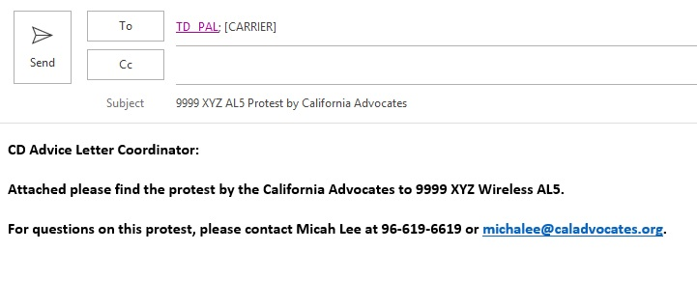
Email body
Notes:
LLT 10/31 notes: add a note that the protest must be served to the carrier that filed the Advice letter; Response must be served to the protester.

Slide 28
Step 4. Submit Protest or Response via Email
The cut off time to be considered filed the same day as submitted is 5:00 PM PST. Files received by CD after 5:00 PM PST or on a non-business day will be considered filed the following business day.
Notes:
Are protests and responses confidential?
10/31 LLT notes: this needs to be updated to 5pm PST. Please check if protests and responses can be filed confidentially --- I don’t think so.

Slide 29
Submission and Confirmation
Email protest or response to TD._PAL@cpuc.ca.gov and
the carrier (for protest) and the protester (for response).
CD
Protest or response
Note: An automatic reply from TD._PAL@cpuc.ca.gov will be sent confirming the receipt of the filing.

Slide 30
Just to recap the filing process for protests and responses
1. Prepare the Protest or Protest Response
Protest or response
2. Ensure Docs Comply with Requirements
PDF format
File size
3. Submit Filing via Email
Communications Division
PDF/A
File name format
Email Subject
Email body
Carrier or Protester

Slide 31
Links to AL Resources
Advice Letter website
Information related to ALs e.g. tier summary, new summary form, manuals, contact info
Advice Letter Manual
Step-by-step guide to filing ALs
General Order 96-B
Detailed rules and requirements covering ALs
CPUC Secure File Transfer Protocol
User guide for CPUC’s sFTP (for large or non-PDF files e.g. Shapefiles)
Advice Letter Hotline: 415-703-2431
For advice letter related inquiries only
Notes:
provide links the website for AL information, Tier summary, AL summary form; link to GO 96-B, links to the narrative manual

Slide 32
Thank you!
Questions or Comments?
Notes:
provide links the website for AL information, Tier summary, AL summary form; link to GO 96-B, links to the narrative manual

