Slide 1
Rural Broadband Auctions:
Rural Digital Opportunity Fund Phase I
(Auction 904)
California PUC
June 10, 2020

Slide 2
Ex Parte Information
With a limited exception, attending and/or participating in this webinar on draft procedures to conduct the Rural Digital Opportunity Fund Phase I auction made by the Commission will not require a filing under the Commission’s rules governing ex parte communications
Presentations to Commission personnel directed to the merits or the outcome of the matters raised in the Auction 904 Comment Public Notice or other pending proceedings will require the filing of an ex parte notice

Slide 3
Rural Broadband Auctions Overview
Connect America Fund Phase II Auction (completed):
$1.48B over 10 years for fixed broadband and voice services
Rural Digital Opportunity Fund (adopted):
Up to $20.4B over 10 years for fixed broadband and voice services
Phase I: up to $16B (Auction 904)
Phase II: up to $4.4B + remainder of Phase I budget
Phase I auction bidding expected to commence on October 29, 2020
5G Fund for Rural America (proposed):
Up to $9B for 5G service, with up to $1B for network deployments facilitating precision agriculture

Slide 4
Task Force Overview
Rural Broadband Auctions Task Force created to implement rural broadband auctions
Task Force coordinates with multiple Bureaus and Offices to develop and implement regulatory / technical details of auctions

Slide 5
How Did We Get Here?
2011 USF Transformation Order
Introduced new funding approach for price-cap areas using cost-model to identify high-cost areas and competitive bidding to allocate support
2014 Connect America Cost Model (CAM)
Estimated cost of providing service, and numbers of locations, in census blocks nationwide
Identified census blocks with costs above a specified benchmark
2015 Offer of Model-Based Support to Price Cap Carriers
9 carriers accepted over $1.5 billion/year to serve 3.6M homes and businesses in their study areas by end of 2020 in 45 states & 1 territory

Slide 6
CAF Phase II Auction Framework
Reverse auction of high-cost support to census blocks
Included census blocks in price cap study areas where carriers declined offers of model-based support, and certain other areas
Excluded areas where carriers reported voice and broadband service with speeds of ≥ 10/1 Mbps
Census blocks were aggregated to census block groups (CBGs) for bidding
Each CBG had reserve price and estimated number of locations
30,000 CBGs, 210,000 census blocks, 975,000 locations
CAF Phase II Auction Budget: $2.15B

Slide 7
CAF Phase II Auction Results Overview
CAF Phase II Auction closed on August 21, 2018
Approximately $1.5 billion in support awarded to provide service to close to 700,000 locations in 45 states
Locations assigned had initial reserve price of $5B over 10 years
Support authorized as of May 14, 2020:
$1.44 billion for 631,961 locations in 45 states

Slide 8
Rural Digital Opportunity Fund Framework
Up to $20.4 billion in support over 10 years
High-cost support to serve locations in census blocks that lack voice and broadband service with minimum speeds of 25/3 Mbps
Two-phased auction approach
Phase I (Auction 904): census blocks that entirely lack voice and 25/3 Mbps broadband service ($16B)
Phase II: partially served census blocks and census blocks unsold in Phase I auction (remainder of $20.4B)
Multi-round, reverse clock auction format, similar to CAF Phase II auction format

Slide 9
Auction 904 Eligible Areas
Areas eligible for support:
All census blocks that lack voice and 25/3 Mbps broadband, excluding:
Census blocks with CAM costs < $40, or, for Tribal areas and blocks that lack even 10/1 Mbps broadband, CAM costs < $30
Census blocks awarded funding in CAF Phase II Auction
Census blocks awarded funding through federal or state broadband subsidy programs to provide ≥ 25/3 Mbps
Rate of Return service areas, except areas the provider has indicated it will not serve
Preliminary Eligible Areas Public Notice (DA 20-275):
Identified preliminary eligible areas, and
Established a limited challenge process

Slide 10
Auction 904 Challenge Process
Challenge process provided an opportunity to identify census blocks:
That have been served with 25/3 Mbps and voice since the June 2019 Form 477 filing (for Form 477 filers)
That have been awarded funding by a federal or state broadband subsidy
Only applies to census blocks for which a provider has an enforceable commitment to provide broadband service of ≥ 25/3 Mbps or where a formal commitment has been executed
Within rate-of-return carriers’ service areas where the carrier does not expect to extend broadband as part of its USF obligations

Slide 11
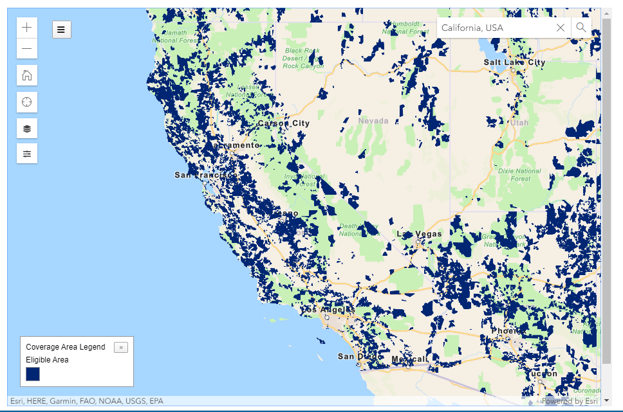
473,522 preliminary eligible locations in California
https://www.fcc.gov/reports-research/maps/auction-904-preliminary-eligible-areas

Slide 12
Auction 904 Preliminary Eligible Area Data
State | Locations
Alabama | 207,644
Arkansas | 215,793
Arizona | 138,175
California | 473,522
Colorado | 98,983
Connecticut | 3,817
Delaware | 7,905
Florida | 155,310
Georgia | 189,042
Hawaii | 13,951
Iowa | 63,631
Idaho | 44,400
Illinois | 201,075
Indiana | 182,628
Kansas | 57,183
Kentucky | 102,789
Louisiana | 182,458
State | Locations
Massachusetts | 32,313
Maryland | 48,439
Maine | 33,522
Michigan | 275,778
Minnesota | 166,540
Missouri | 216,683
Mississippi | 223,152
Montana | 49,540
North Carolina | 168,171
North Dakota | 3,346
Nebraska | 53,623
New Hampshire | 19,525
New Jersey | 13,561
New Mexico | 67,354
Nevada | 34,122
New York | 74,135
State | Locations
Ohio | 214,701
Oklahoma | 141,792
Oregon | 88,675
Pennsylvania | 197,833
Rhode Island | 4,477
South Carolina | 113,037
South Dakota | 11,962
Tennessee | 176,096
Texas | 364,213
Utah | 13,992
Virginia | 211,043
Vermont | 24,631
Washington | 117,312
Wisconsin | 262,382
West Virginia | 128,086
Wyoming | 19,554
Interactive map and data files available for download:
https://www.fcc.gov/auction/904

Slide 13
Adopt auction procedures
Short-form applications
Auction bidding
Announce winning bidders
Long-form applications
Authorize funding
Timeline for Auction 904 in draft Procedures Public Notice:
June 9, 2020
Consideration of Auction 904 Procedures PN
By June 15, 2020
Application tutorial available
July 1, 2020 at 12:00 PM EDT
Short-form application filing window opens
July 15, 2020 at 6:00 PM EDT
Short-form application filing window closes
By October 14, 2020
Bidding tutorial available
October 26, 2020
Mock auction held
October 29, 2020
Commencement of auction bidding
Post-Auction
Release of Auction 904 Closing PN
Long-form application window
Funding authorized for winning bidders

Slide 14
Auction 904 Bidding
Descending clock auction
Each bid is a commitment to provide service to an area at a percentage of the reserve price
Clock denominated in terms of a percentage
Percentage decreases in each round
To determine implied support amounts, bid percentage is adjusted for performance tier and latency, and multiplied by the area’s reserve price
Each performance tier and latency combination (T+L) has an associated adjustment weight
Service must meet minimum performance and latency requirements

Slide 15
Auction 904 Performance Tiers
 | Speed | Usage Allowance | Weight
Minimum | ≥ 25/3 Mbps | ≥ 250 GB or U.S. median, whichever is higher | 50
Baseline | ≥ 50/5 Mbps | ≥ 250 GB or U.S. median, whichever is higher | 35
Above Baseline | ≥ 100/20 Mbps | ≥ 2 TB | 20
Gigabit | ≥ 1 Gbps/500 Mbps | ≥ 2 TB | 0
Auction 904 Latency Tiers
 | Latency | Weight
Low Latency | ≤ 100 ms | 0
High Latency | ≤ 750 ms & MOS ≥ 4 | 40

Slide 16
Auction 904 Clearing & Closing
Auction will “clear” once the aggregate bids for support decrease to within the budget ($16B)
Support awarded in an area to bidder with lowest Tier + Latency weight at the “clearing round”
If there are multiple bids for an area with the same lowest Tier + Latency weight at the clock percentage, bidding continues in additional rounds until there is no competition
Auction will close after:
the budget clears and
there are no areas with competing bids

Slide 17
Auction 904 Service Obligations
Winners must deploy service to the number of locations won, on a statewide basis:
20% of CAM locations by year two (optional)
40% of CAM locations by year three
Additional 20% in each subsequent year
100% of CAM locations by year six
100% of actual locations by year eight
Newly built locations upon reasonable request after actual locations determined and before year eight
Mandatory reporting on progress
Rates charged must be reasonably comparable to rates for similar services in urban areas

Slide 18
Auction 904 / CAF Phase II Comparison
Two-step auction application process largely the same
Per-location funding threshold is lower than CAF Phase II: $40 vs. $52.50
Tribal areas and areas lacking 10/1 Mbps service subject to lower funding threshold of $30
Per-location support cap is higher than CAF Phase II: $212.50 vs. $146.10
Tribal areas and areas lacking 10/1 Mbps service subject to higher support cap of $222.50
In the clearing round, for bids at the same percentage, support will be awarded to the bidder with lowest Tier + Latency weight
However, bidding will continue (like in CAF Phase II) if 2+ bidders have the same lowest weight

Slide 19
Participating in Auction 904
Interested parties should prepare now to complete their short-form applications
Application window is expected to open on July 1 at noon EDT and to close on July 15 at 6:00 pm EDT
Process for participating in Auction 904 is similar to process for Auction 903 (CAF-II)
Parties interested in participating in Auction 904 should familiarize themselves with resources from Auction 903 to prepare to apply
Auction 903 resources are available at https://fcc.gov/auction/903

Slide 20
Auction 903 Resources
Additional information about completing the short-form application can be found at the following Auction 903 links:
Instructions for filing the short-form application
Auction 903 application tutorial (video)
Checklist of information needed to complete the short-form application
Auction 903 application process workshop

Slide 21
Applying for Auction 904
All parties that wish to participate in Auction 904 must submit the short-form application by the deadline
Late applications will not be accepted
Submitting the short-form application does not obligate an entity to bid in the auction
To complete the short-form application, parties must submit:
Financial information
Ownership information
Technical information
Information detailing previous provision of telecommunications services, if applicable

Slide 22
Financial Information
Required financial information includes:
Financial statements
If operated for at least two years: one year of audited financial statements (if not audited in the ordinary course of business, may submit unaudited, but must submit audited in long-form application if announced as a winning bidder)
All other applicants: three years of audited financial statements
Must indicate if audited financial statements have a clean audit opinion letter
If the applicant or its parent company has provided only an electric transmission or distribution service for at least two years, it must submit qualified operating or financial reports for the past 2 years
If the applicant has not been operating for at least two years, it must submit a letter of interest from a qualified bank

Slide 23
Technical Information
Required technical information includes:
Each state, performance tier (speed and usage), and latency for which the applicant wants to bid, and the technology that would be used to provide service at that tier and latency
If the applicant plans to use wireless technology, it must submit information on spectrum bands and bandwidth to which the applicant has access
Answers to questions listed in Appendix A of the Auction 904 Procedures Public Notice

Slide 24
Ownership Information
Required ownership information includes:
Applicant’s name and legal classification
Individuals who can communicate with Commission staff and place bids on behalf of the applicant
All parties, including non-applicants, with whom the applicant has entered into any agreements regarding the applicant’s participation in the auction
The individuals and entities with an ownership interest, whether direct or indirect, in the applicant and FCC-regulated businesses in which the applicant has a direct interest

Slide 25
Additional Required Information
Additional required information includes:
List of study area codes, if the applicant is already an eligible telecommunications carrier (ETC)
List of FRNs used to file FCC Form 477 data during the past two years, as applicable
Filer ID used to file FCC Form 499-A in the past year, if the applicant files Form 499-A
Required certifications
Further requirements and specifications as adopted in the Auction 904 Procedures PN:
https://docs.fcc.gov/public/attachments/DOC-364457A1.pdf

Slide 26
Forming a Consortium
Interested parties may form a consortium
A consortium is an entity made up of multiple parties that participates in the auction as one bidder
Short-form application
Consortium must choose one lead entity to certify how long it has been operating and submit its financial statements
All other information (e.g., ownership, responses to Appendix A questions, spectrum) must be submitted for each member of the consortium; provide roadmap to explain
A consortium bids as its own, single entity
May then divide winning bids among its members after the auction concludes

Slide 27
Prohibited Communications
All auction applicants must follow the Commission’s prohibited communications rule (section 1.21002)
An auction applicant is prohibited from communicating with any other applicant in any manner the substance of its own, or one another’s, or any competing applicant’s bids or bidding strategies
Applies to applicants starting at application deadline whether they qualify or bid
“Applicant” includes entity submitting an application, any party with control of the entity, any party controlled by the applicant entity or controlled by a party controlling the applicant entity
Take care with communications to third parties that may be conduits
If you have any questions about the prohibited communications rules, please send questions to auction904@fcc.gov

Slide 28
Additional Resources
Auction 904​
Website: https://www.fcc.gov/auction/904 ​
Email: auction904@fcc.gov ​
Rural Broadband Auctions​ Task Force
Website: https://www.fcc.gov/auctions/ruralbroadbandauctions​
Email: ruralbroadband@fcc.gov ​
FCC Office of Intergovernmental Affairs​
Gregory Cooke, Chief: gregory.cooke@fcc.gov
FCC Office of Native Affairs and Policy
Matthew Duchesne, Chief, matthew.duchesne@fcc.gov

Slide 29
Thank you for participating in this webinar on the Rural Digital Opportunity Fund Phase I Auction - Auction 904
Please check the Auction 904 website for updates, releases, and educational materials:
https://www.fcc.gov/auction/904
Entities interested in participating in Auction 904 can email: auction904@fcc.gov
###

