Slide 1

DER ACTION PLAN UPDATE
Commissioner Committee on Emerging Trends
California Public Utilities Commission
March 21, 2018
Simon Baker
Deputy Director, Energy Division

Slide 2
Outline
DER Action Plan overview
Action Element status snapshot
Achievements since July 2017
Action Elements requiring attention
  Off-track
  Not yet scoped
Challenges and opportunities
Hot topics for 2018/19

Slide 3
DER Action Plan Overview
Endorsed by the Commission in November 2016
The DER Action Plan is a 7-page document that:
  Sets a long-term vision for DERs and supporting policies
  Identifies CPUC actions needed to meet that vision
  Establishes a coordinating framework across 15 proceedings and 2 CAISO stakeholder initiatives
Does not determine outcomes of individual proceedings
Living Document

Slide 4
DER Action Plan Structure
17 “Vision Elements” and 35 “Action Elements” grouped into 3 tracks:
  Track 1: Rates and Tariffs
  Track 2: Distribution Grid Infrastructure, Planning, Interconnection, and Procurement
  Track 3: Wholesale DER Market Integration and Interconnection
Notes:
Plan Structure
7 pages
Housed on
The plan has 17 vision statements for DERs and 35 action items needed to achieve those vision elements
Now I’m going to turn it over to Simon, who’s going to summarize the vision elements in each track, and then highlight areas where EPIC projects could support the actions in the Plan.

Slide 5
Track 1: Rates and Tariffs
Vision
Customer choice Time varying rates Innovative rates and tariffs Aligned with cost causation Affordable to non-DER customers

Slide 6
Track 2: Distribution Planning, Infrastructure, Interconnection, and Procurement
Vision
Transparent planning and sourcing Utility “2.0” / IOU business model Technology-neutral sourcing Recognize full GHG and grid services value Streamlined interconnection DER-enabling grid investments for ratepayer benefit Data communications and cybersecurity

Slide 7
Track 3: Wholesale DER Market Integration and Interconnection
Vision
Robust DER participation in wholesale markets Multiple revenue streams Market and interconnection rules supportive of BTM DERs Predictable EV behavior in grid operations Non-discriminatory market rules for EVs

Slide 8
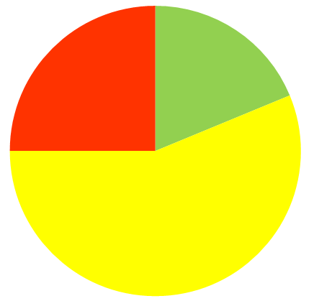
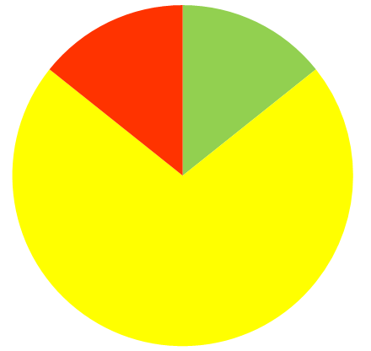
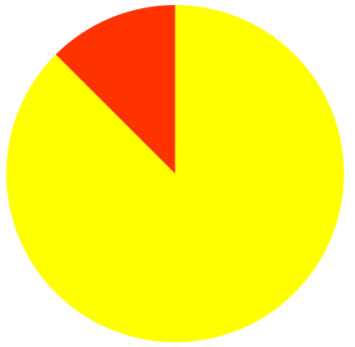
Action Element Status Snapshot
Track 1: Rates and Tariffs
Track 2: Distribution Grid Infrastructure, Planning, Interconnection, and Procurement
Track 3: Wholesale DER Market Integration and Interconnection
Done
Underway
Pending*
*Pending elements are either waiting on another task or have not yet been started.
For status of individual Action Elements, see handout.

Slide 9
Achievements Since July 2017
Track 1: Rates and Tariffs
Non-residential Rates Forum
Default TOU applications filed
Residential fixed charge decision
Track 2: Distribution Planning, Procurement, et al.
DIDF decision coordinated with IDER resolution
LNBA/ICA decision coordinated with IDER cost-effectiveness
Grid Mod decision coordinated with GRC
Smart Inverter draft resolutions
Continued…

Slide 10
Achievements Since July 2017
Track 2: Distribution Planning, Procurement (cont.)
AB 693 decision on multifamily solar
NEM DAC PD and APD mailed
IDER scoping
Track 3: Wholesale Markets
AB 2868 storage applications filed
MUA decision coordinated with RA → WG launched
DR decision → Load Consumption WG launched

Slide 11
Status Update
Track 1: Rates and Tariffs
  Residential TOU (Actions 1.2, 1.8, 1.11)
  Opt-in pilots (2016-17) approved and underway
  Default pilots (2018) approved.
General Rate Cases (Actions 1.3, 1.9)
  D.17-08-030 in SDG&E GRC2 approves late-shift of TOU peak (to 3-9PM), new daytime super off-peak period during spring months, and demand charge reforms.
  Pending PG&E GRC2 (A.16-06-013) and SCE GRC2 (A.17-06-030) cases have similar issues in scope.
11

Slide 12
Status Update
Track 1: Rates and Tariffs (cont’d)
Rate design to absorb renewables (Action 1.4)
  Residential opt-in TOU pilots (PG&E / SCE Rate 3)
  D.17-08-030 in SDG&E GRC2 - Daytime super off-peak (weekday Mar-Apr 10-2), demand charge exemption rate option during Mar-Apr super off-peak window
  IOUs “matinee pricing” pilots rejected or withdrawn in lieu of broader rate changes
Net Energy Metering (NEM) successor Disadvantaged Community alternative (Action 1.5)
  Under consideration in R.14-07-002
Non-residential rate forum considered innovative tariffs and rates (Action 1.10)
  2-day workshop in Dec 2017

Slide 13
Status Update
Track 1: Rates and Tariffs (cont’d)
  Analytical tools to support 2019 NEM revisit (Action 1.12)
  D.17-09-026 approved “locational value” methods in the DRP proceeding. Expect Q2 2018 decision to further refine. Implementation over the coming year.
Marketing, Education and Outreach plans (Action 1.13)
  Draft resolution approving PG&E plan on 11/9 Commission agenda. Other IOUs imminent.
  Meet statutory requirements for default residential TOU rates (Action 1.14)
  D.17-09-036 made findings required per P.U. Code Section 745 re: potentially vulnerable customers

Slide 14
Status Update
Track 2: Distribution Grid
  Progress in DRP Proceeding (R.14-08-013) (Actions 2.1 et al., 2.5, 2.8 & 2.9)
  D.17-02-007 and D.17-06-012 approved IOUs’ demonstration pilots
    All IOUs pilots to prove-out locational benefits (“Demo C”)
    PG&E and SCE pilots to on grid operations at high DER penetration (“Demo D”)
    SDG&E and SCE micro-grid pilots (“Demo E”)
  D.17-09-026 approved “locational value” and “hosting capacity” methods
  PD pending on distribution deferral framework, grid modernization. (SCE $2.3B grid modernization request under consideration in A. 16-09-001.)
Progress in Integrated Distributed Energy Resources (R.14-10-003) (Action 2.2 et al.)
  D.16-12-036 approved competitive solicitation and shareholder incentive pilot for DER provision of distribution grid services. Draft resolution E-4889 on 11/30 agenda.
  D.16-06-007 adopted consistent avoided cost calculator for all DERs D.17-08-022 adopted interim GHG adder.
  Societal Cost Test proposal under consideration (Action 2.6)

Slide 15
Status Update
Track 2: Distribution Grid (cont’d)
  Streamlined interconnection (Action 2.3 et al., Action 2.11)
  Res ALJ-347 established expedited dispute resolution process per AB 2861 (Ting, 2016)
  New Interconnection OIR (R.17-07-017) considering use of hosting capacity methods approved in DRP (Action 2.11)
Locational targeting of energy efficiency (Action 2.4)
  IOU pilots completed, under review
  Distributed Energy Resource Management Systems (Action 2.10)
  SCE DERMs proposal under consideration in the GRC (A.16-09-001) as part of its grid modernization investment request.
  Smart inverter implementation (Action 2.13)
  Phase 1 (autonomous) functionalities implemented Sep 2017 – required for all new installations.
  Staff proposal for reactive power priority; expect IOU implementation Q2 2018.

Slide 16
Status Update
Track 3: Wholesale Market Integration
  Storage proceeding (R.15-03-011) (Action 3.1)
  PD imminent on Multi-Use Applications (MUAs)
Demand Response proceeding (R.13-09-011) and CAISO stakeholder processes (Actions 3.2 and 3.3)
  D.17-10-017 authorizes additional DR auction mechanism (2018 DRAM) and working groups to resolve remaining barriers to whsl market integration and new market models for advanced DR (“shift DR” and ancillary services)
  Res E-4868 approved DR “click-through” platform to facilitate third-party DR provider access to customer data, with consent.
  ESDER 2 proposal approved by CAISO Board Jul 2017: alternative baselines for DR.
  Transmission-distribution grid interface issues (Action 3.4)
  CAISO’s Distributed Energy Resource Provider (DERP) tariff approved by FERC; IOUs in advanced stages of implementation of T-D interface coordination procedures.
  Interconnection issues (Action 3.6)
  New Interconnection OIR (R.17-07-017) is scoped to address “seams issues” with FERC rules such as the Wholesale Distribution Open Access Tariff (WDAT)

Slide 17
Action Elements Requiring Attention
Action 1.6. By 2017, complete a review of non-residential demand charges and recommend alignment of pricing with DER vision elements
  Off track: NCD rates proposed by PG&E settlement fail to advance Vision 1.D (rates and demand charges better reflect cost causation)
    Missed deadline: Changes to non-res rate design, including demand charges, are currently being handled piecemeal in PG&E and SCE GRC 2s
Action 1.9. By 2017, consider changes to nonresidential rate design, including modification of demand charges
    Missed deadline: see above
Action 2.3.b. Conducting a formal review of utility administration of Rule 21 to identify areas for process improvement
  Delayed over a year due to contracts backlog

Slide 18
Action Elements Not Yet Scoped
Action 1.13. By 2018, establish clear marketing, education and outreach plans that maximize the take-up of time-varying rates by customers able to take advantage of them with DERs
Action 2.7. By 2017, consider how existing DER sourcing mechanisms (e.g., programs and tariffs) should reflect location value and/or be transitioned to a competitive sourcing mechanism already reflecting
Action 3.5. By 2018, consider eligibility of NEM resources in wholesale markets.
(?) Action 3.7. By 2018, complete research critical to vehicle-grid integration and incorporate results into transportation electrification policy.

Slide 19
Challenges and Opportunities
Track 1: Rates and Tariffs
Rates Forum follow-up
  No home for rates-based solutions to SGIP GHG issue
Track 2: Distribution Planning, Procurement, et al.
No contracts yet for distribution deferral DER projects
  PRP PD (SCE)
  PG&E and SDG&E advice letters decline to strike on bids
Action 2.7 delayed (IDER consideration of how existing DER programs and tariffs should reflect location value)

Slide 20
Challenges and Opportunities
Track 2: Distribution Planning, Procurement (cont.)
Business model questions
  SDG&E and PG&E only put in for 1 IDER pilot
  DRP decision went against IOU position on [double payment?]
Need for smart inverter advanced functionality disputed by solar industry
PRP PD
Track 3: Wholesale Markets
[any challenges related to demand response or electric vehicles?]

Slide 21
Hot Topics for 2018/19
TOU RDW applications
NEM methods
Using ICA to streamline interconnection
Developing valuation mechanisms and operational requirements (not just capabilities) for smart inverters
[EV topic – maybe rates?]
[What else?]
[Implementation of DIDF, Grid Mod, other DRP frameworks?]
[Defaulting residential customers to TOU?]

Slide 22
Questions?
DER Action Plan Contacts:
Simon Baker (Simon.Baker@cpuc.ca.gov)
Gabriel Petlin (Gabriel.Petlin@cpuc.ca.gov)
Mary Claire (MC) Evans (MaryClaire.Evans@cpuc.ca.gov)

