Slide 1

Distributed Energy Resources Action Plan
California Public Utilities Commission
LSI Conference on Electric Power and Project Financing in CA
November 2, 2017
Simon Baker
Deputy Director, Energy Division, CPUC

Slide 2
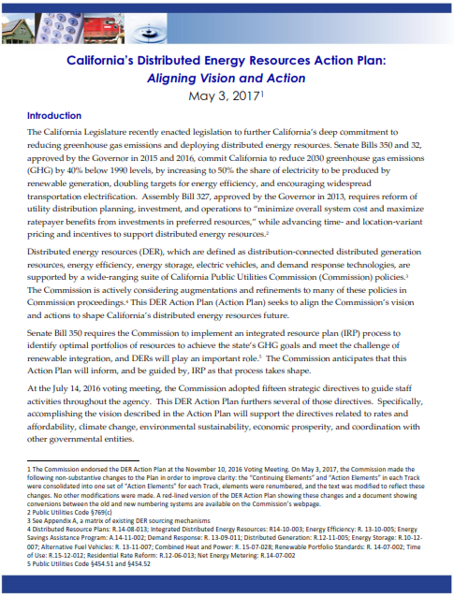
DER Action Plan Overview
Endorsed by CPUC Commissioners in November 2016
The DER Action Plan is a brief document that:
  Sets a long-term vision for DERs and supporting polices
  Identifies CPUC actions needed to meet that vision
  Establishes a coordinating framework across implicated CPUC proceedings
Publicly available on CPUC website at http://www.cpuc.ca.gov/picker/
Notes:
The DER Action Plan is a document that articulates the CPUC’s vision for DERs and supporting policies, identifies the actions the CPUC needs to take to achieve that vision, and sketches out a framework for the CPUC to coordinate internally across DER-related proceedings
The Action Plan was spearheaded by President Picker’s Office and Energy Division, and was endorsed by all five CPUC Commissioners at a Commission Business Meeting in November 2016.
Can be found on President Picker’s webpage

Slide 3
DER Action Plan Implementation
Guides development and implementation of DER policy across 15 CPUC proceedings and 2 CAISO stakeholder initiatives
    Does not determine outcomes of individual proceedings
Provides a platform for common understanding of the direction the CPUC intends for DER policy to take
    Stimulates coordination across proceedings on priority issues
    Living document

Slide 4
DER Action Plan Structure
17 “Vision Elements” and 35 “Action Elements” grouped into 3 tracks:
  Track 1: Rates and Tariffs
  Track 2: Distribution Grid Infrastructure, Planning, Interconnection, and Procurement
  Track 3: Wholesale DER Market Integration and Interconnection
Notes:
Plan Structure
7 pages
Housed on
The plan has 17 vision statements for DERs and 35 action items needed to achieve those vision elements
Now I’m going to turn it over to Simon, who’s going to summarize the vision elements in each track, and then highlight areas where EPIC projects could support the actions in the Plan.

Slide 5
Track 1: Rates and Tariffs
Vision
Customer choice Time varying rates Innovative rates and tariffs Aligned with cost causation Affordable to non-DER customers

Slide 6
Track 2: Distribution Planning, Infrastructure, Interconnection, and Procurement
Vision
Transparent planning and sourcing Utility “2.0” / IOU business model Technology-neutral sourcing Recognize full GHG and grid services value Streamlined interconnection DER-enabling grid investments for ratepayer benefit Data communications and cybersecurity
6

Slide 7
Track 3: Wholesale DER Market Integration and Interconnection
Vision
Robust DER participation in wholesale markets Multiple revenue streams Market and interconnection rules supportive of BTM DERs Predictable EV behavior in grid operations Non-discriminatory market rules for EVs
7

Slide 8
Early Accomplishments
DER Action Plan referenced in the record of five proceedings (DR, Storage, Rule 21, SCE RDW, EE)
Updated CPUC Commissioners briefed at Jul 2017 “Emerging Trends” Committee meeting
Referenced in trade press
Precipitating movement on non-residential rate reform (Actions 1.9, 1.10)
Mapped timing of handoffs from DRP, IDER, and Residential RDWs to “NEM Revisit” in 2019 (Action 1.12)
8

Slide 9
Example: Timing of Handoffs to “NEM Revisit”
Caveat: Staff Conceptual Timeline based on Status Quo Procedural Approach
9

Slide 10
Status Updates
DER Action Plan
10

Slide 11
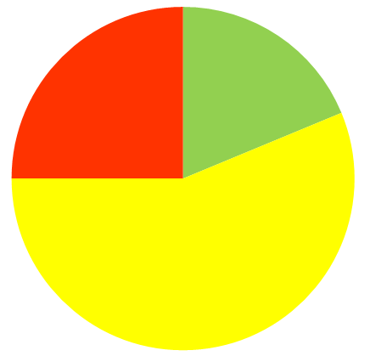
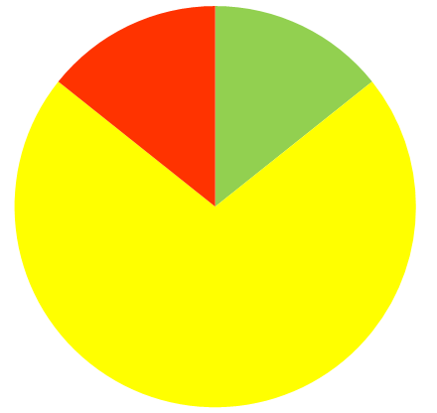
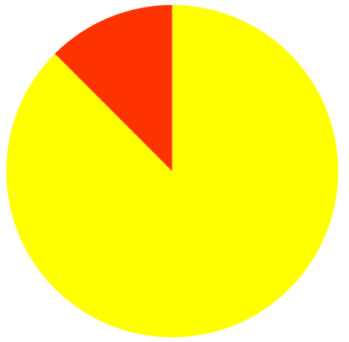
Action Element Status Snapshot
(as presented to Commissioners at July 12 Emerging Trends Meeting)
Track 1: Rates and Tariffs
Track 2: Distribution Grid Infrastructure, Planning, Interconnection, and Procurement
Track 3: Wholesale DER Market Integration and Interconnection
Done
Underway
Pending*
*Pending elements are either waiting on another task or have not yet been started.
11

Slide 12
Status Update
Track 1: Rates and Tariffs
  TOU Periods (Actions 1.1, 1.7)
  D.17-01-006 adopted policy guidelines for setting TOU periods (grandfathering rules, menu of rate options), in collaboration with CAISO
  Residential TOU (Actions 1.2, 1.8, 1.11)
  Opt-in pilots (2016-17) approved and underway
  Default pilots (2018) approved.
General Rate Cases (Actions 1.3, 1.9)
  D.17-08-030 in SDG&E GRC2 approves late-shift of TOU peak (to 3-9PM), new daytime super off-peak period during spring months, and demand charge reforms.
  Pending PG&E GRC2 (A.16-06-013) and SCE GRC2 (A.17-06-030) cases have similar issues in scope.
12

Slide 13
Status Update
Track 1: Rates and Tariffs (cont’d)
Rate design to absorb renewables (Action 1.4)
  Residential opt-in TOU pilots (PG&E / SCE Rate 3)
  D.17-08-030 in SDG&E GRC2 - Daytime super off-peak (weekday Mar-Apr 10-2), demand charge exemption rate option during Mar-Apr super off-peak window
  IOUs “matinee pricing” pilots rejected or withdrawn in lieu of broader rate changes
Net Energy Metering (NEM) successor Disadvantaged Community alternative (Action 1.5)
  Under consideration in R.14-07-002
Rate forum to consider innovative tariffs and rates (Action 1.10)
  Workshop planned for Dec 2017

Slide 14
Status Update
Track 1: Rates and Tariffs (cont’d)
  Analytical tools to support 2019 NEM revisit (Action 1.12)
  D.17-09-026 approved “locational value” methods in the DRP proceeding. Expect Q2 2018 decision to further refine. Implementation over the coming year.
Marketing, Education and Outreach plans (Action 1.13)
  Draft resolution approving PG&E plan on 11/9 Commission agenda. Other IOUs imminent.
  Meet statutory requirements for default residential TOU rates (Action 1.14)
  D.17-09-036 made findings required per P.U. Code Section 745 re: potentially vulnerable customers

Slide 15
Status Update
Track 2: Distribution Grid
  Progress in DRP Proceeding (R.14-08-013) (Actions 2.1 et al., 2.5, 2.8 & 2.9)
  D.17-02-007 and D.17-06-012 approved IOUs’ demonstration pilots
    All IOUs pilots to prove-out locational benefits (“Demo C”)
    PG&E and SCE pilots to on grid operations at high DER penetration (“Demo D”)
    SDG&E and SCE micro-grid pilots (“Demo E”)
  D.17-09-026 approved “locational value” and “hosting capacity” methods
  PD pending on distribution deferral framework, grid modernization. (SCE $2.3B grid modernization request under consideration in A. 16-09-001.)
Progress in Integrated Distributed Energy Resources (R.14-10-003) (Action 2.2 et al.)
  D.16-12-036 approved competitive solicitation and shareholder incentive pilot for DER provision of distribution grid services. Draft resolution E-4889 on 11/30 agenda.
  D.16-06-007 adopted consistent avoided cost calculator for all DERs D.17-08-022 adopted interim GHG adder.
  Societal Cost Test proposal under consideration (Action 2.6)

Slide 16
Status Update
Track 2: Distribution Grid (cont’d)
  Streamlined interconnection (Action 2.3 et al., Action 2.11)
  Res ALJ-347 established expedited dispute resolution process per AB 2861 (Ting, 2016)
  New Interconnection OIR (R.17-07-017) considering use of hosting capacity methods approved in DRP (Action 2.11)
Locational targeting of energy efficiency (Action 2.4)
  IOU pilots completed, under review
  Distributed Energy Resource Management Systems (Action 2.10)
  SCE DERMs proposal under consideration in the GRC (A.16-09-001) as part of its grid modernization investment request.
  Smart inverter implementation (Action 2.13)
  Phase 1 (autonomous) functionalities implemented Sep 2017 – required for all new installations.
  Staff proposal for reactive power priority; expect IOU implementation Q2 2018.

Slide 17
Status Update
Track 3: Wholesale Market Integration
  Storage proceeding (R.15-03-011) (Action 3.1)
  PD imminent on Multi-Use Applications (MUAs)
Demand Response proceeding (R.13-09-011) and CAISO stakeholder processes (Actions 3.2 and 3.3)
  D.17-10-017 authorizes additional DR auction mechanism (2018 DRAM) and working groups to resolve remaining barriers to whsl market integration and new market models for advanced DR (“shift DR” and ancillary services)
  Res E-4868 approved DR “click-through” platform to facilitate third-party DR provider access to customer data, with consent.
  ESDER 2 proposal approved by CAISO Board Jul 2017: alternative baselines for DR.
  Transmission-distribution grid interface issues (Action 3.4)
  CAISO’s Distributed Energy Resource Provider (DERP) tariff approved by FERC; IOUs in advanced stages of implementation of T-D interface coordination procedures.
  Interconnection issues (Action 3.6)
  New Interconnection OIR (R.17-07-017) is scoped to address “seams issues” with FERC rules such as the Wholesale Distribution Open Access Tariff (WDAT)

Slide 18
Questions?
DER Action Plan Contacts:
Mary Claire Evans (MaryClaire.Evans@cpuc.ca.gov)
Simon Eilif Baker (Simon.Baker@cpuc.ca.gov)
18

Slide 19
appendices
19

Slide 20
DRP and IDER Back-UP

Slide 21
Origin of Distribution Resource Planning Policy and Regulation
AB 327, Perea (2013) added PUC Sec. 769 (paraphrasing)
Defines DERs: EE, DR, renewable DG, storage, EVs.
IOUs file DRP proposals by July 1, 2015 to identify “optimal” locations for the deployment of DERs.
Approved DRPs must minimize overall system costs and maximize ratepayer benefit from investments in DERs.
IOUs shall propose any spending on distribution infrastructure necessary to accomplish the DRP in its GRC. Spending may be approved if ratepayers would realize net benefits and costs are just and reasonable.
21

Slide 22
CPUC DER Vision for Modern Distribution Grid: Plug and Play
CPUC guidance directed the utility DRPs to:
Modernize the electric distribution system to accommodate two-way flows of energy and energy services throughout the IOUs’ networks
Enable customer choice of new technologies and services that reduce emissions and improve reliability in a cost efficient manner
Animate opportunities for DERs to realize benefits through the provision of grid services.
22

Slide 23
Section 769(b) Jointly Implemented Through Two Proceedings:
Distributed Resource Plans (DRP) R.14-08-013
Integrated DER (IDER) R.14-08-003
DRP
Evaluate locational benefits and costs of DERs;
Propose standard tariffs and contracts needed to source DERs that provide net ratepayer benefits;
Propose cost-effective means to coordinate existing CPUC programs related to distribution system planning and investment;
Identify additional utility spending necessary to integrate distributed resources; and
Identify barriers to deployment, including but not limited to safety standards and operational reliability.
IDER
DRP
23

Slide 24
DRP Tracks
Track 1: Methodological Issues surrounding Integration Capacity Analysis (ICA) and Locational Net Benefits Analysis (LNBA)
Track 2: Demonstration and Deployment Projects
Track 3: Policy/Process Alignment Issues:
  DER Growth and Load Forecasting
  Grid Modernization Investment Framework
  Distribution Investment Deferral Framework
24

Slide 25
Integration Capacity Analysis
Calculates available circuit hosting capacity to accommodate additional DERs w/o grid upgrades
Results published in online “heat” maps and databases, likely updated on a monthly basis
Three primary use cases:
  Inform DER developers of grid locations where DERs can interconnect without system upgrades;
  Streamline (and potentially automate) the Rule 21 interconnection process; and
  Inform annual distribution planning, e.g. where to proactively upgrade the grid to accommodate expected autonomous DER growth.
Status: Full system roll-out by Q2 2018 (est)
25

Slide 26
Locational Net Benefits Analysis
Determines optimal locations for DER deployment based on opportunities for DERs to cost-effectively defer or avoid traditional distribution (and transmission*) system investments.
Provides indicative avoided costs of DER solutions for candidate distribution investment deferral opportunities
  Results published in a Public LNBA tool and online circuit heat maps
  Helps prioritize candidate DER deferral opportunities for solicitation in Distribution Investment Deferral Framework (Track 3)
  Will help inform new rates and tariffs and future NEM 3.0 policy
  Status: Full system roll-out by Q2 2018 (est)
26
Notes:
In the future, we expect the LNBA to be expanded to proactively provide location-specific avoided costs for inclusion in a unified cost effectiveness framework, which would inform broader DER sourcing activities (i.e., beyond competitive solicitations) and future regimes of DER incentives such as NEM/SGIP, as well as system-level optimization and resource procurement decisions coming out of IRP

Slide 27
Distribution Investment Deferral Framework
Determines opportunities to defer traditional grid infrastructure capital investments through competitively sourced DERs at lower cost.
DERs, aka “non-wires” alternative solutions must serve same grid needs as “wires” solutions.
Process alignment needed between the distribution planning process, capital planning process, and the General Rate Case process
Status: Staff proposal in May 2017, Q4 2017 Proposed Decision
27

Slide 28
Distribution Investment Deferral Framework
Key elements in development:
  Annual Grid Needs Assessment IOU deliverable
  Distribution Planning Advisory Group
  Competitive Solicitation (or future DER sourcing mechanisms developed in IDER)
  IDER Shareholder Incentive Pilot
Next steps: Proposed Decision imminent
28

Slide 29
Grid Modernization Investment Framework
Primary objective is to guide GRC funding decisions on technology investments that enable utilities to:
Accelerate the adoption of DERs that can cost-effectively provide GHG reductions and provide grid services;
Connect DERs to existing and new markets to reduce costs and to create value for ratepayers;
Facilitate the inclusion of DERs into distribution system planning to produce technological, economic and societal benefits; and
Enhance customer choice and ensure DER-related Grid Modernization investments result in net benefits that are equitably distributed to all ratepayers.
Status: Proposed Decision imminent
29

Slide 30
Definition of Grid Modernization for Distribution Resource Planning
DER -Related
Investments:
Enable DER
Penetration,
Integration, and
Value
Maximization
Investments that Support DER Growth, Grid Services and Safety & Reliability
Investments that Support and Safety & Reliability
“A modern grid allows for the seamless interconnection of distributed energy resources while maximizing ratepayer benefits, minimizing impacts and risks of safety and reliability. A modern grid facilitates the efficient integration of these resources into all stages of distribution system planning and operations to fully utilize the capabilities that the resources offer, and enables distributed energy resources to participate in established and emerging markets to more fully realize the value of the resources.”
30

Slide 31
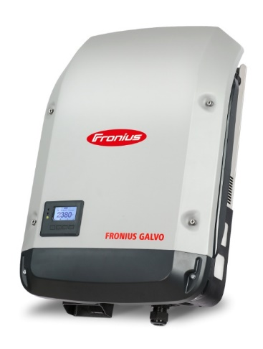
What is a Smart Inverter?
What Problem Do They Solve?
A inverter is a power electronic device needed by many distributed energy resources (DERs) to interconnect to the grid and a smart inverter is one with advanced capabilities.
Smart inverters mitigate many of the traditional concerns associated with variable DER generation, enable greater penetration of DERs, and enhance DER value by enabling grid services.
31

Slide 32
What Makes an Inverter Smart?
Additional functionality beyond conversion of DC to AC:
Autonomous response to grid conditions
Bidirectional communication for monitoring and control
Advanced functionality for DER dispatch
32
Notes:
Smart Inverters
Have additional functionality beyond merely conversion of DC to AC
Ramping, ride-through capabilities, voltage and power quality management, communication abilities, and more
Through the use of smart inverters, DERs will have the ability to perform many of the functions that traditional fossil fueled power plants have and do so at a local level.

Slide 33
Smart Inverter Functionality Benefits
Mitigates impact DERs may have on the grid (i.e. voltage and frequency fluctuations, power quality, islanding concerns, etc.)
Increases hosting capacity
Improves distribution operations and system efficiency
Increases grid safety and reliability, especially in emergency situations
Reduces distribution upgrades which would be used to integrate and utilize DERs as well as mitigate impacts of Zero Net Energy projects
Provides gateway for provision of grid services
Projects demonstrating these benefits have been completed and many more are being tested currently.
33
Notes:
Example: CAISO, NREL, and First Solar project. 300 MW solar PV plant which assisted on frequency control, voltage control, and ramping capacity. Project demonstrated that renewable energy plants with smart inverter technology can offer electric reliability services similar to, or in some cases superior to, conventional power plants. However, it should be noted that to provide these services, the plant does not operate at maximum capacity (30% below maximum) and must have a properly sized inverter.
Several studies from SolarCity, NREL, and SDG&E have shown the ability of smart inverters to reduce voltage issues on distribution feeders.

Slide 34
History of the California Smart Inverter and the Smart Inverter Working Group
Formed in 2013 to develop recommendations for technical steps needed to optimize inverter‐based DERs to support grid operations.
Weekly meetings led to recommendations for smart inverter functionality in three phases.
Tariff Revisions: Proposed and Approved
Phase 1: Autonomous Functions
January 2014
January 2015
April 2015
Phase 2: Communications
February 2015
December 2016
April 2017
Phase 3: Advanced Functions
March 2016
Revised March 2017
TBD
Likely Later of a Date in 2019 or a Time Period Following a Test Standard
June 2017
TBD
Later of (a) March 2018 or (b) 9 Months Following a Test Standard
September 2017
Recommendations Completed
Required Date
DER Action Plan
By 2020, fully operationalize advanced smart inverter functionalities to enhance the integration of DERs into the grid.
34
Notes:
CEC and CPUC collaboration
SIWG categorized as “quasi-legislative” No financial/ratemaking/regulatory/legal topics were/are allowed.
Phase 1 adopted in a decision (D.14-12-035) in 2014. Included in Rule 21 as Section Hh, “Smart Inverter Generating Facility Design and Operating Requirements”. Effective September 8, 2017.
Current developments include:
Certification of inverters (model number, firmware updates, etc.)
Certification data summary provided to the IOU
CEC list must be updated to show certification
Rule 21 revisions to reflect UL 1741 SA and other clarifications
Volt/Var vs fixed power factor
Real power priority vs reactive power priority
Phase 2 communications is the later of (a) March 2018 or (b) 9 months after the release of the SunSpec Alliance communication protocol certification test standard or the release of another industry recognized communication protocol certification test standard.
As of April 2017, the SunSpec standard and test procedure is on schedule.
New Phase 3 recommendations recently completed through weekly calls in February and March 2017. The SIWG recommends syncing with IEEE 1547 standard when possible. There is consensus that the original Phase 3 functions have been developed sufficiently in both the SIWG calls and the IEEE 1547 development that they can be added to Rule 21 by June 2017. Two of these functions will be optional as one is not in IEEE 1547 and the other is optional in IEEE 1547. The date of mandatory functionality has yet to be determined and the Energy Division will work with the SIWG to prepare the draft tariff revisions over the next few months.
Will still need to figure out market, regulatory, and legal questions around DER sourcing.

Slide 35
Smart Inverter Functions
Phase 1 Autonomous Functions | Phase 2 Communications | Phase 3 Advanced Functions
Anti-Islanding Voltage Ride-Through Frequency Ride-Through Volt/VAR Control Default and Emergency Ramp Rates Fixed Power Factor “Soft-Start” Methods | Three Pathways: IOU – DER IOU – DERMS IOU – Retail Aggregator Default Protocol: IEEE 2030.5 (aka SEP 2.0) | Monitor Key DER Data DER Cease to Energize/Return to Service Request Limit Maximum Real Power Mode Set Real Power Mode Frequency-Watt Emergency Mode Volt-Watt Mode Dynamic Reactive Current Support Mode Scheduling Power Values and Modes
35
Notes:
Phase 1: predetermined responses or settings that respond to grid conditions.
Phase 2: bidirectional communication which allows for updating settings, responses, and getting data. Involved determining who the IOU will be interacting with and in what way, as in the protocol and how to use the protocol.
Phase 3: forward-looking capability around DER monitoring and control. Leverages Phase 2 communications to provide grid services that likely entail compensation as many of the functions revolve around augmenting power delivered, which is what the customer is paid for currently.

Slide 36
Smart Inverter Benefits by Phase
Phase 1 Autonomous Functions | Phase 2 Communications | Phase 3 Advanced Functions
Reduces impact of DERs contributing to system disturbances and unnecessary disconnections Mitigates DER voltage and power quality issues | Enables active management, monitoring, and coordination of DERs with distribution equipment Allows for updating of Phase 1 settings and Phase 3 functions | Increases utility visibility and control of DERs Enables DERs to assist grid operations under normal (ex. maintenance) and abnormal (ex. emergency) grid situations Further reduces impact of DERs contributing to system disturbances and unnecessary disconnections
36

