Slide 1

Undergrounding Proceeding R.17-05-010 Phase I Workshop – Staff Data Request Highlights
Jonathan Frost
Energy Division
California Public Utilities Commission
Notes:
Note: Please defer questions until completion of the presentation. Thank you.

Slide 2
Presentation Outline
Introduction
  Background to the R.17-05-010 Data Request
Data Request Highlights:
  Basic Details and Status of Projects
  Project Costs and Credit Allocations
  Expenditures and Unexpended Funds
  Rule 20A Credit Trading
  Community Rule 20A Work Credits Redeemed
  Work Credit Debt
  Rule 20A Program Cost to Residential Customers
  Rule 20A Maps
Questions & Answers
Notes:
Part 9 is still in progress.

Slide 3
Background to Data Request
§ 5.2.1 “Preliminary Information from Electric Utilities” of the R.17-05-010 OIR lists the basic items that the Commission seeks to gather.
  “As part of this Order Instituting Rulemaking (OIR), we anticipate directing each electric utility to file and serve the following data for the 2005-2016 calendar years. This data will create a common baseline on the relevant issues identified in this rulemaking” (OIR, p.16-18)
In November 2017, Energy Division sent SCE, PG&E, SDG&E, Liberty Utilities, PacifiCorp and Bear Valley a comprehensive data request based on the outline in § 5.2.1.
The data CPUC Staff received is primarily for 2005 to present, with some data points dating back to the 1960s.

Slide 4
I. Basic Details and Status of Projects:
 | PG&E | SCE | SDG&E
Total Projects Underway | 145 | 77 | 65
Total Projects Completed (2005-17) | 282 | 134 | 186
Total Communities | 266 | 208 | 27
Eligible Communities | All* | All* | 24
Ineligible Communities | None | None | 3**
Active Communities*** | 174 | 63 | 15
Inactive Communities | 92 | 145 | 12
Total Work Credit Balance of Inactive Communities | $108,815,591 | $88,348,414 | $16,630,018
*Includes communities served by municipal utilities, and communities that are served by more than one IOU
**The three ineligible communities in SDG&E are Aliso Viejo, Laguna Hills, and Mission Viejo
***Active communities are defined as communities that have formed an undergrounding district, and/or started or completed an undergrounding project within the past 8 years
Notes:
The three ineligible communities in SDG&E (Aliso Viejo, Laguna Hills, and Mission Viejo) are ineligible as they have 0 overhead meters and are ineligible per SDG&E’s Rule 20A section 2.b (formula). There are about 22,000 meters served in ineligible communities.
Average completed project length 3,700 ft for SCE, 5,700 ft for PG&E
Average years from passing a muni resolution to completion of project: 7 years (assuming 261 work days); 3-5 years from design to completion

Slide 5
II. Project Cost and Credit Allocations: Cost Per Distance
PG&E
  Cost per distance: $650-$1,150 per ft ($3.4 M-$6.1M per mile)
  Cost per median project (Half Mile or 5 blocks): $2,000,000 to $3,500,000
  Cost per minimum project (600 feet or one block): $400,000 to $700,000
SCE
  Cost per distance: $500-$750 per ft (or $2.6M to $4M per mile)
  Cost per median project (Half Mile or 5 blocks): $1,500,000 to $2,250,000
  Cost per minimum project: between $300,000 and $450,000
SDG&E
  Cost per distance: $500-$700 per ft ($2.64M-$3.696M per mile)
  Cost per median project (Half Mile or 5 blocks): $1,500,000 to $2,100,000
  Cost per minimum project: $300,000 to $420,000
Notes:
$3.8 million per mile ave. across the IOUs,
PG&E: 2013-2017 average: $696 per foot, 2017 average: $688
SCE: 2013-2017 average: $498 per foot, 2017 average: $795
Data comes from IOU R.1705010 Data Request

Slide 6
II. Project Cost and Credit Allocations: Cost Per Distance
Notes:
$3.8 million per mile ave. across the IOUs,
PG&E: 2013-2017 average: $696 per foot, 2017 average: $688
SCE: 2013-2017 average: $498 per foot, 2017 average: $795
Data comes from IOU R.1705010 Data Request

Slide 7
II. Project Cost and Credit Allocations:
Allocations – 2019 Annual and Total Historical
2019 Rule 20A Annual Allocations
Liberty Utilities – $1.43 Million
PacifiCorp – $520,000
Bear Valley – $0
PG&E – $41.3 Million
SCE – $30.1 Million
SDG&E* – $28.7 Million
Total 2019 Rule 20A Allocations – $102 Million
Total Rule 20A Allocations (1967-2019)
Liberty Utilities – $41.3 Million
PacifiCorp – $14.1 Million
Bear Valley – $0
PG&E – $2.1 Billion
SCE – $1.52 Billion
SDG&E – $848.4 Million
Total Rule 20A Allocations Since 1967 – $4.6 Billion
*SDG&E also allocated $1 Million in Rule 20D work credits, which are not included in this total
Notes:
D.73078 established Electric Tariff Rule 20 in September 1967
$3.4 Billion Spent Across all IOUs from 1968 to 2015
*SDG&E 20D – $1 Million
Total is as reported by the utilities

Slide 8
III. Expenditures and Unexpended Funds:
Total Expenditures and Unexpended Funds for Conversion Since 1967-2018
Expenditures
PG&E – $1.5 Billion
SCE – $1.2 Billion
SDG&E – $735.3 Million
Liberty – $20.1 Million
PacifiCorp – $4.2 Million
Bear Valley – $0
Total – $3.4 Billion
Unused, Uncommitted, Funds*
PG&E – $254 Million
SCE – $207.6 Million
SDG&E – ($79.1Million)
Liberty – $18.9 Million
PacifiCorp – $8.8 Million
Bear Valley – $0
Total – $489.3 Million**
* There are $963.1 million unused funds in total, and $501.5 million are committed to projects underway.
** Excludes SDG&E since all unused funds are committed.

Slide 9
IV. Rule 20A Work Credit Trading
Refers to buying, selling, loaning or gifting work credits. Not in the Rule 20A tariff and not condoned by the Commission.
Total Rule 20A work credits traded since 2005: $62.2 Million
PG&E: 44 transactions dating back to 2009 totaling $46,081,487
SCE: 27 transactions since 2008 totaling $13,026,453
SDG&E: one trade in 2010 in which San Diego County loaned $2.9 million to the City of Vista for its East Vista Way project.
PacifiCorp: Siskiyou County transferred $250,000 to the City of Weed’s 2016 Rule 20A project.
Notes:
SDG&E - Vista: This trade accounted for 26% of the total Rule 20A funding on the project.
PG&E: Of the 11 completed projects that utilized traded work credits, 63% of the $16.5M in costs ($10.3M) were paid for with traded work credits.

Slide 10
V. Community Rule 20A Work Credits Redeemed
 | Community | Total Work Credit Expenditures
1 | City and County of San Francisco | $174,194,533
2 | City of San Diego | $123,959,969
3 | Unincorporated Los Angeles County | $80,199,098
4 | Unincorporated San Diego County | $66,219,539
5 | City of Long Beach | $66,113,635
6 | City of Oakland | $59,290,182
7 | City of San Jose | $54,445,341
8 | Unincorporated San Bernardino County | $38,824,162
9 | City of Fresno | $ 34,846,837
10 | City of Chula Vista | $30,601,828

Slide 11
V. Community Rule 20A Work Credits Redeemed (Cont.)
SDG&E Communities That Have Not Completed a Project Since 2005
Dana Point
Laguna Beach
Mission Viejo
Notes:
Data comes from March 2018 Data Request

Slide 12
V. Community Rule 20A Work Credits Redeemed (Cont.)
PG&E Communities That Have Not Completes Any Projects Since 2005
ALPINE COUNTY
ATHERTON
BIGGS
BLUE LAKE
BRISBANE
BUELLTON
CALISTOGA
CLOVERDALE
CORCORAN
DOS PALOS
FOSTER CITY
IONE
LAKEPORT
LASSEN COUNTY
LIVINGSTON
MARICOPA
MARYSVILLE
MENDOTA
MENLO PARK
MONTE SERENO
OAKLEY
PLYMOUTH
POINT ARENA
ROSEVILLE
SACRAMENTO COUNTY
SAN BENITO COUNTY
SAN BRUNO
SAN JOAQUIN
SAN JUAN BAUTISTA
SARATOGA
SHASTA LAKE
SIERRA COUNTY
SISKIYOU COUNTY
SOLEDAD
SUTTER CREEK
TEHAMA
WHEATLAND
WILLIAMS
Notes:
Data comes from March 2018 Data Request

Slide 13
V. Community Rule 20A Work Credits Redeemed (Cont.)
SCE Communities that Have not Completed a Project Since 2005
Aliso Viejo
Anaheim
Banning
Calabasas
Colton
Eastvale
Glendale
Goleta
Grand Terrace
Jurupa Valley
Laguna Hills
Laguna Niguel
Laguna Woods
Los Angeles, City of
Menifee
Pasadena
Rancho Santa Margarita
Riverside, City of
Unincorporated Imperial
Unincorporated Madera
Unincorporated San Diego
Unincorporated Tuolomne
Wildomar
Yucca Valley
Notes:
Data comes from March 2018 Data Request

Slide 14
VI. Work Credit Debt
57 communities across the State have work credit debt and are unable to participate in the program.
Communities with highest levels of work credit debt shown to the right.

Slide 15
VII. Rule 20A Program Cost to Residential Customers
PG&E: Estimated at $9.46 per customer in 2017.
2017 revenue requirement for projects installed from 1968 through 2017:
Total plant additions (1968 through 2017): $1.4 billion
2017 Rate Base: $428 million (plant in service less accumulated depreciation and deferred taxes)
2017 Revenue Requirement: $90.8 million
Total number of customers: 5.47 million
2017 Revenue Requirement per customer (average): $16.60
Revenue Requirement allocated to residential class: $45.4 million (before CARE reallocation)
Number of residential customers: 4.80 million
2017 Revenue Requirement per residential customer (average): $9.46

Slide 16
VII. Rule 20A Program Cost to Residential Customers (Cont.)
SDG&E:

Slide 17
VII. Rule 20A Program Cost to Residential Customers (Cont.)
SCE:

Slide 18
VIII. Rule 20A Maps

Slide 19
Questions & Answers

Slide 20
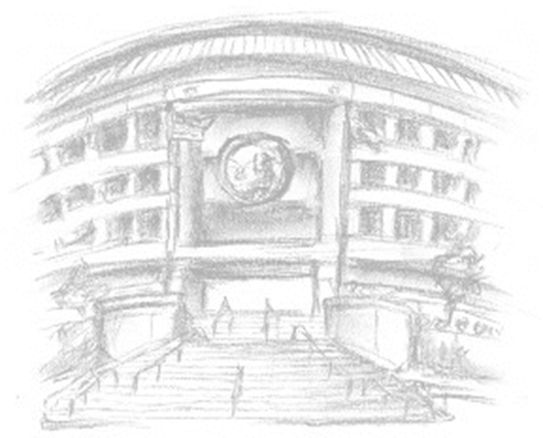
Thank You!
Jonathan Frost
CPUC
jf6@cpuc.ca.gov
415-703-5412

Slide 21
Additional Slides

Slide 22
Notes:
Data comes from March 2018 Data Request

Slide 23
VI. Rule 20A Program Cost to Residential Customers
SDG&E:

Slide 24
VI. Rule 20A Program Cost to Residential Customers
SCE:

