Slide 1

Rule 20 Undergrounding Staff Proposal Workshop
Jonathan Frost
Energy Division
California Public Utilities Commission
March 2020

Slide 2
Safety and Emergency Information
In the event of an emergency, please proceed calmly out the exits.
The Evacuation Location is at Garden Plaza, between the Herbst Theater and the War Memorial Opera House.
It is located on the other side of City Hall. Exit the building at the main entrance at Van Ness and McAllister streets and walk past the Herbst Theater and City Hall.

Slide 3
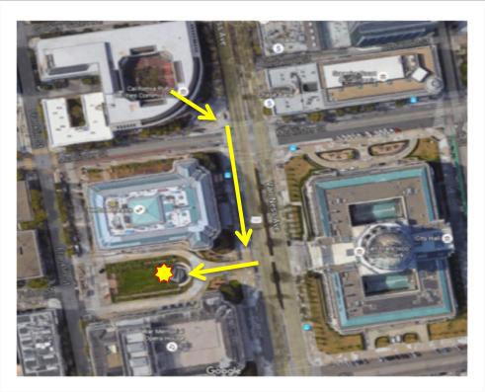
Safety and Emergency Information
Herbst Theater
City Hall
Opera House
CPUC meeting spot is at the Garden Plaza, next to the War Memorial Opera House. The location is illustrated above by the yellow star.

Slide 4
Agenda

Slide 5
Current Rule 20 Program Goals and Criteria
Current Rule 20 undergrounding program focus is aesthetics only. Factors such as safety and reliability are not considered in Rule 20. Prospective projects must meet one of the following criteria for full ratepayer funding:
unusually heavy concentration of overhead electric facilities;
heavy volume of pedestrian or vehicular traffic;
limited or impeded wheelchair access (SDG&E only);
civic area or public recreation area or an area of unusual scenic interest to the general public; or
arterial street or major collector

Slide 6
Issues with the Existing Rule 20 Program
Large unused work credit balances
Unregulated work credit trading
Inequity in the program
Lack of transparency
No program mechanisms to incentivize timely, cost-efficient project completion
Inflation-adjusted project costs have risen since 2005

Slide 7
Large Unused Work Credit Balances, Work Credit Debt
As of March 2019, there was $489.3 million in equivalent unused and un-committed work credits among the municipalities served by all the utilities.
As of March 2019, there were 57 communities in “work credit debt” in excess of 5 years due to significant project cost overruns. 12 communities have work credit debt in excess of 20 years.
Unused, Uncommitted, Funds** for Rule 20A (1967-2018)*
PG&E – $254 Million
SCE – $207.6 Million
SDG&E – ($79.1Million)
Liberty – $18.9 Million
PacifiCorp – $8.8 Million
Bear Valley – $0
Total – $489.3 Million***
* 2019 expenditure data will be submitted by the IOUs in annual reports in March 2020
** There are $963.1 million unused funds in total, and $501.5 million are committed to projects underway.
*** Excludes SDG&E since all unused funds are committed.
Notes:
Both demonstrates inefficiency in the program and potential risk

Slide 8
Unregulated Rule 20A Work Credit Trading
Refers to buying, selling, loaning or gifting work credits. Neither allowed or disallowed in the Rule 20 Tariff and not condoned by the CPUC.
Total Rule 20A work credits traded since 2005: $86,553,751 Million
PG&E: 57 transactions dating back to 2009 totaling $55,276,564
SCE: 27 transactions since 2006 totaling $28,127,187
SDG&E: one trade in 2010 in which San Diego County loaned $2.9 million to the City of Vista for its East Vista Way project.
PacifiCorp: Siskiyou County transferred $250,000 to the City of Weed’s 2016 Rule 20A project.
Notes:
SDG&E - Vista: This trade accounted for 26% of the total Rule 20A funding on the project.
PG&E: Of the 11 completed projects that utilized traded work credits, 63% of the $16.5M in costs ($10.3M) were paid for with traded work credits.

Slide 9
Inequity in the Rule 20 Program – Winners and Losers
Project expenditures have primarily occurred in economically core areas like the Bay Area and coastal San Diego County.
Small communities do not receive enough work credit allocations to fund projects.
82 communities (16 percent) state-wide did not complete any Rule 20A projects from 2005 – 2019.

Slide 10
Community Rule 20A Work Credits Redeemed
 | Community | Total Work Credit Expenditures
1 | City and County of San Francisco | $174,194,533
2 | City of San Diego | $123,959,969
3 | Unincorporated Los Angeles County | $80,199,098
4 | Unincorporated San Diego County | $66,219,539
5 | City of Long Beach | $66,113,635
6 | City of Oakland | $59,290,182
7 | City of San Jose | $54,445,341
8 | Unincorporated San Bernardino County | $38,824,162
9 | City of Fresno | $34,846,837
10 | City of Chula Vista | $30,601,828
IOU data as of March 2019

Slide 11

Inadequate Reporting and Transparency
Current utility reporting is sparse on information (e.g. municipal balances, project cost estimates and variances, costs on a dollar per mile basis)
There is no Program Guidebook available for interested parties
Notes:
PG&E has now included balances and contact information. Get PG&E to talk about what they have done since 2019 workshop.

Slide 12
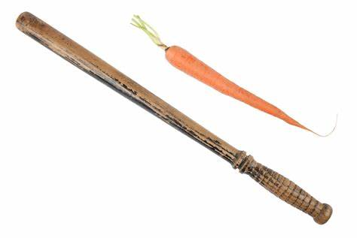
Lack of Program Mechanisms to Incentivize Timely, Cost Efficient Project Completion
Projects typically are completed within 7 years; however, there have been many instances where projects stall out for years.
The PG&E Rule 20A Audit revealed that utility-driven delays from re-prioritizing resources away from Rule 20 program can extend project timelines and drive up project costs.
Project costs in real terms have increased by approximately 33% and 44% for PG&E and SCE respectively. SDG&E’s costs have declines modestly by <6%
Notes:
PG&E has now included balances and contact information. Get PG&E to talk about what they have done since 2019 workshop.

Slide 13
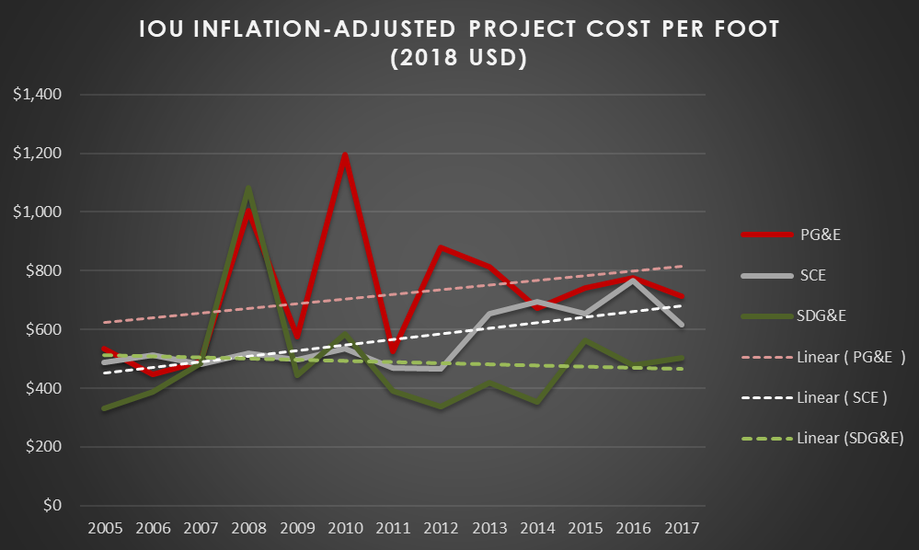
IOU Rule 20A Project Costs 2005-2017
(CPUC Data as of April 2019)
Notes:
project costs in real terms have increased by approximately 33% and 44% for PG&E and SCE respectively. SDG&E’s costs have declines modestly by less than 6%

Slide 14
Proposed Guiding Principles for Rule 20 Program Reform
Program objectives should be defined and made relevant to current undergrounding goals held by various stakeholders including safety and reliability.
Program reform should be informed by the governmental entities which have benefitted from undergrounding and those which have not.
Maintain regulatory efficiency of the program.
Minimize general ratepayer impacts.
Recognize and encourage projects that can leverage local funds.
Improve program operation and efficiency.

Slide 15
Staff Proposal on Undergrounding – Recommendations
  Refine and Expand the Rule 20 Public Interest Criteria
  Modify Rule 20B to Incorporate Tiered Ratepayer Contributions Commensurate with Public Benefits
  Sunset Rule 20A and 20D as Currently Designed
  Incentivize Municipal Utility Surcharge Undergrounding Programs
  Eliminate Work Credit Trading With Limited Exceptions
  Modify the Rule 20A Annual Completion and Allocation Reports
  Adopt an Updated Rule 20 Guidebook
  Improve Communications with the Communities and Publish Relevant Rule 20 Program Information, Documents and Reports Online
  Implement Incentives to Reduce Project Completion Timelines and Costs
Notes:
Rule 20A projects are performed for cities and counties. To qualify for full utility funding, projects must produce a benefit to the general public by satisfying one or more of the following criteria:
Avoids or eliminate an unusually heavy concentration of overhead electrical facilities.
Street/road carries heavy vehicular or pedestrian traffic
Overhead facilities located within or passes through a civic, recreational, or scenic area
Street/road is identified as an arterial street or major collector road

Slide 16
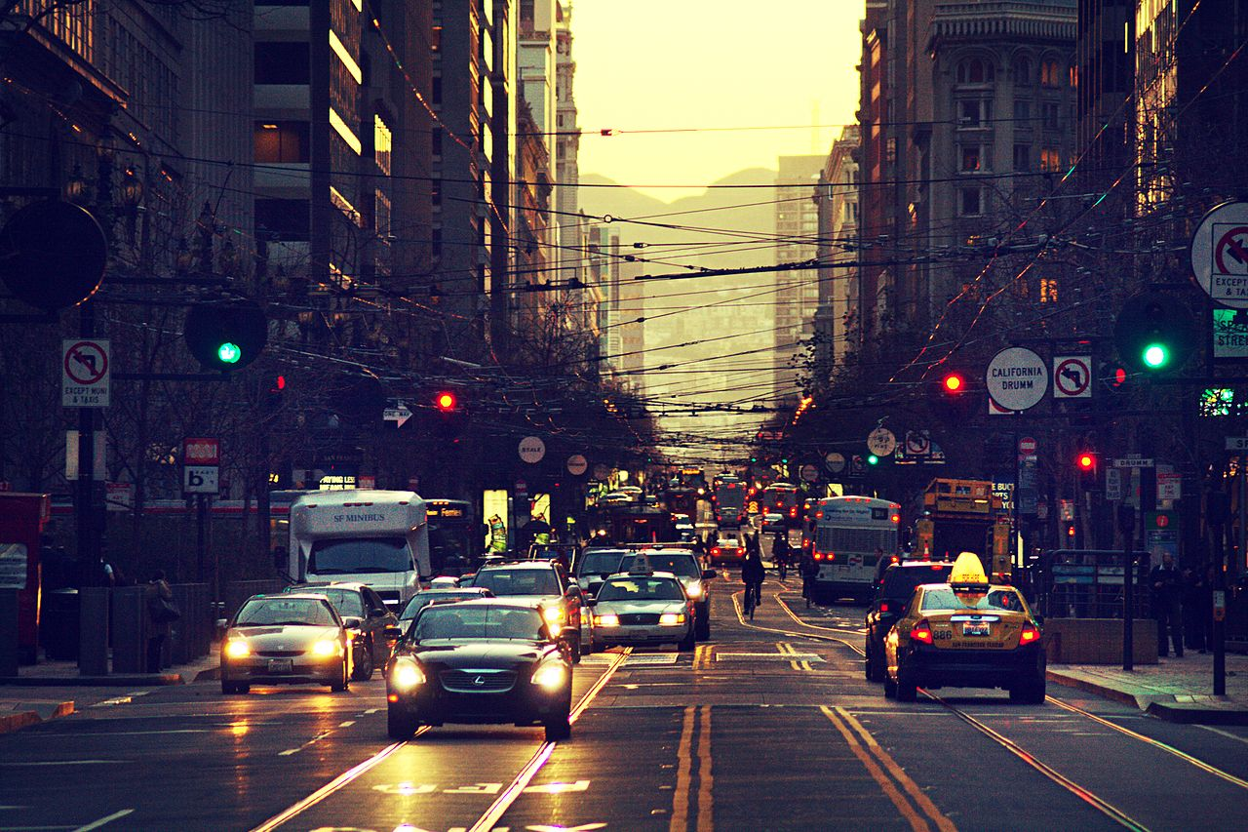
1) Refine and Expand Rule 20 Criteria – Refinements
Key: Black=Original Tariff Language, Red=Proposed New Tariff Language
Such undergrounding will avoid or eliminate an unusually heavy concentration of overhead electric facilities. This is defined as poles that serve circuits in addition to a single primary and secondary circuit;
The street or road or right-of-way serves as a major thoroughfare for is extensively used by the general public and carries a heavy volume of pedestrian, bicycle, rail, vehicular, or other traffic. Heavy traffic volume means a minimum of 5,000 average trips per day among all personal and public transportation forms collectively;
Wheelchair access is limited or impeded by existing above ground electric and/or telecommunications infrastructure including pad mounted facilities on sidewalks or in other areas in the pedestrian right-of-way that is otherwise not compliant with the Americans with Disabilities Act;

Slide 17
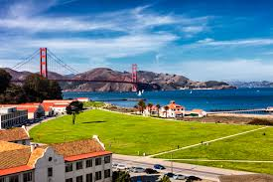
1) Refine and Expand Rule 20 Criteria – Refinements
The street or road or right-of-way adjoins or passes through a civic area or public recreation area or an area of significant unusual scenic, cultural and/or historic interest to the general public; or
The street or road or right-of-way is considered an arterial street or major collector as defined by the California Department of Transportation’s California Road System functional classification system.in the Governor’s Office of Planning and Research General Plan Guidelines.
Key: Black=Original Tariff Language, Red=Proposed New Tariff Language

Slide 18
1) Refine and Expand Rule 20 Criteria – Proposed New Criteria
Key: Black=Original Tariff Language, Red=Proposed New Tariff Language
The existing above ground infrastructure is within a Tier 2 or Tier 3 area of the State’s High Fire-Threat District as defined by the CPUC and the California Department Forestry and Fire Protection;
The street or road or right-of-way serves as an egress, ingress, or is designated an evacuation route by local or state government entities;
The above ground infrastructure dangerously limits visibility for motorists, pedestrians, bicyclists, and/or other road users, particularly in intersections;
The existing above ground infrastructure is along a road or right-of way that has a history of vehicle-pole collisions;

Slide 19
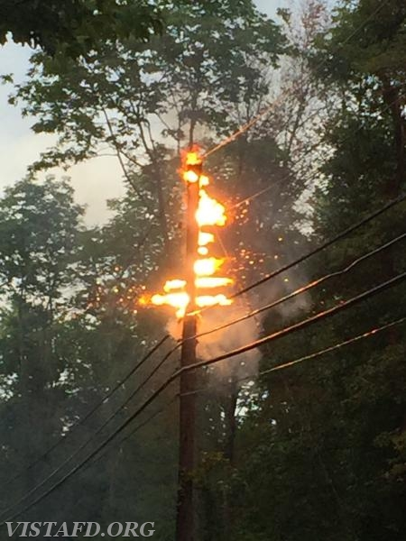
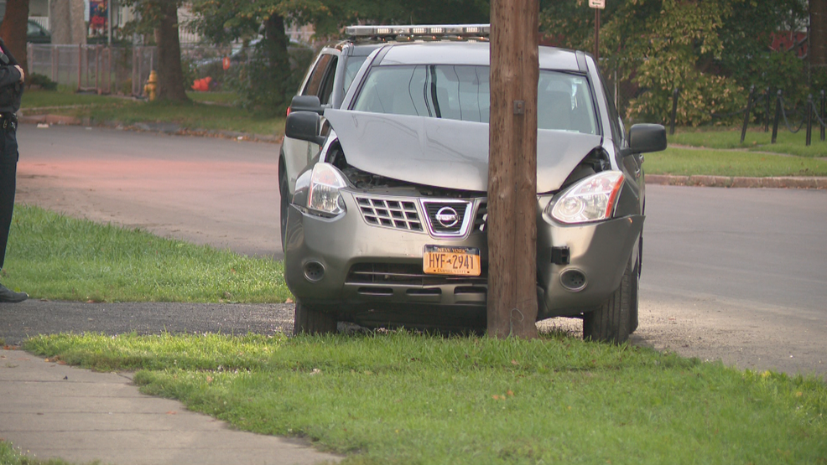
1) Refine and Expand Rule 20 Criteria – Proposed New Criteria
Key: Black=Original Tariff Language, Red=Proposed New Tariff Language
The existing above ground infrastructure is within a Tier 2 or Tier 3 area of the State’s High Fire-Threat District as defined by the CPUC and the California Department Forestry and Fire Protection;
The street or road or right-of-way serves as an egress, ingress, or is designated an evacuation route by local or state government entities;
The above ground infrastructure dangerously limits visibility for motorists, pedestrians, bicyclists, and/or other road users, particularly in intersections;
The existing above ground infrastructure is
  along a road or right-of way that has a
  history of vehicle-pole collisions;

Slide 20

1) Refine and Expand Rule 20 Criteria – Additional Proposed Criteria
Benefit-to-cost metrics
Projects with a potential benefit-to-cost ratio of one or greater would qualify under Rule 20A; could encourage projects that would yield quantifiable positive net benefits for the ratepayers and the general public
Benefit streams could include safety, reliability, efficiency/economies of scale, and replacement of aging overhead infrastructure.
Minimum Project Distance
Increase from 600 feet or 1 block to ½ mile or 5 blocks
Service Laterals, Panel Conversions
Remove the $1,500 limit for service panel conversion. The conversion of electric service panels to accept underground service. , up to $1,500 per service entrance, excluding permit fees.

Slide 21
1) Refine and Expand Rule 20 Criteria – Additional Proposed Criteria
Project Viability and Actionability
Community would need to demonstrate that it could absorb at least a 100% increase in price with additional work credits or pre-arranged community funds
The joint trench participants (i.e. city, telecommunications companies, electric utility) for the project would draft a binding charter for the project in which they would agree to complete the project in seven years or less and plan to execute it following the formation of the undergrounding district.

Slide 22
2) Modify Rule 20B to Incorporate Tiered Ratepayer Contributions Commensurate with Public Benefits
Staff proposes a three-tiered Rule 20B program with higher portions of ratepayer contribution commensurate with greater public benefits and public policy objectives. The three tiers are:
Tier 1
20% Ratepayer contribution
Tier 2
30% Ratepayer contribution
Tier 3
50% Ratepayer contribution
Meets existing Rule 20B criteria (at least 600 ft/one block, both sides of the street
Meets Tier 1 criteria and one or more of the expanded public interest criteria of this staff proposal, such as wildfire risk mitigation.
Meets Tier 2 criteria and one or more equity criteria (project is in or adjacent to a disadvantaged community at the time of the district formation or the community has not completed a Rule 20 project in 10 or more years).

Slide 23

3) Sunset the Current Rule 20A and Rule 20D Programs
Staff proposes that the existing allocation-based Rule 20A and Rule 20D programs be sunsetted over a 10-year period and either be replaced with the modified Rule 20B program, other new programs or be terminated.
  Year 1: No issuance of work credits and work credit trading will be strictly limited to non-monetary work credit transfers within counties. Historically underserved communities would receive a one-time allocation to allow them to have the opportunity to complete a Rule 20A project before the program ends.
  Year 10: Any remaining Rule 20A credits must be applied to a designated undergrounding district in the community. Any unused Rule 20A credits will be eliminated and all work credit balances will revert to zero.

Slide 24
4) Incentivize Municipal Utility Surcharge Undergrounding Programs
Staff proposes for the utilities to provide municipalities matching funds of up to $2 million per year per participating community that pursues self-taxation-based undergrounding programs in collaboration with their local utilities.
An example of such a program is the City of San Diego’s utility surcharge program which has accelerated undergrounding in San Diego.
While the CPUC does not oversee this type of program but can authorize the utility to collect the franchise fee through rates that goes directly to funding the undergrounding

Slide 25

5) Eliminate Work Credit Trading with Limited Exceptions
Staff recommends that the CPUC prohibit the trading of work credits with the limited exceptions:
  Intra-county non-monetary transfers from a county government to cities and towns within the county; and
  Credit pooling amongst two or more adjoining municipalities for a project with community benefit.

Slide 26

6) Modify the Rule 20A Annual Completion and Allocation Reports
Staff recommends that utilities provide more details to the CPUC, communities and the public regarding the projects that are underway, cost breakdowns for projects, project cost trends, performance metrics, and modify the summary statistics.
Additionally, the utilities’ allocation reports should include how the utilities derive the allocations from the general rate case and the allocation formula in the Rule 20A Tariff.

Slide 27

7) Adopt an Updated Rule 20 Program Guidebook
The utilities should meet and confer with the League of California Cities, the California State Association of Counties, AT&T and the CPUC Staff to draft an updated version of the Rule 20 Guidebook that would be subject to CPUC review prior to its formal adoption and circulation among the cities and counties.

Slide 28

8) Improve Communications with the Communities and Public
New utility program communication strategies should include annual meetings with interested cities and counties to discuss their ten-year plans for undergrounding.
The utilities should coordinate more closely with the communities and the broader public to enhance transparency and allow them public to have a greater voice in the planning process for projects.
The utilities should publish the relevant Rule 20A program information and reports online on dedicated utility undergrounding webpages to enhance the public’s access to information about the Rule 20 program.

Slide 29

9) Implement Incentives to Reduce Project Completion Timelines and Costs
These new incentives would include:
  Requiring the communities to serve as the default project lead, These new incentives would include:
  Requiring the communities to serve as the default project lead,
  Establishing threshold timeframes for project milestones, and
  Delineating all task and cost responsibilities in updated guidance documents.
Establishing threshold timeframes for project milestones, and
Delineating all task and cost responsibilities in updated guidance documents.

Slide 30
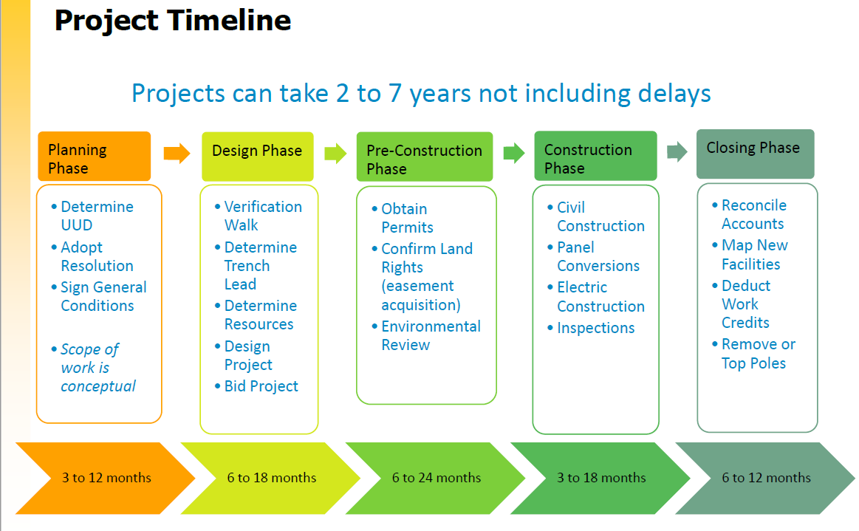
9) Implement Incentives to Reduce Project Completion Timelines and Costs
(Source: Joint IOU Presentation on Project Completion Issues. April 2019)

Slide 31
Public Questions and Comments

Slide 32
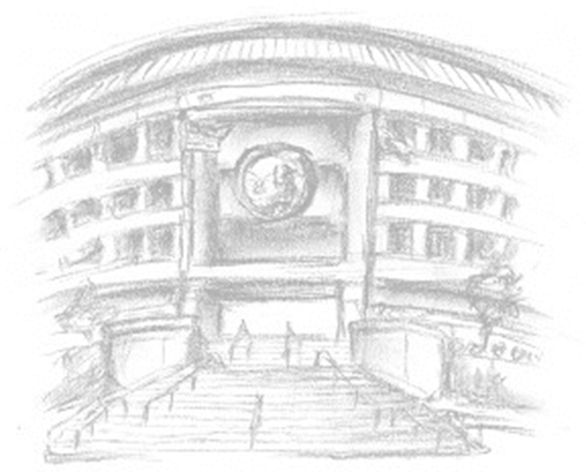
Thank You!
Jonathan Frost
CPUC
jf6@cpuc.ca.gov
415-703-5412

Slide 33
Additional Slides

Slide 34
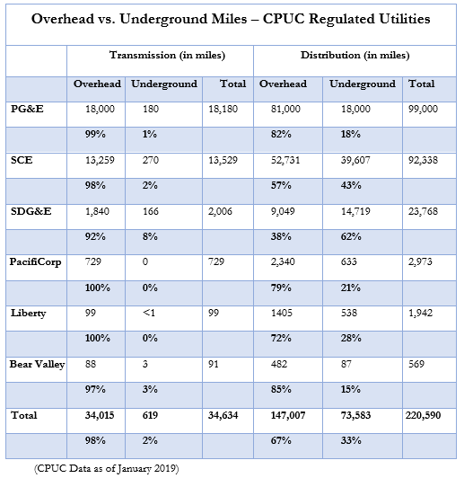
Background – Status of IOUs Programs

Slide 35
Status of IOUs Programs (as of April 2019)
 | PG&E | SCE | SDG&E
Total Projects Underway | 145 | 77 | 65
Total Projects Completed (2005-17) | 282 | 134 | 186
Total Communities | 266 | 208 | 27
Eligible Communities | All* | All* | 24
Ineligible Communities | None | None | 3**
Active Communities*** | 194 | 63 | 15
Inactive Communities | 72 | 145 | 12
Total Work Credit Balance of Inactive Communities | $108,815,591 | $88,348,414 | $16,630,018
Source: IOU Data as of April 2019
*Includes communities served by municipal utilities, and communities that are served by more than one IOU
**The three ineligible communities in SDG&E are Aliso Viejo, Laguna Hills, and Mission Viejo
***Active communities are defined as communities that have formed an undergrounding district, and/or started or completed an undergrounding project within the past 8 years

Slide 36
Work Credit Debt
57 communities across the State have work credit debt and are unable to participate in the program.
Communities with highest levels of work credit debt shown to the right.
(Source: IOU Data as of April 2019)

