Slide 1
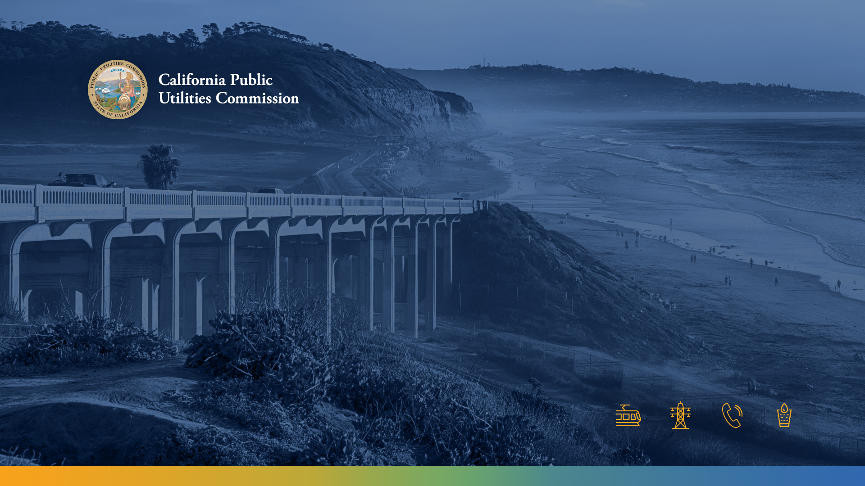
Community Engagement & Equity Workshop
Climate Adaptation Proceeding (R.18-04-019)
Meghan Cook – CPUC Climate Adaptation Analyst
September 19, 2024

Slide 2
Welcome & Introduction

Slide 3
Restrooms & Safety Procedures
Restrooms located in Atrium
In event of evacuation, meet at Roosevelt Park
  Across street, diagonal to building
Notes:
Restrooms are located in the Atrium
Please note the exits in case of emergency
If we need to evacuate the building, please follow staff to Roosevelt Park, located across the street, diagonal to the building

Slide 4


Webex Logistics
Mute/ Unmute
Participant List
Chat
Audio Options
Leave Meeting
Today's presentations (.pdf) and agenda are available on the WebEx link under “Event Material” type password “ADAPT24!” into the box and click “View Info”
Please note this meeting is being recorded
Raise Hand
Please submit questions for speakers in the Chat box or raise your hand to be unmuted by staff.
  *3 to raise hand and *6 to unmute/mute over the phone
Questions will be read aloud by staff (Reminder: Mute back!)

Slide 5
Purpose of Workshop Series
Goal: 1) Gather input to refine existing requirements for utility Community Engagement for Climate Adaptation Vulnerability Assessments (CAVAs) for energy infrastructure; 2) discuss methods to measure equity impacts of CAVAs within climate adaptation planning
Outcome: Stakeholder input will help inform a future CPUC Decision to improve Equity guidance and impacts, anticipated in 2025
Focus: Long-term planning related to extreme climate impacts on energy infrastructure / utility operations
Notes:
We are seeking to obtain input, facilitate discussion on Task 2 scoping items for the Climate Adaptation Proceeding.
Today’s workshop and your input will be incorporated into the record for this proceeding
A similar workshop will be held in Southern California and then one on Equity Metrics in S.F. in November

Slide 6
Today’s Agenda
Time | Content | Presenters/Participants
Introductory Information
10:00 AM | Welcome | Meghan Cook - CPUC
10:10 AM | Commissioner Opening Remarks | Commissioner Houck
10:30 AM | Introduction & Background | Meghan Cook - CPUC
Lessons Learned: IOU Presentations & Panel – Coordinated Local Gov’t Perspective
11:00 AM 11:15 AM | PG&E Presentation – 30 minutes Lessons learned from previous CEP Facilitated Discussion/ Q&A | PG&E + Advisory Group Members & Local Government
Noon | Lunch
Climate Vulnerability Metrics Overview
1:15 PM | Overview of Climate Equity Metrics, Tools, & Methodologies | Meghan Cook – CPUC
2:15 PM | 15 Minute Break
ESJ Roundtable Discussion: Equity Principles + Climate Vulnerability Metrics
2:30 PM | Facilitated ESJ Roundtable Discussion on: Community Engagement & Capacity Building CAVA Demonstrated Impacts & Metrics | Community, Local Government, and Tribal Perspectives
4:00 PM | Next Steps & Closing Remarks | CPUC
4:15 PM | End of Workshop
Notes:
Highlight denotes items that will need updating in final slides.

Slide 7
Community Agreements
Workshop is structured to stimulate an honest dialogue and engage different perspectives
  Keep comments friendly and respectful
  Be present (as few additional screens as possible)
  Assume best intentions but be mindful of impact
  One person speak at a time
  Be considerate of allowing those with less privilege to do more of the talking
  Half thoughts are welcome
Chat feature is only for Q&A or technical issues
Notes:
Meghan and Zara are here to help facilitate the discussion

Slide 8
Commissioner Remarks
Commissioner Darcie L. Houck

Slide 9
Background: Climate Adaptation Proceeding

Slide 10
Climate Adaptation Proceeding - (R.) 18-04-019
Purpose: Requires IOUs to assess forecasted extreme climate impacts on energy infrastructure and IOU operations decades into the future and identify options to mitigate threats by developing and submitting to CPUC:
    Climate Adaptation Vulnerability Assessment (CAVA) every 4 years
    Community Engagement Plan (CEP) one year before their CAVA
Equity Targets: Disadvantaged and Vulnerable Communities (DVC) defined as: 1) Tribes, 2) 25% highest CalEnviroScreen scores, 3) median income less than 60% of state median
Informational: CAVAs are used to inform Risk Mitigation (RAMP), general rate cases (GRCs), and may be used in other long-term planning proceedings (e.g., Integrated Resource Plans, Gas Planning)
Notes:
The CPUC regulates California investor-owned electric utilities and their infrastructure
The CPUC makes policies through proceedings
Proceedings covers specific topics and require that a record of facts be built to determine policy Decisions
This workshop is part of the CPUC’s Climate Adaptation Proceeding
This workshop and your input within this workshop will be incorporated into the record for this proceeding
This workshop and your input will help inform a future Decision anticipated in mid-2025
Through the Climate Adaptation Proceeding, the CPUC requires the large electric Investor-Owned Utilities to develop and file CAVAs every four years
CAVAs are an analysis of the climate vulnerabilities of all an IOU’s assets and operations and potential options to mitigate those vulnerabilities.
These CAVAs can be used to inform IOU investment requests in a subsequent General Rate Case proceeding at the CPUC, where an IOU’s spending is approved

Slide 11
CAVA Process
YR 1
YR 2
Climate Adaptation Vulnerability Assessment
YR 3
Risk Assessment Mitigation Phase &
Community Engagement Plan
YR 4
General
Case
Post-CAVA
Engagement
Survey
Rate

Slide 12
Recent CAVA Decision - D. 24-08-005
Commission adopted updated CAVA guidelines on August 1, 2024
Updates climate science & analysis requirements for CAVAs to align with best available science
  Adopts new baseline climate scenario: SSP 3-7.0
  Adopts Global Warming Level Approach for climate modeling
    Requires IOUs to examine 1.5°C and 2°C warming scenarios
  Orders IOUs to update requirements as Climate Assessments update best practices
Requires IOUs to publicly present and seek stakeholder input on draft CAVAs 90 days prior to submitting to the CPUC
Requires that IOUs demonstrate Incrementality, Prioritization, Cost-Effectiveness, and
Justification of any post-CAVA investment requests in GRC or other applications
Notes:
Adopts best available science as established by Cal-Adapt and the California Statewide Climate Assessments and the International Panel on Climate Change (IPCC)
Cal-Adapt is a public-private partnership under the California Energy Commission that takes IPCC climate modeling practices and data and maps them onto the state level for use by the Climate Assessment and others, including the IOUs.
IOUs are required to update these modeling requirements as Cal-Adapt and the Climate Assessments update their practices.
This decision also identifies these climate modeling approaches as a model of best practice for all other CPUC proceedings that may incorporate climate modeling.
The decision does not order other proceedings to use these practices. That must be litigated within each proceeding
IOUs must publicly present the results of their CAVA 90 days before submission, for comment from stakeholders and parties to the proceeding. They must then incorporate their responses to those comments as an appendix to their CAVA upon submission.
The decision also provides guidance for investment proposals that IOUs might submit in their GRC or a standalone application based on the results of their CAVA
Requires that IOUs demonstrate Incrementality (meaning the proposal would not have happened without considering climate risk), Prioritization (the project is of the highest priority), Cost-Effectiveness, and Justification of Investments in all investment proposals.

Slide 13
Today’s Goals
Proceeding Scope to Consider Improvements:
1. | Should the Commission refine requirements regarding consultations with DVCs and the preparation of CEPs adopted in D.20-08-046 with regard to large IOUs, including but not limited to:
1.1 | Additional guidance regarding the purpose and intended outcomes of the CEP and DVC consultation processes?
1.2 | Ways to reduce consultation fatigue and/or coordinate with other proceeding outreach processes?
1.3 | Modifications to the definition of DVC adopted in D.20-08-026?
1.4 | Additional guidance regarding consultation and collaboration with local governments during risk and vulnerability assessment processes? During adaptation proposal identification processes?
1.5 | Refinement of Tribal consultation processes specific to climate adaptation matters?
1.6 | Additional guidance regarding methods and scope for the determination of community adaptive capacity in CAVA analyses?
2. | What are the impacts on environmental and social justice communities of actions taken in this proceeding, including the extent to which requirements impact achievement of any of the nine goals of the Commission’s Environmental and Social Justice Action Plan?
Notes:
Obtain input, facilitate discussion on refinements to CEP Preparation, DVC and Tribal Consultation Requirements for Large IOUs.

Slide 14
Your Role – Provide Feedback
Your unique perspective related to community needs, barriers, and solutions for community engagement and measurable equity impacts
Sharing existing models of best practices
Opportunities for Collaboration and Streamlining
Identifying indicators of climate vulnerability and adaptive capacity
Discussing the discrete and coordinating roles of local, tribal, and state government in community engagement efforts
Notes:
Adopts best available science as established by Cal-Adapt and the California Statewide Climate Assessments and the International Panel on Climate Change (IPCC)
Cal-Adapt is a public-private partnership under the California Energy Commission that takes IPCC climate modeling practices and data and maps them onto the state level for use by the Climate Assessment and others, including the IOUs.
IOUs are required to update these modeling requirements as Cal-Adapt and the Climate Assessments update their practices.
This decision also identifies these climate modeling approaches as a model of best practice for all other CPUC proceedings that may incorporate climate modeling.
The decision does not order other proceedings to use these practices. That must be litigated within each proceeding
IOUs must publicly present the results of their CAVA 90 days before submission, for comment from stakeholders and parties to the proceeding. They must then incorporate their responses to those comments as an appendix to their CAVA upon submission.
The decision also provides guidance for investment proposals that IOUs might submit in their GRC or a standalone application based on the results of their CAVA
Requires that IOUs demonstrate Incrementality (meaning the proposal would not have happened without considering climate risk), Prioritization (the project is of the highest priority), Cost-Effectiveness, and Justification of Investments in all investment proposals.

Slide 15
Questions?

Slide 16
Lessons Learned
Nathan Bengtsson & Maegan Cowan – PG&E
Michael McCormick – Farallon Strategies, BayCAN
May Gnia – Stone Soup Fresno
George Chan – Chinese Newcomers Service Center
Barry Boyd – Sacramento Environmental Justice Coalition

Slide 17
PG&E CAVA Community Engagement:
Lessons Learned and Next Steps
Nathan Bengtsson, Maegan Cowan
September 19th, 2024

Slide 18
Objective and Overview
Objective:
  Share lessons learned from PG&E’s 2024 CAVA community engagement to inform potential refinements to adaptation-related community engagement.
Guiding Questions:
  What outcome are we intending to cause with CAVA community engagement?
  Does the current structure of CAVA community engagement align with our desired outcomes?
  How might we adjust CAVA community engagement requirements to best support the climate resilience of the communities we serve?

Slide 19

overall_0_132808723522956168 columns_1_132808723522956168 123_1_132808723522956168
PURPOSE: WHY WE EXIST
OUR 10-YEAR TRUE NORTH STRATEGY
Delivering for our hometowns
Serving our planet
Leading with love
WHERE WE ARE HEADED
CUSTOMERS
Rebuild trust with our customers and our local communities by delivering affordable energy & excellent customer experiences every day
STANDS: WHAT WE WILL DELIVER
ENERGY SYSTEM
PEOPLE
Architect an electric system that is:
Resilient to climate change
Decarbonized 24 x 7 x 365
Optimized to local and system needs
Continue to invest in a safe and reliable gas system
Everyone and everything
is always safe
Catastrophic wildfires shall stop
It is enjoyable to work
with and for PG&E
Boldly shape the future through:
Targeted electrification
Greening the gas supply
Shaping California’s policy
Electric
Unleash the full potential of electric vehicles
Gas
HOW WE WILL DO IT
PLANET
Clean and resilient energy for all.
FOUNDATIONAL CAPABILITIES
Public & workforce safety
and risk mitigation
Diversity, equity, inclusion & belonging
PG&E Performance Playbook
Coworker development and well-being
Simple, affordable financial model
Efficient end-to-end work management system
Regional service model
IT platforms and data management capabilities
Stakeholder, policy, and regulatory advocacy
PROSPERITY
Our work shall create prosperity for all customers and investors
VIRTUES: WHO WE ARE
Trustworthy, Empathetic, Curious, Tenacious, Nimble, Owners

Slide 20
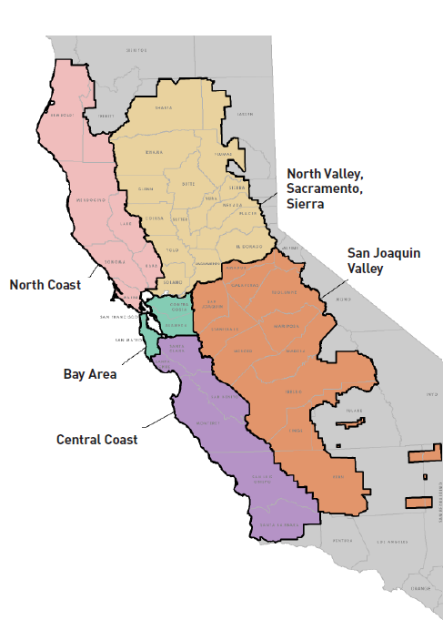
PG&E CAVA Community Engagement – Approach to 5 Regions
Given the significant geography of PG&E’s service area, the CEP for the Resilient Together initiative reflects PG&E’s regional service model, which is organized by PG&E’s five distinct regions.
  The Project Team’s approach featured the development of regional advisory groups comprised of CBOs. CBOs can provide specific information about community vulnerabilities and adaptation needs.
  Resilient Together Advisory Group (RTAG) members advised the Project Team on the methodology for the Resilient Together initiative and supported the implementation of the Community Engagement Plan by conducting on-the-ground outreach in the communities they serve.
  Some RTAG members chose to serve an advisory role due to capacity constraints. Those who conducted community outreach are referred to as “Outreach Partners.” Each Outreach Partner was expected to reach or engage at least two hundred community members as part of their outreach efforts.
  Across the five regions, the Resilient Together initiative partnered with 52 CBOs to conduct over 200 outreach activities, resulting in a total of 5,754 surveys completed across 451 unique zip-codes and 49 unique counties.

Slide 21
PG&E CAVA Community Engagement – Key Findings
DVC community members delivered the message that affordability and reliability are the topline concerns over and above these specific recommendations:
Center equity in all decision-making processes, investments and programs
Expand weatherization programs to provide highly subsidized or no-cost home improvements that make homes more resilient to a variety of climate hazards.
Provide distribution of free safety resources that improve household resilience.
Provide direct reimbursements for costs associated with power outages.
Maximize enrollment and longevity of existing PG&E programs in Disadvantaged and Vulnerable communities.
Provide financial support for the development and sustained operation of community resilience centers.
Improve emergency notifications and community education on hazards and resources.
Enable the expansion of distributed energy resources (DER) to help minimize power outages in DVCs.
Expand urban greening and forest management programs and investments.
Improve emergency evacuations and transportation access to cooling centers.
Invest in and expand existing workforce development programs.

Slide 22
PG&E CAVA Community Engagement – Material Outcomes
  RTAG participants noted the following regarding outcomes associated with the CAVA Community Engagement effort:
  Increased awareness of and familiarity with climate change resilience and adaptation concepts
  Increased understanding of how the impacts of climate change intersect with the primary focus of their work serving community (housing, health, economic development, etc.)
  Benefits of building connections with other CBOs working within each RTAG region
  Potential for improving relationship with PG&E contingent on sustained engagement
  However, RTAG efforts did not result in any direct positive impacts to community resilience

Slide 23
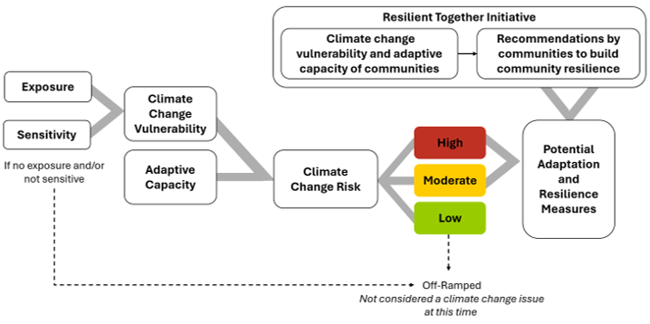
PG&E CAVA Community Engagement – Key Learnings
Challenge | Strategy
Misalignment with existing regulatory/planning process | Transparency, significant internal socialization
Extremely long chain of impact for feedback | Transparency, compensation, significant internal socialization
Highly technical subject matter | Focus on lived experience and accessible language
Extremely diverse DVC communities | Reliance on local, trusted CBO leaders to design and execute culturally appropriate outreach
Mistrust of PG&E | Transparency, deliberate relationship building process
Community resilience extends beyond PG&E’s locus of control | Transparency, a commitment to honor input in the CAVA regardless
Lack of awareness of existing PG&E support programs | Comparing recommendations to existing programs and outreach strategies
Local vs. policy definitions of vulnerability | Working with community experts to consider local vulnerability (i.e. farmworkers)
See Appendix C of CAVA for the entirety of the Resilient Together initiative report.

Slide 24
Guiding Questions:
What outcome are we intending to cause with CAVA community engagement?
Does the current structure of CAVA community engagement align with our desired outcomes?
How might we adjust CAVA community engagement requirements to best support the climate resilience of the communities we serve?

Slide 25
1.1 Additional guidance regarding the purpose and intended outcomes for the CEP and DVC Consultation Process?
Challenge | Strategy
Misalignment with existing regulatory/planning process | Transparency, significant internal socialization
Extremely long chain of impact for feedback | Transparency, compensation, significant internal socialization
Highly technical subject matter | Focus on lived experience and accessible language
Extremely diverse DVC communities | Reliance on local, trusted CBO leaders to design and execute culturally appropriate outreach
Mistrust of PG&E | Transparency, deliberate relationship building process
Community resilience extends beyond PG&E’s locus of control | Transparency, a commitment to honor input in the CAVA regardless
Lack of awareness of existing PG&E support programs | Comparing recommendations to existing programs and outreach strategies
Local vs. policy definitions of vulnerability | Working with community experts to consider local vulnerability (i.e. farmworkers)
  “The purpose of the Community Engagement Plan shall be to identify and prioritize utility climate adaptation investments in DVCs.” 120
  CAVA’s themselves are defined as assessments and only include “adaptation options,” rather than specific adaptation proposals that could the focus of engagement
  Lack of clarity regarding the directive to prioritize investments in DVCs relative to other planning considerations (see next slide)
  The Way Forward:
  Move toward CEP process focused on tangible objectives that build community resilience.
  Clarify relationship of distributional equity outcomes to existing investment planning requirements.

Slide 26
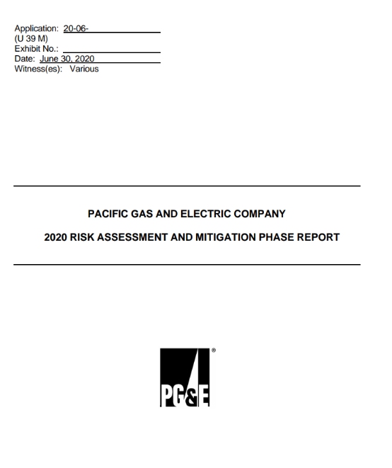
RTAG Engagement's Long Chain of Impact
CAVA is one element of a complex, multi-year planning process
RAMP, Risk
Company Plan
2027 GRC Filing
Risk Informed
CAVA
Community Engagement
Takes into consideration Climate, Affordability etc.
2023
2024
2025
2027-2030

Slide 27
1.2 Ways to reduce consultation fatigue and/or coordinate with other proceeding outreach processes?
Challenge | Strategy
Misalignment with existing regulatory/planning process | Transparency, significant internal socialization
Extremely long chain of impact for feedback | Transparency, compensation, significant internal socialization
Highly technical subject matter | Focus on lived experience and accessible language
Extremely diverse DVC communities | Reliance on local, trusted CBO leaders to design and execute culturally appropriate outreach
Mistrust of PG&E | Transparency, deliberate relationship building process
Community resilience extends beyond PG&E’s locus of control | Transparency, a commitment to honor input in the CAVA regardless
Lack of awareness of existing PG&E support programs | Comparing recommendations to existing programs and outreach strategies
Local vs. policy definitions of vulnerability | Working with community experts to consider local vulnerability (i.e. farmworkers)
More direct chain of impact = more meaningful, fulfilling engagement (something gets done)
Coordination of engagement: local governments responsible for community resilience; PG&E can and should be part of that conversation (e.g. San Jose Climate Action and Resilience Plan)
Across proceedings: ensuring meaningful engagement by connecting engagement to meaningful outcomes; utilizing expertise already shared by community
The Way Forward:
  Align with the needs and efforts of local government resilience outreach; communities with different levels of resources will need different kinds of engagement from energy utilities

Slide 28
1.3 Modifications to the definition of DVC adopted in 20-08-026
Challenge | Strategy
Misalignment with existing regulatory/planning process | Transparency, significant internal socialization
Extremely long chain of impact for feedback | Transparency, compensation, significant internal socialization
Highly technical subject matter | Focus on lived experience and accessible language
Extremely diverse DVC communities | Reliance on local, trusted CBO leaders to design and execute culturally appropriate outreach
Mistrust of PG&E | Transparency, deliberate relationship building process
Community resilience extends beyond PG&E’s locus of control | Transparency, a commitment to honor input in the CAVA regardless
Lack of awareness of existing PG&E support programs | Comparing recommendations to existing programs and outreach strategies
Local vs. policy definitions of vulnerability | Working with community experts to consider local vulnerability (i.e. farmworkers)
DVC designation “both too broad and too specific”
  Almost 50% of PG&E’s service area
  Many RTAGs expanded the DVC definition
Virtually all communities in California exposed to more than one climate hazard
If the desired outcome is to enhance local climate resilience, targeting based on the capacity of local government to build community resilience is one way forward.
The Way Forward:
  Allow communities to define their own strengths and vulnerabilities via local adaptation planning
  Support equity by scaffolding engagement to the appropriate level based on local government capacity/progress

Slide 29
1.4 Additional guidance regarding consultation and collaboration with local governments during risk and vulnerability assessment processes? During adaptation proposal identification process?
Challenge | Strategy
Misalignment with existing regulatory/planning process | Transparency, significant internal socialization
Extremely long chain of impact for feedback | Transparency, compensation, significant internal socialization
Highly technical subject matter | Focus on lived experience and accessible language
Extremely diverse DVC communities | Reliance on local, trusted CBO leaders to design and execute culturally appropriate outreach
Mistrust of PG&E | Transparency, deliberate relationship building process
Community resilience extends beyond PG&E’s locus of control | Transparency, a commitment to honor input in the CAVA regardless
Lack of awareness of existing PG&E support programs | Comparing recommendations to existing programs and outreach strategies
Local vs. policy definitions of vulnerability | Working with community experts to consider local vulnerability (i.e. farmworkers)
Local governments play a key role in implementing community resilience. Engagement should include communities and local governments together.
Engagement should target projects in communities to ensure more specific and actionable outcomes.
There is an opportunity cost of doing our own engagement rather than with local governments who are already working on resilience issues.
The Way Forward:
  Center community engagement around partnered resilience projects with local governments that are mutually beneficial.

Slide 30

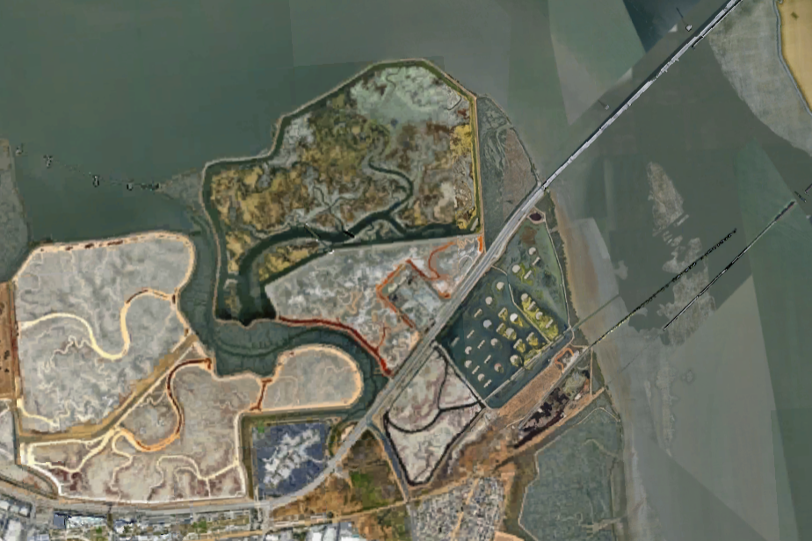
Local Government Engagement
We want to create more opportunities like our Ravenswood Project
PG&E’s Ravenswood Substation is located on the San Francisco Bay in Menlo Park.
The substation and coastal habitats around it are vulnerable to tidal inundation.
In 2020, PG&E partnered with the city of Menlo Park, Meta, and an NGO to apply for a FEMA BRIC grant to install flood protection
Outcome = partnership combined capabilities of all parties made FEMA grant proposal more competitive
Substation

Slide 31
1.5 Refinement of Tribal consultation processes specific to climate adaptation measures?
Challenge | Strategy
Misalignment with existing regulatory/planning process | Transparency, significant internal socialization
Extremely long chain of impact for feedback | Transparency, compensation, significant internal socialization
Highly technical subject matter | Focus on lived experience and accessible language
Extremely diverse DVC communities | Reliance on local, trusted CBO leaders to design and execute culturally appropriate outreach
Mistrust of PG&E | Transparency, deliberate relationship building process
Community resilience extends beyond PG&E’s locus of control | Transparency, a commitment to honor input in the CAVA regardless
Lack of awareness of existing PG&E support programs | Comparing recommendations to existing programs and outreach strategies
Local vs. policy definitions of vulnerability | Working with community experts to consider local vulnerability (i.e. farmworkers)
Engagement with tribal governments needs to be separate from non-tribal communities and be targeted specifically to their government structure and needs.
Relationships with tribal governments need to be in parity with local governments and should not mimic CBO engagement.
The Way Forward:
  Engage with tribal governments on potential shared resilience projects, similar to how PG&E intends to engage other governmental jurisdictions.

Slide 32
1.6 Additional guidance regarding methods and scope for the determination of community adaptive capacity in CAVA analyses?
Challenge | Strategy
Misalignment with existing regulatory/planning process | Transparency, significant internal socialization
Extremely long chain of impact for feedback | Transparency, compensation, significant internal socialization
Highly technical subject matter | Focus on lived experience and accessible language
Extremely diverse DVC communities | Reliance on local, trusted CBO leaders to design and execute culturally appropriate outreach
Mistrust of PG&E | Transparency, deliberate relationship building process
Community resilience extends beyond PG&E’s locus of control | Transparency, a commitment to honor input in the CAVA regardless
Lack of awareness of existing PG&E support programs | Comparing recommendations to existing programs and outreach strategies
Local vs. policy definitions of vulnerability | Working with community experts to consider local vulnerability (i.e. farmworkers)
It is more actionable to determine readiness of communities to partner on shared resilience projects rather than determining adaptive capacity.
The Way Forward:
  Determine readiness of different communities to inform targeted engagement.
  Engagement should meet communities where they are and be based on their level of readiness.

Slide 33
Local Government Engagement
Quantitative Adaptive Readiness Assessment
In addition to looking at risk and vulnerability, we need to understand who is ready to work with us on adaptation initiatives.
Quantitative framework to calculate a “readiness” score for communities.
  Readiness = the capacity a society has to mobilize adaptation investments from private sectors and to target investments more effectively.
Communities categorized as small, mid-size, or large based on population.
Economic | Social | Governance
City Debt (Bond worthiness database) | Civic Engagement (Voter turnout database) | Public Corruption Convictions (U.S. Attorney Office Database)
Tax Incentives for Renewables (State database on incentives) | Innovation (Patent count per resident) | Population with Higher Education (Census)
Median Income (Census) | High School Dropout Rate (Census) | Climate Opinion (Yale’s Climate Communication Data)
Unemployment Rate (Census) |  | Adaptation Level (Resilient California Data)

Slide 34
Local Government Engagement
Assessment shows geographic disparities in readiness
Low Readiness
Engagement Focus: providing substantial support to elevate their capacity for climate resilience.
Activities: Capacity-building, technical assessments, resource allocation
Outcome: Enable these communities to progress to a medium level of readiness, where they can begin to plan for and implement climate adaptation projects more independently.
High Readiness
Engagement Focus: will resemble a partnership. These communities are well-prepared and capable of mobilizing resources for climate adaptation.
Activities: Information Sharing, Collaborative Projects, Joint Funding Applications
Outcome: A strong, cooperative relationship that enhances the climate resilience of both PG&E and the community.
Medium Readiness
Engagement Focus: laying the groundwork for future. For communities that are approaching readiness but need additional preparation, collaboration.
Activities: Capacity-building, Initial Project Assessments
Outcome: Establishing a foundation for future, more in-depth collaboration once these communities reach a higher level of readiness.
High Readiness
Engagement Focus: will resemble a partnership. These cities are well-prepared and capable of mobilizing resources for climate adaptation.
Activities: Information Sharing, Collaborative Projects, Joint Funding Applications
Outcome: A strong, cooperative relationship that enhances the climate resilience of both PG&E and the city.

Slide 35
2 What are the impacts on environmental and social justice communities of action taken in this proceeding, including extent to which requirements impact achievement of any of the nine goals of the Commission's Environmental and Social Justice Action Plan?
Challenge | Strategy
Misalignment with existing regulatory/planning process | Transparency, significant internal socialization
Extremely long chain of impact for feedback | Transparency, compensation, significant internal socialization
Highly technical subject matter | Focus on lived experience and accessible language
Extremely diverse DVC communities | Reliance on local, trusted CBO leaders to design and execute culturally appropriate outreach
Mistrust of PG&E | Transparency, deliberate relationship building process
Community resilience extends beyond PG&E’s locus of control | Transparency, a commitment to honor input in the CAVA regardless
Lack of awareness of existing PG&E support programs | Comparing recommendations to existing programs and outreach strategies
Local vs. policy definitions of vulnerability | Working with community experts to consider local vulnerability (i.e. farmworkers)
Although RTAG member capacity increased and PG&E was able to build new relationships, the material impacts to environmental and social justice communities from the CVA have been minimal.
Although our ESJ capabilities have expanded externally in recent years, it was not the result of this proceeding.
The Way Forward:
  Focus engagement on specific partnered resilience projects where community members can have a real impact in the near term.
Details on how PG&E advances the nine goals of the Commission's Environmental and Social Justice Action Plan can be found in our CAVA (Appendix D, pg. 6-7)

Slide 36
Funding
Challenge | Strategy
Misalignment with existing regulatory/planning process | Transparency, significant internal socialization
Extremely long chain of impact for feedback | Transparency, compensation, significant internal socialization
Highly technical subject matter | Focus on lived experience and accessible language
Extremely diverse DVC communities | Reliance on local, trusted CBO leaders to design and execute culturally appropriate outreach
Mistrust of PG&E | Transparency, deliberate relationship building process
Community resilience extends beyond PG&E’s locus of control | Transparency, a commitment to honor input in the CAVA regardless
Lack of awareness of existing PG&E support programs | Comparing recommendations to existing programs and outreach strategies
Local vs. policy definitions of vulnerability | Working with community experts to consider local vulnerability (i.e. farmworkers)
Affordability is an overriding consideration and dedicated funding expectations are needed for engagement and coordination beyond CAVAMA.
We would like to continue to engage our RTAGs but have not been authorized to do so yet.
The Way Forward:
  Explicit expectations within CAVA compliance requirements that support ongoing engagement and linkages with local government resilience efforts.
  CAVAMA still a viable method of tracking and recovering costs, but explicit authorizations needed to protect against inability to recover.

Slide 37
Summary of Lessons Learned
The long-term, asset-focused nature of the CAVAs does not align well with community desires for immediate support and services regarding energy-related resilience.
Efforts should be made to limit the burden of community engagement requirements across proceedings on both utilities and community partners.
"All DVCs" is both too broad, and also too narrow. Other methods of defining and targeting which communities require the most support regarding climate adaptation should be investigated.
Local governments play a key role in implementing community resilience. Engagement should include communities and local governments together.
Engagement should target projects in communities to ensure more specific and actionable outcomes.
Tribal engagement should be done separately than other engagement recognizing the unique nature of tribal governments.
It is most actionable to determine readiness of communities to partner on shared resilience projects rather than determining adaptive capacity.
Affordability is an overriding consideration and dedicated funding expectations are needed for engagement/coordination beyond CAVAMA. We would like to continue to engage our RTAGs but have not been authorized to do so at this time.

Slide 38
Climate Vulnerability Metrics Overview

Slide 39
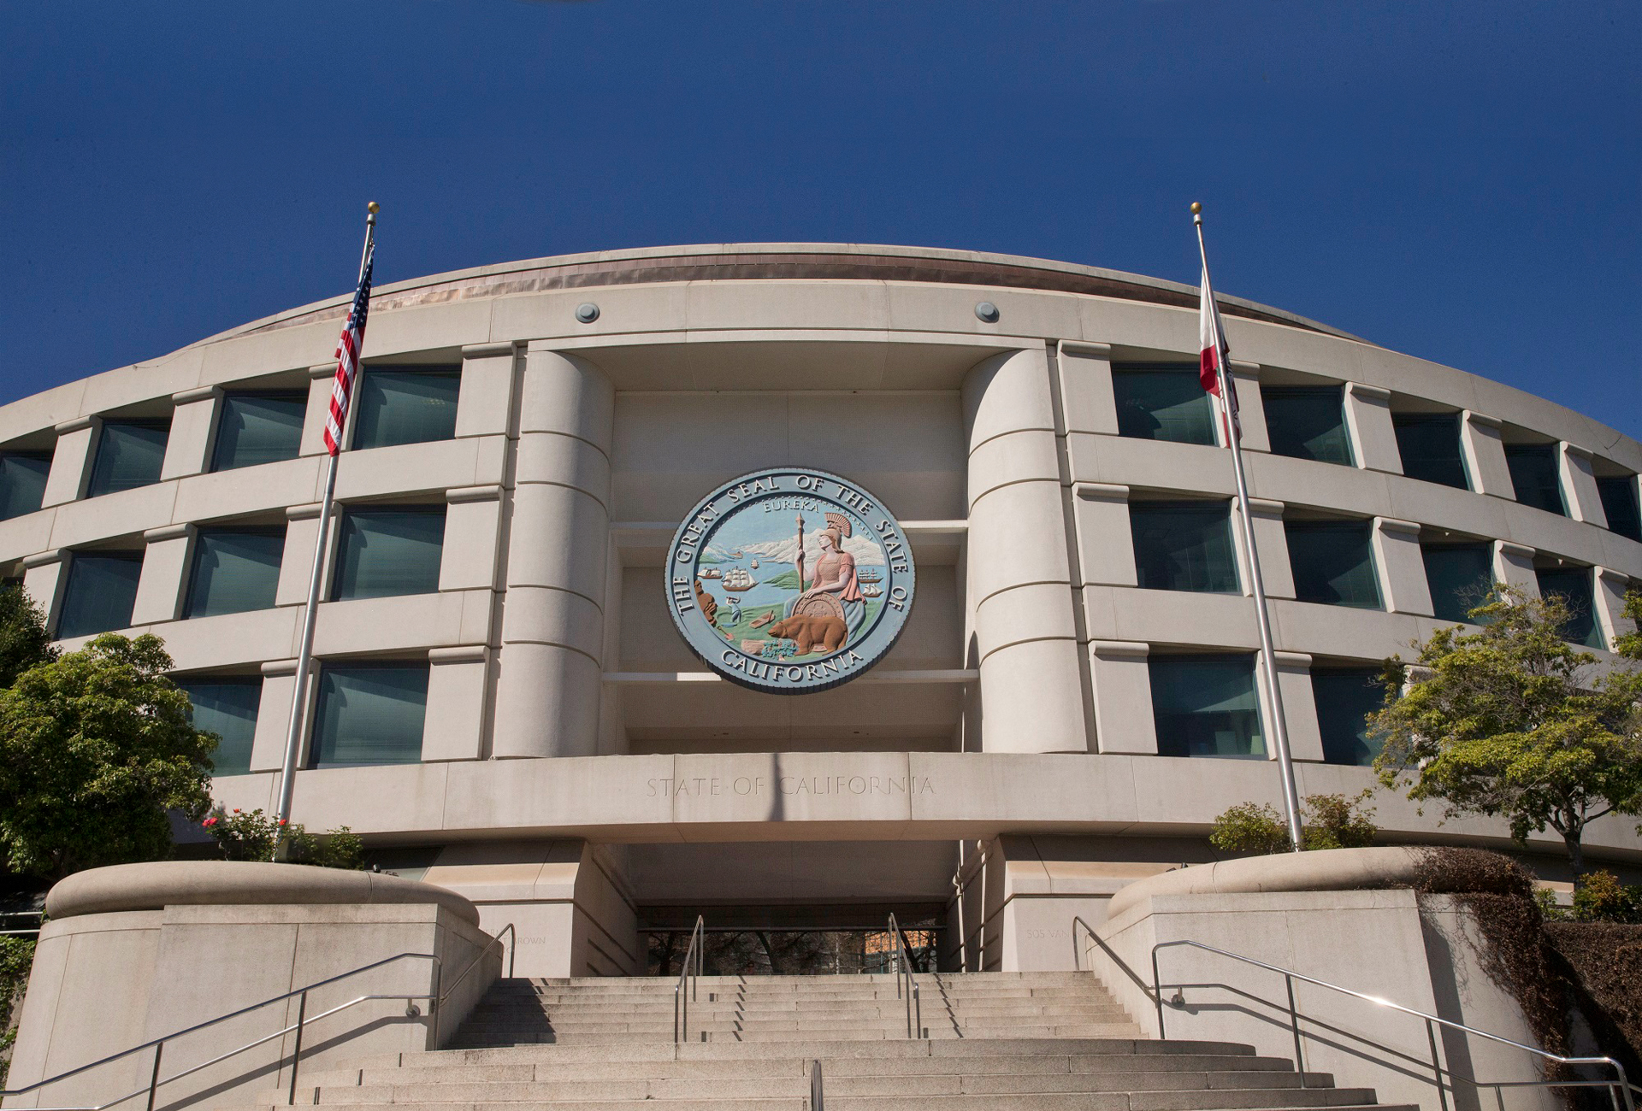
Community Engagement & Equity Workshop
Climate Adaptation Equity Metrics
Meghan Cook – CPUC Climate Adaptation Analyst
September 19, 2024

Slide 40
Assessing Impacts of CAVAs on ESJ Communities
Purpose: Identify Methodologies and Metrics that can quantify impacts and benefits of CAVA planning on ESJ Communities
November 20 Workshop: Deep-dive on Quantitative Methodologies
Today:
  Overview of equity metrics to inform:
    Roundtable Discussion
    Nov 20 Workshop
  Discussion of equity metrics for climate adaptation and why they matter
Notes:
Obtain community input on use of equity metrics in CAVA process in ESJ Round Table Discussion
Input will inform subsequent technical workshop on November 20th

Slide 41
Qualities of Equity Metrics in Climate Adaptation
Method for quantitatively measuring a community’s climate vulnerability or adaptive capacity to climate impacts
  Climate Vulnerability: How likely/ how intensely a community may be affected by climate impacts such as fire, flooding, heat, etc.
  Adaptive Capacity: A community’s ability to adapt to climate impacts either by preventing impacts or recovering from them
Often a combination of different metrics and methods
Different metrics are useful for different purposes
CAVAs consider vulnerability of both communities and the energy infrastructure they rely on

Slide 42
Equity Metrics & the CAVA Process
CAVAs are informational reports intended to inform long-term planning decisions via an IOU’s General Rate Case or other Application
  Can inform what projects / investments / programs are considered and how they are prioritized
The existing process for incorporating equity into the CAVA process is qualitative
  Community Engagement Plans
  Public comment opportunities on CAVAs
Equity metrics can be incorporated into the analysis to provide a quantitative equity lens for climate adaptation in IOU planning
Notes:
Emphasize CAVAs are informational and do NOT include investment or funding decisions. That happens outside this proceeding.

Slide 43
Equity Metrics May Include
Household or census tract median income
Proximity to resources
Access to transportation
Pollution burden
Race or ethnicity
Age
Gender
Physical ability/ health
Language barriers
Risk of a given climate event (flood, fire, heat, etc.)

Slide 44
Potential Outcomes of Using Equity Metrics
Quantitative approach to incorporating equity into decision-making
  Complementary to qualitative methods like community engagement
Approximate approach to measure vulnerability / adaptive capacity
  Results may vary depending on what metrics are used or how they are weighted
Notes:
Explain how using these tools can benefit planning, but especially how it can benefit them as communities. Also explain drawbacks or limitations.

Slide 45
Anticipated Technical Workshop Tools & Methodologies
Tool / Methodology | Description | Developer
ReNCAT (Resilient Node Cluster Analysis Tool) | Application that maps community climate risk of and resiliency during outage events to inform where infrastructure or other adaptation measures are most needed. See: SCE/Sandia workshop of CAVA/ReNCAT pilot held November 2023. | Sandia National Lab
Research, Database on Current State of U.S. Energy Equity Regulation and Legislation | Examines state energy equity actions from January 2020 to July 2022. Developed database of results. | Lawrence Berkeley National Lab (LBNL) & Pacific Northwest National Lab (PNNL)
Notes:
Briefly describe ReNCAT, and other examples

Slide 46
Anticipated Technical Workshop Tools & Methodologies
Tool / Methodology | Description | Developer
Climate READi Texas Case Study | A tool to manage climate risk in the power system. Texas Case study incorporates potential equity metrics into the Climate READi tool. | Electric Power Research Institute (EPRI)
Vulnerable Communities Platform | Aggregate of many layers of California community climate vulnerability spatial data. | California Governor’s Office of Planning and Research (OPR)

Slide 47
Questions?

Slide 48
ESJ Round Table

Slide 49
CAVA Process
YR 1
YR 2
Climate Adaptation Vulnerability Assessment
YR 3
Risk Assessment Mitigation Phase &
Community Engagement Plan
YR 4
General
Case
Post-CAVA
Engagement
Survey
Rate

Slide 50
Definition: Disadvantaged and Vulnerable Community (DVC)
Defined within the Climate Adaptation Proceeding as communities that consist of:
  25% highest scoring census tracts in CalEnviroScreen
  Census tracts with highest 5% pollution burden in CalEnviroScreen
  Census tracts with median household income at less than 60% of state median income
  All California Tribal lands

Slide 51
Equity Metrics
Climate Vulnerability: How likely/ how intensely a community may be affected by climate impacts such as fire, flooding, heat, etc.
Adaptive Capacity: A community’s ability to adapt to climate impacts either by preventing impacts or recovering from them

Slide 52
Next Steps

Slide 53
Next Steps
October 11: September 19 workshop comments due
  Submit via email: Meghan.cook@cpuc.ca.gov
October 25: Southern California Workshop – [Irvine, Quail Community Center]
November 20: Technical Workshop on Equity Metrics – CPUC Headquarters, San Francisco
Early 2025: Staff Proposal - anticipated to be issued for Comment
Mid 2025: Proposed Decision - anticipated

Slide 54
How to Participate
Staff will use the mailing list you received this Notice for upcoming follow-up;
  If we don’t have your email, sign-up at the check-in table
The full docket card for each proceeding can be accessed through the CPUC docket card search tool.
  Enter the proceeding number (R1804019) without any periods or dashes to search.
  Final decisions can also be located on the CPUC website using this decision search tool.
The CPUC’s Public Advisor's Office provides procedural information and advice to individuals and groups who want to formally participate in proceedings.
Notes:
We are seeking to obtain input, facilitate discussion on Task 2 scoping items for the Climate Adaptation Proceeding.
Today’s workshop and your input will be incorporated into the record for this proceeding

Slide 55
Closing Remarks

Slide 56
For more information:
Visit: www.cpuc.ca.gov/industries-and-topics/electrical-energy/climate-change
Email: Meghan Cook at meghan.cook@cpuc.ca.gov

Slide 57


Slide 58
Appendix

Slide 59
Glossary of Terms
Investor-Owned Utility (IOU) – Utilities regulated by the CPUC. In this context, we are referring to the large electric IOUs:
  Southern California Edison (SCE), Pacific Gas & Electric (PG&E), San Diego Gas & Electric (SDG&E), and Southern California Gas (SCG)
General Rate Case (GRC) – Proceedings used to address the costs of operating and maintaining the utility system and the allocation of those costs among customer classes. An IOU submits a proposal which the CPUC reviews, and then makes a decision on for the IOU’s budget for the next four years.

Slide 60
Glossary of Terms
Climate Adaptation Vulnerability Assessment (CAVA) – An analysis of the climate vulnerabilities of all an IOU’s assets and operations and potential options to mitigate those vulnerabilities.
  Large document (~1000 pages) completed by each IOU and submitted to the CPUC every four years.
  This informational document is intended to inform long-term climate adaptation investment decisions within an IOU’s GRC.

Slide 61
Glossary of Terms
Disadvantaged and Vulnerable Community (DVC) – Defined within the Climate Adaptation Proceeding as communities that consist of:
  25% highest scoring census tracts in CalEnviroScreen
  Census tracts with highest 5% pollution burden in CalEnviroScreen
  Census tracts with median household income at less than 60% of state median income
  All California Tribal lands

Slide 62
Glossary of Terms
Community Engagement Plan (CEP) –This shorter more qualitative document (~50-80 pages) outlines an IOU’s plans to engage communities, particularly DVC communities, prior, during, and after their CAVA analysis.
  Submitted by each IOU one year prior to submitting their CAVA.

Slide 63
Proceeding History – Phase 1
November 2019, Decision (D.) 19-10-054
  Defines climate adaptation for electric IOUs
  Ordered large IOUs to use specific climate scenarios and projections from California Statewide Climate Assessment when analyzing climate risk for investments and operations
September 2020, D. 20-08-046
  Defines DVC for purposes of the proceeding
    Requires IOUs to prepare and submit CAVA every 4 years
    Requires IOUs to prepare and file a CEP for DVCs one year before submitting their CAVA
      And to conduct and file surveys of the effectiveness of their CEP one year after filing their CAVA

Slide 64
Proceeding History – Phase 2
August 2024, D. 24-08-005
  Updates climate science & analysis requirements for CAVAs to align with best available science
    Adopts new baseline climate scenario and degree-based approach to climate modeling
    Orders IOUs to update requirements as Climate Assessments update best practices
  Establishes these requirements as best practice for climate modeling across proceedings
  Requires IOUs to publicly present CAVAs prior to submitting to the CPUC
  Adopts guidance for adaptation investment requests Included in GRC or free-standing applications
Notes:
Best available science as established by the CA Climate Assessments and International Panel on Climate Change (IPCC)
Encourages IOUs to work with CPUC staff and stakeholders on a standard CAVA format for readability
Establishes lexicon working group to develop list of and consensus on definitions for key terms in this proceeding

Slide 65
CAVA & CEP Submission Timeline
 | 2021 | 2022 | 2023 | 2024 | 2025 | 2026 | 2027 | 2028 | 2029 | 2030 | 2031
SCE | CEP | CAVA & RAMP | Survey & GRC |  | CEP | CAVA & RAMP | Survey & GRC | CEP | CAVA | RAMP & Survey | GRC
PG&E |  |  | CEP | CAVA & RAMP | Survey & GRC | CEP* | CAVA* | RAMP & Survey | GRC
SDG&E |  |  |  | CEP | CAVA & RAMP | Survey & GRC | CEP | CAVA | RAMP & Survey | GRC
SCG |  |  |  | CEP | CAVA & RAMP | Survey & GRC | CEP | CAVA | RAMP & Survey | GRC
*Note that CAVAs and CEPs move up one year starting in 2026 with PG&E as per D.24-08-005

