Slide 1

CPUC Public Agenda 3320
Thursday, August 29, 2013, 1:00 p.m.
San Francisco, CA
Commissioners:
Michael R. Peevey
Michel Peter Florio
Catherine J.K. Sandoval
Mark J. Ferron
Carla J. Peterman
www.cpuc.ca.gov

Slide 2
Safety and Emergency Information
The restrooms are located at the far end of the lobby outside of the security screening area.
In the event of an emergency, please calmly proceed out of the exits. There are four exits total. Two exits are in the rear and two exits are on either side of the public speakers area.
In the event of an emergency and the building needs to be evacuated, if you use the back exit, please head out through the courtyard and down the front stairs across McAllister.
If you use the side exits you will end up on Golden Gate Ave. Please proceed around the front of the building to Van Ness Ave and continue on down to the assembly point.
Our assembly point is between the War Memorial Building and the Opera Building (House) which is on Van Ness Ave, located between McAllister and Grove.

Slide 3
Public Comment
Per Resolution ALJ-252, any member of the public who wishes to address the CPUC about matters before the Commission must sign up with the Public Advisor’s Office table before the meeting begins. If an individual has signed up using the electronic system on the Commission’s website, they must check in with the Public Advisor’s Office on the day of the meeting, by the sign-up deadline.
Once called, each speaker has up to 3 minutes at the discretion of the Commission President, depending on the number of speakers the time limit may be reduced to 1 minute.
A sign will be posted when 1 minute remains.
A bell will ring when time has expired.
At the end of the Public Comment Section, the Commission President will ask if there are any additional individuals who wish to speak. Individuals who wish to speak but did not sign up by the deadline, will be granted a maximum of one minute to make their comments.
The following items are NOT subject to Public Comment:
  All items on the Closed Session Agenda

Slide 4
Public Comment
Per Resolution ALJ-252, any member of the public who wishes to address the CPUC about matters before the Commission must sign up with the Public Advisor’s Office table before the meeting begins. If an individual has signed up using the electronic system on the Commission’s website, they must check in with the Public Advisor’s Office on the day of the meeting, by the sign-up deadline.
Once called, each speaker has up to 2 minutes to address the Commission.
A sign will be posted when 1 minute remains.
A bell will ring when time has expired.
At the end of the Public Comment Section, the Commission President will ask if there are any additional individuals who wish to speak. Individuals who wish to speak but did not sign up by the deadline, will be granted a maximum of one minute to make their comments.
The following items are NOT subject to Public Comment:
  All items on the Closed Session Agenda

Slide 5
Public Comment
Per Resolution ALJ-252, any member of the public who wishes to address the CPUC about matters before the Commission must sign up with the Public Advisor’s Office table before the meeting begins. If an individual has signed up using the electronic system on the Commission’s website, they must check in with the Public Advisor’s Office on the day of the meeting, by the sign-up deadline.
Once called, each speaker has up to 1 minute to address the Commission.
A bell will ring when time has expired.
At the end of the Public Comment Section, the Commission President will ask if there are any additional individuals who wish to speak. Individuals who wish to speak but did not sign up by the deadline, will be granted a maximum of one minute to make their comments.
The following items are NOT subject to Public Comment:
  All items on the Closed Session Agenda

Slide 6
Agenda Changes
Items shown on the Consent Agenda will be taken up and voted on as a group in one of the first items of business of each CPUC meeting.
Item on Today’s Consent Agenda is: 1.
Any Commissioner, with consent of the other Commissioners, may request an item from the Regular Agenda be moved to the Consent Agenda prior to the meeting.
Item: None from the Regular Agenda have been added to the Consent Agenda.
Any Commissioner may request an item be removed from the Consent Agenda for discussion on the Regular Agenda prior to the meeting.
Item: None have been moved to the Regular Agenda.
Item: None have been withdrawn.
The following items have been held to future Commission Meetings: None.

Slide 7
Regular Agenda
Each item on the Regular Agenda (and its alternate if any) will be introduced by the assigned Commissioner or CPUC staff and discussed before it is moved for a vote.
For each agenda item, a summary of the proposed action is included on the agenda; the CPUC’s decision may, however, differ from that proposed.
The complete text of every Proposed Decision or Draft Resolution is available for download on the CPUC’s website: www.cpuc.ca.gov.
Late changes to agenda items are available on the Escutia Table.

Slide 8
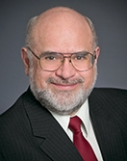
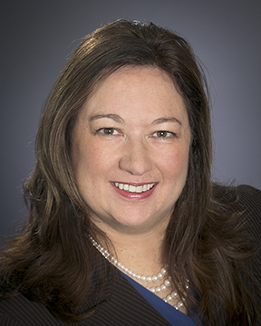
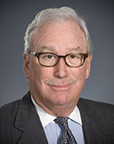
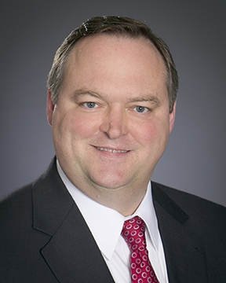
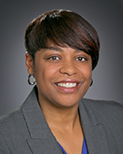
Commissioners’ Reports

Slide 9

Management Reports

Slide 10
Regular Agenda – Management Reports and Resolutions
Item #2 [12251]
Report and Discussion by Safety and Enforcement Division on Recent Safety Program Activities
------------------------------------------------------------------------

Slide 11

The CPUC Thanks You
For Attending Today’s Meeting
The Public Meeting is adjourned.
The next Public Meeting will be:
September 5, 2013, at 9:30 a.m.
in San Francisco, CA

