Slide 1

CPUC Public Agenda 3321
Thursday, September 5, 2013, 9:30 a.m.
San Francisco, CA
Commissioners:
Michael R. Peevey
Michel Peter Florio
Catherine J.K. Sandoval
Mark J. Ferron
Carla J. Peterman
www.cpuc.ca.gov

Slide 2
Safety and Emergency Information
The restrooms are located at the far end of the lobby outside of the security screening area.
In the event of an emergency, please calmly proceed out of the exits. There are four exits total. Two exits are in the rear and two exits are on either side of the public speakers area.
In the event of an emergency and the building needs to be evacuated, if you use the back exit, please head out through the courtyard and down the front stairs across McAllister.
If you use the side exits you will end up on Golden Gate Ave. Please proceed around the front of the building to Van Ness Ave and continue on down to the assembly point.
Our assembly point is between the War Memorial Building and the Opera Building (House) which is on Van Ness Ave, located between McAllister and Grove.

Slide 3
Public Comment
Per Resolution ALJ-252, any member of the public who wishes to address the CPUC about matters before the Commission must sign up with the Public Advisor’s Office table before the meeting begins. If an individual has signed up using the electronic system on the Commission’s website, they must check in with the Public Advisor’s Office on the day of the meeting, by the sign-up deadline.
Once called, each speaker has up to 3 minutes at the discretion of the Commission President, depending on the number of speakers the time limit may be reduced to 1 minute.
A sign will be posted when 1 minute remains.
A bell will ring when time has expired.
At the end of the Public Comment Section, the Commission President will ask if there are any additional individuals who wish to speak. Individuals who wish to speak but did not sign up by the deadline, will be granted a maximum of one minute to make their comments.
The following items are NOT subject to Public Comment:
  Item: 6, 26, 30, 39 & 41
  All items on the Closed Session Agenda

Slide 4
Public Comment
Per Resolution ALJ-252, any member of the public who wishes to address the CPUC about matters before the Commission must sign up with the Public Advisor’s Office table before the meeting begins. If an individual has signed up using the electronic system on the Commission’s website, they must check in with the Public Advisor’s Office on the day of the meeting, by the sign-up deadline.
Once called, each speaker has up to 2 minutes to address the Commission.
A sign will be posted when 1 minute remains.
A bell will ring when time has expired.
At the end of the Public Comment Section, the Commission President will ask if there are any additional individuals who wish to speak. Individuals who wish to speak but did not sign up by the deadline, will be granted a maximum of one minute to make their comments.
The following items are NOT subject to Public Comment:
  Item: 6, 26, 30, 39 & 41
  All items on the Closed Session Agenda

Slide 5
Public Comment
Per Resolution ALJ-252, any member of the public who wishes to address the CPUC about matters before the Commission must sign up with the Public Advisor’s Office table before the meeting begins. If an individual has signed up using the electronic system on the Commission’s website, they must check in with the Public Advisor’s Office on the day of the meeting, by the sign-up deadline.
Once called, each speaker has up to 1 minute to address the Commission.
A bell will ring when time has expired.
At the end of the Public Comment Section, the Commission President will ask if there are any additional individuals who wish to speak. Individuals who wish to speak but did not sign up by the deadline, will be granted a maximum of one minute to make their comments.
The following items are NOT subject to Public Comment:
  Item: 6, 26, 30, 39 & 41
  All items on the Closed Session Agenda

Slide 6
Agenda Changes
Items shown on the Consent Agenda will be taken up and voted on as a group in one of the first items of business of each CPUC meeting.
Items on Today’s Consent Agenda are: 1, 6, 7, 8, 9, 10, 11, 15, 16, 17, 18, 19, 20, 22, 23, 24, 26, 28, 29, 30, 31, 32, 33, 34, 35, 36, 37, 38, 39, 40, 41, 42, 43, 44, 45 & 46
Any Commissioner, with consent of the other Commissioners, may request an item from the Regular Agenda be moved to the Consent Agenda prior to the meeting.
Items: 49 from the Regular Agenda has been added to the Consent Agenda.
Any Commissioner may request an item be removed from the Consent Agenda for discussion on the Regular Agenda prior to the meeting.
Item: None have been moved to the Regular Agenda.
Item: None have been withdrawn.
The following items have been held to future Commission Meetings:
Held to 9/19/13: 4, 5, 12, 13, 14, 21, 25, 27 & 47
Held to 10/3/13: 3
Held to 10/17/13: 2

Slide 7
Regular Agenda
Each item on the Regular Agenda (and its alternate if any) will be introduced by the assigned Commissioner or CPUC staff and discussed before it is moved for a vote.
For each agenda item, a summary of the proposed action is included on the agenda; the CPUC’s decision may, however, differ from that proposed.
The complete text of every Proposed Decision or Draft Resolution is available for download on the CPUC’s website: www.cpuc.ca.gov.
Late changes to agenda items are available on the Escutia Table.

Slide 8
Regular Agenda – Energy Orders
Item #48 [12281] Efficiency Savings and Performance Incentive Mechanism
R12-01-005 Order Instituting Rulemaking to Reform the Commission’s Energy Efficiency Risk/Reward Incentive Mechanism.
Ratesetting Comr. Ferron/ Judge Pulsifer
---------------------------------------------------------------------------------------------------------------
PROPOSED OUTCOME:
Adopts a reformed incentive program to promote greater achievement of energy efficiency (EE) goals through programs.
This Efficiency Savings and Performance Incentive mechanism shall apply to EE program activity covering the 2013-2014 program cycle for the investor-owned energy utilities, Pacific Gas and Electric Company, Southern California Edison Company, San Diego Gas & Electric Company, and Southern California Gas Company.
Closes the proceeding.
SAFETY CONSIDERATIONS:
By offering incentives for EE, reduced energy consumption will reduce safety risks as a function of energy use.
ESTIMATED COST:
The potential for incentive earnings available over the 2013-2014 cycle will be capped at
maximum earnings potential of $159 million.

Slide 9
Regular Agenda – Transportation/Rail Safety Orders
Item #50 [12291] Rules and Regulations to Regulate New Online Enabled Transportation Services
R12-12-011 Order Instituting Rulemaking on Regulations Relating to Passenger Carriers, Ridesharing, and New Online-Enabled Transportation Services.
Quasi-Legislative Comr. Peevey/ Judge Mason
---------------------------------------------------------------------------------------------------------------
PROPOSED OUTCOME:
Finds that Transportation Network Companies (TNC) are charter-party carriers subject to the Commission’s Jurisdiction.
For example, Lyft, SideCar, and UberX are found to be TNCs.
Commission’s existing Transportation Charter Party rules still apply to all limousines.
SAFETY CONSIDERATIONS:
Compliance with the Commission’s rules and regulations should ensure public safety.
ESTIMATED COST:
None.

Slide 10
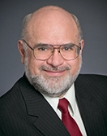
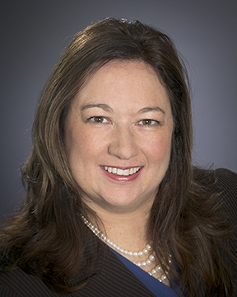
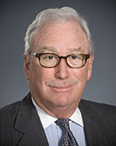
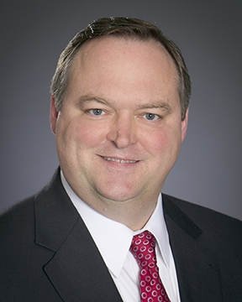
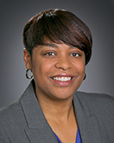
Commissioners’ Reports

Slide 11

Management Reports

Slide 12
Regular Agenda – Management Reports and Resolutions
Item #51 [12268]
Report and Discussion by Safety and Enforcement Division on Recent Safety Program Activities
------------------------------------------------------------------------

Slide 13

Rail Safety Staff Activities:
Federal Rulemaking Follow-up to the
Lac-Mégantic Crude-Oil Train Tragedy
Paul W. King, PhD
Deputy Director, Office of Rail Safety
Safety and Enforcement Division
September 5, 2013

Slide 14
Presentation Overview
Review of Hazardous Materials Rail Accidents.
Crude Oil and Ethanol Rail Shipments.
Federal Railroad Administration (FRA) Emergency Order 28.
FRA Railroad Safety Advisory Committee (RSAC) Emergency Meeting.
Tasks Accepted by RSAC.

Slide 15
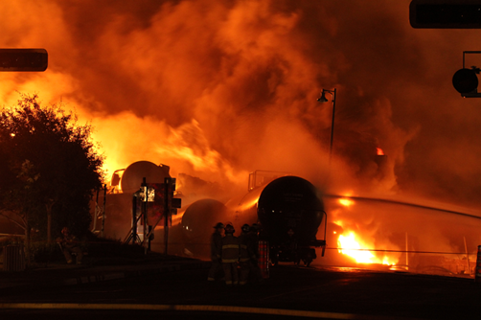
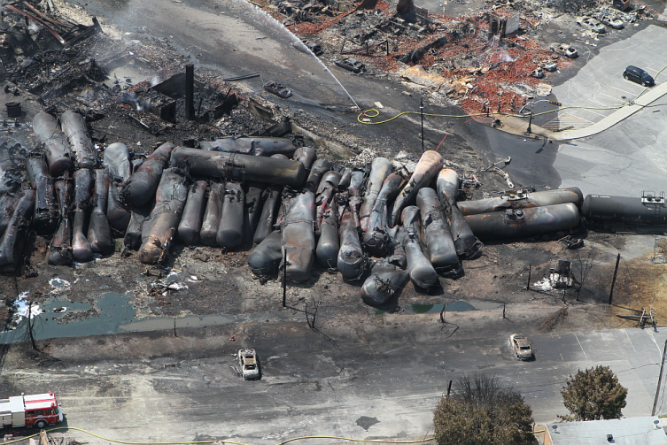
Review of Hazardous Material Rail Accidents
Lac-Megantic, Canada
Unattended 72-car crude-oil train.
Rolled uncontrolled into downtown, July 6, 2013.
63 tank cars derailed
1.5 million gallons light crude spilled and ignited.
47 fatalities from the explosion and fire.
Dozens of buildings destroyed.

Slide 16
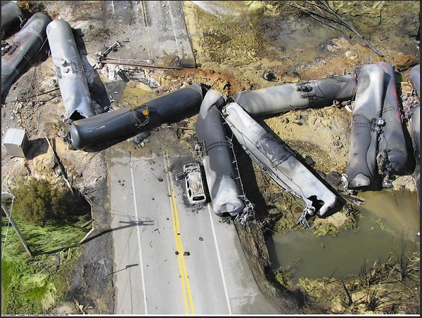
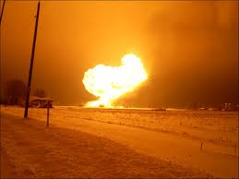
Hazardous Material Rail Accidents (cont.)
Ethanol shipment rail accidents:
June 2009, Cherry Valley, IL, 19 loaded ethanol tank cars derailed.
  Thirteen ethanol cars caught fire, some exploded.
  One fatality, nine reported injuries.
  600 residences, 1⁄2- mile radius, evacuated.
  Cause: track structure washout.
February 2011, Arcadia, OH, 33 loaded ethanol tank cars derailed.
  Explosions, major fire, one-mile radius evacuation.
  Cause: Broken rail.

Slide 17
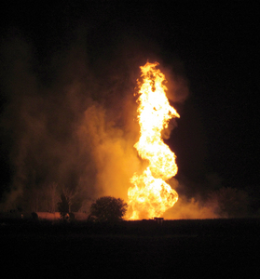
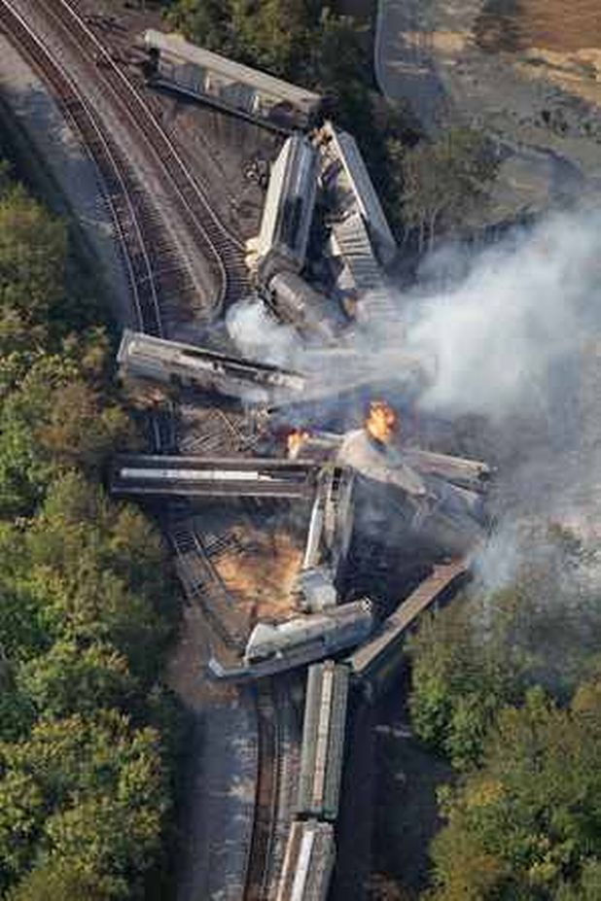
Hazardous Material Rail Accidents (cont.)
October 2011, Tiskilwa, IL, 10 loaded ethanol tank cars derailed.
  Explosions, fire, town evacuated.
  Cause: broken rail.
July 2012, Columbus, OH, 13 loaded ethanol cars derailed.
  Explosions, fire, one-mile radius evacuation.

Slide 18
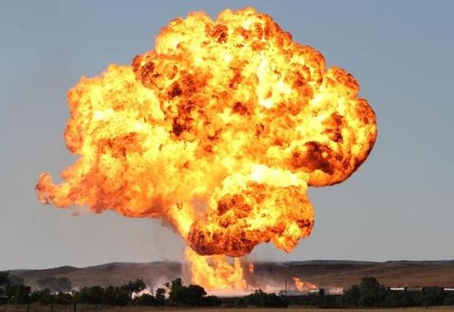
Hazardous Material Rail Accidents (cont.)
August 2012, near Plevna, MT, 17 loaded ethanol tank cars derailed.
  Explosions, fire, evacuation of the immediate area.
  Cause: Track alignment (buckled or sunkink).

Slide 19
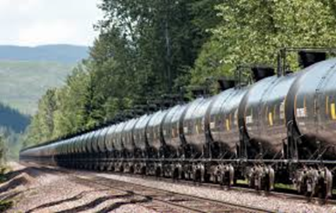
Crude Oil and Ethanol Rail Shipments
400,000 barrels out of the North Dakota Bakken oil fields each day.
71% by train, up from 25% in January 2012.
20% by pipeline, down from 61% in 2011.

Slide 20
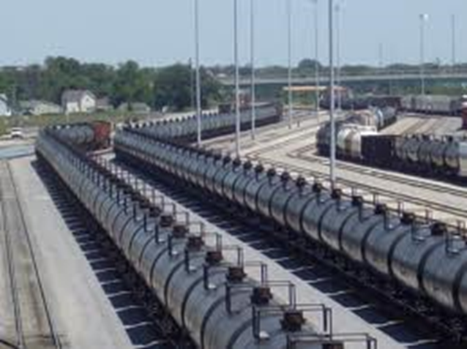
Crude Oil and Ethanol Rail Shipments
Rail shipping is very competitive with pipelines:
No need for long-term contracts.
No need to wait for pipelines to be built.
Pipes connect point A to point B, refiners can access nearly any market in the U.S. by rail.
Pipeline companies have started rail projects, including terminal to be built in Bakersfield.

Slide 21
Crude Oil and Ethanol Rail Shipments
Source: Federal Railroad Administration, https://rsac.fra.dot.gov/meetings/20130829.php

Slide 22
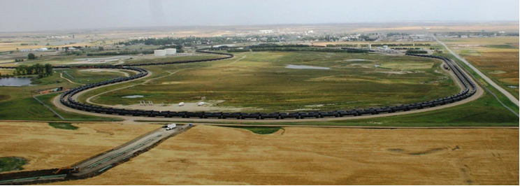
North Dakota Oil-train Loading Facility
Source: Federal Railroad Administration, https://rsac.fra.dot.gov/meetings/20130829.php

Slide 23
Federal Railroad Administration (FRA) Emergency Order 28
Issued August 7, effective September 1
Emergency Order (EO) 28 applies to any train with:
(1) Five or more tank car loads of poisonous by inhalation materials, including anhydrous ammonia and ammonia solutions; or
(2) Twenty rail car loads of any one or any combination of materials including:
  Poisonous by inhalation materials, including anhydrous ammonia and ammonia solutions.
  Flammable gas.
  Class 3 flammable liquid.
  Combustible liquid.
  Class 1.1 or 1.2 explosive.
Source: FRA Emergency Order, Appendix A

Slide 24
Emergency Order 28 (cont.)
No trains left unattended on mainline track or mainline siding outside of a yard or terminal, until:
  Railroad develops, adopts, complies with a plan identifying specific locations and circumstances.
  Plan must provide safety justification for allowing unattended train.
  Plan must be provided to FRA.
  If plan deemed insufficient, no unattended trains.
Source: FRA Emergency Order, Appendix A. Abbreviated summary. For compliance purposes, see https://rsac.fra.dot.gov/meetings/20130829.php

Slide 25
Emergency Order 28 (cont.)
2. Railroads shall develop processes for securing unattended trains on a mainline track or mainline siding outside of a yard or terminal including:
Controlling locomotive cab must be locked or the reverser on the controlling locomotive must be removed and secured.
Employees must communicate to the train dispatcher:
    the number of hand brakes applied,
    the tonnage and length of the train or vehicle,
    the grade and terrain features of the track, any relevant weather conditions,
    the type of equipment being secured;
Train dispatchers must record the information provided.
Train dispatchers or other qualified railroad employees must verify and confirm securement complies.
Abbreviated summary. For compliance purposes, see https://rsac.fra.dot.gov/meetings/20130829.php

Slide 26
Emergency Order 28 (cont.)
3. Railroads must:
  Adjust, as necessary, procedures and processes determining number of hand brakes to be set and
  Ensure means of verifying appropriateness.
4. Job briefing must include securement operating rules and practices.
5. Qualified railroad employee must inspect train that any emergency responder has been on, under, or between – to ensure that train is properly secured.
6. Notice of E.O. 28 shall be provided to all relevant employees.
Abbreviated summary. For compliance purposes, see https://rsac.fra.dot.gov/meetings/20130829.php

Slide 27
Railroad Safety Advisory Committee
  Sponsored by Federal Railroad Administration
  Consists of about 50 members
  Railroad industry, unions, shippers, states.
    Association of State Rail Safety Managers (ASRSM) – one representative.
  Purpose: To strive for consensus in recommending regulations to the Federal Railroad Administration.
  49th meeting, August 29, 2013.
  Emergency meeting to consider issues arising from the Lac-Megantic tragedy.
  ASRSM appointed SED Deputy Director as RSAC representative.

Slide 28
Railroad Safety Advisory Committee (RSAC) Tasks
Task # 13-02: Hazardous materials issues.
Review and recommend regulatory changes for:
  Classification, quantity thresholds for hazardous materials.
  Operating rules for handling hazardous materials.
  Route analyses and security plans.
  Hazardous materials testing for proper classification.
  Tank car marking and shipping paper information.
  Quantity thresholds for applying regulations.
  Risk assessment for unattended trains.

Slide 29
RSAC Tasks (cont.)
Task # 13-03, 13-04 (combined): Train securement.
Review and recommend regulatory changes for:
  Appropriate processes for determining securement sufficiency.
  Securement technical guidance.
  Risk assessment.
  Operational testing programs.
  Testing conditions, records.

Slide 30
RSAC Tasks (cont.)
Task # 13-05: Crew size issues.
Review and report on:
  Crew size, redundancy, safety benefit.
  Performance and crew size.
  Cost/benefit of crew redundancy.
  Regulations for crew size.

Slide 31
Regular Agenda – Management Reports and Resolutions
Item #51 [12268]
Report and Discussion by Safety and Enforcement Division on Recent Safety Program Activities
------------------------------------------------------------------------

Slide 32
Management Reports

Slide 33

The CPUC Thanks You
For Attending Today’s Meeting
The Public Meeting is adjourned.
The next Public Meeting will be:
September 19, 2013, at 9:30 a.m.
in San Francisco, CA

