Slide 1

CPUC Public Agenda 3340
Thursday, August 14, 2014, 9:30 a.m.
San Francisco, CA
Commissioners:
Michael R. Peevey
Michel Peter Florio
Catherine J.K. Sandoval
Carla J. Peterman
Michael Picker
www.cpuc.ca.gov

Slide 2
Safety and Emergency Information
The restrooms are located at the far end of the lobby outside of the security screening area.
In the event of an emergency, please calmly proceed out of the exits. There are four exits total. Two exits are in the rear and two exits are on either side of the public speakers area.
In the event of an emergency and the building needs to be evacuated, if you use the back exit, please head out through the courtyard and down the front stairs across McAllister.
If you use the side exits you will end up on Golden Gate Ave. Please proceed around the front of the building to Van Ness Ave and continue on down to the assembly point.
Our assembly point is between the War Memorial Building and the Opera Building (House) which is on Van Ness Ave, located between McAllister and Grove.

Slide 3
Public Comment
Per Resolution ALJ-252, any member of the public who wishes to address the CPUC about matters before the Commission must sign up with the Public Advisor’s Office table before the meeting begins. If an individual has signed up using the electronic system on the Commission’s website, they must check in with the Public Advisor’s Office on the day of the meeting, by the sign-up deadline.
Once called, each speaker has up to 3 minutes at the discretion of the Commission President, depending on the number of speakers the time limit may be reduced to 1 minute.
A sign will be posted when 1 minute remains.
A bell will ring when time has expired.
At the end of the Public Comment Section, the Commission President will ask if there are any additional individuals who wish to speak. Individuals who wish to speak but did not sign up by the deadline, will be granted a maximum of one minute to make their comments.
The following items are NOT subject to Public Comment:
  Items: 27, 34, 67, 67a, 69, and 69a.
  All items on the Closed Session Agenda

Slide 4
Public Comment
Per Resolution ALJ-252, any member of the public who wishes to address the CPUC about matters before the Commission must sign up with the Public Advisor’s Office table before the meeting begins. If an individual has signed up using the electronic system on the Commission’s website, they must check in with the Public Advisor’s Office on the day of the meeting, by the sign-up deadline.
Once called, each speaker has up to 2 minutes to address the Commission.
A sign will be posted when 1 minute remains.
A bell will ring when time has expired.
At the end of the Public Comment Section, the Commission President will ask if there are any additional individuals who wish to speak. Individuals who wish to speak but did not sign up by the deadline, will be granted a maximum of one minute to make their comments.
The following items are NOT subject to Public Comment:
  Items: 27, 34, 67, 67a, 69, and 69a.
  All items on the Closed Session Agenda

Slide 5
Public Comment
Per Resolution ALJ-252, any member of the public who wishes to address the CPUC about matters before the Commission must sign up with the Public Advisor’s Office table before the meeting begins. If an individual has signed up using the electronic system on the Commission’s website, they must check in with the Public Advisor’s Office on the day of the meeting, by the sign-up deadline.
Once called, each speaker has up to 1 minute to address the Commission.
A bell will ring when time has expired.
At the end of the Public Comment Section, the Commission President will ask if there are any additional individuals who wish to speak. Individuals who wish to speak but did not sign up by the deadline, will be granted a maximum of one minute to make their comments.
The following items are NOT subject to Public Comment:
  Items: 27, 34, 67, 67a, 69, and 69a.
  All items on the Closed Session Agenda

Slide 6
SPECIAL MEETING
Item # 90 [13226] - Energy: Appliance Standards: Public Domain Computer Program: Home Energy Rating: Energy Efficiency Program for Appliances
AB 2581 (Bradford) As Amended: June 30, 2014
------------------------------------------------------------------------------------------------------------------------------------------------------------------------------------
This bill will significantly alter the California energy efficiency portfolio, incentive structure, and cost-effectiveness methodologies.
(Recommended Position: Oppose Unless Amended)
This item is proposed to be considered pursuant to the Special Meeting provision of Government Code Section 11125.4(a)(2) (to consider proposed legislation.)

Slide 7
Motion to Add Item 89 to the Agenda
Item # 89 [13219] – Res W-5000
Water Utilities to Comply with the State Water Resources Control Board Resolution No. 2014-0038 Adopting an Emergency Regulation for Statewide Urban Water Conservation
---------------------------------------------------------------------------------------------------------------------------------------------

Slide 8
Agenda Changes
Items shown on the Consent Agenda will be taken up and voted on as a group in one of the first items of business of each CPUC meeting.
Items on Today’s Consent Agenda are: 1, 2, 3, 5, 6, 7, 9, 10, 13, 14, 15, 17, 18, 19, 20, 21, 22, 23, 24, 25, 26, 27, 28, 29, 30, 31, 32, 33, 35, 36, 37, 39, 40, 41, 42, 43, 44, 45, 46, 47, 49, 50, 52, 53, 54, 55, and 56.
Any Commissioner, with consent of the other Commissioners, may request an item from the Regular Agenda be moved to the Consent Agenda prior to the meeting.
Items: 65, 66, 70, and 75q from the Regular Agenda have been added to the Consent Agenda.
Any Commissioner may request an item be removed from the Consent Agenda for discussion on the Regular Agenda prior to the meeting.
Item: None has been moved to the Regular Agenda.
Item: None has been withdrawn.
Item 89 is being considered as late add.
Item 90 is subject to Special Meeting.
The following items have been held to future Commission Meetings:
Held to 8/28/14: 4, 8, 11, 12, 16, 34, 38, 48, 68, 72, 73, 75 with the exception of 75q.
Held to 9/11/14: 51, 51a, 57, 71, 71a.

Slide 9
Regular Agenda
Each item on the Regular Agenda (and its alternate if any) will be introduced by the assigned Commissioner or CPUC staff and discussed before it is moved for a vote.
For each agenda item, a summary of the proposed action is included on the agenda; the CPUC’s decision may, however, differ from that proposed.
The complete text of every Proposed Decision or Draft Resolution is available for download on the CPUC’s website: www.cpuc.ca.gov.
Late changes to agenda items are available on the Escutia Table.

Slide 10
Regular Agenda – Energy Orders
Item # 58 [12911] – Compensation to Utility Consumers' Action Network
A13-05-012 - Application of San Diego Gas & Electric Company for Approval of a Settlement Agreement and Related Amendments to its Power Purchase Agreements with Otay Mesa Energy Center, LLC and Calpine Energy Services, L.P.
Ratesetting Comr. Peevey / Judge Yacknin
------------------------------------------------------------------------------------------------------------------------------------------------
PROPOSED OUTCOME:
Awards Utility Consumers’ Action Network for substantial contribution to Decision 13-11-004.
SAFETY CONSIDERATIONS:
Substantial contribution by intervenors, as found here, enhances the Commission’s ability to resolve safety and other issues under Pub. Util. Code Section 451 to take all actions “… necessary to promote the safety, health, comfort, and convenience of its patrons, employees, and the public.”
ESTIMATED COST:
$8,771.60, plus interest, to be paid by the San Diego Gas & Electric Company.

Slide 11
Regular Agenda – Energy Orders
Item # 58a [13126] – ALTERNATE TO ITEM 12911
A13-05-012 - Application of San Diego Gas & Electric Company for Approval of a Settlement Agreement and Related Amendments to its Power Purchase Agreements with Otay Mesa Energy Center, LLC and Calpine Energy Services, L.P.
Ratesetting Comr. Peevey
------------------------------------------------------------------------------------------------------------------------------------------------
PROPOSED OUTCOME:
Awards the Utility Consumers’ Action Network for substantial contribution to Decision (D.) 13-11-004.
SAFETY CONSIDERATIONS:
Substantial contribution by intervenors, as found here, enhances the Commission’s ability to resolve safety and other issues under Pub. Util. Code Section 451 to take all actions “… necessary to promote the safety, health, comfort, and convenience of its patrons, employees, and the public.”
ESTIMATED COST:
$26,416.60, plus interest, to be paid by San Diego Gas & Electric Company.

Slide 12
Regular Agenda – Energy Orders
Item # 59 [12920] – Addresses Compensation Request of the Natural Resources Defense Council
A11-05-023 - Application of San Diego Gas & Electric Company for Authority to Enter into Purchase Power Tolling Agreements with Escondido Energy Center, Pio Pico Energy Center and Quail Brush Power.
Ratesetting Comr. Peevey / Judge Yacknin
------------------------------------------------------------------------------------------------------------------------------------------------
PROPOSED OUTCOME:
Denies award to Natural Resources Defense Council for failure to make a substantial contribution to Decision 13-03-029.
SAFETY CONSIDERATIONS:
None as a result of this decision.
ESTIMATED COST:
None.

Slide 13
Regular Agenda – Energy Orders
Item # 59a [13139] – ALTERNATE TO ITEM 12920
A11-05-023 - Application of San Diego Gas & Electric Company for Authority to Enter into Purchase Power Tolling Agreements with Escondido Energy Center, Pio Pico Energy Center and Quail Brush Power.
Ratesetting Comr. Peevey
------------------------------------------------------------------------------------------------------------------------------------------------
PROPOSED OUTCOME:
Awards Natural Resources Defense Council for substantial contribution to Decision 13-03-029.
SAFETY CONSIDERATIONS:
Allows the Commission to continue to fulfill its duties under Public Utilities Code Section 451, including to take all actions necessary to promote the safety, health, comfort, and convenience of utility patrons, employees, and the public.
ESTIMATED COST:
$17,775.00, plus interest, to be paid by San Diego Gas & Electric Company.

Slide 14
Regular Agenda – Energy Orders
Item # 60 [12947] – California Energy Storage Alliance's Petition for Modification of Decision 12-04-045
A11-03-001, A11-03-002, A11-03-003 – Related Matters - Application of Pacific Gas and Electric Company for Approval of Demand Response Programs, Pilots and Budgets for 2012-2014.
Ratesetting Comr. Peevey / Judge Hymes
------------------------------------------------------------------------------------------------------------------------------------------------
PROPOSED OUTCOME:
Denies the request to modify Decision 12-04-045 to revise the categorization of small thermal energy storage systems from mature technology to emerging technology.
Closes the proceeding.
SAFETY CONSIDERATIONS:
The petitioner did not request any safety-related modification.
ESTIMATED COST:
None.

Slide 15
Regular Agenda – Energy Orders
Item # 60a [13074] – ALTERNATE TO ITEM 12949
A11-03-001, A11-03-002, A11-03-003 – Related Matters - Application of Pacific Gas and Electric Company for Approval of Demand Response Programs, Pilots and Budgets for 2012-2014.
Ratesetting Comr. Picker
------------------------------------------------------------------------------------------------------------------------------------------------
PROPOSED OUTCOME:
Grants in part the California Energy Storage Alliance’s request to modify Decision 12-04-045 to find that small thermal energy storage system should not be categorized as “mature” technology and should be treated as “emerging” technology and thus not eligible for Permanent Load Shifting Program.
SAFETY CONSIDERATIONS:
The petitioner did not request any safety-related modification.
ESTIMATED COST:
None.

Slide 16
Regular Agenda – Energy Orders
Item # 61 [13000] – Phase II and Guidance on Large Investor-Owned Utilities' 2012-2014 Energy Savings Assistance and California Alternate Rates for Energy Applications and Budgets
A11-05-017, A11-05-018, A-11-05-019, A11-05-020 – Related Matters - Application of Southern California Edison Company for Approval of its 2012- 2014 California Alternate Rates for Energy (CARE) and Energy Savings Assistance Programs and Budgets.
Ratesetting Comr. Sandoval / Judge Kim
------------------------------------------------------------------------------------------------------------------------------------------------
PROPOSED OUTCOME:
Resolves outstanding petitions, motions, and request in the above captioned proceedings;
Reviews, resolves, and/or continues the review of several pending Phase II issues;
Provides guidance for the 2015-2017 applications;
Makes minor corrections and clarifications; and
Closes the proceeding.
SAFETY CONSIDERATIONS:
Allows the Commission to continue to fulfill its duties under Pub. Util. Code § 451, including to take all actions necessary to promote the safety, health, comfort, and convenience of utility patrons, employees, and the public.
ESTIMATED COST:
None.

Slide 17
Regular Agenda – Energy Orders
Item # 61a [13116] – ALTERNATE TO ITEM 13000
A11-05-017, A11-05-018, A-11-05-019, A11-05-020 – Related Matters - Application of Southern California Edison Company for Approval of its 2012- 2014 California Alternate Rates for Energy (CARE) and Energy Savings Assistance Programs and Budgets.
Ratesetting Comr. Florio
------------------------------------------------------------------------------------------------------------------------------------------------
PROPOSED OUTCOME:
Allows utilities to treat all of a building that is at least 80% income-qualified;
Defines income as excluding means-tested housing subsidies for purposes of eligibility for Energy Savings Assistance/California Alternate Rates for Energy (ESA/CARE);
Expedites enrollment for government-assisted housing buildings;
Requires the utilities to propose new whole-building measures and an associated budget for the multifamily sector;
Requires the utilities to improve coordination and leverage with the Commission’s non-low-income energy efficiency program, Energy Upgrade California, as well as federal programs;
Modifies the Commission’s basis for approval of ESA/CARE to full program cost-effectiveness, rather than cost-effectiveness at the measure level;
Replaces the existing cost-effectiveness tests with two recommended tests, the Total Resource Cost and Energy Savings Assistance Cost-Effectiveness Test; and
Continues funding for the Community Help and Awareness of Natural Gas and Electricity Services pilot program.
Closes the proceeding.
SAFETY CONSIDERATIONS:
Allows the Commission to continue to fulfill its duties under Pub. Util. Code § 451, including to take all actions necessary to promote the safety, health, comfort, and convenience of utility patrons, employees, and the public.
ESTIMATED COST:
None.

Slide 18
Regular Agenda – Energy Orders
Item # 62 [13044] – Request for Compensation to Black Economic Council, National Asian American Coalition, and Latino Business Chamber of Greater Los Angeles
A10-11-015 - Application of Southern California Edison Company for Authority to, Among Other Things, Increase Its Authorized Revenues for Electric Service in 2012, and to Reflect That Increase in Rates.
Ratesetting Comr. Peevey / Judge Darling
---------------------------------------------------------------------------------------------------------------------------------------------
PROPOSED OUTCOME:
Denies award to Black Economic Council, National Asian American Coalition, and Latino Business Chamber of Greater Los Angeles filing as Joint Parties for lack of substantial contribution to Decision 12-11-051.
SAFETY CONSIDERATIONS:
None were raised by this decision.
ESTIMATED COST:
None.

Slide 19
Regular Agenda – Energy Orders
Item # 62a [13045] – ALTERNATE TO ITEM 13044
A10-11-015 - Application of Southern California Edison Company for Authority to, Among Other Things, Increase Its Authorized Revenues for Electric Service in 2012, and to Reflect That Increase in Rates.
Ratesetting Comr. Peevey
---------------------------------------------------------------------------------------------------------------------------------------------
PROPOSED OUTCOME:
Awards National Asian American Coalition and Latino Business Chamber of Greater Los Angeles for substantial contribution to Decision (D.) 12-11-051 with some disallowances.
Denies compensation to Black Economic Council for failure to make a substantial contribution to D.12-11-051.
SAFETY CONSIDERATIONS:
Substantial contribution by intervenors, as found here, enhances the Commission’s ability to resolve safety and other issues under Pub. Util. Code Section 451 to take all actions “… necessary to promote the safety, health, comfort, and convenience of its patrons, employees, and the public.”
ESTIMATED COST:
$108,948.90, plus interest, to be paid by Southern California Edison Company.

Slide 20
Regular Agenda – Energy Orders
Item # 63 [13083] – Pacific Gas and Electric Company's General Rate Case Revenue Requirement for 2014-2016
A12-11-009, I13-03-007 – Related Matters - Application of Pacific Gas and Electric Company for Authority, Among Other Things, to Increase Rates and Charges for Electric and Gas Service Effective on January 1, 2014.
Ratesetting Comr. Florio / Judge Pulsifer
---------------------------------------------------------------------------------------------------------------------------------------------
PROPOSED OUTCOME:
Authorizes 2014 Test Year General Rate Case revenue requirement increase of $453 million for Pacific Gas and Electric Company.
This is a 6.8% increase over the projected revenue requirement at present rates with $211 million for the Electric Department and $242 million for the Gas Department.
Authorizes 2015 and 2016 post-test year base rate attrition increases of 4.5% and 5%, respectively.
The proceeding remains open to consider prospective recommendations to implement improved safety and reliability risk assessment and mitigation measures.
SAFETY CONSIDERATIONS:
Adopts funding to implement various safety measures and programs to meet appropriate service quality levels consistent with statutory and public policy standards.
ESTIMATED COST:
Overall, increases base rates for 2014 test year by 6.8%; and increases post test year 2015 and
2016 base rates by 4.5% and 5%, respectively.

Slide 21
Regular Agenda – Energy Orders
Item # 64 [13206] – New Order Instituting Rulemaking
R._________- Order Instituting Rulemaking Regarding Policies, Procedures, and Rules for Development of Distribution Resources Plans Pursuant to Public Utilities Code Section 769.
---------------------------------------------------------------------------------------------------------------------------------------------
PROPOSED OUTCOME:
Opens rulemaking to establish policies, procedures, and rules to guide California investor-owned electric utilities (IOUs) in developing Distribution Resources Plans to be filed July 1, 2015, in compliance with Pub. Util. Code Section 769.
The rulemaking will evaluate the IOUs existing and future electric distribution infrastructure and planning procedures with respect to incorporating Distributed Energy Resources into the planning and operation of their electric distribution systems.
SAFETY CONSIDERATIONS:
Proper Development of Distribution Resources Plans will help ensure safe and reliable electric grid operation.
ESTIMATED COST:
Unknown at this time.

Slide 22
Regular Agenda – Communication Orders
Item # 67 [12952] – Modified Presiding Officer's Decision Finding Unauthorized
Charges on California Telephone Bills
I10-12-010 - Order Instituting Investigation on the Commission’s own motion into the operations, practices, and conduct of Telseven, LLC, Calling 10 LLC dba California Calling 10, and Patrick Hines, an individual, to determine whether Telseven, Calling 10, and Patrick Hines have violated the laws, rules and regulations of this State in the provision of directory assistance services to California consumers.
Adjudicatory Comr. Sandoval / Judge Bushey
------------------------------------------------------------------------------------------------------------------------------------------------
PROPOSED OUTCOME:
Finds that all charges were unauthorized.
Orders refunds.
Imposes fine of $19 million.
Closes the proceeding.
SAFETY CONSIDERATIONS:
Local Exchange Carriers remain responsible for safe operation of their systems.
ESTIMATED COST:
A fine of $19 million.

Slide 23
Regular Agenda – Communication Orders
Item # 67a [13106] – DECISION DIFFERENT TO AGENDA ITEM 12952
I10-12-010 - Order Instituting Investigation on the Commission’s own motion into the operations, practices, and conduct of Telseven, LLC, Calling 10 LLC dba California Calling 10, and Patrick Hines, an individual, to determine whether Telseven, Calling 10, and Patrick Hines have violated the laws, rules and regulations of this State in the provision of directory assistance services to California consumers.
Adjudicatory Comr. Sandoval
------------------------------------------------------------------------------------------------------------------------------------------------
PROPOSED OUTCOME:
Finds that all charges were unauthorized, and orders refunds.
Imposes fine of $19.76 million to Telseven, LLC, and Calling 10 LLC, and Patrick Hines jointly and severally.
Closes the proceeding.
SAFETY CONSIDERATIONS:
Local Exchange Carriers remain responsible for safe and lawful operation of their systems, including provisions against imposition of unauthorized charges on customer bills.
ESTIMATED COST:
A fine of $19.76 million.

Slide 24
Regular Agenda – Communication Orders
Item # 69 [13189] – Addresses Late-filed Notices of Intent to Claim Compensation
I13-10-003 - Investigation on the Commission’s Own Motion into the Operations, Practices, and Conduct of Comcast Phone of California, LLC and its Related Entities (Collectively "Comcast") to Determine Whether Comcast Violated the Laws, Rules, and Regulations of this State in the Unauthorized Disclosure and Publication of Comcast Subscribers’ Unlisted Names, Telephone Numbers, and Addresses.
Adjudicatory Comr. Peterman / Judge Burcham
------------------------------------------------------------------------------------------------------------------------------------------------
PROPOSED OUTCOME:
Affirms three rulings of the Administrative Law Judge which deny late-filed notices of intent to claim compensation by The Greenlining Institute and the Consumer Federation of California.
SAFETY CONSIDERATIONS:
Allows the Commission to continue to fulfill its duties under Pub. Util. Code § 451, including to take all actions necessary to promote the safety, health, comfort, and convenience of utility patrons, employees, and the public.
ESTIMATED COST:
None.

Slide 25
Regular Agenda – Communication Orders
Item # 69a [13190] – ALTERNATE TO ITEM 13189
I13-10-003 - Investigation on the Commission’s Own Motion into the Operations, Practices, and Conduct of Comcast Phone of California, LLC and its Related Entities (Collectively "Comcast") to Determine Whether Comcast Violated the Laws, Rules, and Regulations of this State in the Unauthorized Disclosure and Publication of Comcast Subscribers’ Unlisted Names, Telephone Numbers, and Addresses.
Adjudicatory Comr. Peterman
------------------------------------------------------------------------------------------------------------------------------------------------
PROPOSED OUTCOME:
Permits the Consumer Federation of California and the Greenlining Institute to file a Notice of Intent to seek intervenor compensation within 30 days of a second prehearing conference.
SAFETY CONSIDERATIONS:
Substantial contribution by intervenors enhances the Commission’s ability to resolve safety and other issues under Pub. Util. Code § 451 to take all actions “…necessary to promote the safety, health, comfort, and convenience of its patrons, employees, and the public.”
ESTIMATED COST:
None.

Slide 26
Regular Agenda – Water/Sewer Resolutions and Reports
Item # 89 [13219] – Water Utilities to Comply with the State Water Resources Control Board Resolution No. 2014-0038 Adopting an Emergency Regulation for Statewide Urban Water Conservation
Res W-5000
---------------------------------------------------------------------------------------------------------------------------------------------
PROPOSED OUTCOME:
Orders Commission jurisdictional water utilities to notify their customers within 10 days of the effective date of Res. W-5000, of the State Water Resources Control Board’s enactment of mandatory water use restrictions.
Orders Class A and B water utilities to provide monthly reports to the Director of the Division of Water and Audits on their progress in assisting local enforcement agencies responsible for enforcing compliance with the enumerated mandatory water use restrictions.
This matter is added to the agenda pursuant to Government Code Section 11125.3(a)(2).
SAFETY CONSIDERATIONS:
It is the utility’s responsibility to adhere to all Commission rules, decisions, General Orders and statutes including Public Utilities Code Section 451 to take all actions “…necessary to promote the safety, health, comfort, and convenience of its patrons, employees, and the public.”
ESTIMATED COST:
Unknown.

Slide 27
Regular Agenda – Legal Division Matters
Item # 74 [13201] – Comments Before the Federal Communications Commission on the Applications of Comcast Corporation, Time Warner Cable Inc., Charter Communications, Inc., and Spinco
MB Docket No. 14-57 (DA 14-986)
---------------------------------------------------------------------------------------------------------------------------------------------
In the Matter of Applications of Comcast Corporation and Time Warner Cable Inc., for Consent to Transfer Control of Licenses and authorizations; MB Docket No. 14-57 (DA 14-986); Released: July 10, 2014.
The Federal Communications Commission (FCC) seeks comment on the applications of Comcast Corporation, Time Warner Cable Inc., Charter Communications, Inc., and Spinco to assign and transfer control of FCC licenses and other authorizations. Staff seeks authority to file comments.

Slide 28
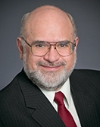
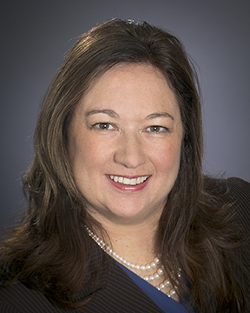
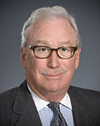
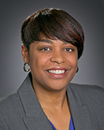
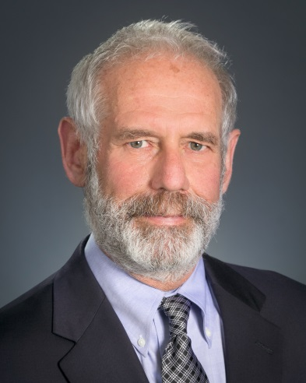
Commissioners’ Reports

Slide 29

Commissioner Catherine J.K. Sandoval
California Public Utilities Commission
Digital 395 Dedication
August 1, 2014

Slide 30
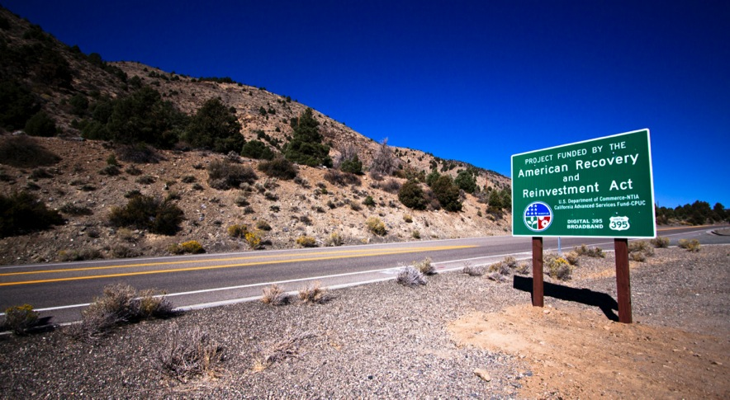

Slide 31
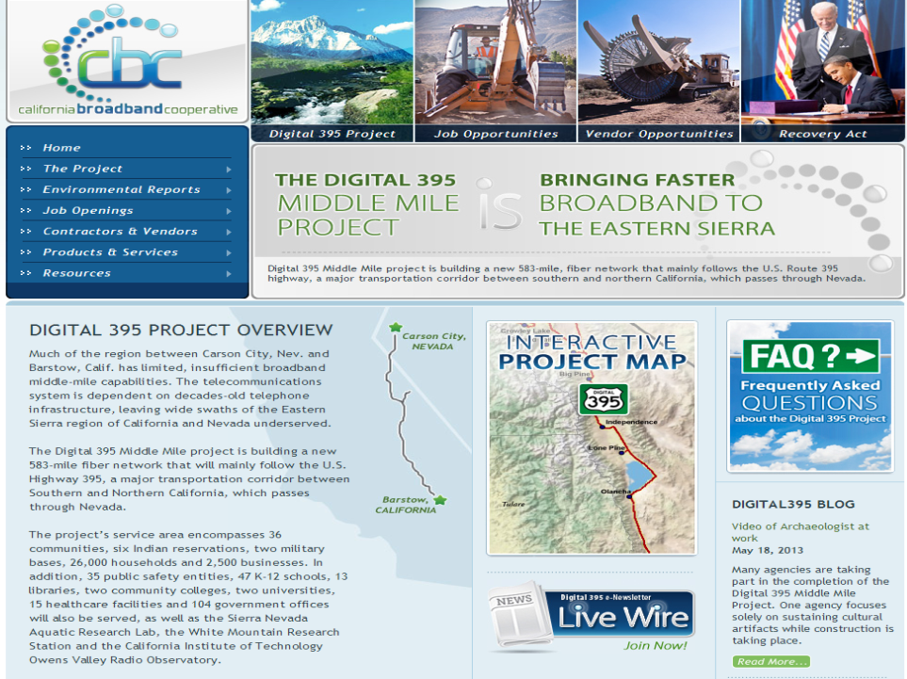

Slide 32










Suppliers and Vendors

Slide 33
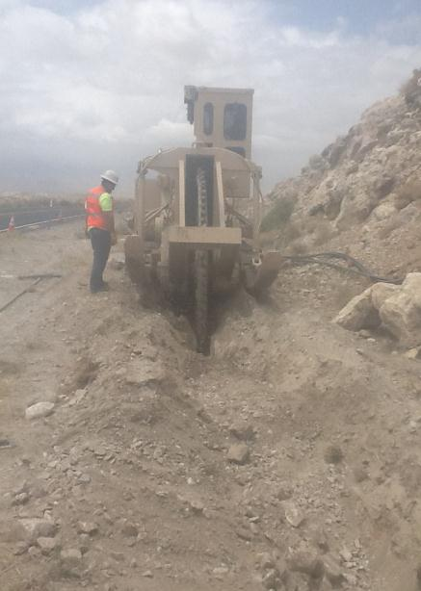
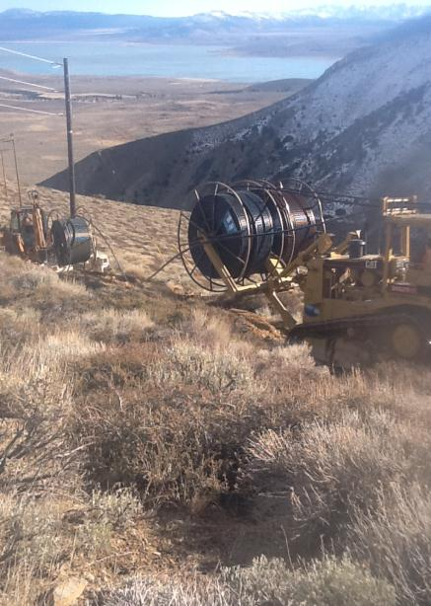

Slide 34
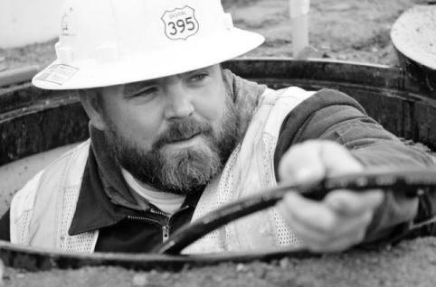



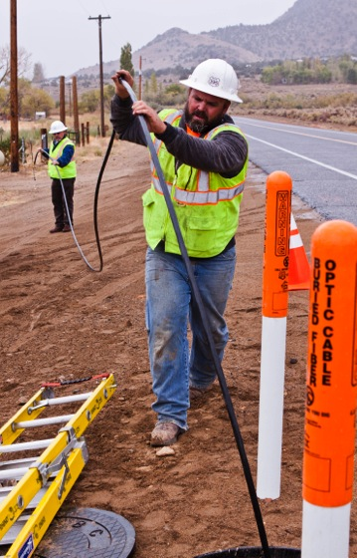

Slide 35
Commissioners’ Reports

Slide 36

Management Reports

Slide 37
Regular Agenda – Management Reports and Resolutions
Item #78 [13092]
Report and Discussion by Safety and Enforcement Division on Recent Safety Program Activities
------------------------------------------------------------------------

Slide 38
Regular Agenda – Management Reports and Resolutions
Item #80 [13209]
Director Ryan Dulin and Director Marzia Zafar Report
------------------------------------------------------------------------
Communications Division and Policy and Planning Division Report on Telecommunications Guiding Principles. The Commission’s telecommunications policy goals are to promote public safety, consumer protection, universal service, competition, and network reliability. Similar to the Commission’s Water Action Plan and Energy Action Plan, this document sets policy direction for the telecommunications industry. This document directs staff to create a comprehensive Action Plan detailing the steps necessary to create a path for achieving our vision and goals based on the guiding principles we have established in this document. This agenda item is before the Commission for discussion and action.

Slide 39
Telecommunications Guiding Principles
August 14, 2014
Ryan Dulin – Communications Director
Marzia Zafar - Policy & Planning Division Director

Slide 40
Why are we doing this?
The Commission’s vision is for all Californians to have access to safe, reliable telecommunications at just and reasonable rates.
TO PROVIDE POLICY DIRECTION FROM THE COMMISSION TO STAFF.

Slide 41
Other Industries Have It
Energy Action Plan
  Adopted by the Commission in 2003
  It created a unified goal and six broad principles
Water Action Plan
  Adopted by the Commission in 2005
  Identified policy objectives and four key principles
Safety Policy Statement
  Adopted by the Commission in 2014
  Identified an overarching goal and eight principles
Telecommunication
  Commission does not have any established principles or action plan for this industry division

Slide 42
Telecommunications Guiding Principles
Promote the safety and resiliency of telecommunications infrastructure.
Connect all Californians using the most advanced telecommunications technology.
Protect consumers from the potential of fraud, waste, and abuse as a result of market conditions.
Serve as an independent source of data for policy makers at both State and Federal level.
Promote public safety through network reliability and access to emergency services.

Slide 43
NEXT STEPS
Commission adopt Telecommunications Guiding Principles
Convene a group that will do the staff work on developing an Action Plan
Action Plan to be presented to the Commission in 180 days

Slide 44
Regular Agenda – Management Reports and Resolutions
Item #80 [13209]
Director Ryan Dulin and Director Marzia Zafar Report
------------------------------------------------------------------------
Communications Division and Policy and Planning Division Report on Telecommunications Guiding Principles. The Commission’s telecommunications policy goals are to promote public safety, consumer protection, universal service, competition, and network reliability. Similar to the Commission’s Water Action Plan and Energy Action Plan, this document sets policy direction for the telecommunications industry. This document directs staff to create a comprehensive Action Plan detailing the steps necessary to create a path for achieving our vision and goals based on the guiding principles we have established in this document. This agenda item is before the Commission for discussion and action.

Slide 45
Management Reports

Slide 46

The CPUC Thanks You
For Attending Today’s Meeting
The Public Meeting is adjourned.
The next Public Meeting will be:
August 28, 2014, at 9:30 a.m.
in San Francisco, CA

