Slide 1

CPUC Public Agenda 3363
Thursday, September 17, 2015 9:30 a.m.
San Francisco, CA
Commissioners:
Michael Picker, President
Michel Peter Florio
Catherine J.K. Sandoval
Carla J. Peterman
Liane M. Randolph
www.cpuc.ca.gov

Slide 2

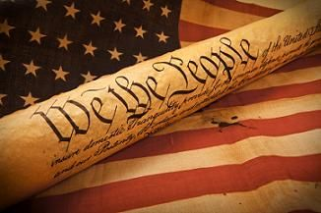
The Pledge of Allegiance
“I pledge allegiance to the Flag of the
United States of America,
and to the Republic for which it stands,
one nation under God,
indivisible,
with liberty and justice for all.”

Slide 3
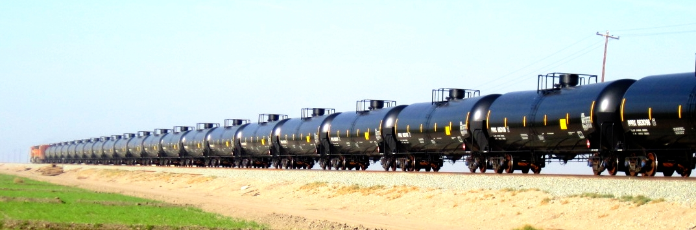

Crude Oil, Ethanol Railroad Shipments
Update and Safety Activity
Paul King, PhD
Deputy Director, Office of Rail Safety
Safety and Enforcement Division
California Public Utilities Commission
February 26, 2015

Slide 4
Public Comment
Per Resolution ALJ-252, any member of the public (excluding parties and their representatives) who wishes to address the CPUC about matters before the Commission must sign up with the Public Advisor’s Office table before the meeting begins. If an individual has signed up using the electronic system on the Commission’s website, they must check in with the Public Advisor’s Office on the day of the meeting, by the sign-up deadline.
Once called, each speaker has up to 3 minutes at the discretion of the Commission President. Depending on the number of speakers, the time limit may be reduced to 1 minute.
A sign will be posted when 1 minute remains.
A bell will ring when time has expired.
At the end of the Public Comment Section, the Commission President will ask if there are any additional individuals who wish to speak. Individuals who wish to speak but did not sign up by the deadline, will be granted a maximum of one minute to make their comments.
The following items are NOT subject to Public Comment:
  3, 6, 27
  All items on the Closed Session Agenda

Slide 5
Public Comment
Per Resolution ALJ-252, any member of the public (excluding parties and their representatives) who wishes to address the CPUC about matters before the Commission must sign up with the Public Advisor’s Office table before the meeting begins. If an individual has signed up using the electronic system on the Commission’s website, they must check in with the Public Advisor’s Office on the day of the meeting, by the sign-up deadline.
Once called, each speaker has up to 2 minutes at the discretion of the Commission President. Depending on the number of speakers, the time limit may be reduced to 1 minute.
A sign will be posted when 1 minute remains.
A bell will ring when time has expired.
At the end of the Public Comment Section, the Commission President will ask if there are any additional individuals who wish to speak. Individuals who wish to speak but did not sign up by the deadline, will be granted a maximum of one minute to make their comments.
The following items are NOT subject to Public Comment:
  3, 6, 27
  All items on the Closed Session Agenda

Slide 6
Public Comment
Per Resolution ALJ-252, any member of the public (excluding parties and their representatives) who wishes to address the CPUC about matters before the Commission must sign up with the Public Advisor’s Office table before the meeting begins. If an individual has signed up using the electronic system on the Commission’s website, they must check in with the Public Advisor’s Office on the day of the meeting, by the sign-up deadline.
Once called, each speaker has up to 1 minute to address the Commission.
A bell will ring when time has expired.
At the end of the Public Comment Section, the Commission President will ask if there are any additional individuals who wish to speak. Individuals who wish to speak but did not sign up by the deadline, will be granted a maximum of one minute to make their comments.
The following items are NOT subject to Public Comment:
  3, 6, 27
  All items on the Closed Session Agenda

Slide 7
Public Agenda Changes
Items shown on the Consent Agenda will be taken up and voted on as a group in one of the first items of business of each CPUC meeting.
Items on Today’s Consent Agenda are: 1, 4, 5, 6, 7, 8, 9, 10, 11, 12, 13, 14, 15, 17, 18, 21, 23, 24, 25, 26, 27, 28, 29, 30, 31, 32, 33, 34, 35, 37, 38, 39, 40, 41, and 43.
Any Commissioner, with consent of the other Commissioners, may request an item from the Regular Agenda be moved to the Consent Agenda prior to the meeting.
No items from the Regular Agenda have been added to the Consent Agenda.
Any Commissioner may request an item be removed from the Consent Agenda for discussion on the Regular Agenda prior to the meeting.
No items have been moved to the Regular Agenda.
Item 16 has been withdrawn.
The following items have been held to future Commission Meetings:
Held to 10/1/15: 3, 19, 20, 22, 36, 42, 48, 49, 50.
Held to 10/22/15: 2.

Slide 8
Regular Agenda
Each item on the Regular Agenda (and its alternate if any) will be introduced by the assigned Commissioner or CPUC staff and discussed before it is moved for a vote.
For each agenda item, a summary of the proposed action is included on the agenda; the CPUC’s final decision may, however, differ from that proposed.
The complete text of every Proposed Decision or Draft Resolution is available for download on the CPUC’s website: www.cpuc.ca.gov.
Late changes to agenda items are available on the Escutia Table.

Slide 9
Regular Agenda – Energy Orders
Item # 44 [14211] – Foundational Matters in Rulemaking to Create a Framework for Integrated Demand-Side Resources
R14-10-003 – Order Instituting Rulemaking to Create a Consistent Regulatory Framework for the Guidance, Planning, and Evaluation of Integrated Demand Side Resource Programs.
Quasi-Legislative Comr. Florio / Judge Hymes
--------------------------------------------------------------------------------------------------------------------------------------------------
PROPOSED OUTCOME:
Expands the original scope of the proceeding to include the determination of how resources needed to fill the characteristics determined in Rulemaking 14-08-013 could be sourced.
Expands the original scope to focus on the integration of demand side resources in a holistic way that includes the entire system.
Adopts the following definition: The integration of demand side resources is a regulatory framework, developed by the Commission, to enable customers to effectively and efficiently choose from an array of demand-side and distributed energy resources. This framework is based on the impact and interaction of resources on an individual customers energy usage as well as the system as a whole.
Adopts the following goal for the integration of demand-side resources: To deploy resources that are accounted for in system planning provide optimal customer and system benefits, and allow California to reach its climate and system planning objectives.
Expands the scope of the proceeding to consider the adoption of localized incentives and the methodology to determine the incentives.
SAFETY CONSIDERATIONS:
No safety issues were identified in the scoping memo.
ESTIMATED COST:
No costs as a result of this decision.

Slide 10
Regular Agenda – Water/Sewer Orders
Item # 45 [14221] – Adopting Water-Energy Cost Calculator Tools
R13-12-011 – Order Instituting Rulemaking into Policies to Promote a Partnership Framework between Energy Investor Owned Utilities and the Water Sector to Promote Water-Energy Nexus Programs.
Quasi-Legislative Comr. Sandoval / Judge Edmister
--------------------------------------------------------------------------------------------------------------------------------------------------
PROPOSED OUTCOME:
Adopts two tools to use to value the avoided costs of energy and water that flow from reduced use of cold water.
SAFETY CONSIDERATIONS:
None – a purely technical update to savings models.
ESTIMATED COST:
None – does not approve or require any spending.

Slide 11
Regular Agenda – Orders Extending Statutory Deadline
Item # 46 [14272] – Order Extending Statutory Deadline
A13-02-023 – Application of Pacific Gas and Electric Company for Compliance Review of Utility Owned Generation Operations, Electric Energy Resource Recovery Account Entries, Contract Administration, Economic Dispatch of Electric Resources, Utility Retained Generation Fuel Procurement, and Other Activities for the Period January 1 through December 31, 2012.
Ratesetting Comr. Florio / Judge Roscow
--------------------------------------------------------------------------------------------------------------------------------------------------
PROPOSED OUTCOME:
Extends statutory deadline for completion of this proceeding until December 12, 2015.
SAFETY CONSIDERATIONS:
There are no safety considerations implicated with this Order Extending Statutory Deadline.
ESTIMATED COST:
There is no cost associated with this Order Extending Statutory Deadline.

Slide 12
Regular Agenda – Orders Extending Statutory Deadline
Item # 47 [14273] – Order Extending Statutory Deadline
I12-10-013, A13-01-016, A13-03-005, A13-03-013, A13-03-014 – Related matters –
Order Instituting Investigation on the Commission’s Own Motion into the Rates, Operations, Practices, Services and Facilities of Southern California Edison Company and San Diego Gas and Electric Company Associated with the San Onofre Nuclear Generating Station Units 2
and 3.
Ratesetting Comr. Sandoval / Judge Darling
--------------------------------------------------------------------------------------------------------------------------------------------------
PROPOSED OUTCOME:
Extends statutory deadline for completion of this proceeding until November 26, 2015.
SAFETY CONSIDERATIONS:
There are no safety considerations implicated with this Order Extending Statutory Deadline.
ESTIMATED COST:
There is no cost associated with this Order Extending Statutory Deadline.

Slide 13
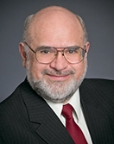
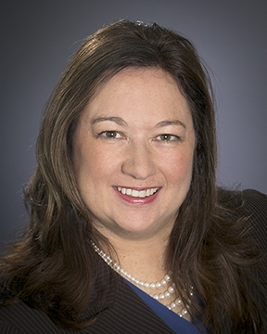
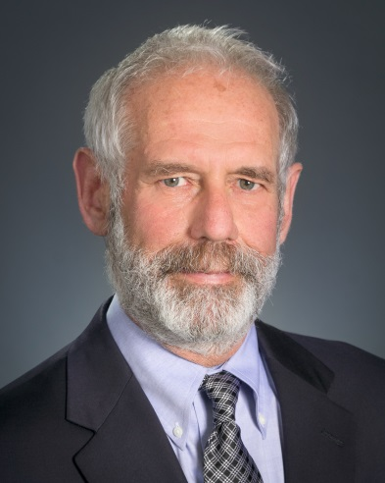
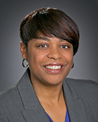
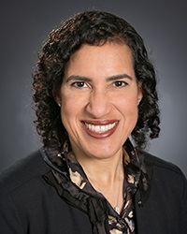
Commissioners’ Reports

Slide 14
Thanks For Your Assistance

Slide 15
Commissioners’ Reports

Slide 16

Management Reports

Slide 17
Regular Agenda – Management Reports and Resolutions
Item #51 [14198]
Report and Discussion by Safety and Enforcement Division on Recent Safety Program Activities
------------------------------------------------------------------------

Slide 18
Electric Safety Enforcement Activities and Issues
Charlotte TerKeurst, Program Manager
Electric Safety and Reliability Branch
Office of Utility Safety and Reliability
Safety and Enforcement Division
September 17, 2015

Slide 19
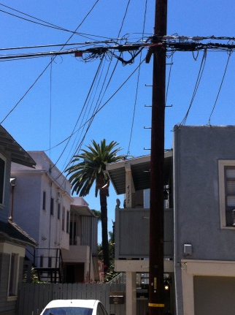
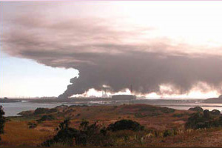
Core Work of
Electric Safety and Reliability Branch
Records audits and facilities/plant inspections
Investigations of incidents
Enforcement for violations of GOs
and other requirements
  Notices of Violation and Corrective Action Plans
  Citations
  Adjudicatory CPUC Investigation proceedings
Participation in other CPUC proceedings
Photos: Belmont Heights Neighborhood Group
and Hofmann, Elkhorn Slough Foundation

Slide 20
Examples of Relevant
PU Code Sections
Sections 315, 362, 451, 701, and other statutes regarding safety of public utilities
Sections 8001 et seq.: Electrical lines and related facilities, including facilities of “any county, city, city and county, or other political subdivision thereof…”
Section 761.3: Facilities for the generation of electricity
Section 767: Joint use of utility poles, ducts, conduits, and right of way
Section 768.5: Plant and equipment owned by cable companies

Slide 21
Safety-Related General Orders
GO 95: Overhead electric & communications facilities
GO 128: Underground electric & communications systems
GO 165: Inspection of electric transmission & distribution
GO 166: Emergency preparedness for electric utilities
GO 167: Electric generating facilities
GO 174: Electric substations
GO 176: High speed rail electrification

Slide 22
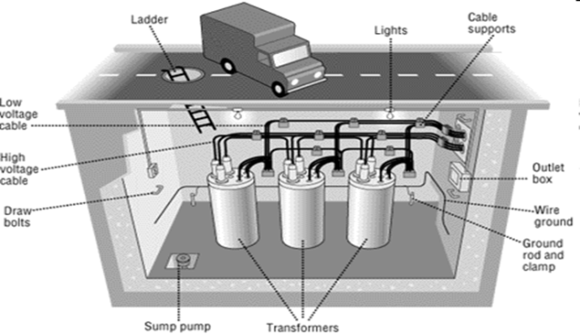
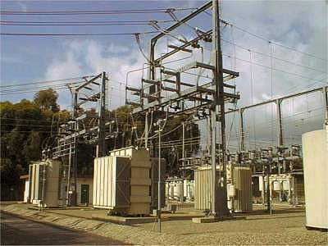
Electric and Communications Facilities Subject to CPUC Safety Regulation
Transmission and distribution lines:
  over 200,000 miles of above-ground lines
  4 million poles
  77,000 miles of underground lines
Electric substations: over 2,200

Slide 23
Electric Generating Asset Owners
Subject to General Order 167
*Limited requirements apply to other generators, including nuclear.

Slide 24
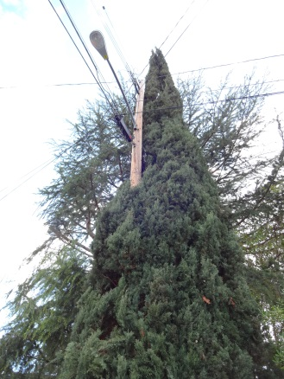
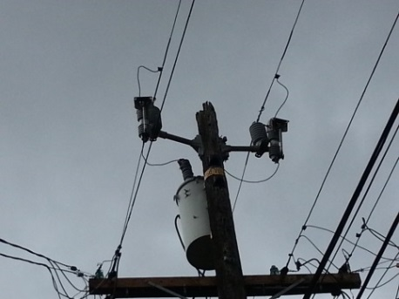
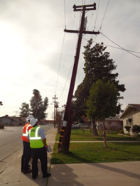
Distribution, Transmission, and Substation Records Audits and Facility Inspections
29 audits/inspections held or planned for 2015
Entities this year include:
PG&E Trinity Public Utilities District
SCE Imperial Irrigation District
SDG&E Donner Public Utility District
PacifiCorp Palo Alto Utilities
LADWP Silicon Valley Power
Cities of Gridley, Biggs, Lompoc, Colton, Pasadena, and Anaheim

Slide 25
Communication Infrastructure Provider (CIP)
Records Audits and Facilities Inspections
11 CIP audits/inspections held or planned for 2015
Entities this year include:
Comcast San Simeon Cable
Charter New Day Broadband
Verizon Cox
AT&T Crown Castle

Slide 26
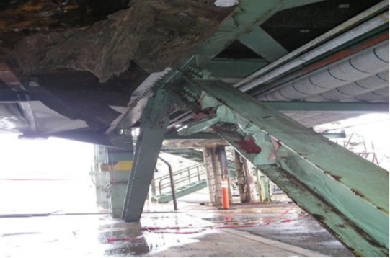
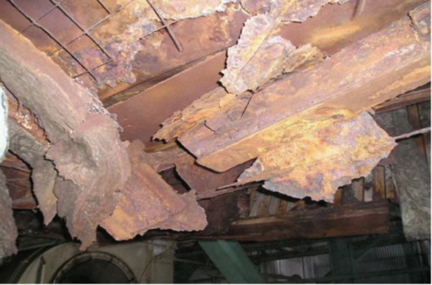
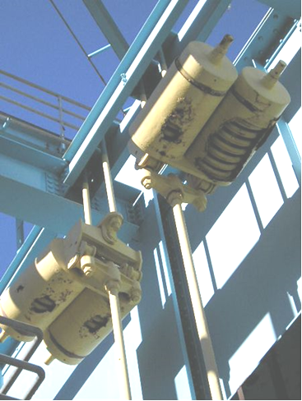
Generating Asset Owner
General Order 167 Audits/Inspections
4 audits/inspections held or planned for 2015:
Gateway Generating Station (PG&E)
Redondo Beach Generating Station (AES Southland)
Inland Empire Energy Center (General Electric)
Los Esteros Critical Energy Center (Calpine)

Slide 27
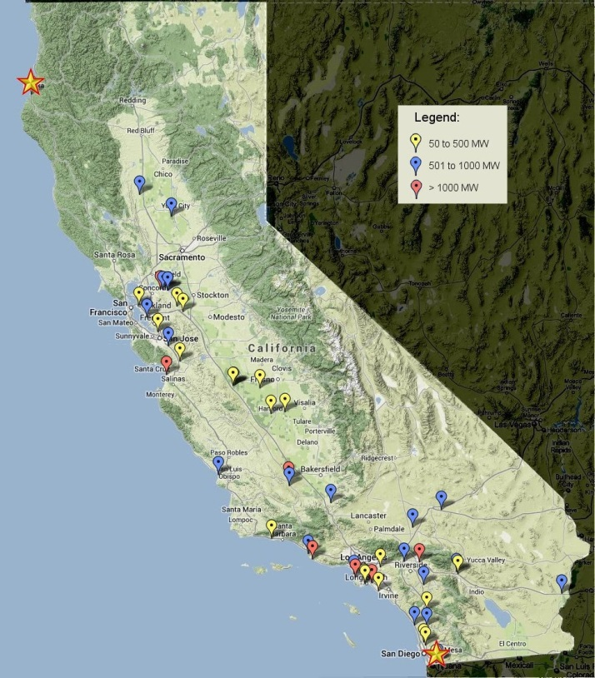
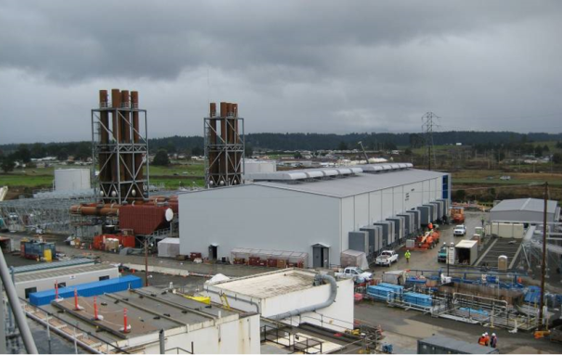
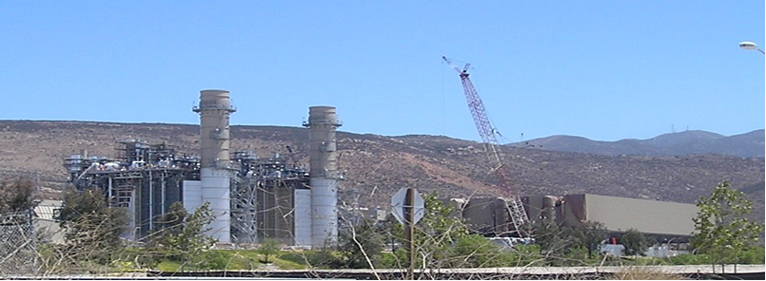
Generating Asset Owner
Outage Inspections
2014 inspections:
  Planned outages 144
  Forced outages 197
  Number of plants 56

Slide 28
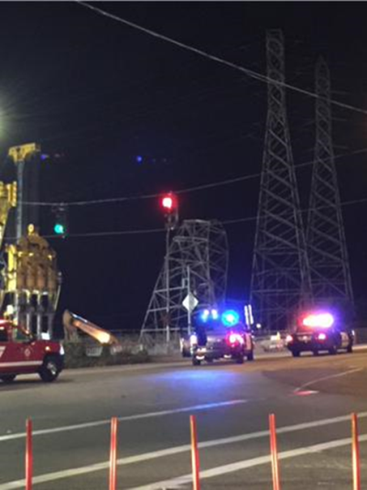
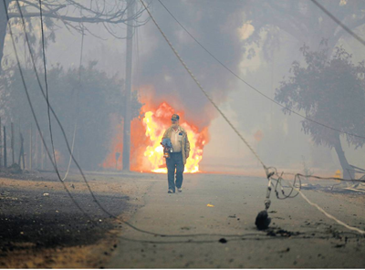
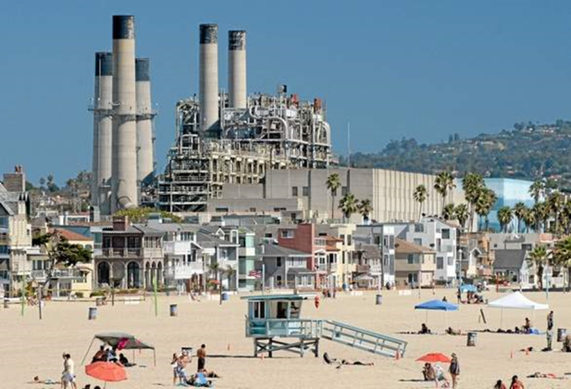
Investigation of Electric Safety Incidents
182 electric facility incidents reported in 2014
2 generation incidents reported in 2014
Recent incidents in the news:
Photo: Daily Breeze, Steve McCrank
Photo: NBC Bay Area News, Photo: SF Chronicle, Connor Radnovich
Twitter post

Slide 29
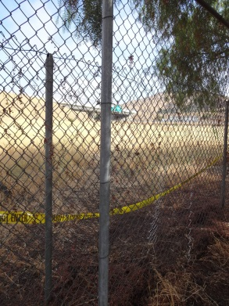
Enforcement Activities
Notices of Violation, Corrective Action Plans, follow-up
Citations
  Electric citation authority as of 1-1-2015
  Two citations issued to date
Commission Investigations
  Recent Kern OII and settlement on PG&E contractor safety and
  cause analysis procedures

Slide 30
ESRB Participation in CPUC Proceedings
(2014-2015)
Physical security rulemaking
Citation proceeding
Applicability of right-of-way rules to CMRS
Fire safety proceeding
Storage proceeding
GO 95 rule change proceeding
Electrification system for high speed rail

Slide 31
Regular Agenda – Management Reports and Resolutions
Item #51 [14198]
Report and Discussion by Safety and Enforcement Division on Recent Safety Program Activities
------------------------------------------------------------------------

Slide 32
Management Reports

Slide 33

The CPUC Thanks You
For Attending Today’s Meeting
The Public Meeting is adjourned.
The next Public Meeting will be:
October 1, 2015 at 9:30 a.m.
in San Francisco, CA

