Slide 1
2021 SDG&E AC Saver Day Of Impact Evaluation
IOU 2022 Load Impact Protocol Workshop
George Jiang, Managing Consultant
Jeremy Smith, Senior Consultant
Chris Ramee, Consultant
05•03•2022

Slide 2
Agenda
Program overview
Ex post methodology
Ex post results and comparison to 2019 & 2020
Enrollment forecast
Ex ante methodology
Ex ante results and comparison
Conclusions

Slide 3
Program Overview
Day-of demand response program offered to residential and commercial customers
Direct load control of central air conditioning (CAC)
Switches with one-way communication
Events can be called on non-holidays from April – October
2 to 4 hours in length
12 PM to 9 PM
Maximum of 20 events
Customer Type | Cycling Strategy | Enrolled Customers (Oct. 2021) | % CAC Tonnage Enrolled | Incentive per Ton Enrolled
Residential | 50% | 5,715 | 71% | $10.35
 | 100% | 1,959 | 29% | $27.00
Commercial | 30% | 602 | 25% | $4.50
 | 50% | 2,055 | 75% | $7.50

Slide 4
Event Dates and Times
7 events in 2021
Called for 17 hours total
4 events from 6 to 8 PM
No weekend events
70 °F to 76 °F mean17 temperatures
74 °F to 89 °F max event window temperatures
Event # | Date | Hour Ending |  |  |  |  |  | Mean17 (°F) | Max Event Window Temp (°F)
 |  | 17 | 18 | 19 | 20 | 21 | 22
1 | 6/15/2021 |  |  | x | x |  |  | 74 | 89
2 | 6/16/2021 |  |  | x | x |  |  | 71 | 76
3 | 6/17/2020 |  |  | x | x | x |  | 70 | 75
4 | 7/12/2021 |  |  | x | x |  |  | 71 | 74
5 | 7/29/2021 |  |  | x | x | x |  | 73 | 80
6 | 9/9/2021 |  |  | x | x |  |  | 75 | 84
7 | 9/10/2021 |  | x | x | x |  |  | 76 | 84

Slide 5
Ex Post Methodology - Residential
Residential reference loads were estimated using a randomized controlled trial (RCT)
Approximately 1,600 residential customers (800 from each cycling group) are held back from cycling for each event
The control group used alternates each month
Control customers were validated using CAC tonnage per household, Baseline Accuracy Working Group (BAWG) protocols, and load comparisons during event-like (proxy) days from 2020 (figure to right),
Cycling Strategy | Group | Sample Size | Month(s) Used as Control
50% | A | 729 | July, Sept.
 | B | 729 | June
100% | A | 723 | July, Sept.
 | B | 714 | June

Slide 6
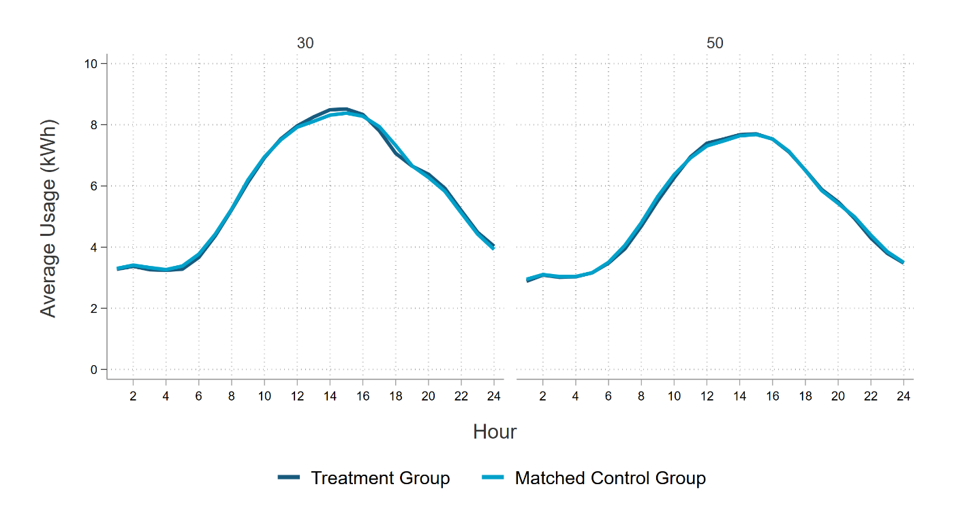
Ex Post Methodology - Commercial
Commercial reference loads were estimated using a matched control group
Matches were found using a dissimilarity statistic incorporating:
Peak demand on 2021 proxy days
Demand before and after event hours
Matched on industry, climate zone, NEM
Regressions are used to estimate impacts for residential and commercial customers
An adjustment is applied to remove remaining treatment and control differences that incorporates event day and proxy window event day usage
Commercial Load Comparison Using 2021 Proxy Days by Cycling Option

Slide 7
Residential Ex Post Results
Per site impacts range from 0.00 kW to 0.17 kW
4 event days have statistically significant impacts
Impacts generally increase as the temperature increases
The 3 coldest event days have impacts that are not statistically significant
Date | Impact |  |  | Max Event Window Temperature (°F) | Event Hours | Statistically Significant at 90% Level
 | Per CAC Unit (kW) | Per Site (kW) | Aggregate (MW)
6/15/2021 | 0.09 | 0.10 | 0.77 | 89 | 6pm - 8pm | Yes
6/16/2021 | 0.00 | 0.00 | 0.03 | 76 | 6pm - 8pm | No
6/17/2021 | 0.01 | 0.01 | 0.06 | 75 | 6pm - 9pm | No
7/12/2021 | 0.00 | 0.00 | 0.01 | 74 | 6pm - 8pm | No
7/29/2021 | 0.07 | 0.09 | 0.66 | 80 | 6pm - 9pm | Yes
9/9/2021 | 0.11 | 0.12 | 0.93 | 84 | 6pm - 8pm | Yes
9/10/2021 | 0.15 | 0.17 | 1.28 | 84 | 5pm - 8pm | Yes
Average* | 0.05 | 0.06 | 0.43 | 81 | 6pm - 8pm | Yes
* Blue rows reflect the average 6 PM - 8PM weekday 2021 AC Saver Day Of event

Slide 8
Commercial Ex Post Results
Per site impacts range from 0.02 kW to 0.14 kW
5 event days have statistically significant impacts
Date | Impact |  |  | Max Event Window Temperature (°F) | Event Hours | Statistically Significant at 90% Level
 | Per CAC Unit (kW) | Per Site (kW) | Aggregate (MW)
6/15/2021 | 0.06 | 0.14 | 0.31 | 88 | 6pm - 8pm | Yes
6/16/2021 | 0.02 | 0.05 | 0.11 | 75 | 6pm - 8pm | No
6/17/2021 | 0.01 | 0.02 | 0.04 | 73 | 6pm - 9pm | No
7/12/2021 | 0.03 | 0.08 | 0.16 | 73 | 6pm - 8pm | Yes
7/29/2021 | 0.02 | 0.04 | 0.09 | 79 | 6pm - 9pm | Yes
9/9/2021 | 0.04 | 0.11 | 0.28 | 83 | 6pm - 8pm | Yes
9/10/2021 | 0.03 | 0.08 | 0.21 | 82 | 5pm - 8pm | Yes
Average* | 0.04 | 0.09 | 0.22 | 80 | 6pm - 8pm | Yes
* Blue rows reflect the average 6 PM - 8PM weekday 2021 AC Saver Day Of event

Slide 9
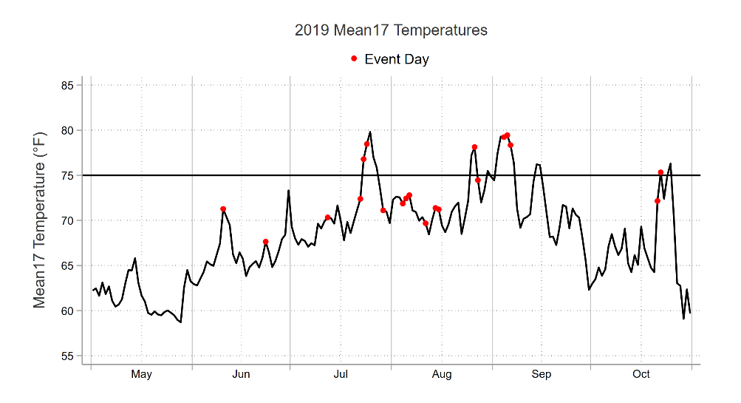
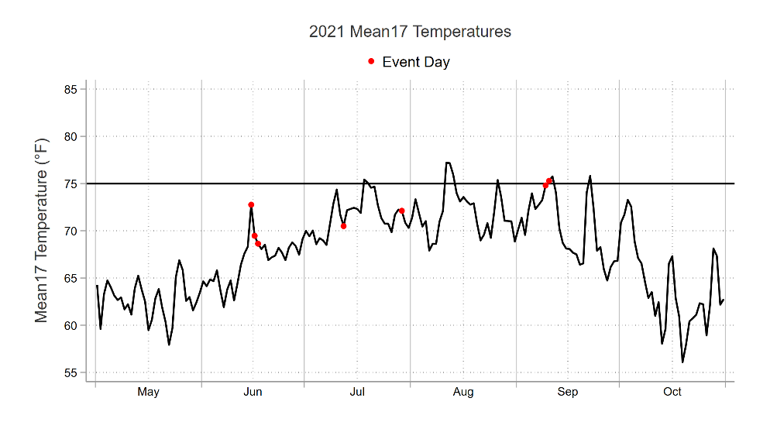
PY2021 vs. 2020 & 2019 Events
In 2019, 6 events (out of 20) were called with a mean17 over 75 °F
In 2020, 9 events (out of 20) were called with a mean17 over 75 °F
In 2021, 2 events (out of 7) were called with a mean17 over 75 °F
Last two events in September are 75 °F and 76 °F

Slide 10
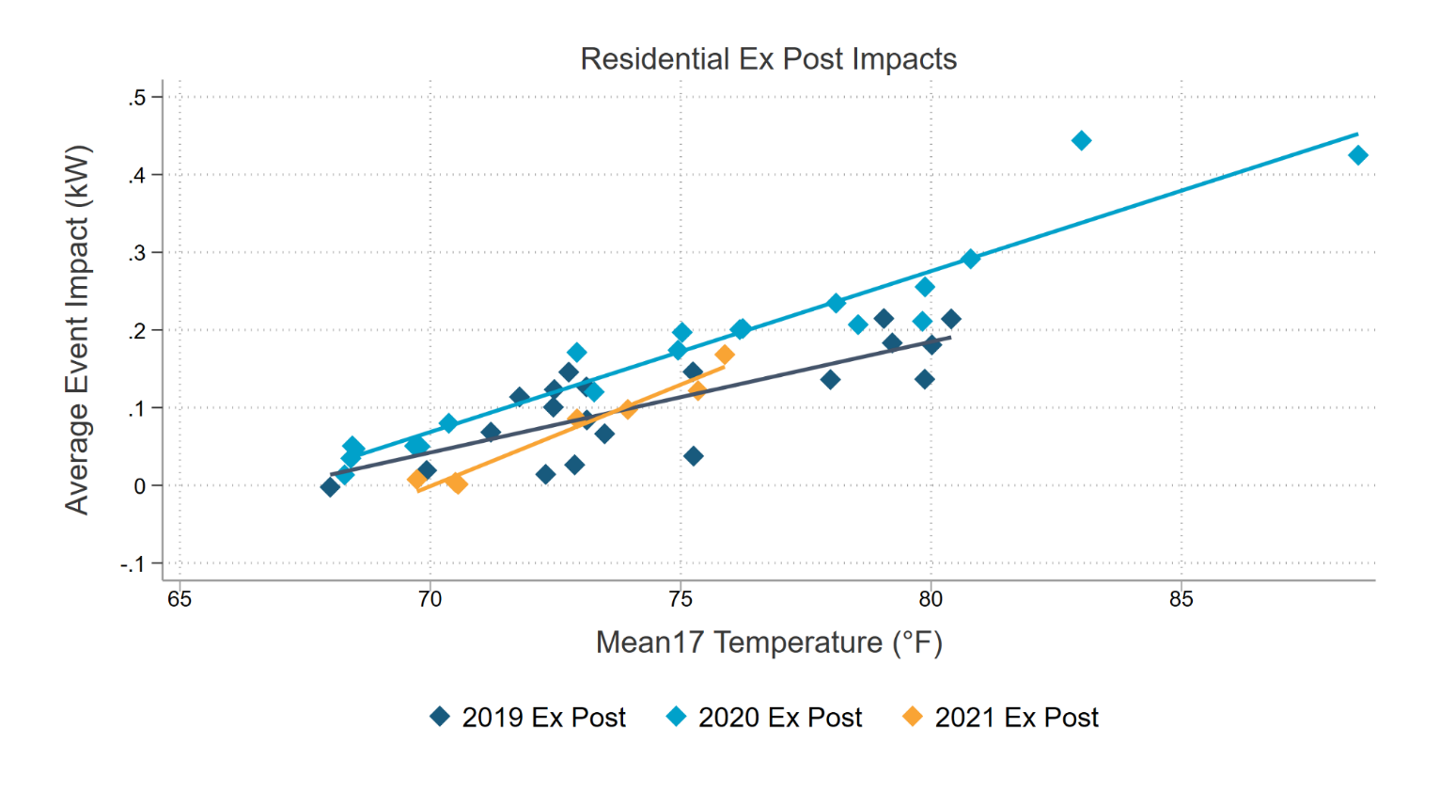
PY2021 vs. 2020 & 2019 Ex Post - Residential
In 2020, increased reference loads for residential customers led to increased impacts because of COVID
2021 residential events had impacts more like 2019 than 2020

Slide 11
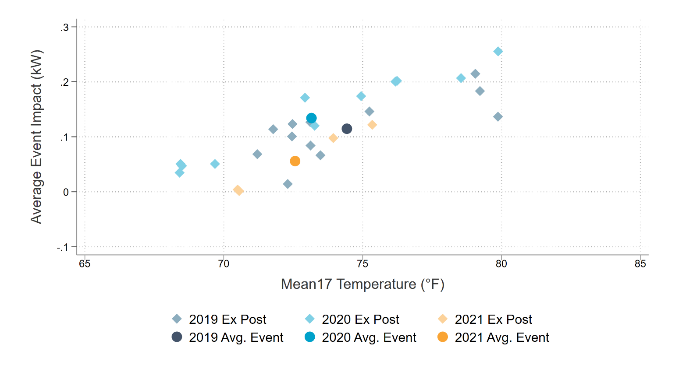
PY2021 vs. 2020 & 2019 Ex Post - Residential
The average residential event impact in 2021 was lower than 2019 and 2020
Year | Avg. Event Hours | Customers Called | Mean17 Avg. Temp. (°F) | Avg. Reference Load (kW) | Avg. Load w/DR (kW) | Impact (kW) | Impact (%) | Aggregate Impact (MW)
2019 Average Event Day | 6PM - 8PM | 7,913 | 74 | 1.29 | 1.18 | 0.11 | 8.9% | 0.91
2020 Average Event Day | 6PM - 8PM | 6,975* | 73 | 1.44 | 1.31 | 0.13 | 9.3% | 0.94
2021 Average Event Day | 6PM - 8PM | 7,798 | 73 | 1.37 | 1.31 | 0.06 | 4.1% | 0.44

Slide 12
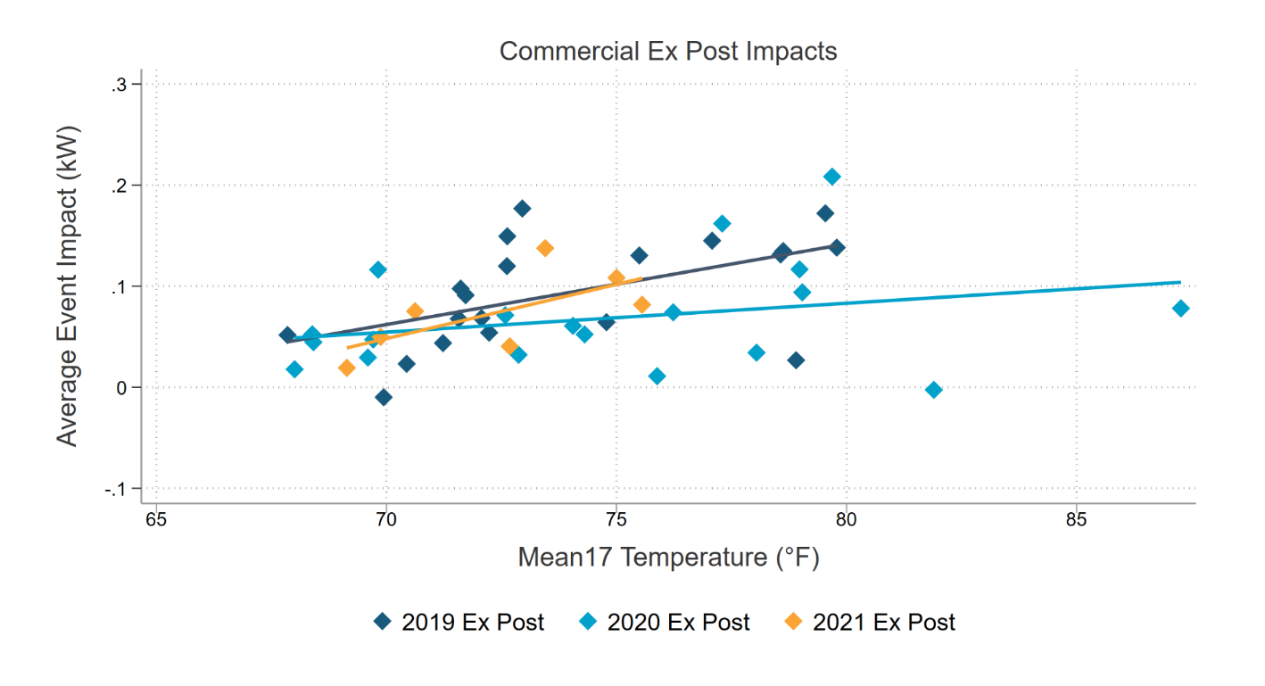
PY2021 vs. 2020 & 2019 Ex Post - Commercial
In 2020, decreased reference loads for commercial customers led to decreased impacts because of COVID
2021 commercial impacts are more comparable to 2019 than 2020

Slide 13
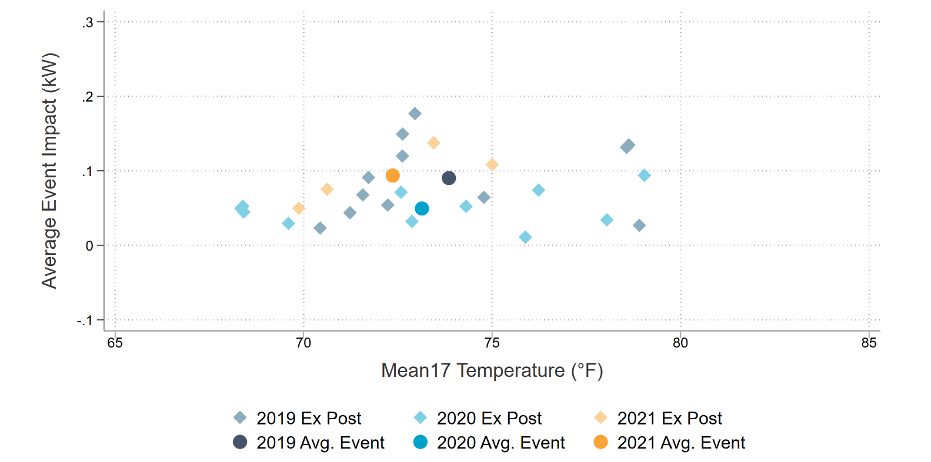
PY2021 vs. 2020 & 2019 Ex Post - Commercial
2021 commercial average event impacts are more comparable to 2019 than 2020
Year | Avg. Event Hours | Customers Called | Mean17 Avg. Temp. (°F) | Avg. Reference Load (kW) | Avg. Load w/DR (kW) | Impact (kW) | Impact (%) | Aggregate Impact (MW)
2019 Average Event Day | 6PM - 8PM | 3707 | 74 | 6.09 | 6.00 | 0.09 | 1.5% | 0.33
2020 Average Event Day | 6PM - 8PM | 3124 | 73 | 4.98 | 4.93 | 0.05 | 1.0% | 0.15
2021 Average Event Day | 6PM - 8PM | 2312 | 72 | 5.85 | 5.75 | 0.09 | 1.6% | 0.22

Slide 14
Enrollment Forecast
Both residential and commercial enrollments are expected to decline
Enrollment forecast is static in 2027 and beyond
Program is not being actively marketed

Slide 15
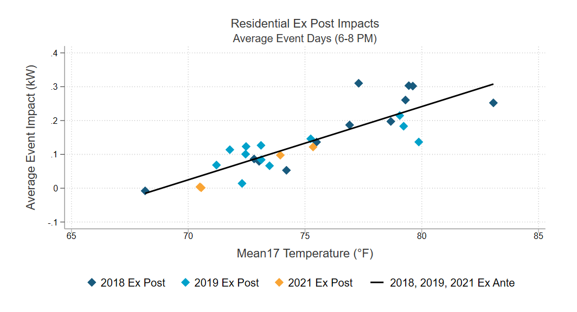
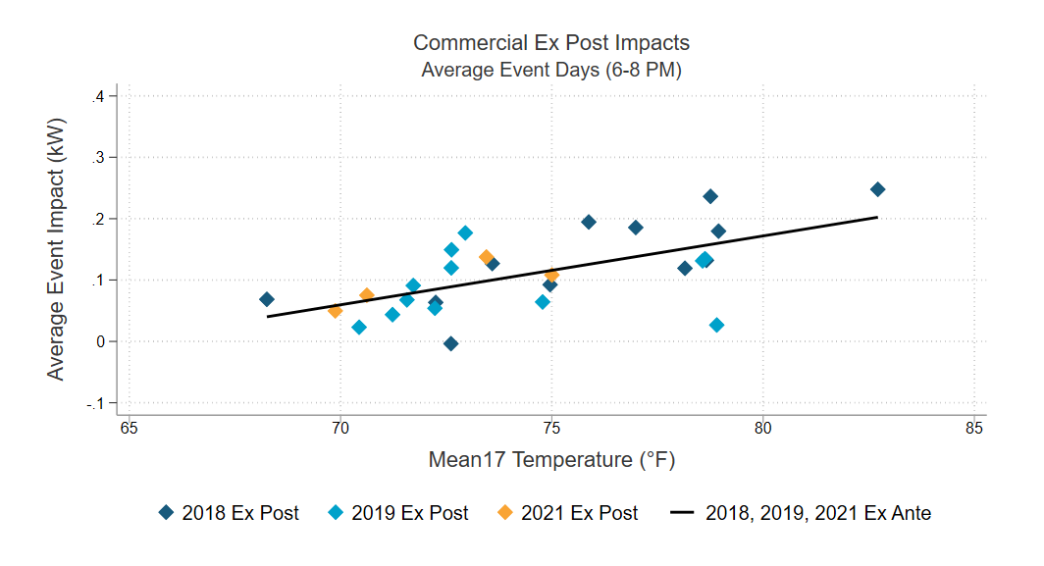
Ex Ante Methodology
Average event day impacts (6-8 PM) and reference loads are modeled as a function of mean17
Ex post impacts from 2018, 2019 and 2021 are included
Due to COVID effects, 2020 is excluded from the ex ante methodology

Slide 16
2022 Ex Ante Results – SDG&E Peaking Conditions
Aggregate residential and commercial ex ante impacts peak in September
Ex ante predictions for residential customers are more weather sensitive than commercial
Weather Year | Day Type | Residential Average (MW) | Commercial Average (MW)
1-in-2 | Typical Event Day | 1.1 | 0.3
 | September Monthly Peak | 2.0 | 0.4
1-in-10 | Typical Event Day | 1.9 | 0.3
 | September Monthly Peak | 2.5 | 0.4

Slide 17
Ex Ante PY2020 vs. PY2021 Comparison for 2022
In 2020, the ex ante methodology was changed to account for COVID
2019 vs. 2020 reference loads were compared
A timing variable was included
Ex ante predictions for 2022 between PY2022 and PY2021 are generally comparable
Weather Year | Day Type | Residential Average (MW) |  | Commercial Average (MW)
 |  | PY2020 | PY2021 | PY2020 | PY2021
1-in-2 | Typical Event Day | 1.1 | 1.1 | 0.3 | 0.3
 | September Monthly Peak | 1.8 | 2.0 | 0.3 | 0.4
1-in-10 | Typical Event Day | 1.7 | 1.9 | 0.3 | 0.3
 | September Monthly Peak | 2.3 | 2.5 | 0.3 | 0.4

Slide 18
Conclusions
Ex post
Average residential impacts in 2021 were smaller compared to 2019 and 2020 due to lower event temperatures
Average commercial impacts were higher in 2021 than 2020 and comparable to impacts in 2019
Ex ante
The ex ante methodology reverted to align with previous evaluations after changing for 2020
Changes in future ex ante MW predictions will largely be driven by enrollment

Slide 19
Contact Information
George Jiang
Managing Consultant
gjiang@resource-innovations.com
Jeremy Smith
Senior Consultant
jsmith@resource-innovations.com
Chris Ramee
Consultant
cramee@resource-innovations.com

