Slide 1
Southern California Edison
Summer Discount Plan: 2021 Load Impact Evaluation
May 3, 2022

Slide 2
SDP Participant Characteristics and Loads

Slide 3
The SDP program is an AC Cycling program, Where Events are dispatched by geographically defined regional subgroups
~80% of participants, tonnage, and devices are in 100% cycling
~50% of resources are in the SCE-Central SubLAP
~13% of participants have solar
~27% of SDP-R participants are low income (CARE or FERA)
Schools and religious organizations account for ~80% of SDP-C tonnage

Slide 4
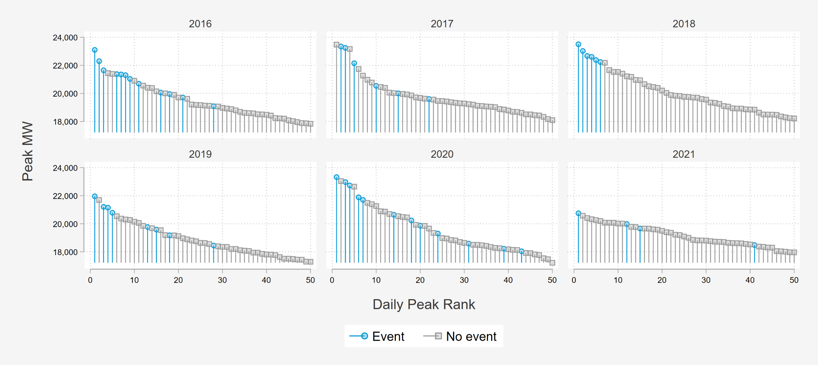
2021 System Peak loads were Lower Than Previous Years

Slide 5
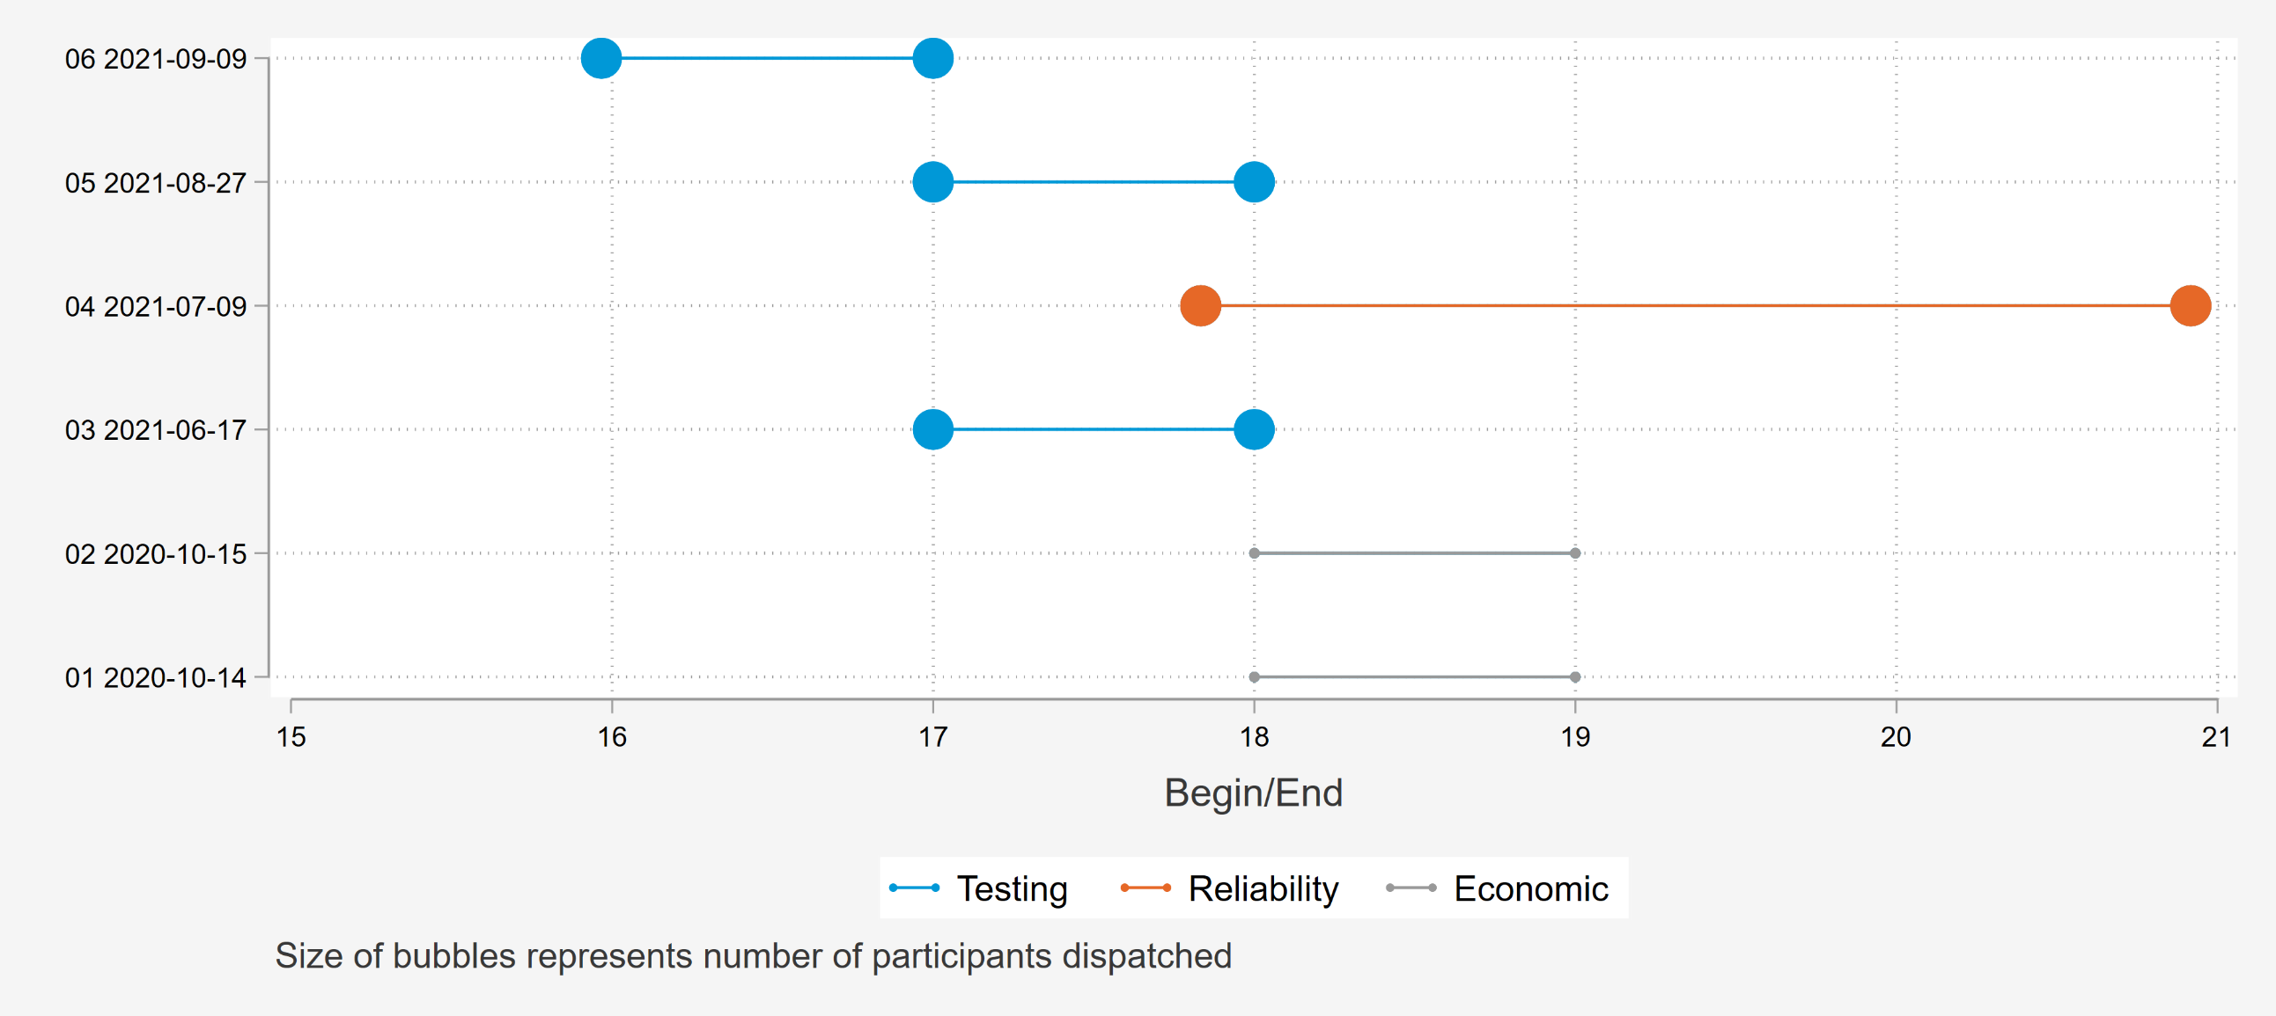
2021 Events varied in timing and were mostly dispatched for Testing Purposes

Slide 6
2021 SDP-R Evaluation Results

Slide 7
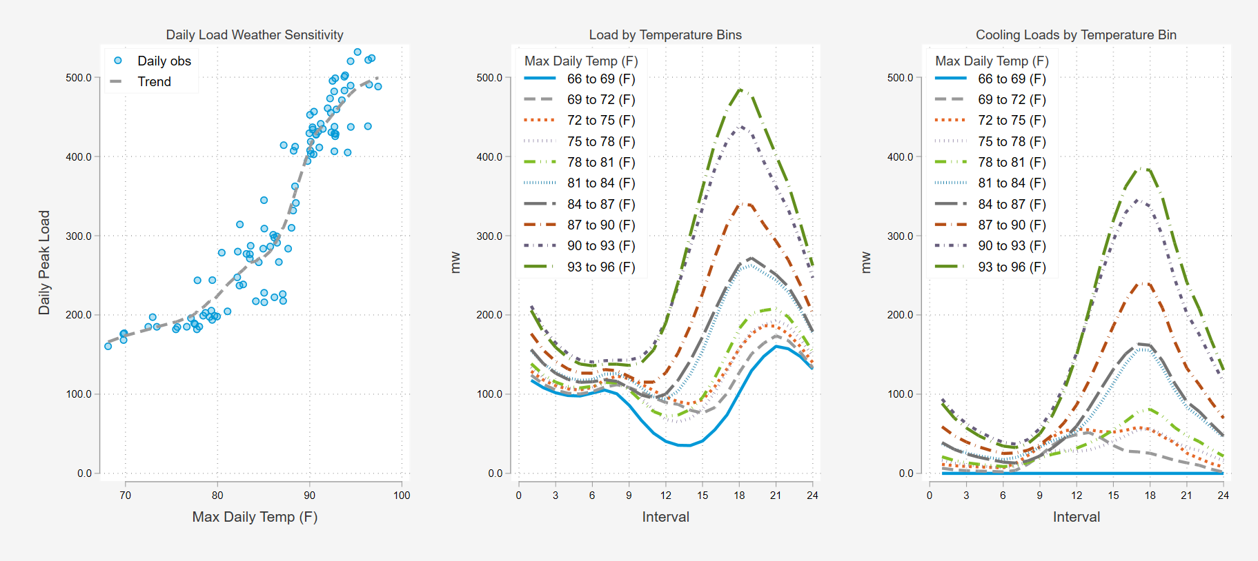
SDP-R participants have over 400 MW of cooling load when temperatures are hot
4-9 PM

Slide 8
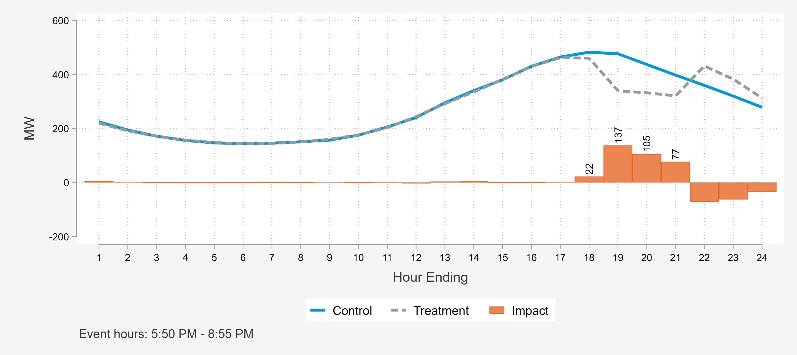
Load impacts on the Reliability Event (July 9th)

Slide 9
Summary of impacts for each event – Full Event Hours
 |  |  |  | MW Metrics |  |  |  |  | Impact per … (kW)
Date | Event start | Event end | Accts | Reference Load | Load with DR | Impact | 90% Lower Bound | 90% Upper Bound | Acct | Device | Ton | % Impact | Wght. Temp (F)
6/17/2021 | 5:00 PM | 6:00 PM | 168,129 | 396 | 280 | 116 | 111 | 121 | 0.69 | 0.60 | 0.16 | 29.3% | 89.7
7/9/2021* | 5:50 PM | 8:50 PM | 175,532 | 457 | 336 | 121 | 116 | 126 | 0.69 | 0.60 | 0.16 | 26.5% | 91.4
8/27/2021 | 6:00 PM | 7:00 PM | 175,588 | 481 | 342 | 140 | 134 | 145 | 0.80 | 0.69 | 0.19 | 29.0% | 95.5
9/9/2021 | 3:58 PM | 5:00 PM | 175,962 | 478 | 334 | 144 | 138 | 150 | 0.82 | 0.71 | 0.19 | 30.1% | 94.5
Avg. Event | First Event Hour |  | 173,803 | 456 | 324 | 132 | 129 | 135 | 0.76 | 0.66 | 0.18 | 29.0% | 93.1

Slide 10
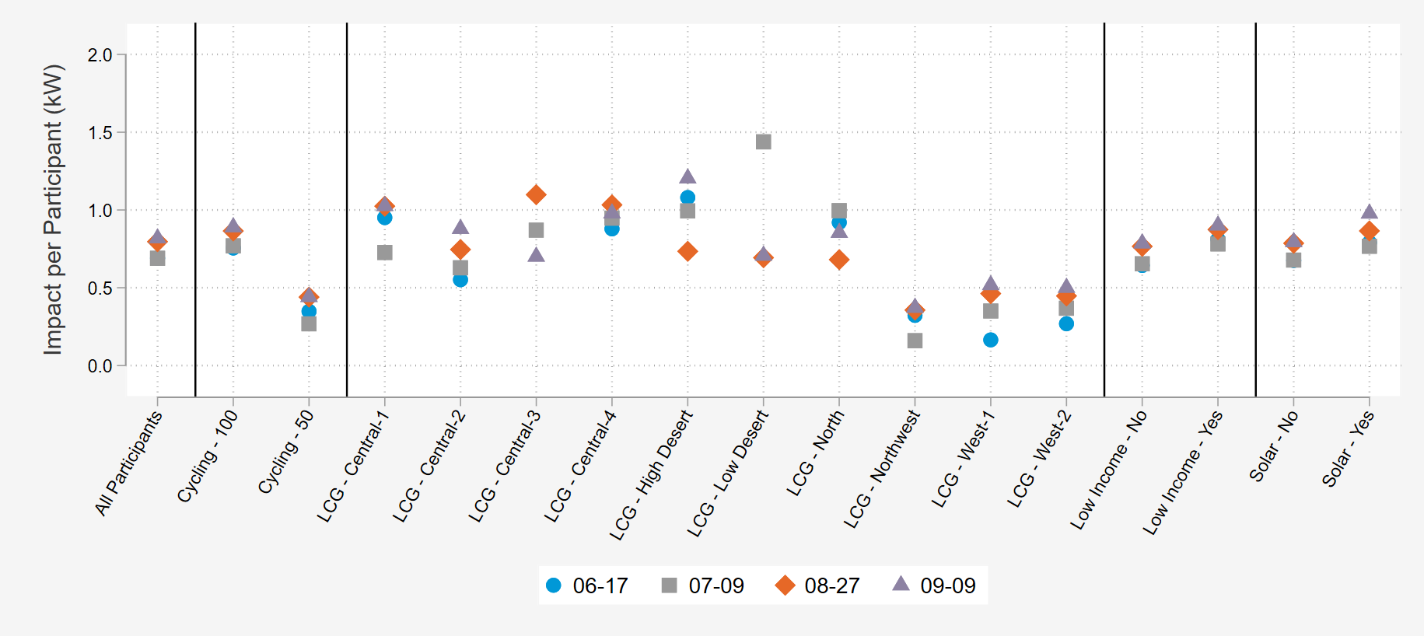
Average Impacts by Date and Key Subcategories

Slide 11
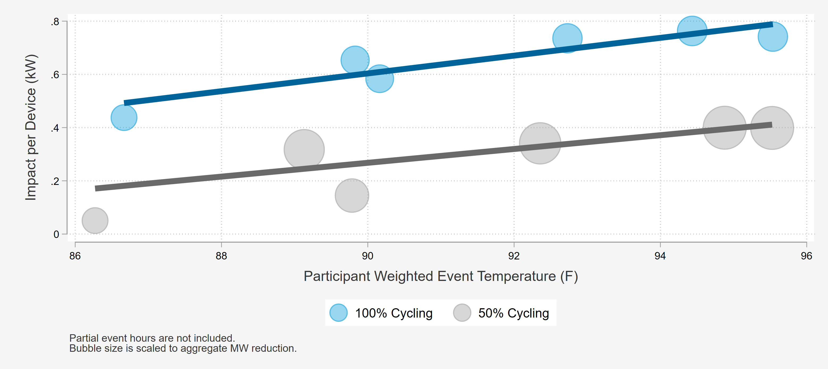
Impacts for key segments – cycling strategy

Slide 12
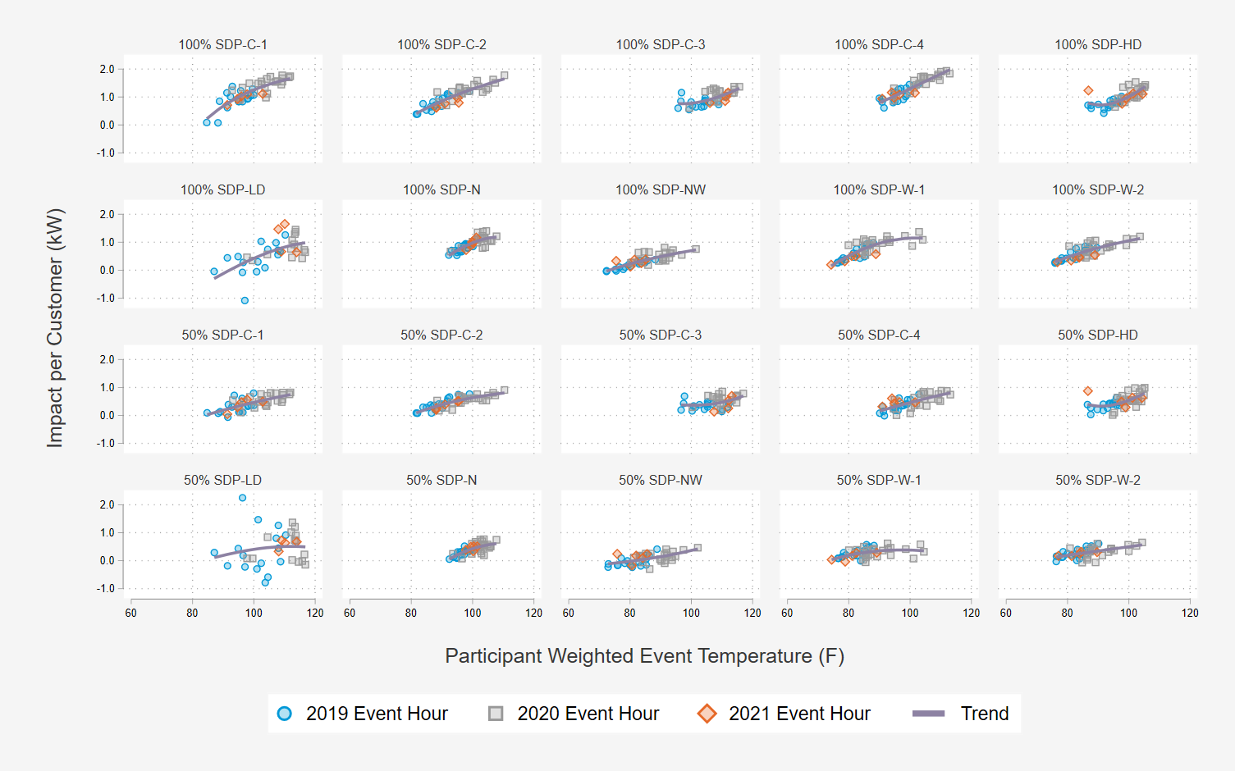
we used Per customer impacts from 2019-2021 to model reductions as function of temperature and hour
Done by load control group and cycling strategy
Population varies by load control group
Load control groups have different event history
At low end temperatures, impacts are flatten out to near zero impacts

Slide 13
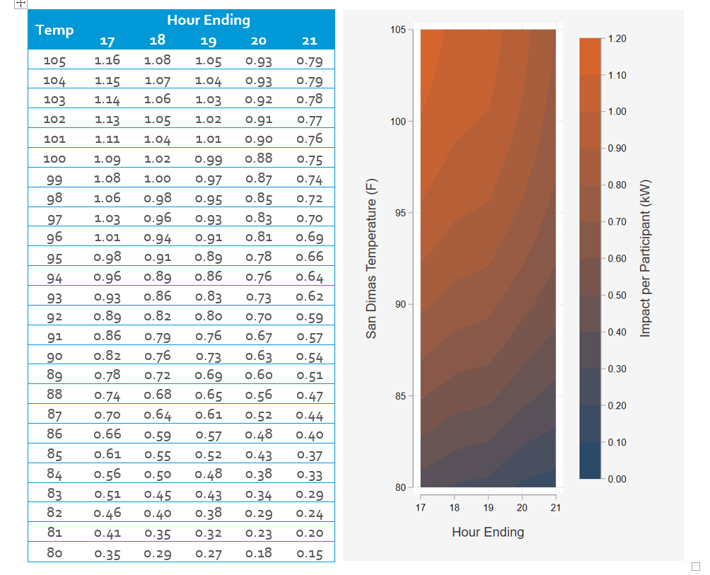
The analysis of historical performance was used to produce a time temperature Matrix
Per customer impacts
As a function of weather and hour of day

Slide 14
Ex-Ante impacts – Projected demand reductions under standardized weather conditions
Forecast Year 2022 Load Impacts on the 1-in-2 August Peak Day
August Peak Day Ex-Ante Aggregate Load Reductions
Forecast Year | Enrollment Forecast | SCE Weather |  | CAISO Weather
 |  | 1-in-2 | 1-in-10 | 1-in-2 | 1-in-10
2022 | 163,670 | 150 | 166 | 150 | 159
2023 | 153,226 | 140 | 156 | 141 | 149
2024 | 144,005 | 132 | 146 | 132 | 140
2025 | 135,864 | 124 | 138 | 125 | 132

Slide 15
Ex-Ante Comparison to ex-post
Unit | Date | Accounts | Devices | Max Daily Temp (F) | Average Daily Temp (F) | 4:00-5:00 PM | 5:00-6:00 PM | 6:00-7:00 PM | 7:00-8:00 PM | 8:00-9:00 PM
Aggregate Impact MW | 7/9/2021 (5:50pm-8:55pm) | 175,532 | 202,999 | 95.2 | 82.8 | --- | --- | 137.1 | 104.9 | 76.8
 | 9/9/2021 (3:58pm-5:00pm) | 175,962 | 203,485 | 95.1 | 81.7 | 144.0 | --- | --- | --- | ---
 | 2022 SCE Ex-ante 1-in-2 July Peak Day | 163,670 | 191,082 | 95.5 | 82.3 | 168.3 | 159.0 | 147.1 | 118.0 | 103.8
Impact per Device | 7/9/2021 (5:50pm-8:55pm) | 175,532 | 202,999 | 95.2 | 82.8 | --- | --- | 0.68 | 0.52 | 0.38
 | 9/9/2021 (3:58pm-5:00pm) | 175,962 | 203,485 | 95.1 | 81.7 | 0.71 | --- | --- | --- | ---
 | 2022 SCE Ex-ante 1-in-2 July Peak Day | 163,670 | 191,082 | 95.5 | 82.3 | 0.88 | 0.83 | 0.77 | 0.62 | 0.54
7/9 was the one reliability event of the summer and 9/9 was the system peak day
We compare with the 1-in-2 July peak day because the weather is the most similar
Ex-post impacts are slightly lower than the Ex-Ante impacts likely due to:
  Lower levels of heat build-up in September

Slide 16
Ex-Ante Comparison to prior years – per customer impacts
Month | Vintage Year 2019 |  | Vintage Year 2020 |  | Vintage Year 2021
 | 1-in-2 | 1-in-10 | 1-in-2 | 1-in-10 | 1-in-2 | 1-in-10
June | 0.37 | 0.94 | 0.53 | 0.97 | 0.60 | 0.99
July | 0.71 | 1.14 | 0.81 | 1.13 | 0.85 | 1.13
August | 0.80 | 0.95 | 0.87 | 1.00 | 0.92 | 1.02
September | 0.82 | 0.99 | 0.88 | 1.02 | 0.93 | 1.04
Data Leveraged
  PY 2021
    Reference Loads: 2019 and 2021
    Impact Modelling: 2019-2021
  PY 2020
    Reference loads and impact modelling from 2018-2020
  PY 2019
    Reference loads and impact modelling from 2018-2019

Slide 17
2021 SDP-C Evaluation Results

Slide 18
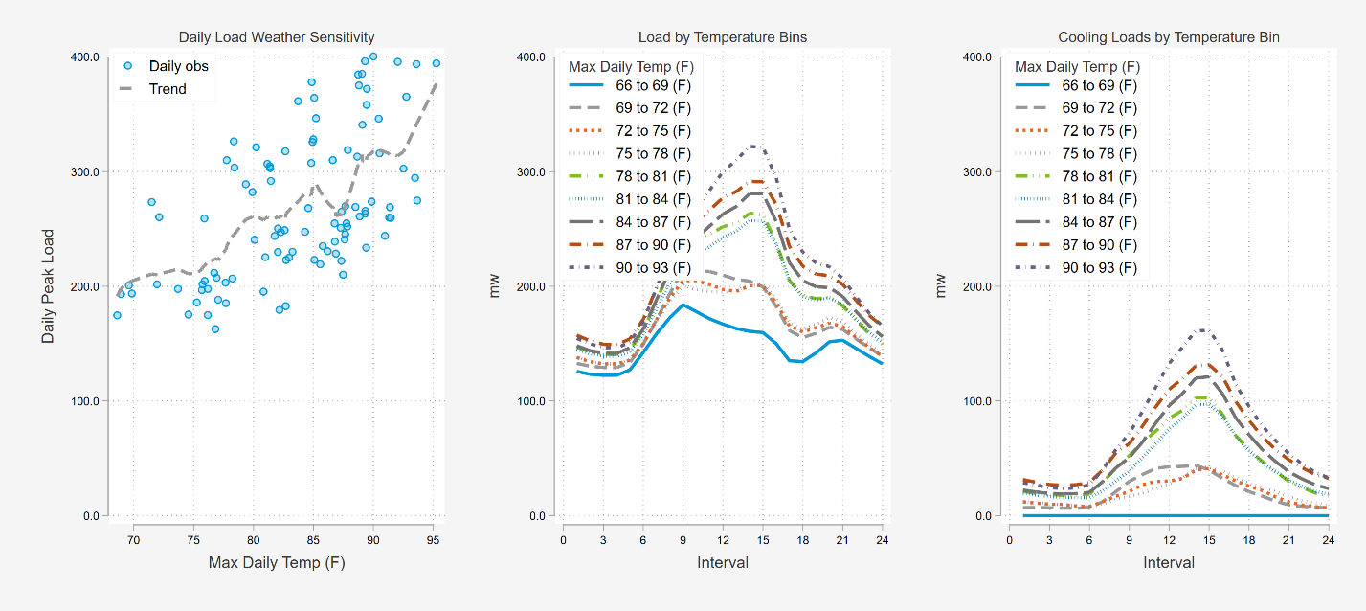
SDP-C participants cooling loads are lower over the 4-9 pM window
4-9 PM

Slide 19
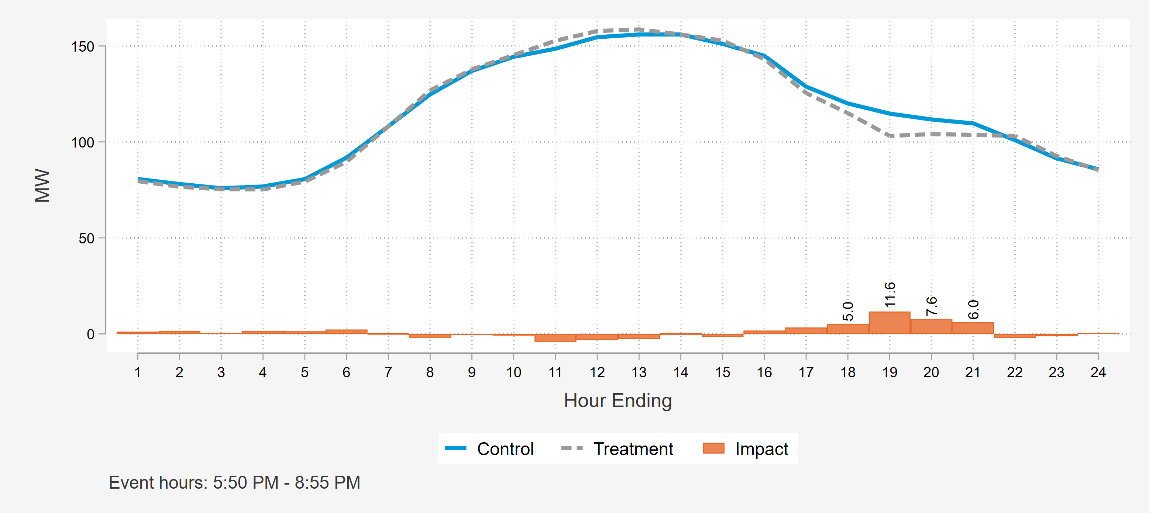
Load impacts on the Reliability Event (July 9th)

Slide 20
Summary of impacts for each event – Full Event Hours
 |  |  |  | MW Metrics |  |  |  |  | Impact per … (kW)
Date | Event start | Event end | Accts | Reference Load | Load with DR | Impact | 90% Lower Bound | 90% Upper Bound | Acct | Device | Ton | % Impact | Wght. Temp (F)
6/17/2021 | 5:00 PM | 6:00 PM | 7,418 | 113 | 106 | 7 | 3 | 12 | 1.00 | 0.11 | 0.02 | 6.6% | 85.5
7/9/2021* | 5:50 PM | 8:50 PM | 7,567 | 113 | 104 | 10 | 6 | 13 | 1.27 | 0.14 | 0.03 | 8.5% | 88.6
8/27/2021 | 6:00 PM | 7:00 PM | 7,514 | 153 | 135 | 18 | 13 | 22 | 2.36 | 0.27 | 0.05 | 11.6% | 91.2
9/9/2021 | 3:58 PM | 5:00 PM | 7,517 | 199 | 177 | 22 | 18 | 26 | 2.94 | 0.34 | 0.07 | 11.1% | 92.2
Avg. Event | First Event Hour |  | 7,504 | 145 | 130 | 15 | 13 | 17 | 2.00 | 0.23 | 0.04 | 10.3% | 89.7

Slide 21
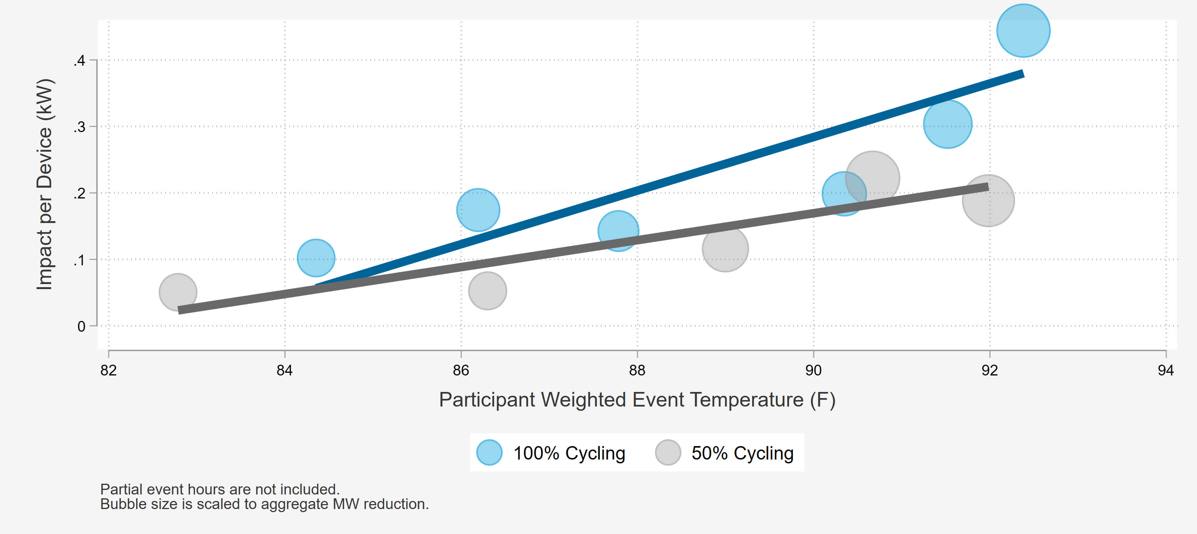
Impacts for key segments – cycling strategy

Slide 22
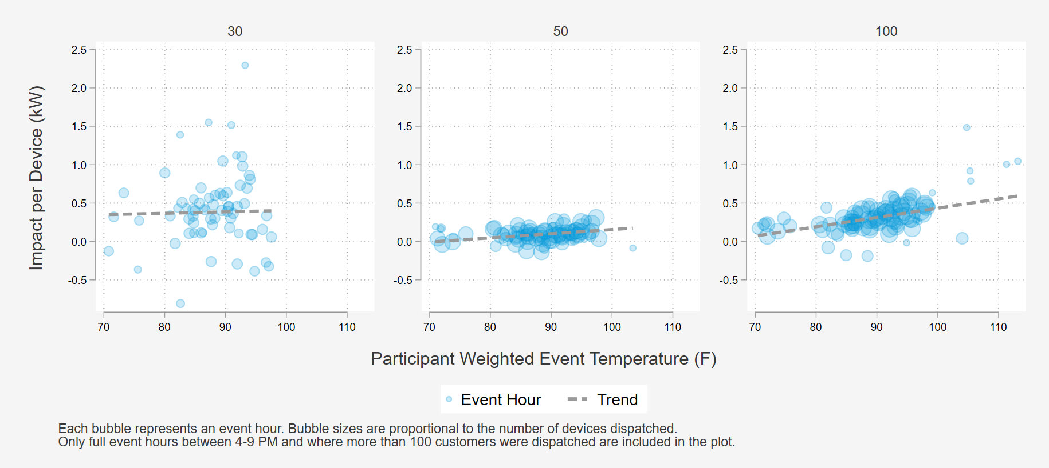
we used Per customer impacts from 2019-2021 to model reductions as function of temperature and hour

Slide 23
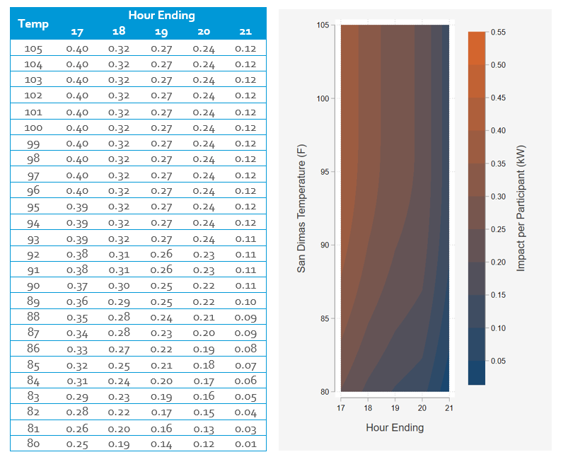
The analysis of historical performance was used to produce a time temperature Matrix
Per device impacts
As a function of weather and hour of day

Slide 24
Ex-Ante impacts – Projected demand reductions under standardized weather conditions
Forecast Year 2022 Load Impacts on the 1-in-2 August Peak Day
August Peak Day Ex-Ante Aggregate Load Reductions
Forecast Year | Enrollment Forecast | Total Devices | SCE Weather |  | CAISO Weather
 |  |  | 1-in-2 | 1-in-10 | 1-in-2 | 1-in-10
2022 | 7,062 | 61,051 | 16.1 | 18.8 | 15.8 | 18.2
2023 | 6,643 | 57,427 | 15.1 | 17.7 | 14.9 | 17.2
2024 | 6,267 | 54,173 | 14.3 | 16.7 | 14.0 | 16.2
2025 | 5,929 | 51,251 | 13.5 | 15.8 | 13.3 | 15.3

Slide 25
SDP-C Ex-ante Comparison to ex-post
Unit | Date | Accounts | Devices | Max Daily Temp (F) | Average Daily Temp (F) | 4:00-5:00 PM | 5:00-6:00 PM | 6:00-7:00 PM | 7:00-8:00 PM | 8:00-9:00 PM
Aggregate Impact MW | 7/9/2021 (5:50pm-8:55pm) | 7,567 | 67,726 | 91.9 | 80.7 | --- | --- | 11.6 | 7.6 | 6.0
 | 9/9/2021 (3:58pm-5:00pm) | 7,517 | 65,545 | 92.6 | 79.3 | 22.1 | --- | --- | --- | ---
 | 2022 SCE Ex-ante 1-in-2 August Peak Day | 7,062 | 61,051 | 92.6 | 82.0 | 24.3 | 18.8 | 14.9 | 11.9 | 10.4
Impact per Device | 7/9/2021 (5:50pm-8:55pm) | 7,567 | 67,726 | 91.9 | 80.7 | --- | --- | 0.17 | 0.11 | 0.09
 | 9/9/2021 (3:58pm-5:00pm) | 7,517 | 65,545 | 92.6 | 79.3 | 0.34 | --- | --- | --- | ---
 | 2022 SCE Ex-ante 1-in-2 August Peak Day | 7,062 | 61,051 | 92.6 | 82.0 | 0.40 | 0.31 | 0.24 | 0.20 | 0.17
7/9 was the one reliability event of the summer and 9/9 was the system peak day
We compare with the 1-in-2 August peak day because the weather is the most similar
Ex-post impacts are slightly lower than the Ex-Ante impacts likely due to:
  Schools (68% of the tonnage) not being in session in July
  Lower levels of heat build-up in September

Slide 26
Ex-Ante Comparison to prior years – per customer impacts
Month | Vintage Year 2019 |  | Vintage Year 2020 |  | Vintage Year 2021
 | 1-in-2 | 1-in-10 | 1-in-2 | 1-in-10 | 1-in-2 | 1-in-10
June | 1.90 | 2.99 | 1.91 | 2.52 | 2.16 | 2.45
July | 2.56 | 3.56 | 2.44 | 3.52 | 2.54 | 3.34
August | 2.58 | 2.95 | 2.29 | 2.80 | 2.27 | 2.66
September | 2.76 | 3.12 | 2.65 | 2.96 | 2.62 | 2.80
Data Leveraged
  PY 2021
    Reference Loads: 2019 and 2021
    Impact Modelling: 2018-2021
  PY 2020
    Reference loads and impact modelling from 2018-2020
  PY 2019
    Reference loads and impact modelling from 2018-2019
Refined the placebo day selection in 2021

Slide 27
Discussion & Recommendations

Slide 28
Discussion
Recommendations
SDP has the capability to deliver large magnitudes of flexible loads at very fast ramp rates, delivering larger reductions when the weather is more extreme and resources are needed most.
  Comprised of 1.1+ million tons of air conditioning
The magnitude of SDP resources has been declining in recent years.
  Increased attrition has coincided with lower incentives and a higher number of events (2020)
Develop a time-temperature matrix to address differences between operations and planning conditions
  bridges the gap between operations and planning conditions
Add weekend days to the load impact protocol ex-ante tables and include weekend "test" events
Include "test" event operations to fully assess the load reduction capability
  Facilitates comparison between ex post and ex ante results
Make sure to dispatch "test" events that include enough variation to understand program performance
  Acknowledges the various population groupings

Slide 29

Questions?
Josh Bode
Partner
Demand Side Analytics
jbode@demandsideanalytics.com 415.786.0707

