Slide 1
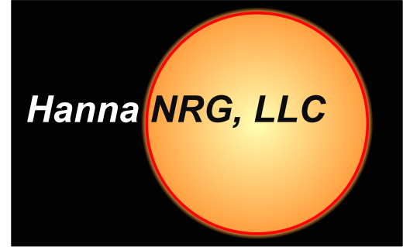
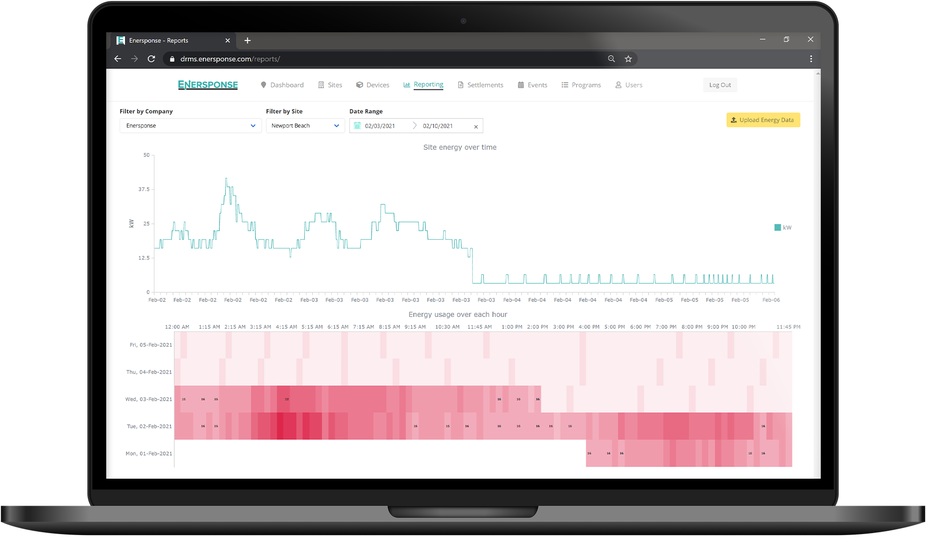
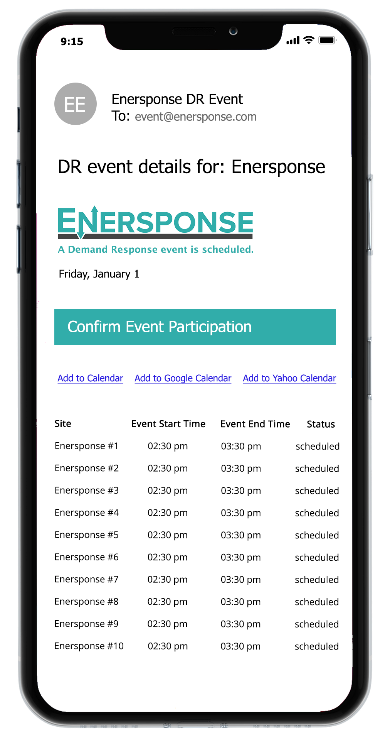
Load Impact Protocols Workshop

Slide 2
PROGRAM BACKGROUND

Slide 3
About
Enersponse Inc is a Demand Response Aggregator, and Auto-DR Integrator, managing nearly 18,000 commercial, industrial, agricultural and municipal water pumping locations across North America.
Enersponse manages customer participation by way of their DERMs platform, connecting to end-use customer controls via a library of software integrations, including custom API’s and OpenADR.
While some Enersponse customers are dispatched using traditional methods (email & sms/text notifications) most of their resources are direct-control.
Enersponse has been actively participating in various California Demand Response programs since 2015. The customer accounts included in this report have been actively managed by Enersponse in California demand response programs during 2021 program year.

Slide 4
EVENTS & DISPATCH

Slide 5
EVENT PARTICIPATION BY LOAD TYPE

Slide 6
EX POST RESULTS

Slide 7
EX POST METHODOLOGY
Enersponse has elected to use performance results from its clients in California that have participated in the 2021 program year.
For the ex-post analysis, baseline loads were estimated using individual regression modeling. Different model configurations were tested for accuracy and bias to determine the best fit. Once the consumer baselines were calculated, the consumer load impacts were calculated by subtracting the baseline loads in each hour from the consumer’s actual load in that hour during the event.

Slide 8
COMBINED EX POST

Slide 9
AVERAGE IMPACTS – AUGUST 30, 2021
Event Start Time: 16:00
Event End Time: 18:00

Slide 10
AVERAGE IMPACTS – February 17, 2021
Event Start Time: 17:00
Event End Time: 21:00

Slide 11
EX-ANTE RESULTS

Slide 12
EX ANTE METHODOLOGY
The ex-ante load impacts were estimated for the DR resource for typical event days and monthly peak days from 2022 through 2032. The ex-ante analysis uses the average percent load drop by end-use, LCA, and season from the ex-post results. This was done because there wasn’t a strong correlation between load impact and other factors, mainly ambient temperature. These load impact predictors were then combined with the Enersponse’s predicted resource changes to estimate potential future impacts.

Slide 13
EX-ANTE IMPACT ESTIMATORS

Slide 14
ENROLLMENT FORECATS (H/M/L)

Slide 15
ENROLLMENT FORECASTS (H/M/L)

Slide 16
EX-ANTE – PUMPING AUGUST EVENT DAY 2022

Slide 17
EX-ANTE – HVAC AUGUST EVENT DAY 2022

Slide 18
COMBINED EX-ANTE RESULTS

Slide 19
EX-ANTE RESULTS BY LCA

Slide 20
FUTURE RECOMMENDATIONS
It has been challenging to develop accurate and unbiased reference loads for customers with pumping loads. These customers tend to be irregular in their load levels and the timing of the changes in load are difficult to predict. However, in aggregate the individual regression baselines are reasonably accurate. Future evaluations need to continue to seek to improve the estimation of the individual baselines.

Slide 21
QUESTIONS

