Slide 1
Voltus - Load Impact Protocols
Third Party DRP LIP Workshop – May 18th, 2022

Slide 2
Agenda
Voltus Load Impact Protocols Workshop
Voltus Background
Portfolio and Program Descriptions
Ex Post Methodology
Ex Post Load Impacts
Ex Ante Methodology
Ex Ante Load Impacts

Slide 3
Voltus Background

Slide 4

Background
Voltus History
Demand Response Provider across North America since 2016
Track record of successful DR programs
Entered PG&E CBP and PG&E BIP in 2019
Awarded DRAM 2020 capacity in PG&E and SCE territory
Became scheduling coordinator in 2020 and is currently providing RA to CCAs in California.
Limited portfolio and event history in California prior to 2020
Actively engaged in the 2022 PG&E and SCE DRAM and the PG&E CBP

Slide 5
Voltus and Program Descriptions

Slide 6
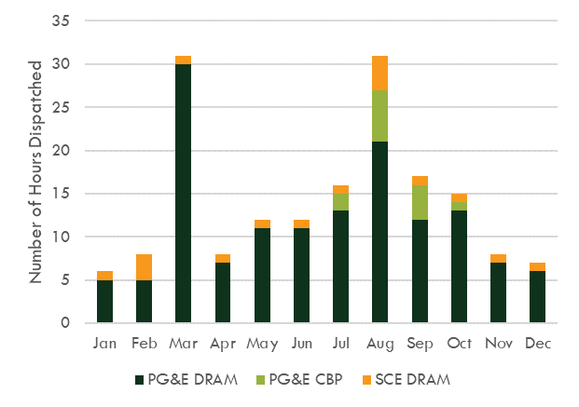
California DR Participation
PY 2021 Programs and Dispatches
 | PG&E DRAM | PG&E CBP | SCE DRAM
Event Season | Full Year | May - October | Full Year
Num. of Voltus Event Days | 51 days (87 dispatches) | 9 | 14
Num. of 1 to 2 Hour Dispatches | 80 | 9 | 14
Num. of Dispatches 3 Hours or Longer | 7 | 0 | 0
2021 Enrolled Facilities by IOU | 413 (All PG&E) |  | 483
Program | Participant Event Hours
Program | HE 16 | HE 17 | HE 18 | HE 19 | HE 20 | HE 21 | HE 22
PG&E CBP | 5 | -- | -- | 39 | 20 | 10 | --
PG&E DRAM | -- | 846 | 711 | 871 | 330 | 21 | 1
SCE DRAM | -- | 4,597 | 761 | 70 | 70 | -- | --

Slide 7
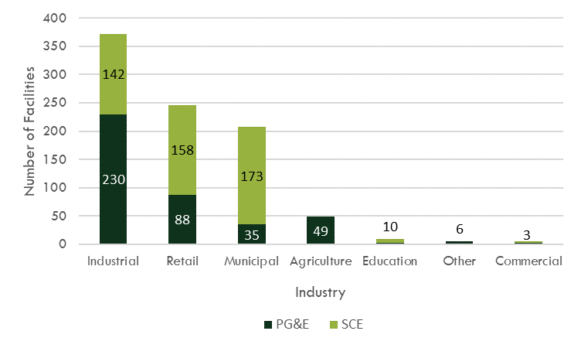
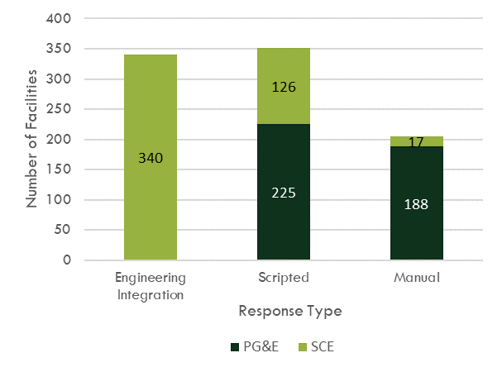
Participant Characteristics
Industry and Response Types

Slide 8
Ex Post Methodology
And Impacts

Slide 9
Ex Post Methodology
Overview
Individual regression models were used to estimate ex post impacts.
Individual models were selected for several reasons which include:
  Data Availability
  Event Variability
  Participant Load Variability
  Reporting Granularity
Individual customers received their best fitting model specification for applicable scenarios which include:
  Summer Weekday Models
  Winter Weekday Models
Model fits (MAPE and CV RMSE) were examined on a set of event like holdout days. The model with the best out-of-sample predictions for each facility was chosen as the final model.

Slide 10
Ex Post Impacts
PG&E Average Event Day
Program | Avg. Number of Facilities | Mean Reference Load (kWh/h) | Avg. Facility Impact (kWh/h) | Pct. Load Reduction | Avg. Total Reduction MWh/h | Avg. Event Temperature (F)
PG&E DRAM | 31 | 224.2 | 29.0 | 13% | 0.9 | 65.4
PG&E CBP | 15 | 319.8 | 56.1 | 18% | 0.8 | 72.2
Note: Event dispatches occur for varying times and durations. To minimize the dilution of impacts, only dispatches with hours HE 19 and HE 20 as event hours are included in the average event day for PG&E programs. PG&E DRAM event days have an average of 1.6 dispatches per event day. As a result, aggregate reductions and participant counts are biased low.

Slide 11
Ex Post Impacts
PG&E Average Event Impact
Average per facility impacts by PG&E event day. Event days not meeting 15/15 reporting rules are excluded.

Slide 12
Ex Post Impacts
SCE DRAM per Capita Event Impacts and Average Event Day
Program | Avg. Number of Facilities | Mean Reference Load (kWh/h) | Avg. Facility Impact (kWh/h) | Pct. Load Reduction | Avg. Total Reduction MWh/h | Avg. Event Temperature (F)
SCE DRAM | 373 | 97.1 | 12.8 | 13% | 4.8 | 72.3
Note: Event dispatches occur for varying times and durations. To minimize the dilution of impacts, only dispatches with hours HE 17 as event hours are included in the average event day for SCE DRAM

Slide 13
Ex Post Impacts
Average Impacts By Segments
Avg per capita impact across all event hours in 2021 is 35.5 kWh/h per event hour
Agriculture and Manual Response provided the largest per capita impacts
Commercial, Education and Other Industry Types are not presented due to participant counts below 15 facilities

Slide 14
Ex Ante Methodology
And Impacts

Slide 15
Ex Ante Methodology
Overview
The ex ante methodology used adjusted customer-specific regressions from the ex post analysis.
Step 1: Predicted per-customer weather-adjusted reference loads and impacts
Step 2: Derate average ex ante impacts to account RA requirements for each hour in the RA window.
  Hourly derate factors explored include long duration events, time of day effects, and Covid-19.
  NY CSRP participation was used to aid derate factor development
Step 3: Per capita impacts are applied to the participant enrollment forecast to calculate total ex ante MW
Total Participant Event Hours By IOU/Program and Hour
Hour Ending | PG&E | SCE | NY CSRP
HE 16 | 5 | -- | 113
HE 17 | 846 | 4,597 | 116
HE 18 | 711 | 761 | 1324
HE 19 | 910 | 70 | 1984
HE 20 | 350 | 70 | 2302
HE 21 | 31 | -- | 2333
HE 22 | 1 | -- | 1067

Slide 16
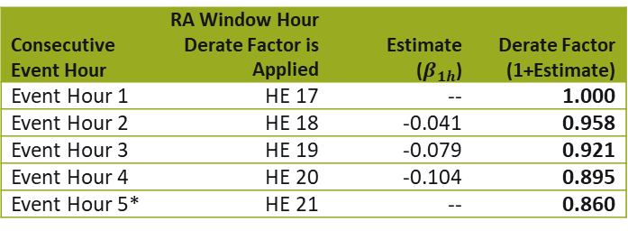
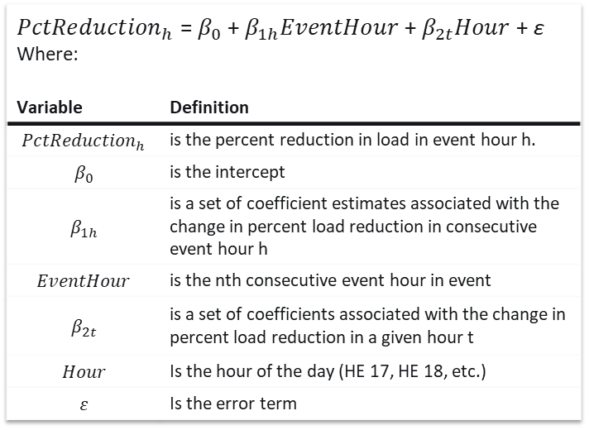
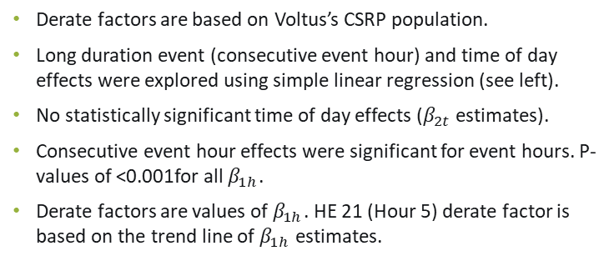
Ex Ante Adjustment Factors
Long Duration Event and Time of Day Adjustment Analysis
Derate factors are based on Voltus’s CSRP population.
Long duration event (consecutive event hour) and time of day effects were explored using simple linear regression (see left).
No statistically significant time of day effects ($β_{2t}$ estimates).
Consecutive event hour effects were significant for event hours. P-values of <0.001for all $β_{1h}$.
Derate factors are values of $β_{1h}$. HE 21 (Hour 5) derate factor is based on the trend line of $β_{1h}$ estimates.
${PctReduction}_{h}$ =$β_{0}$ + $β_{1h}EventHour$ + $β_{2t}Hour$ + ε Where:
Variable | Definition
$${PctReduction}_{h}$$ | is the percent reduction in load in event hour h.
$$β_{0}$$ | is the intercept
$$β_{1h}$$ | is a set of coefficient estimates associated with the change in percent load reduction in consecutive event hour h
$$EventHour$$ | is the nth consecutive event hour in event
$$β_{2t}$$ | is a set of coefficients associated with the change in percent load reduction in a given hour t
$$Hour$$ | Is the hour of the day (HE 17, HE 18, etc.)
$$ε$$ | Is the error term
Consecutive Event Hour | RA Window Hour Derate Factor is Applied | Estimate ($β_{1h}$) | Derate Factor (1+Estimate)
Event Hour 1 | HE 17 | -- | 1.000
Event Hour 2 | HE 18 | -0.041 | 0.958
Event Hour 3 | HE 19 | -0.079 | 0.921
Event Hour 4 | HE 20 | -0.104 | 0.895
Event Hour 5* | HE 21 | -- | 0.860
*Events longer than four hours were excluded from the analysis. As a result, there is no${ β}_{1h}$ for hour 5.

Slide 17
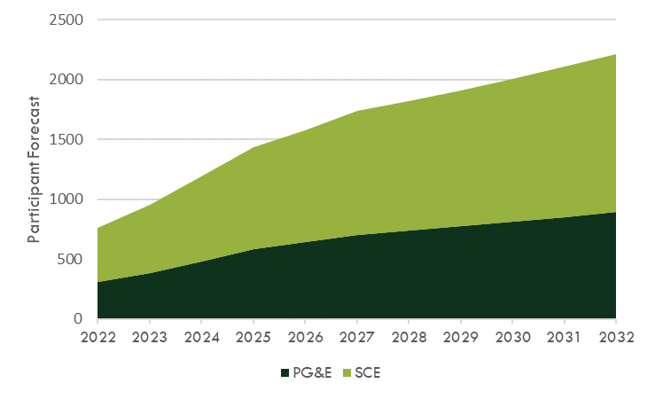
Ex Ante Forecasts
Participant Forecasts 2022 through 2032
Ex Ante forecasts were provided by Voltus
Voltus expects participant growth for existing PG&E and SCE programs
Participants in Voltus programs are expected to total 953 in 2023 and grow to 2,213 by 2032

Slide 18
Ex ANte Impacts
Per Capita Impacts – Month of August

Slide 19
Ex Ante Impacts
PY 2023 Ex Ante Impact Estimates
Utility Territory | Year | Participants | Average Aggerate August System Peak Event Hour Reduction (MW)
Utility Territory | Year | Participants | CAISO 1-in-10 | CAISO 1-in-2 | Utility 1-in-10 | Utility 1-in-2
PG&E | 2023 | 386 | 31.3 | 30.4 | 32.6 | 30.6
 | 2032 | 894 | 72.6 | 70.5 | 75.6 | 71.0
SCE | 2023 | 567 | 17.5 | 16.1 | 18.2 | 16.2
 | 2032 | 1,319 | 40.8 | 37.5 | 42.4 | 37.7
Statewide | 2023 | 953 | 48.8 | 46.5 | 50.8 | 46.7
 | 2032 | 2,213 | 113.4 | 108.0 | 118.0 | 108.7
Statewide, the Voltus Portfolio is anticipated to provide 46.7 MW in 2023

Slide 21
Ex Ante Impacts - Appendix
PY 2023 Impacts – FY 2021 vs. FY 2022 Estimates

