Slide 1
Sunrun Load Impact Protocol Workshop
Casaundra Collyer | May 2023

Slide 2
Agenda
1
2
3
4
Sunrun Introduction
Sunrun Fleet & Operations
LIP Approach for 2023
Reconciliation

Slide 3
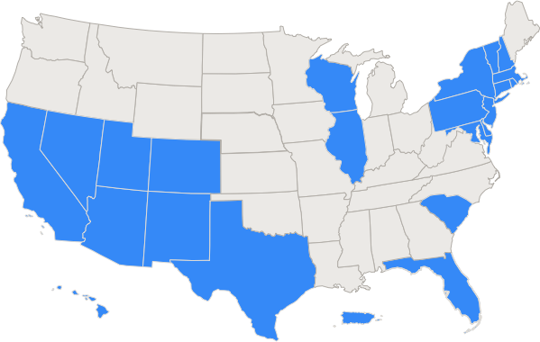
Sunrun at a Glance
OUR MISSION
To create a planet run by the sun.
OUR BEGINNINGS
Founded in 2007
HQ in San Francisco
Pioneered Residential Solar Service
OUR BUSINESS MODEL
Single and multi-family residential
Solar only from 2007 – 2016; growing solar + storage since 2016.
Focused on provision of customer energy historically; since 2018 have begun providing customer services (ie - demand charge and TOU management) and grid services (ie – reliability capacity and distribution loading management).
We have nearly 830,000 customers and sell our solar service in 25 states, the District of Columbia and Puerto Rico.

Slide 4
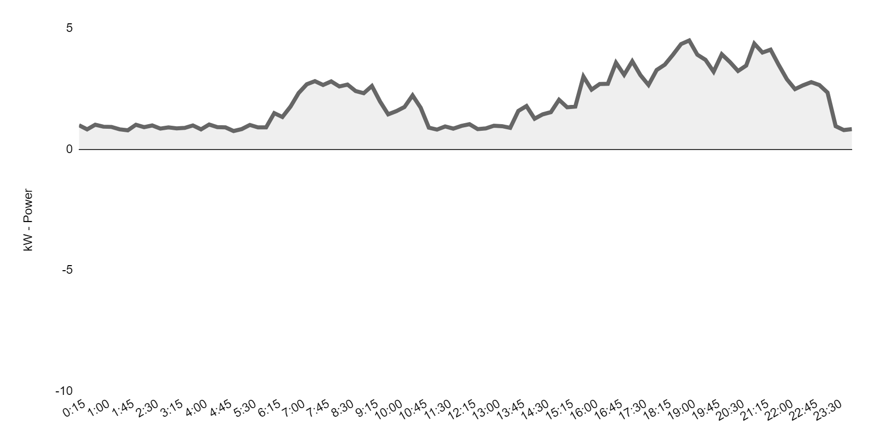
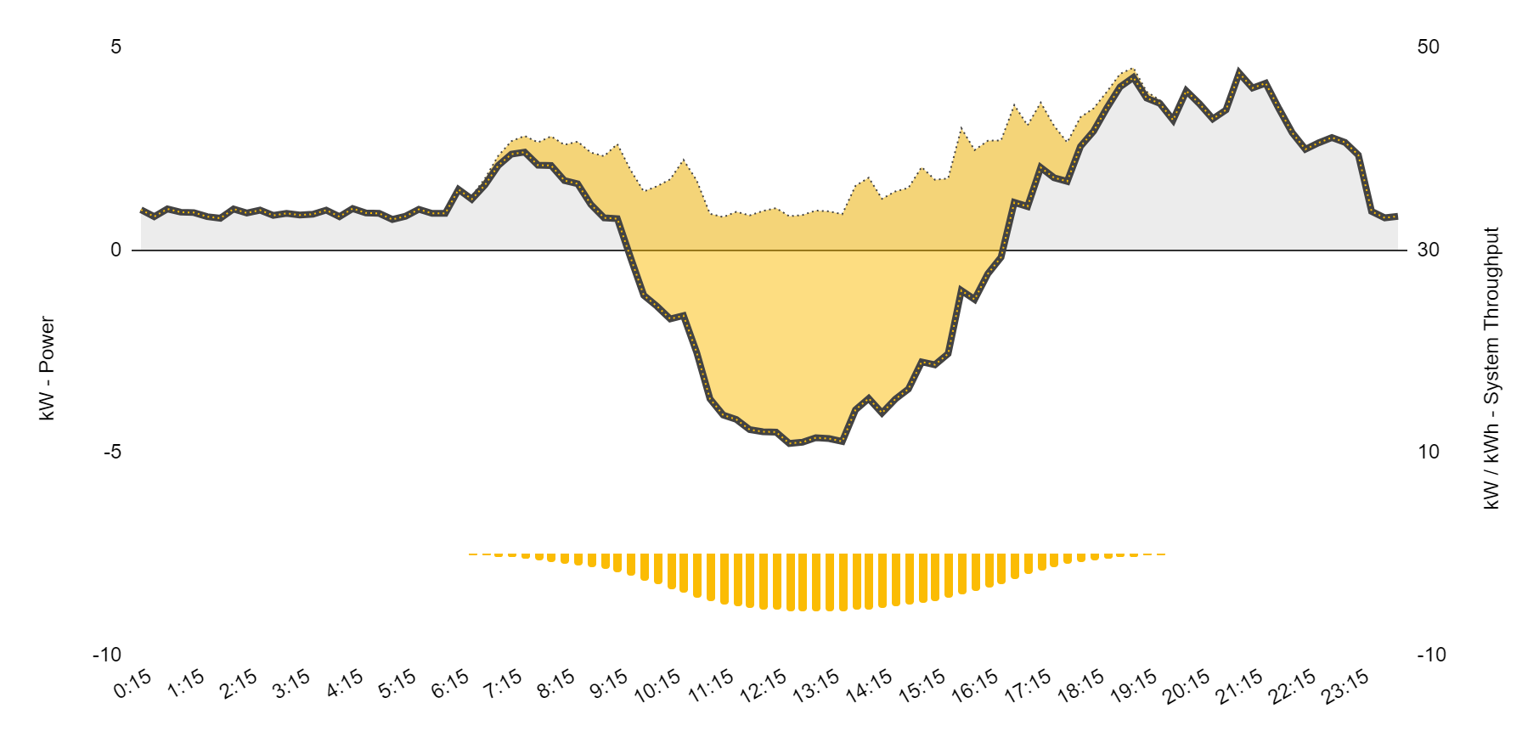
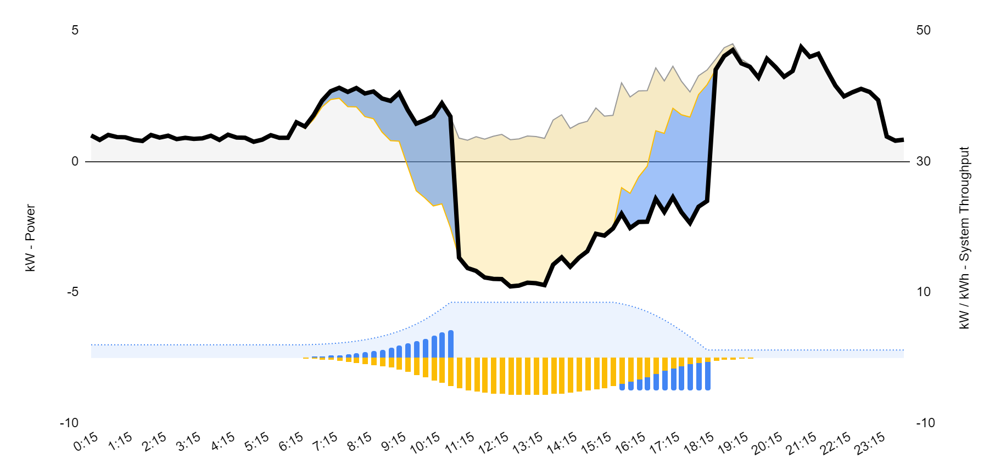
Sunrun’s Batteries: Solar + Storage
b
Customer Load
Sunrun deploys integrated solar + storage systems interconnected behind the customer’s utility meter. All energy generated by the systems serve the customer first, displacing energy served by the grid.
This means Sunrun batteries do not change customer behavior, but they do reduce utility demand.
Customer Load
+ Solar PV
Customer Utility Meter
★
Customer Load
+ Solar PV
+ Energy Storage
M
M
M
M
Solar Output
Solar Energy Served
Net Demand
Native Demand
Native Energy
Storage Throughput
Storage Energy Served
Net Post-Solar Demand
Stored Energy
Notes:
Nathan

Slide 5
Typical Battery Activities
A
B
In California, Sunrun typically provides services to customers including, but not limited to:
TOU bill management by discharging during TOU windows
Minimizing solar export by charging exclusively from solar
Backup power capacity reserved exclusively for grid outage
Distribution system capacity, voltage controls and other grid services by responding to utility / market signals.
C
Solar Output
Solar Energy Served
Net Demand
Native Demand
Native Energy
Storage Throughput
Storage Energy Served
Net Post-Solar Demand
Stored Energy
★
★
★
M
M
M
M
M
M
M
M
M
M
M
M
A. Solar Production/Charging
B. Solar Production/Charging/Export
C. Battery + Solar Discharge/Export
Notes:
Nathan

Slide 6
Sunrun Battery Activities Factored
In our modeling methodology, Sunrun makes the following assumptions relative to battery activity:
TOU bill management: Sunrun models batteries participate in TOU activity on non RA event days only.
This activity is factored into baseline calculations.
Sunrun does not assume battery system operation changes on non-event days to optimize baselines
Minimizing solar export by charging exclusively from solar.
This activity is factored into baseline calculations and the modeled reference load available
Backup power capacity reserved exclusively for grid outage
This back-up power is treated as unusable for providing RA capacity
Distribution system capacity, voltage controls and other grid services by responding to utility / market signals
Sunrun simulates consecutive daily dispatch activity to model system’s ability to recharge on a daily basis.
System export is not counted towards RA

Slide 7
Final Sunrun LIP Report for 2023
Regarding the Calculation of Ex Post Load Impact:
Sunrun operationalized BTM solar and battery assets in the PG&E and SCE territories starting in 2021 and 2022.
CAISO baseline is being leveraged.
Regarding the Calculation of Ex Ante Load Impact:
Sunrun leveraged the ex-post analysis to estimate the load reduction performance for 2024:
Battery dispatching does not change customer or site level behavior, because of this, we are using the ex-post results to create the forecasted load reduction for the 2024 period.
Sunrun ex ante load impact estimates are also based on our customer enrollment forecast for 2024 by IOU and by sublap
In parallel, Sunrun also provided submetering data on BTM battery to measure the average battery output between the hours of 5:00 PM and 9:00 PM on event days.

Slide 8
2021 results vs 2022 results
RECONCILIATION
2021 | Average | Reference Energy Use (kWh) | Observed Energy Use (kWh) | Change in Energy Use (kWh) | Uncertainty Adjusted Impact - Percentiles
 |  |  |  |  | 10th | 30th | 50th | 70th | 90th
 |  | 0.91 | 0.85 | 0.56 | 0.46 | 0.48 | 0.53 | 0.55 | 0.60
2022 | Average | Reference Energy Use (kWh) | Observed Energy Use (kWh) | Change in Energy Use (kWh) | Uncertainty Adjusted Impact - Percentiles
 |  |  |  |  | 10th | 30th | 50th | 70th | 90th
 |  | 1.73 | 1.39 | 0.63 | 0.57 | 0.59 | 0.62 | 0.64 | 0.66
Reasons for Improvement
Improved our data collection and analysis
Improved our solar systems’ performance
Changed distributed energy resources management system

Slide 9
Thank you.
Contact:
casaundra.collyer@sunrun.com

Slide 10
Appendix
The following scenarios have been analyzed for ex post evaluation using empirical market dispatch performance data from 2021
Scenario 1: Sunrun Day Matching Actual (Estimated Load Impact):
Actual load reduction is measured as the difference between the the 5-in-10 Day-Matching adjusted load baseline and actual customer utility meter data
Scenario 2: Max Sunrun Day Matching Possible (Theoretical Load Impact):
As a point of comparison to scenario 1, the maximum theoretical load reduction is measured using the same 5-in-10 Day-Matching adjusted load baseline, but also assuming the initial state of useable energy (kWh) at the beginning of each market dispatch - energy available for dispatch - was fully discharged by the energy storage systems while respecting battery operational constraints, such as, backup reserve and inverter reserve (35% total).
For each battery, the initial usable energy = initial state of charge * full pack energy available * (1 - backup reserve)
Initial state of charge is retrieved for each battery at the beginning of each CAISO market dispatch event
Instead of using battery nameplate capacity, battery full pack energy available is retrieved to include battery degradation impacts
Hourly discharge KWDC= initial usage energy / duration of market dispatch
Hourly discharge KWAC = Hourly discharge KWDC * Inverter DCAC efficiency factor

Slide 11
Appendix
The following methods, assumptions and data sources were used to estimate QC for 2023:
Estimation of load impact per customer based on a combination of Ex Post Day Matching analysis and Ex Ante IOU-specific engineering models.
Forecast of customer enrollment based on signed contracts for RA delivery in 2023.
Estimation of QC values for the 2024 RA year based on, 1) estimation of load impact per customer, 2) forecasted customer enrollment for resource adequacy within each IOU territory.

